Slide 1
PDCWG Report to ROS
Chair: Percy Galliguez, Brazos Electric Power Cooperative, Inc.
Vice Chair: Lei Ye, Austin Energy
ROS
April 5th, 2017

Slide 2
Report Overview & Notes
Report Overview
  Meeting Minutes
  BAL-001-TRE-1 FMEs & IMFR
    1 FME in the month of March
    BAL-001-TRE-1 Unit Performance Report now includes Solar resources.
  Frequency Control Report

Slide 3
Meeting Minutes
PDCWG Meeting 3/8/17
  Regulation & Frequency Control Reports
  GREDP Performance Analysis
  Voltage Ride Through Requirement
  MOD-026-1 & MOD-027-1 Discussion
    NOGRR Proposal/Review Status
  TRE/NERC Retirement of BAL-004
  Reviewed Frequency Events
    1/10/2017 15:13:18
      Loss of 404MW
      641 MW/0.1HZ Response
      4 of 27 Generation Resources providing RRS had less than 75% of their expected Initial Primary Frequency Response.
      5 of 27 Generation Resources providing RRS had less than 75% of their expected Sustained Primary Frequency Response

Slide 4
Frequency Measurable Events Performance
February 2017

Slide 5
Frequency Measurable Events
There was 1 FME in March
  3/9/2017 18:36:50
    Loss of 823 MW
    Interconnection Frequency Response:
    4 of 23 Evaluated Generation Resources had less than 75% of their expected Initial Primary Frequency Response.
    5 of 23 Evaluated Generation Resources had less than 75% of their expected Sustained Primary Frequency Response.

Slide 6
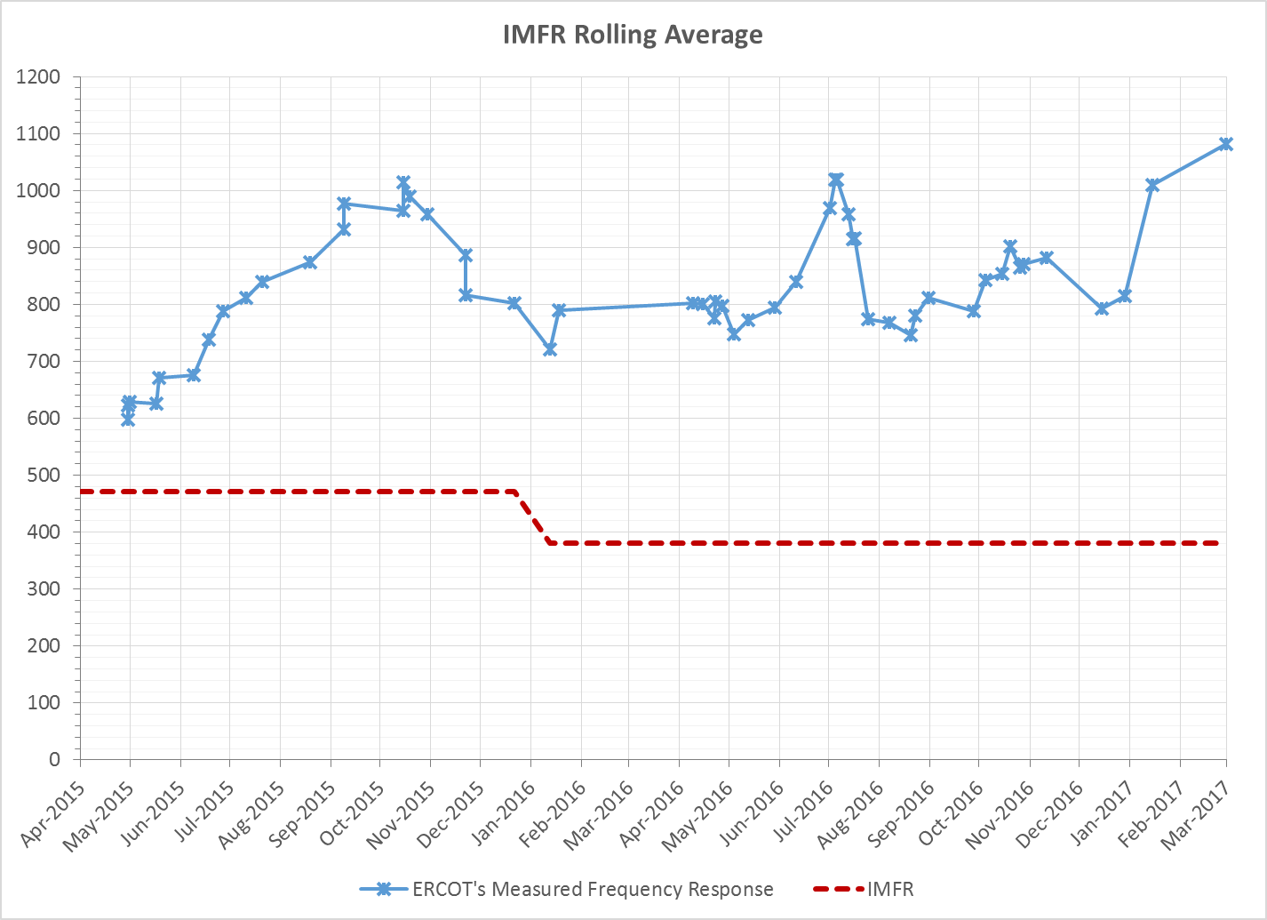
Interconnection Minimum Frequency Response (IMFR) Performance
IMFR Performance currently 1081.57 MW/0.1Hz

Slide 7
Frequency Control Report
February 2017

Slide 8
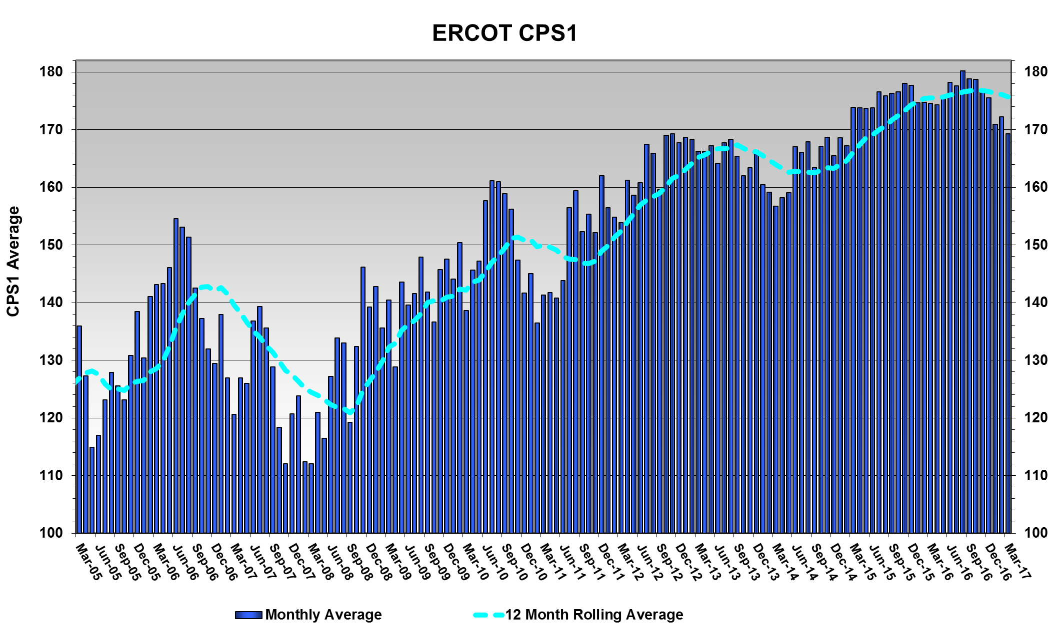
CPS1 Performance
CPS1 12 Month Rolling Average = 175.66%

Slide 9
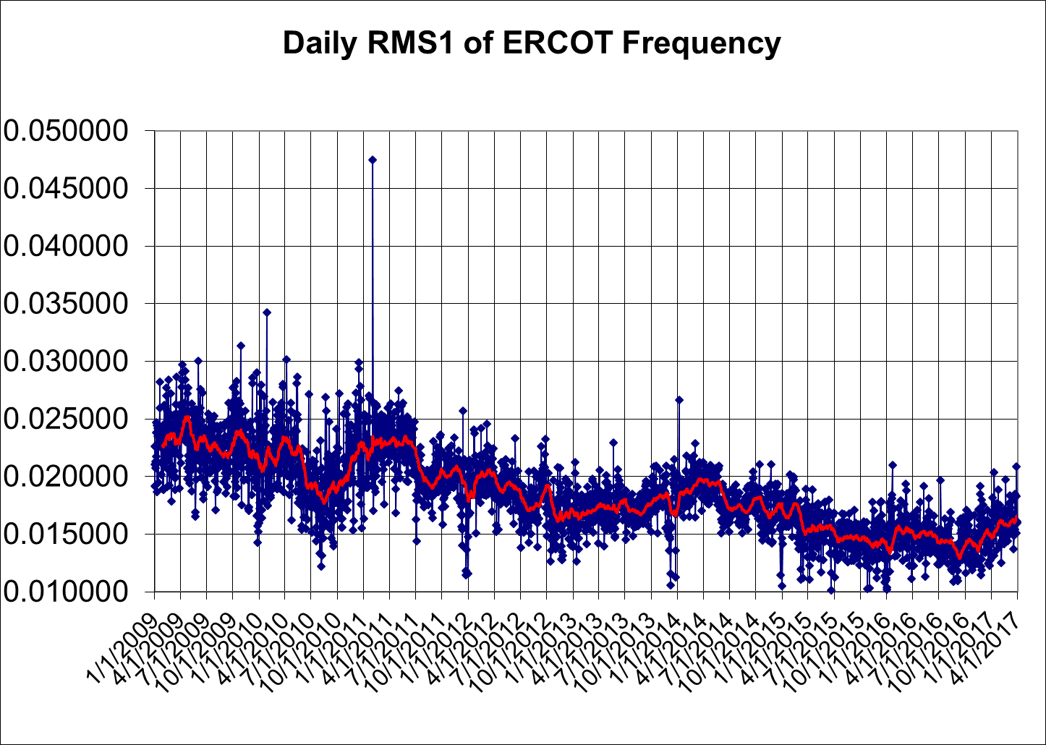
RMS1 Performance of ERCOT Frequency

Slide 10
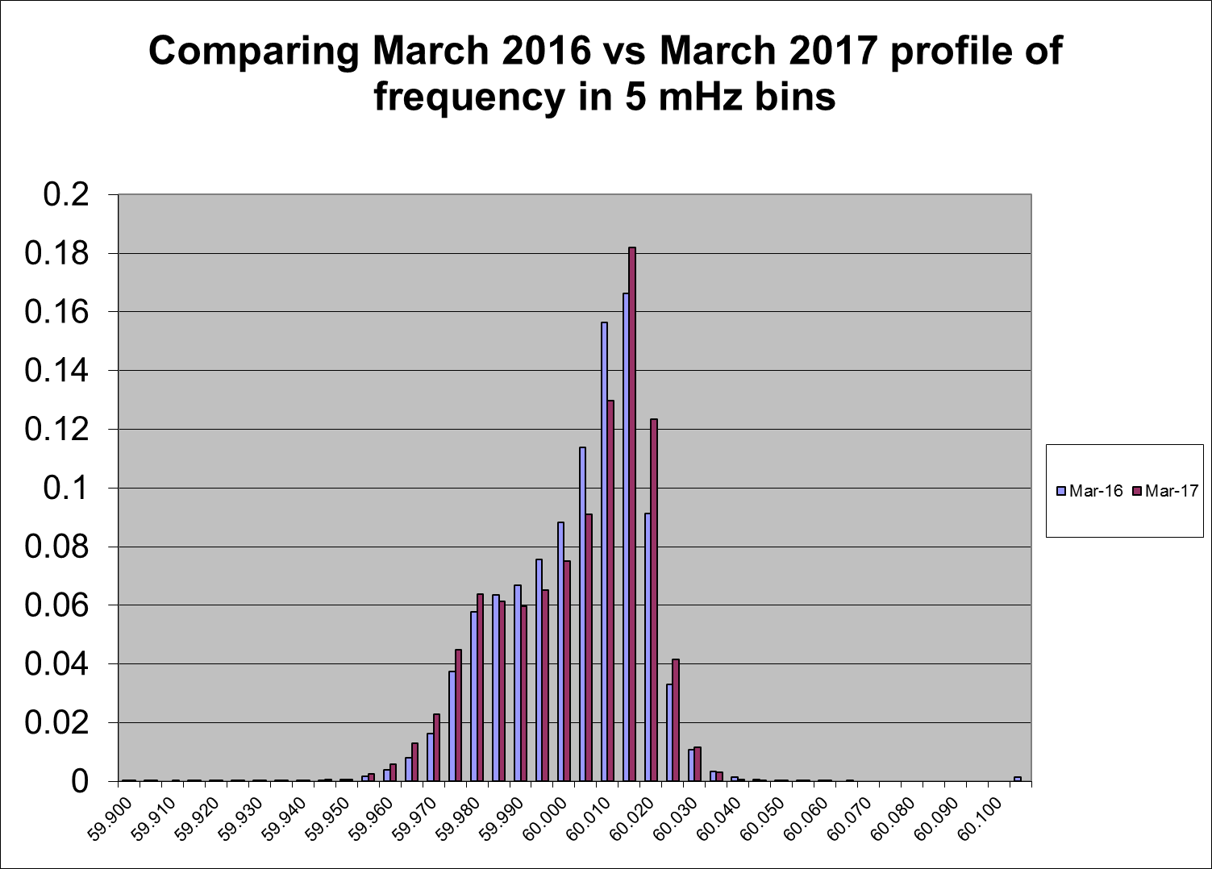
Frequency Profile Analysis
Year | Low Side (<60Hz) | High Side (>60Hz)
2016 | 170.14 | 177.79
2017 | 162.98 | 173.77
Year | Mean | Standard Deviation (from 60Hz)
2016 | 60.00011 | 0.016679
2017 | 60.00015 | 0.016612

Slide 11
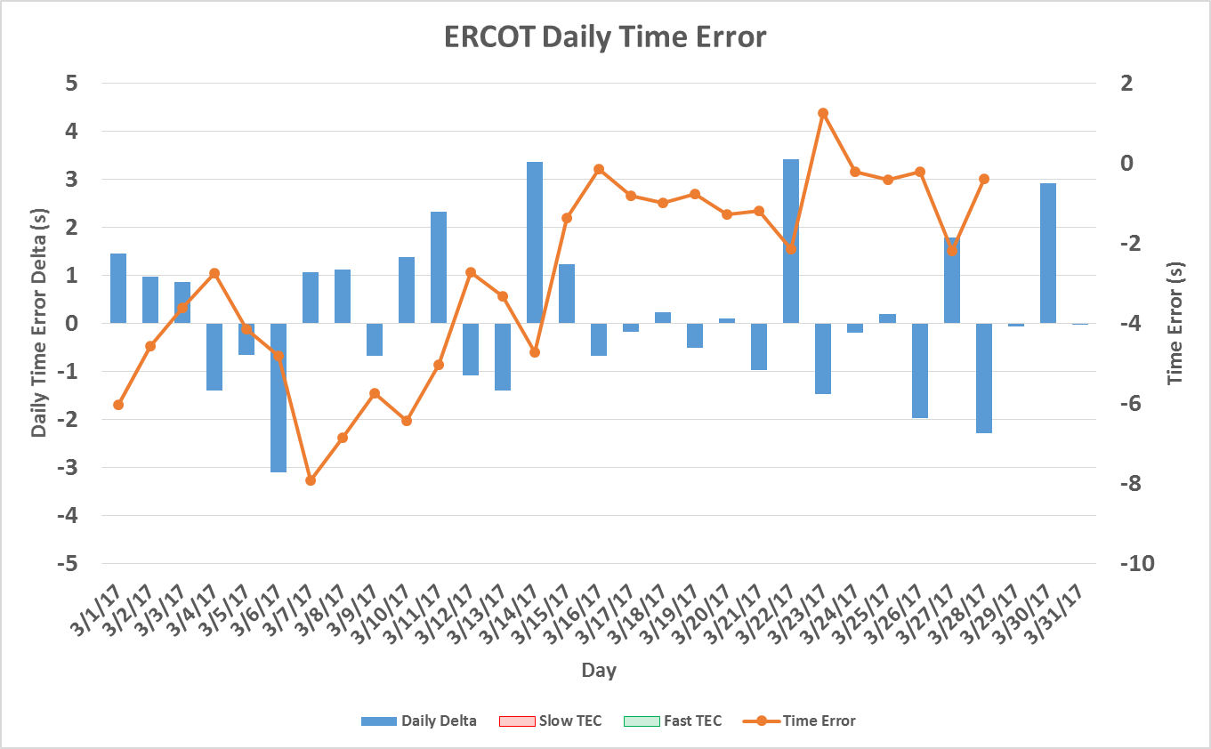
Time Error Corrections
There were no Time Error Corrections (TEC) in March
Notes:
TEC occurred on 12/03/2016 at 23:30. Time Error was 30.06

Slide 12
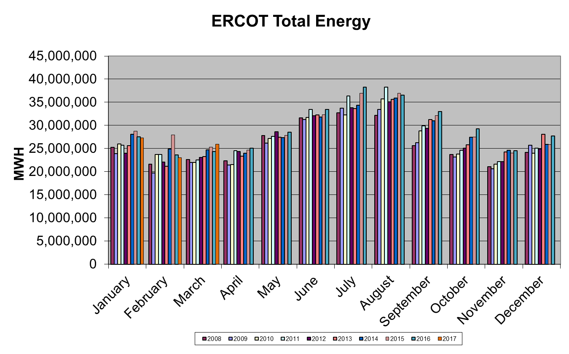
Wind Generation Performance

Slide 13
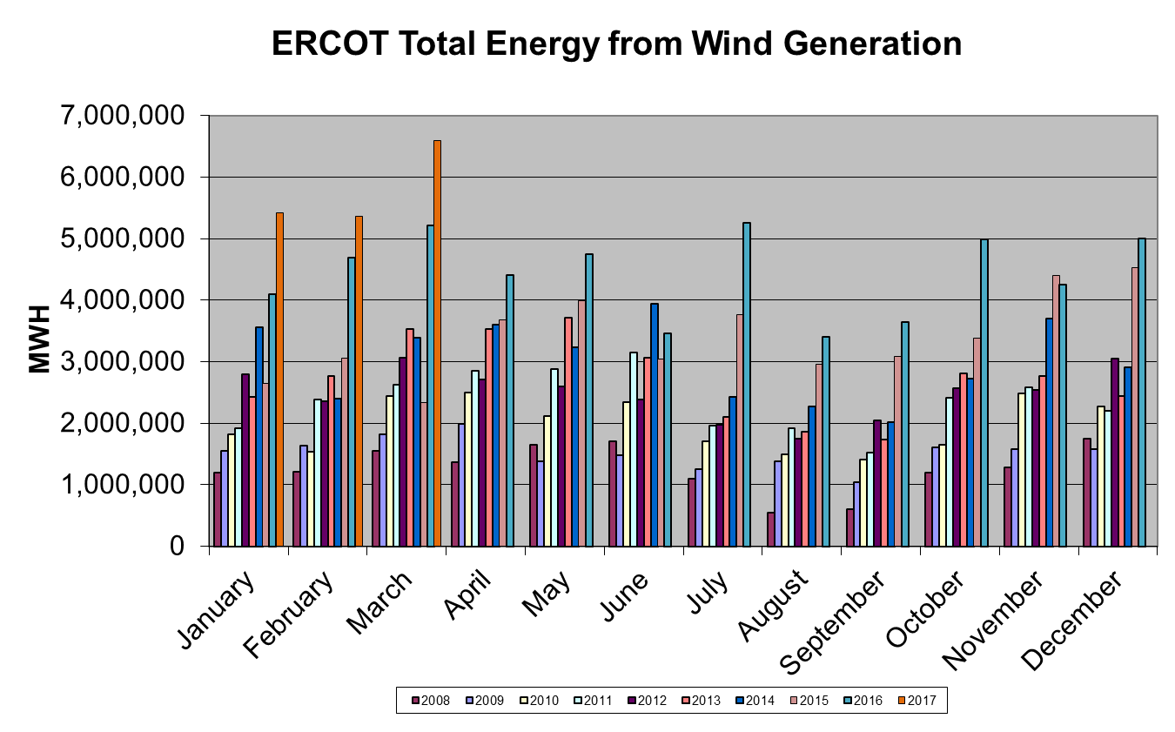
Wind Generation Performance

Slide 14
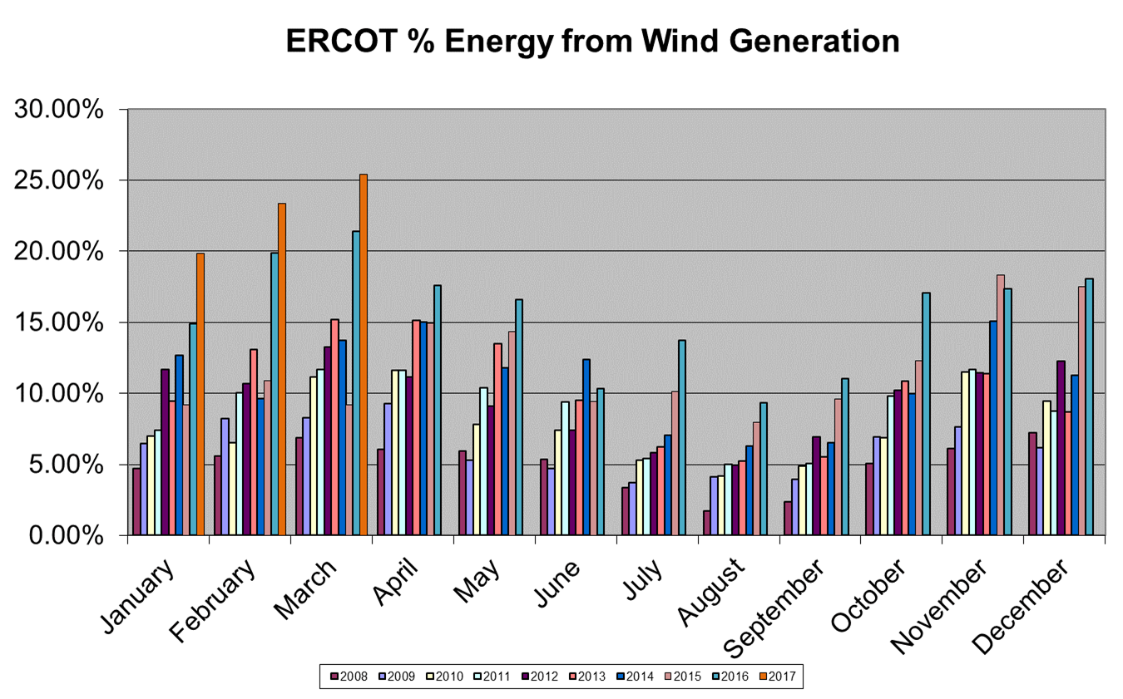
Wind Generation Performance

Slide 15
Questions?

