Slide 1
Congestion Management Working Group
April 5, 2017

Slide 2
Leadership
Greg Thurnher has resigned his position
Nominations
Ian Haley – Luminant Energy - Chair
Seeking nominations for a Vice Chair

Slide 3
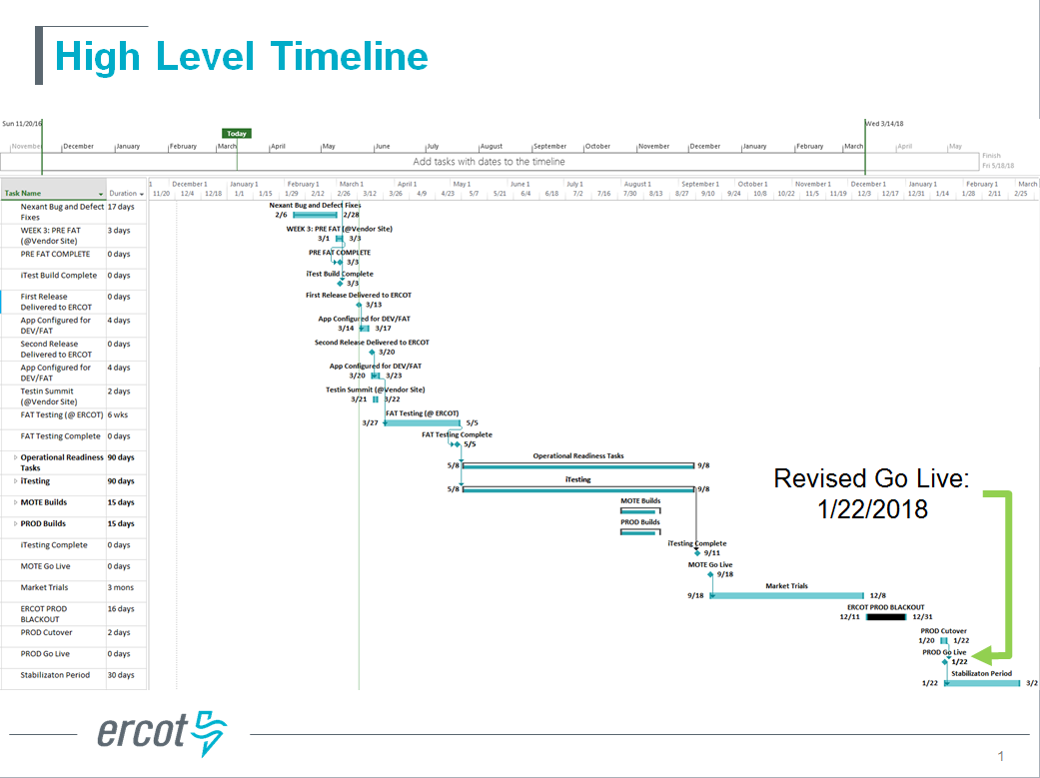
CRR Framework upgrade

Slide 4
Panhandle Generic Transmission Constraint (GTC) limit methodology
  Discussed why real-time limits may differ from the default limits posted in the methodology
  The methodology itself was last updated in September 2016
  ERCOT was asked to update the default limits in the methodology, and will propose a timeline for revision at the next meeting
NPRR822, Designate Resource Node Procedure an Other Binding Document and Adjust the Process for Retiring Resource Nodes
  Discussed moving the Node to another Node or a Bus

Slide 5
Review of Section 4.1 OPERATING PROCEDURE MANUAL Transmission and Security Desk
  Discussion centered around operator management of Houston-area congestion the week of February 20
  ERCOT discussed the concepts of “same element” and “in series” congestion as referenced in the procedure manual
CRR Auction Calendar changes
  ERCOT will not be able to seek approval at the May TAC meeting
  3 year auctions will not begin until 2018

