Slide 1
NPRR 816 / Vendor Index Definitions
WMS
April 5, 2017

Slide 2
FIP and FOP Vendor Selection
ERCOT’s existing contract with Platt’s for FIP and FOP index prices expires August 25, 2017.
On January 19, 2017 ERCOT issued Request for Proposal for Natural Gas and Fuel Index Prices (1-17 JT) to identify potential vendors. The RFP is included with meeting materials.
Responses were received from Platt’s and Argus.
ERCOT is in the process of evaluating the responses and wishes to provide appropriate transparency to stakeholders.

Slide 3
FIP
Current Protocol Section 2 definition
Fuel Index Price (FIP)
The midpoint or average of the daily index prices for fuel for each Operating Day for the Houston Ship Channel area (Houston Ship Channel), expressed in dollars per million British thermal units ($/MMBtu). ERCOT shall issue a Market Notice disclosing the name of the ERCOT-selected source for the average daily index prices used to calculate FIP. In the event that the ERCOT-selected index becomes unavailable, or ERCOT determines that the index has become unsuitable for the intended purpose, ERCOT may select a substitute index source. ERCOT shall issue a Market Notice disclosing its intent to use a substitute index source and the name of the substitute index source at least 60 days prior to the beginning of its use, or as soon as practicable.

Slide 4
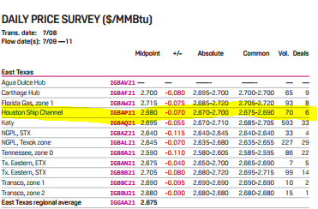
Vendor Fuel Definitions - FIP
Platts Gas Daily (publication)
Argus equivalent is Houston Ship Channel

Slide 5
FOP
Current Protocol Section 2 definition
Fuel Oil Price (FOP)
An average of the daily index prices for fuel oil for each Operating Day, plus five cents per gallon, for U.S. Gulf Coast, Houston pipeline No. 2 oil, converted to dollars per million British thermal units ($/MMBtu). The conversion is 0.1385 MMBtu per gallon. The effective dates for daily index prices shall be as indicated in the ERCOT-selected index. In the event, at the time of settlement or calculation of generic costs, that the effective price for a particular Operating Day is not available, the effective price for the most recent preceding Operating Day shall be used.
ERCOT shall issue a Market Notice disclosing the name of the ERCOT-selected source for the average daily index prices used to calculate FOP. In the event that the ERCOT-selected index becomes unavailable, or ERCOT determines that the index has become unsuitable for the intended purpose, ERCOT may select a substitute index source. ERCOT shall issue a Market Notice disclosing its intent to use a substitute index source and the name of the substitute index source at least 60 days prior to the beginning of its use, or as soon as practicable.

Slide 6
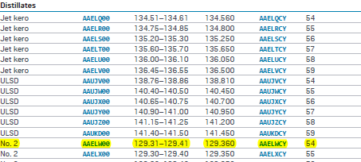
Vendor Fuel Definitions - FOP
Platts OilGram (publication)
HEATING OIL (No. 2)
US Gulf Coast
Pipeline assessments: Platts US Gulf Coast pipeline assessments
reflect product moving on the Colonial Pipeline with input at
Pasadena, Texas. Pipeline assessments reflect southern grade
products on the Colonial Pipeline.
Argus equivalent is Colonial Pipeline Heating Oil 77 Cycle54

Slide 7
RMR Cost Update
Questions

