Slide 1
DAM Point-to-Point Obligation (PTP) Bids under Contingency Analysis
March 31, 2017

Slide 2
Agenda
Technical discussion of PTPs in Contingency Analysis
Alternative implementation
Next Steps

Slide 3
Overview
A PTP is modeled as a simultaneous injection and withdrawal – a linked bid and offer
Clearing price and SPP difference diverge when
  Under a contingency a settlement point associated with either the PTP’ sink or source is disconnected
  A constraint becomes violated/binding under the contingency
  The shift factor for the connected settlement point is non-trivial
  The constraint remains binding for the final DAM solution

Slide 4
Modeling DAM PTPs in Contingency Analysis
Under contingency analysis a contingency disconnects one of the source/sink settlement points
In order to keep post-contingency power balance, any PTP containing a disconnected settlement point will be ignored in the post-contingency power flow.
PTPsource PTPsink

Slide 5
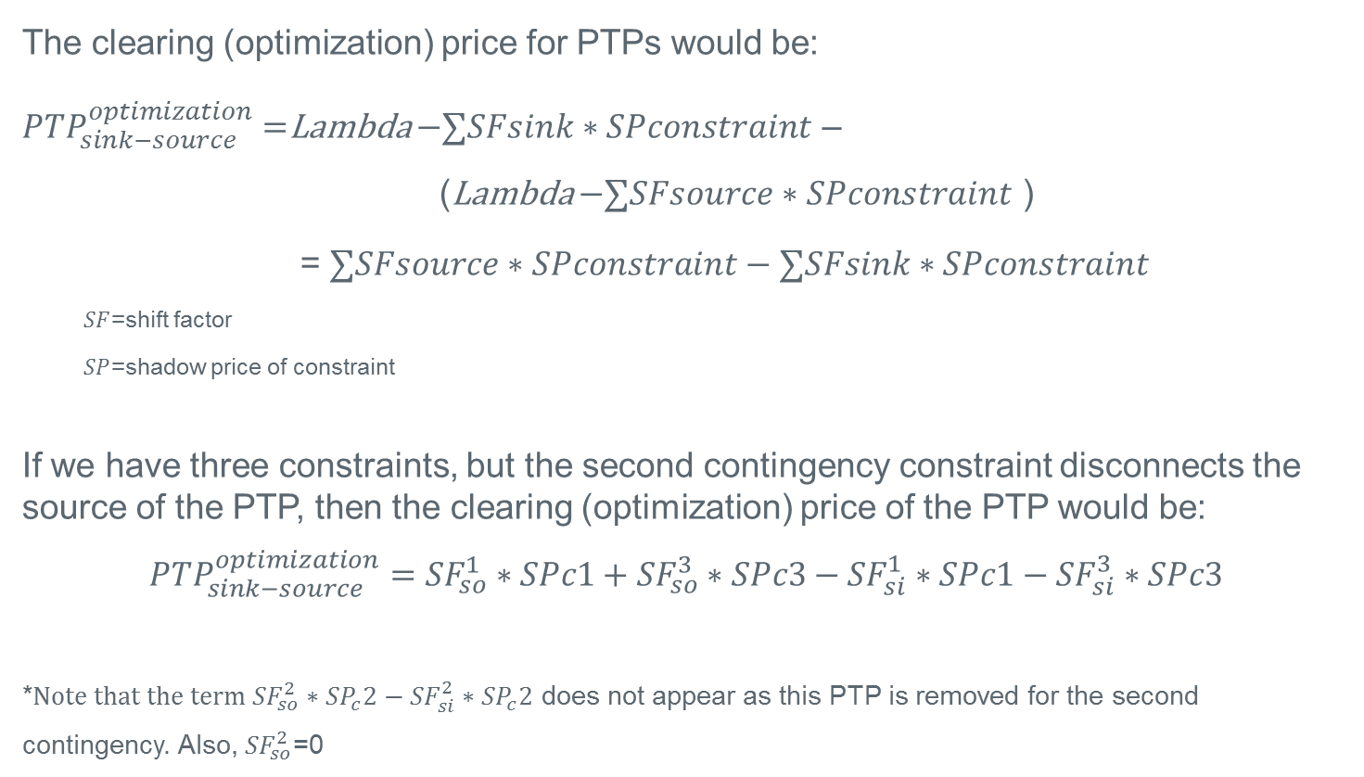
Clearing Price for PTP with source disconnected in a contingency
The clearing (optimization) price for PTPs would be:
${PTP}_{sink−source}^{optimization}=$Lambda $−∑SFsink∗SPconstraint$ –
(Lambda $−∑SFsource∗SPconstraint$ )
= $∑SFsource∗SPconstraint−∑SFsink∗SPconstraint$
  $SF$=shift factor
  $SP$=shadow price of constraint
If we have three constraints, but the second contingency constraint disconnects the source of the PTP, then the clearing (optimization) price of the PTP would be:
$${PTP}_{sink−source}^{optimization}={SF}_{so}^{1}∗SPc1+{SF}_{so}^{3}∗SPc3−{SF}_{si}^{1}∗SPc1−{SF}_{si}^{3}∗SPc3$$
*$Note that the term {SF}_{so}^{2}∗{SP}_{c}2−{SF}_{si}^{2}∗{SP}_{c}2$ does not appear as this PTP is removed for the second contingency. Also, ${SF}_{so}^{2}$=0

Slide 6
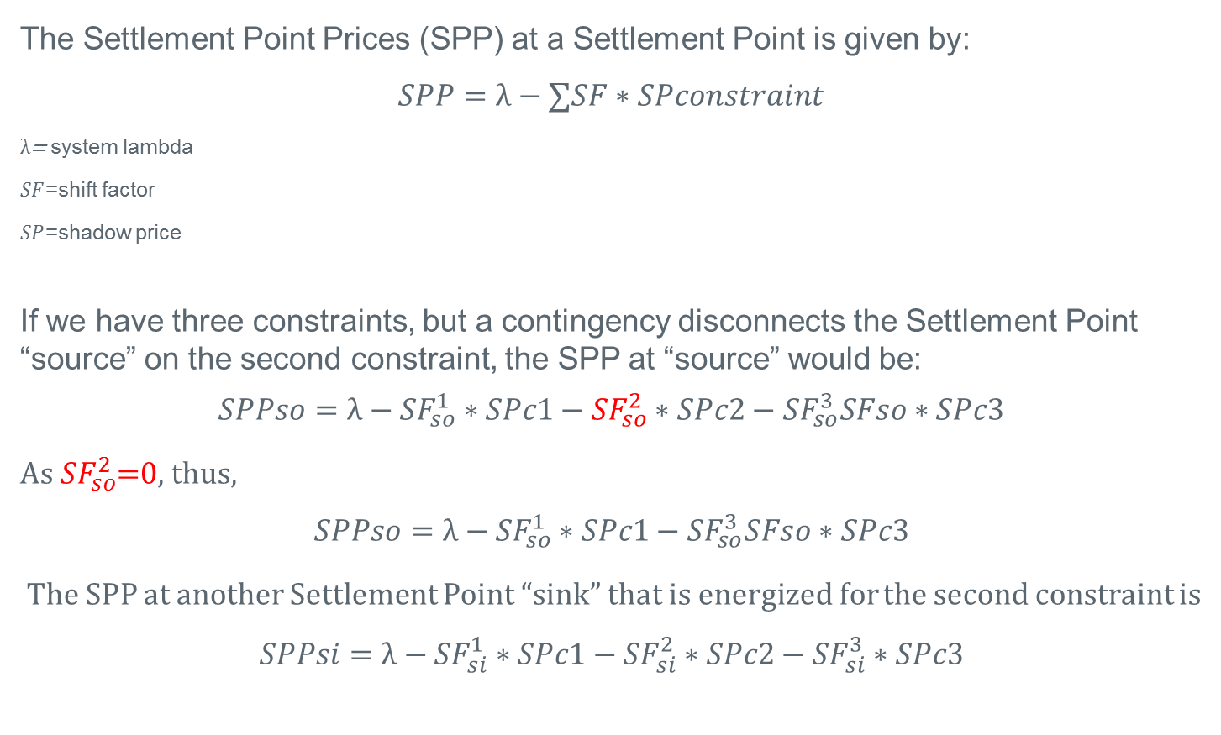
DAM Settlement Point Price
The Settlement Point Prices (SPP) at a Settlement Point is given by:
$$SPP=λ−∑SF∗SPconstraint$$
$λ$= system lambda
$SF$=shift factor
$SP$=shadow price
If we have three constraints, but a contingency disconnects the Settlement Point “source” on the second constraint, the SPP at “source” would be:
$$SPPso=λ−{SF}_{so}^{1}∗SPc1−{SF}_{so}^{2}∗SPc2−{SF}_{so}^{3}SFso∗SPc3$$
As ${SF}_{so}^{2}$=0, thus,
$$SPPso=λ−{SF}_{so}^{1}∗SPc1−{SF}_{so}^{3}SFso∗SPc3$$
The SPP at another Settlement Point “sink” that is energized for the second constraint is
$$SPPsi=λ−{SF}_{si}^{1}∗SPc1−{SF}_{si}^{2}∗SPc2−{SF}_{si}^{3}∗SPc3$$

Slide 7
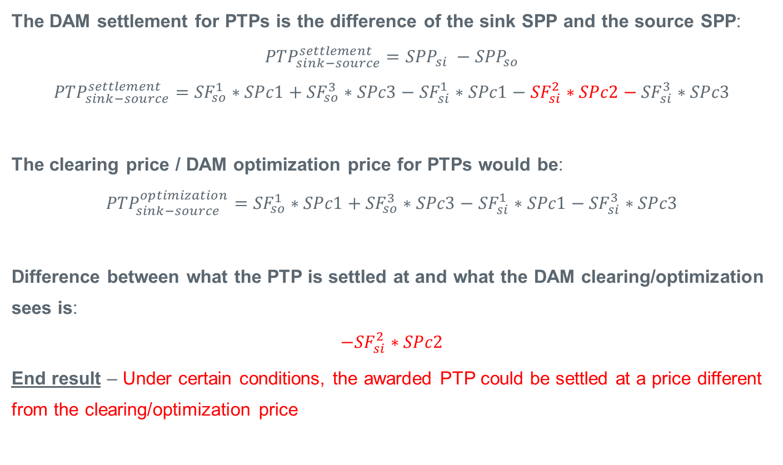
PTP settlement discrepancy when source disconnected in a contingency
The DAM settlement for PTPs is the difference of the sink SPP and the source SPP:
$${PTP}_{sink−source}^{settlement}={SPP}_{si} −{SPP}_{so}$$
$${PTP}_{sink−source}^{settlement}={SF}_{so}^{1}∗SPc1+{SF}_{so}^{3}∗SPc3−{SF}_{si}^{1}∗SPc1−{SF}_{si}^{2}∗SPc2−{SF}_{si}^{3}∗SPc3$$
The clearing price / DAM optimization price for PTPs would be:
$${PTP}_{sink−source}^{optimization}={SF}_{so}^{1}∗SPc1+{SF}_{so}^{3}∗SPc3−{SF}_{si}^{1}∗SPc1−{SF}_{si}^{3}∗SPc3$$
Difference between what the PTP is settled at and what the DAM clearing/optimization sees is:
$$−{SF}_{si}^{2}∗SPc2$$
End result – Under certain conditions, the awarded PTP could be settled at a price different from the clearing/optimization price

Slide 8
Possible alternatives
Preferred option - Change how DAM processes PTP in contingency analysis when a contingency disconnects the source or sink
To maintain power balance in the post-contingency power flow, rather than ignoring PTP in post-contingency power flow, distribute the PTP MW from the disconnected Settlement Point to all the other connected generators
  Would make optimization price and settlement price consistent within a small tolerance
  Considerations:
    PTP flow could contribute to congestion far removed from the path
    Would have to consider changing CRR auction to make consistent
    Requires system change and extensive testing

Slide 9
Possible alternatives
Alternative option - Change settlement price for PTP bids to the optimization price
  Makes the DAM clearing engine and settlements consistent
    Buyer will never see clearing higher than bid
  Considerations:
    CRR value and PTP cost would diverge
    Would affect Balancing Account
    Gaming opportunities exist
    Requires NPRR and integrated system changes
CRR | DAM | RT
CRR charged at optimization price | CRR settles on SPP difference
 | PTP pays optimization price | PTP settles on SPP difference
 | Over/under goes to Balancing Account | Over/under goes to RT Rev. Neutrality Allocation

