Slide 1
GBY5 RMR Cost Update
WMS
April 5, 2017

Slide 2
Original and Updated Budgets
Comparison of budgets
Cancellation Savings

Slide 3
Budget Totals and Avoided Costs from Cancellation
Note: February 2017 and cancellation budgets amounts include settled actuals but do not include Incentive Factor.

Slide 4
Budget Totals in the Cancellation Period Only

Slide 5
Budgeted and Actual Costs
Actuals settled through January 2017
Note: Budgets exclude Incentive Factor.

Slide 6
Budgeted and Actual Costs Totals
Budgets and actuals, June 2016 – January 2017
Note: Budgets exclude Incentive Factor.

Slide 7
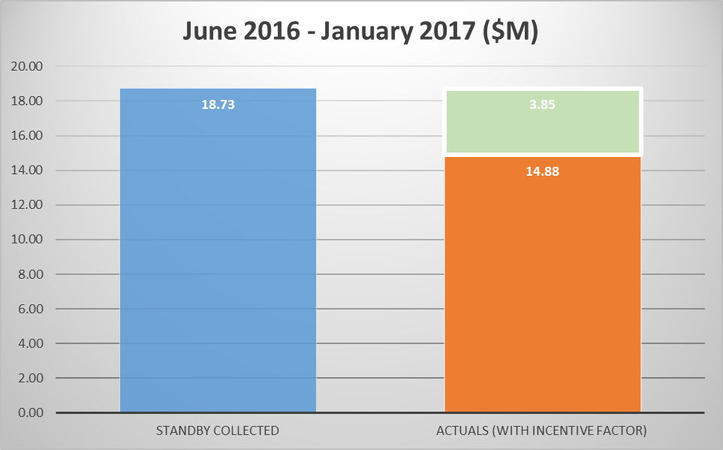
Standby Collected v Actual Costs
Actuals settled through January 2017
Paid back to Load

Slide 8
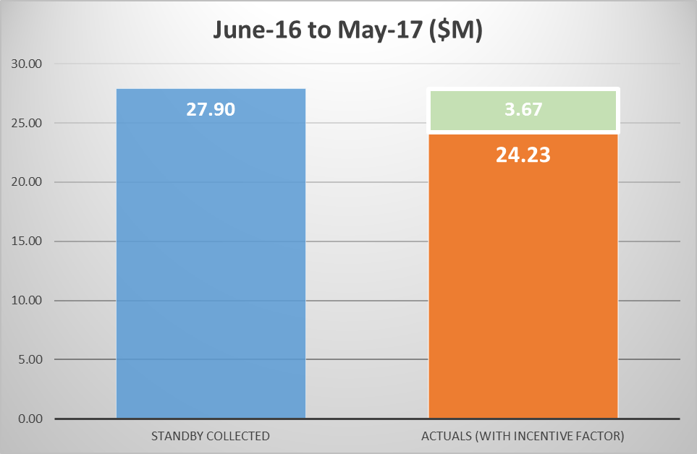
Standby Collected v Actual Costs
Estimates for full term of RMR Agreement
Paid back
to Load
Based on:
1. Actuals for Jun-16 to Jan-17
2. Updated Budget for Feb-17 to May-17.

Slide 9
RMR Cost Update
Questions

