Slide 1
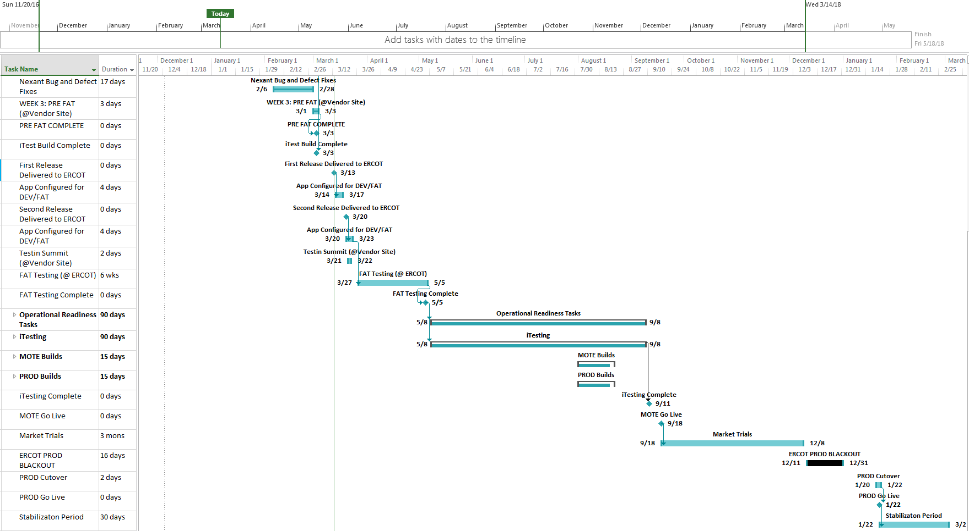
High Level Timeline
Revised Go Live:
1/22/2018

