Slide 1
EDC Process Proposal
Brian Brandaw
Manager of IT Common Platforms
27 March 2017

Slide 2
Objectives
Eliminate use of ActiveX components in the installation and renewal of Certificates
This will resolve the issues currently seen with Microsoft Edge and Windows 10
Improve overall process for all parties involved
The following outlines describe the proposed processes. Changes from current process are in red.

Slide 3
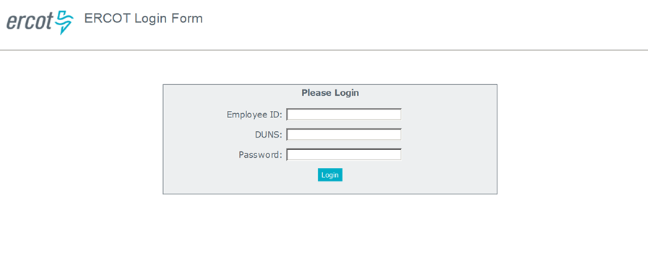
Enrollment
MP USA submits Certificate Request for Company’s User(s) via MPIM
User receives credentials via 2 emails to initiate certificate request process
User authenticates through the Login form using the credentials provided in previous step

Slide 4
Enrollment (continued)
4. User submits request for certificate
User is provided a form to generate a password for the private key
A Password is auto generated based on user request (click Generate Password)
User must save the password for later installation of certificate
User submits the form
Certificate Signing Request (CSR) is generated
CSR is submitted to Certificate Authority (CA)

Slide 5
Enrollment (continued)

Slide 6
Enrollment (continued)
5. User installs or saves the Certificate for future installation
Certificate is generated, signed by Certificate Authority (CA) and streamed / downloaded to user’s computer (no browser dependency)
User is given option to Open/Install PKCS#12 Certificate or Save it to computer for later install using password generated form

Slide 7
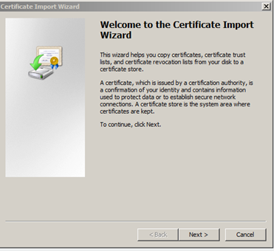
Enrollment (continued)
If “Open” is selected, the Certificate is installed immediately using the desktop’s Operating System tools.

Slide 8
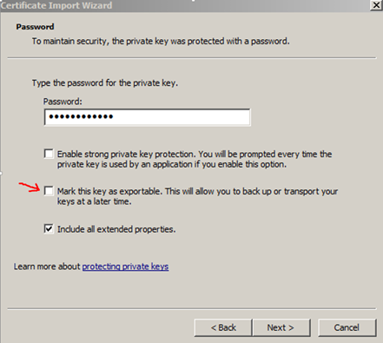
Enrollment (continued)
The Windows Certificate Import Wizard provides the ability to mark a Certificate as exportable.

Slide 9
Renewal
User receives notification of Certificate expiration date
Renewal notification contains data to identify the Certificate to expire, such as UUID
Two emails are sent directly to the user
User navigates to the URL provided in notification email
User logs into the renewal page using the Certificate to be renewed
User initiates a request for a new Certificate following the “Enrollment” process

Slide 10
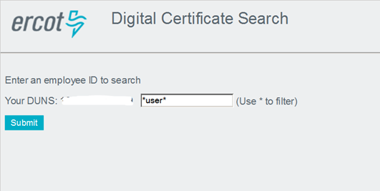
USA Certificate Search (New function)
USA must log into Search Page using valid Cert with MP_USA Role assigned
USA can search by Username or Employee ID

Slide 11
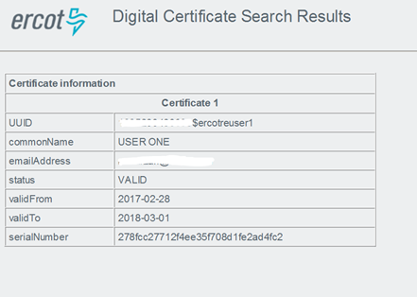
USA Certificate Search (Continued)
Search results contain Certificate attributes such as expiration date, status, and UUID

Slide 12
USA Certificate Search (Continued)
If a Certificate is within the 30 day renewal period, the USA can click a link to initiate the renewal process for that Certificate.
Renewal process would follow the same workflow as “Enrollment” and “Renewal”
Certificate Revocation is supported thru the MPIM interface and is not changing.

Slide 13
Questions?

