Slide 1
Project Update and Summary of
Project Priority List (PPL) Activity
March 9, 2016

Slide 2
Project Update Agenda
Project Portfolio Update p. 3-8
  Recent / Upcoming Project Implementations
  2017 Release Targets
  2017 Project Spending Forecast
  Revision Request Funding Placeholder Status
  Project Reporting
  Priority/Rank Options for Revision Requests with Impacts
Appendix
  Project Portfolio Gantt Chart p. 9-17
Location of Project Priority List (PPL): http://www.ercot.com/services/projects/index

Slide 3
Recent / Upcoming Project Implementations
2017 March Release – Week of 3/7/2017 Complete
  NPRR272 – Definition and Participation of Quick Start Generation Resources
  NPRR649 – Addressing Issues Surrounding High Dispatch Limit (HDL) Overrides
  NPRR753 – Allow AMS Data Submittal Process for TDSP-Read Non-Modeled Gens
  NPRR764 – QSE Capacity Short Calcs Based on 80% Probability of Exceedance (P80)
  NPRR785 – Sync WGR and PVGR COPs with Short Term Wind and PV Forecasts
  RMGRR134 – Allow AMS Data Submittal Process for TDSP-Read Non-Modeled Gens
2017 March Release – Week of 4/7/2017 In Flight
  RRGRR003 – Modifications to Improve Wind Forecasting
  RRGRR006 – Clarification of Descriptions and Alignment with RARF Forms
  RRGRR007 – Adding Solar Resource Registration Inputs
  RRGRR009 – Adding Voltage Limit Sets, Relay Loadability, MLSE, and GMD Data
  PGRR046 – Addition of Geomagnetically Induced Current (GIC) Model Building Reqs
Go-Live date in Q2 2017 In Flight
  NMMS Upgrade project
Note: Projected Go-Live dates are subject to change.
Please watch for market notices as the effective dates approach.

Slide 4
2017 Release Targets – Board Approved NPRRs / SCRs / xGRRs
March 3/7 – 3/9 | May 5/1 – 5/11 | June 6/27 – 6/29 | August 8/29 – 8/31 | October 10/31 – 11/2 | December 12/5 – 12/7
NPRR272 NPRR649 NPRR753 NPRR764 NPRR785 RMGRR134 RRGRR003 RRGRR006 RRGRR007 RRGRR009 PGRR046 NPRR790 | SCR790 NPRR746 NPRR786 NPRR792 NOGRR164 PGRR051 RRGRR003 RRGRR006 RRGRR007 RRGRR009 PGRR046 | NPRR573 NPRR744 NPRR782 NPRR789 NPRR797 NPRR801 | NPRR758 NPRR775 SCR777 | NPRR778 | SCR789
7 | 11 | 6 | 3 | 1 | 1
E
E
E
E
E
E
P
E
P
E
E
P
E
NS
E
NS
NS
9/16 – 9/17
(Retail)
4/7
E
E
E
E
E
7/15 – 7/16
(Retail)
10/2 – 10/3
(Off-Cycle)
11/11 – 11/12 (Retail)
12/9 – 12/10 (Retail)
2/1
Q2 – NMMS Upgrade
2017 TBD Items (and point at which they became “TBD”)
2014 | 2015 | 2016 | 2017
NOGRR084, NPRR664 | None | SCR781 H | None
Go-live dates can differ from Protocol effective dates – Please refer to market notices for more details
APPENDIX
Red Text: New additions and target release changes
Strike-Through Text: Previous target release changes
(a), (b), etc. indicates multiple phases
In-Flight Items Planned for Future Delivery
CMM bundle (Planning):
  By summer 2018: NPRR519, NPRR620,
  NPRR683, NPRR741, NPRR743,
  NPRR755, NPRR760, NPRR800
  TBD: NPRR702
Release targets are subject to change
Project Status Codes: NS = Not Started, I = Initiation, P = Planning, E = Execution, H = On Hold

Slide 5
2017 Project Spending
2017 PPL Budget = $20.5M
“Potential Demand” represents internal ERCOT projects that have not been fully approved

Slide 6
Revision Request Funding Placeholder Status
In 2017, ERCOT forecasted $4.0M for Revision Request work
Yearly Revision Request Spending Forecast Summary
Project Status | 2017
YTD Actuals | $0.25M
Approved – In-Flight / Complete | $1.66M
Approved – On Hold | $0.40M
Approved – Not Started | $0.45M
Remaining Funding | $1.49M
Total Allocation | $4.00M
As of 1/31/2017

Slide 7
Project Reporting
Project Priority List (PPL)
  Location: http://www.ercot.com/services/projects/index
  Frequency: Monthly
  Highlight: “Update Log” tab contains history of changes to key fields
Project Stoplight Report
  Location: http://www.ercot.com/committee/board
    Key Documents section - part of “ERCOT Monthly Operations Overview”
  Frequency: Monthly
  Highlight: Reports project performance against approved schedule and budget
PRS Report
  Location: Included in monthly PRS meeting materials
  Frequency: Monthly
  Highlight: Release Matrix shows plans for Revision Request go-lives for the year

Slide 8
Priority / Rank Options for Revision Requests with Impacts
Options for…
Revision Request | Description | Priority | Rank | Comments
NPRR776 | Voltage Set Point Communication | 2017 | 1970 | This project can be added to the end of the project list and worked into the 2017 delivery plan. If approved, work is expected to start in mid-2017 and run for one year.
NPRR809 | GTC or GTL for New Generation Interconnection | 2017 | 1980 | Reporting system impacts and contract staffing. Project can be added to the end of the project list and worked into the 2017 delivery plan.
NOGRR166 | Removal of the Daily Grid Operations Summary Reports | TBD | TBD | Latest approved language eliminates system impacts.

Slide 9
Appendix
  2/29/2017 Project Gantt
    In-flight items sorted by Project End Date
    “On Hold” projects listed separately
    “Not Started” items sorted by Project Start Date

Slide 10
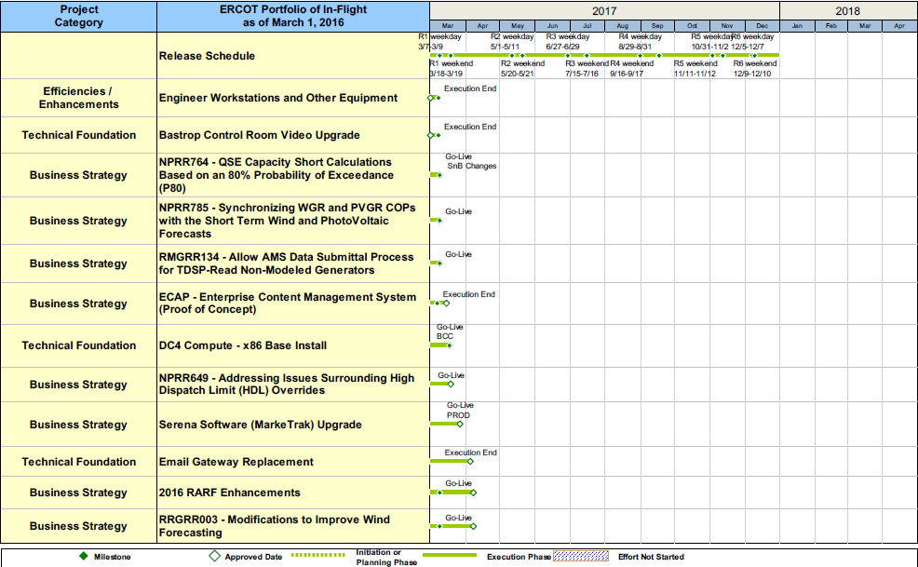
Project Portfolio Status – as of 2/29/2017

Slide 11
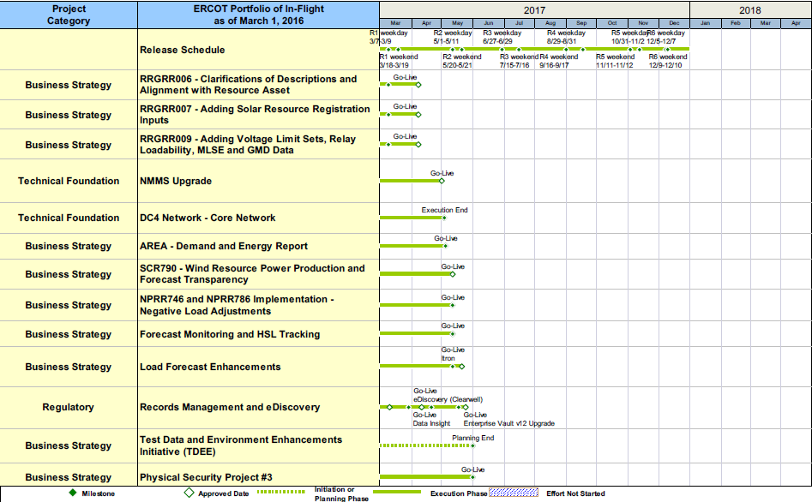
Project Portfolio Status – as of 2/29/2017

Slide 12
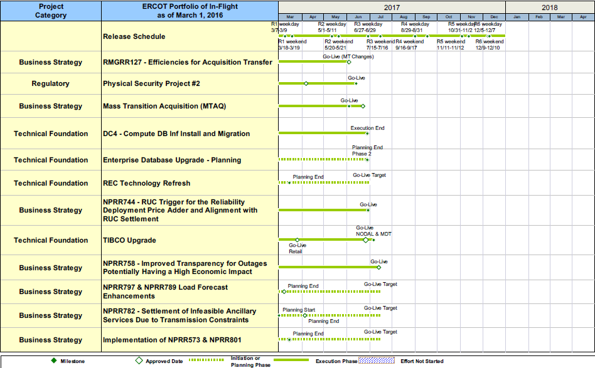
Project Portfolio Status – as of 2/29/2017

Slide 13
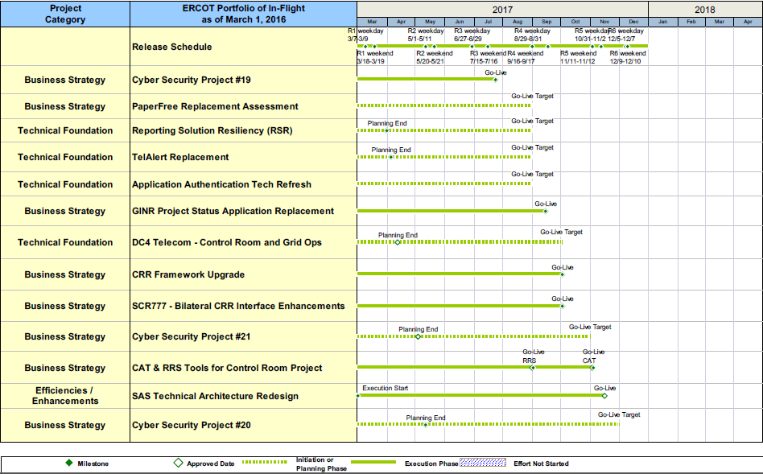
Project Portfolio Status – as of 2/29/2017

Slide 14
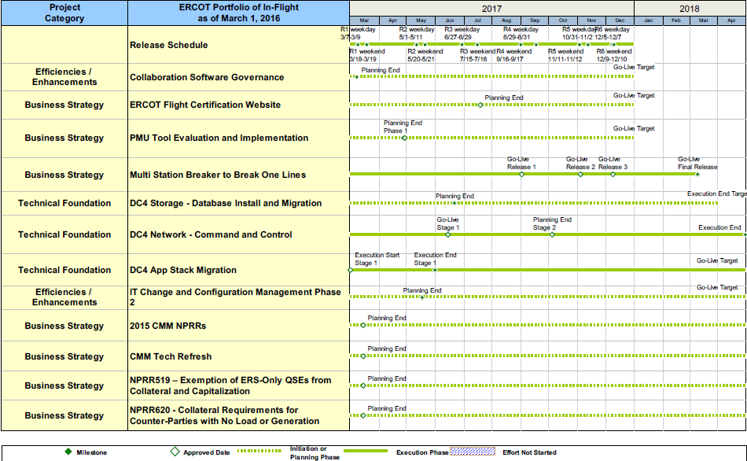
Project Portfolio Status – as of 2/29/2017

Slide 15
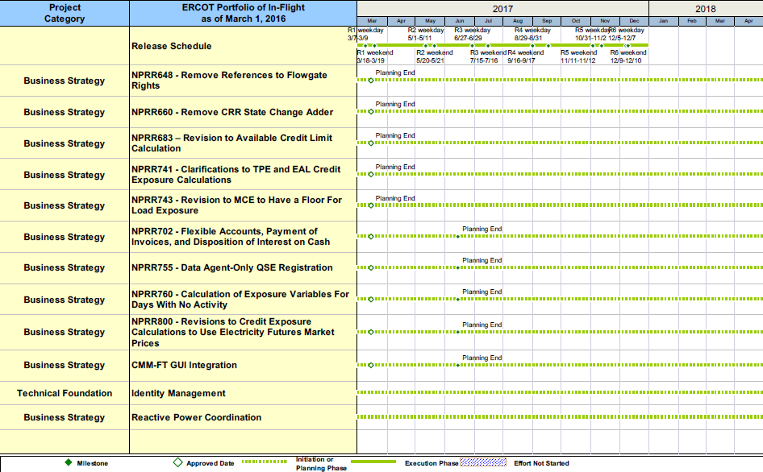
Project Portfolio Status – as of 2/29/2017

Slide 16
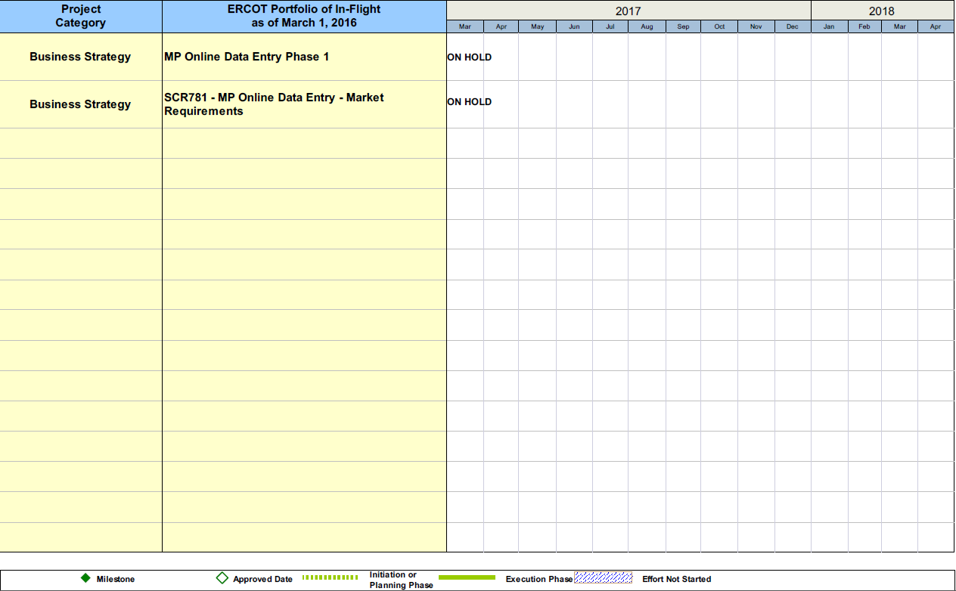
Project Portfolio Status – as of 2/29/2017

Slide 17
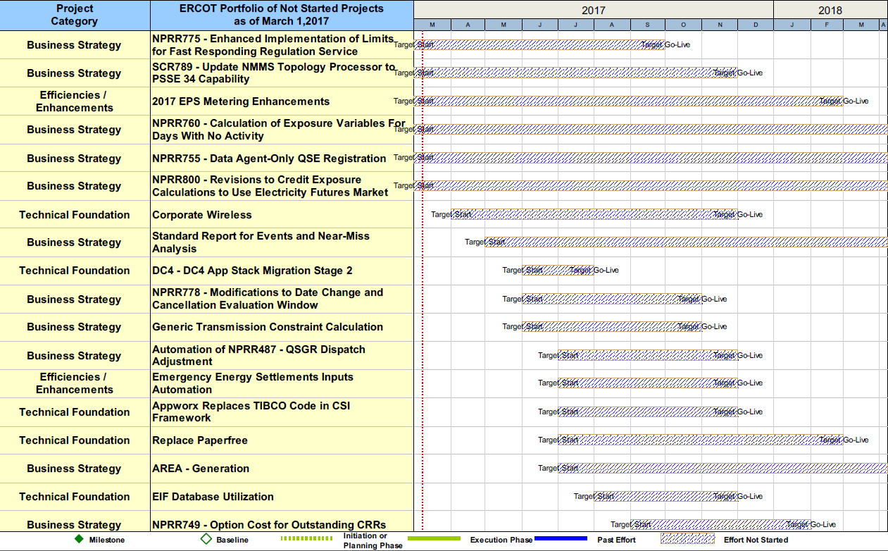
Project Portfolio Status – as of 2/29/2017

