Slide 1
External Web Services Quick Start Guide

Slide 2
GitHub
GitHub is a web-based Git or version control repository and Internet hosting service. It offers all of the distributed version control and source code management (SCM) functionality of Git as well as adding its own features
It provides access control and several collaboration features such as bug tracking, feature requests, task management, and wikis for every project.
As of April 2016, GitHub reports having more than 14 million users and more than 35 million repositories, making it the largest host of source code in the world

Slide 3
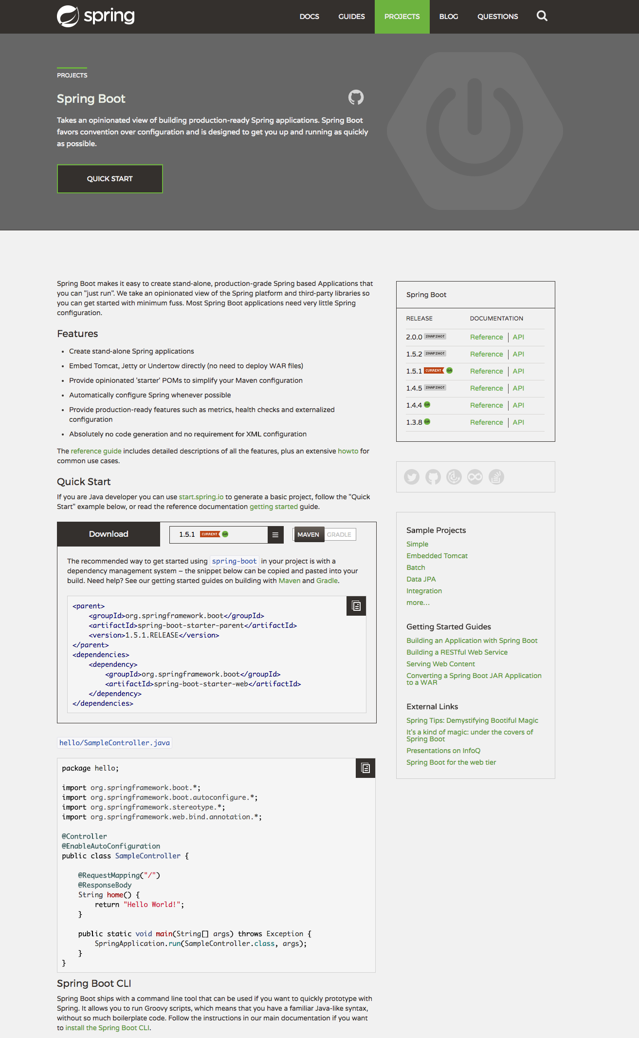
Spring Boot
Takes an opinionated view of building production-ready Java applications. Spring Boot favors convention over configuration and is designed to get you up and running as quickly as possible

Slide 4
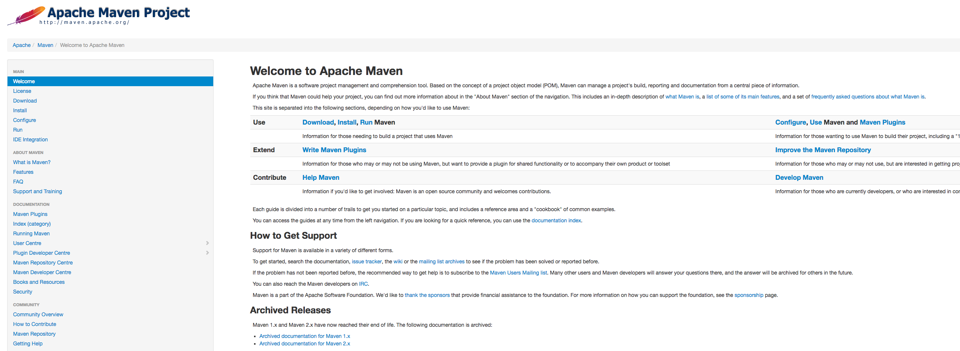
Maven
Maven is a build automation tool used primarily for Java projects
Maven dynamically downloads Java libraries and Maven plug-ins from one or more repositories such as the Maven 2 Central Repository, and stores them locally

