Slide 1
ERCOT Emergency Responsive Service (ERS)
Report to the Public Utility Commission of Texas
for the 2016 ERS Program Year
Project No. 27706
Attachment B

Slide 2
Procurement Summary Trends
Capacity (MW) offered and procured
Number of ERS Resources (All Service Types)
Cumulative Individual Sites Participating in ERID Process
Detailed Procurement Results by 2016 Standard Contract Terms
Settlement Summary

Slide 3
Standard Contract Terms & Time Periods Periods
ERS is procured 3 times annually for 4-month Standard Contract Terms
February through May
June through September
October through January
Participants may offer to provide ERS for one or more Time Periods:
Time Periods are designed to allow flexibility for customers during traditional business hours.
Time Period | Time Period Hours
Time Period 1 | Hours Ending 0600 - 0800 (5:00:00 a.m. to 8:00:00 a.m.) Monday through Friday except ERCOT Holidays.
Time Period 2 | Hours Ending 0900 - 1300 (8:00:00 a.m. to 1:00:00 p.m.) Monday through Friday except ERCOT Holidays.
Time Period 3 | Hours Ending 1400 - 1600 (1:00:00 p.m. to 4:00:00 p.m.) Monday through Friday except ERCOT Holidays.
Time Period 4 | Hours Ending 1700 - 1900 (4:00:00 p.m. to 7:00:00 p.m.) Monday through Friday except ERCOT Holidays.
Time Period 5 | Hours Ending 2000 - 2200 (7:00:00 p.m. to 10:00:00 p.m.) Monday through Friday except ERCOT Holidays.
Time Period 6 | All other hours

Slide 4
Emergency Response Service Trends

Slide 5
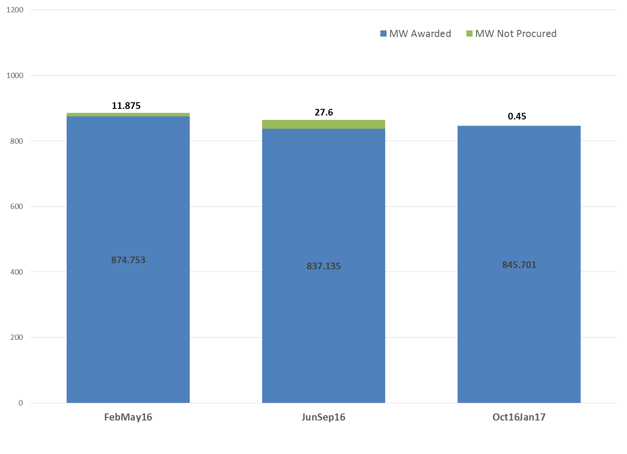
ERS Capacity Procurement Trends (Time Period 1)

Slide 6
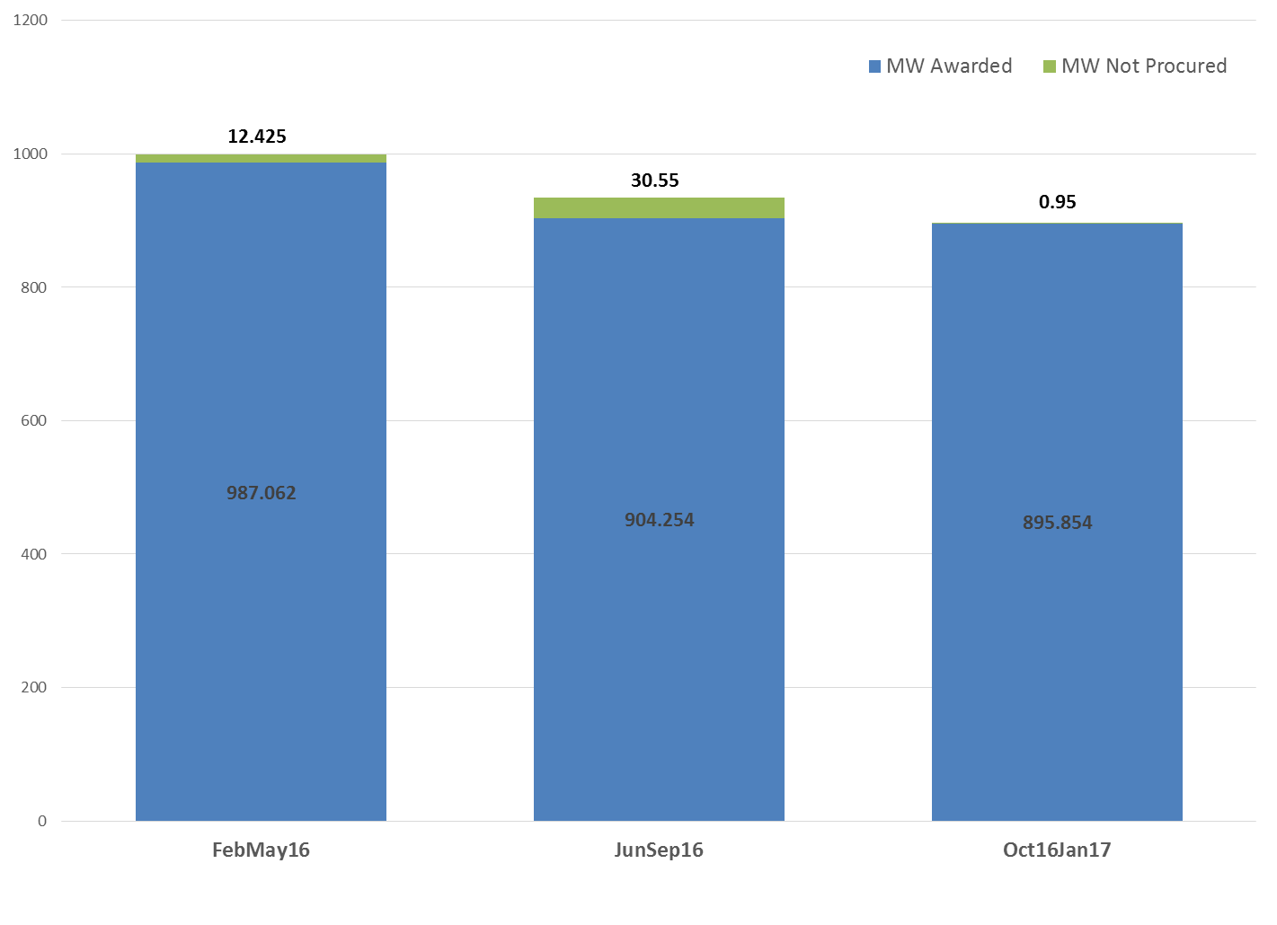
ERS Capacity Procurement Trends (Time Period 2)

Slide 7
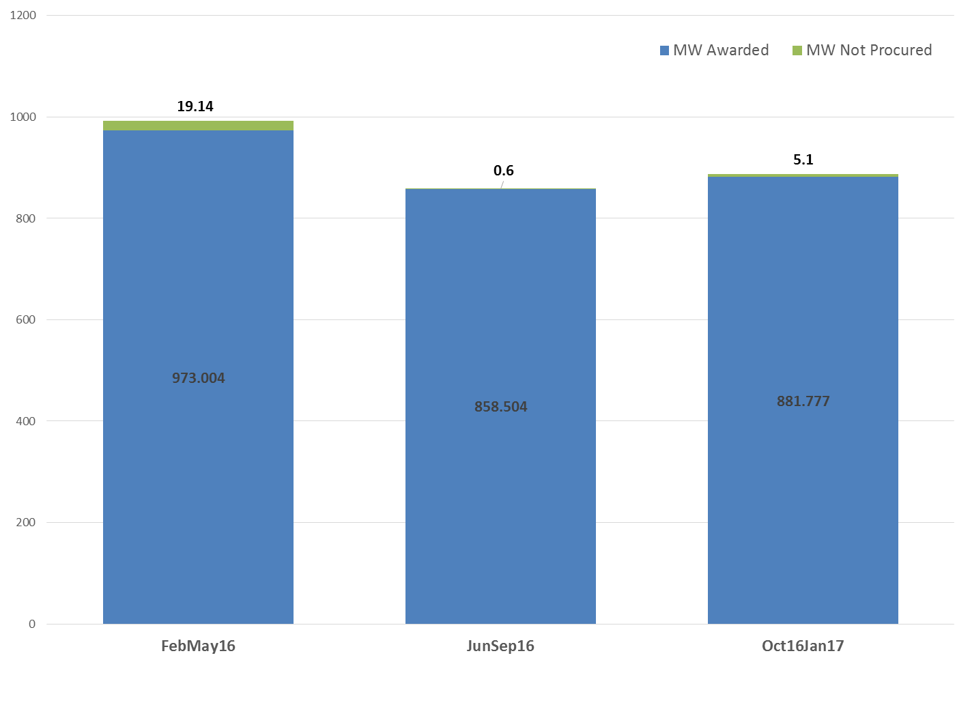
ERS Capacity Procurement Trends (Time Period 3)

Slide 8
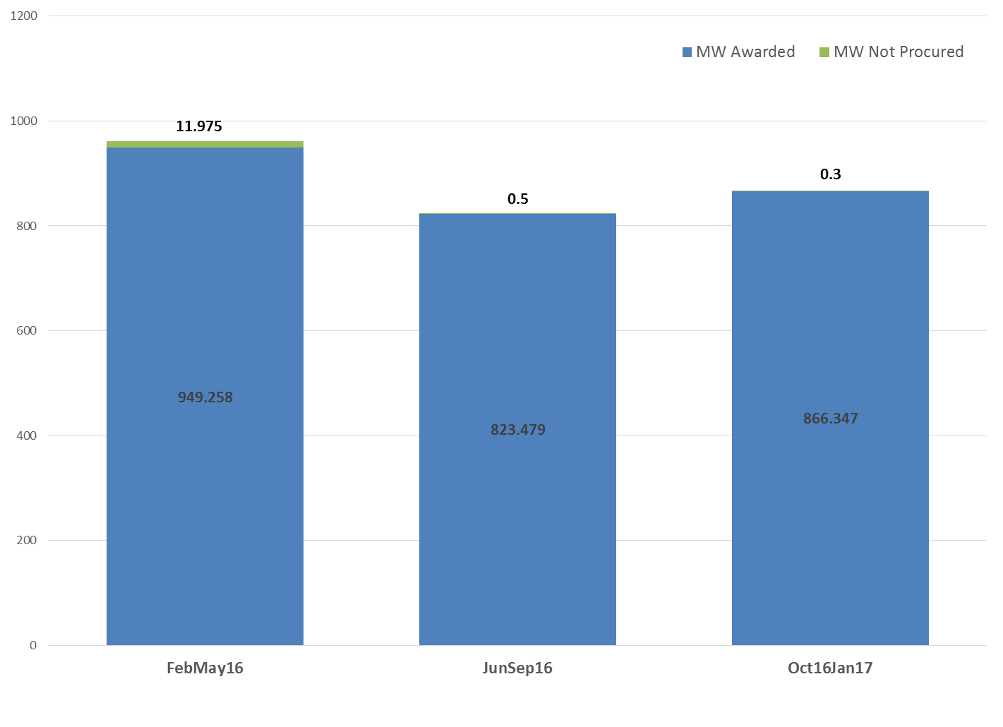
ERS Capacity Procurement Trends (Time Period 4)

Slide 9
ERS Capacity Procurement Trends (Time Period 5)

Slide 10
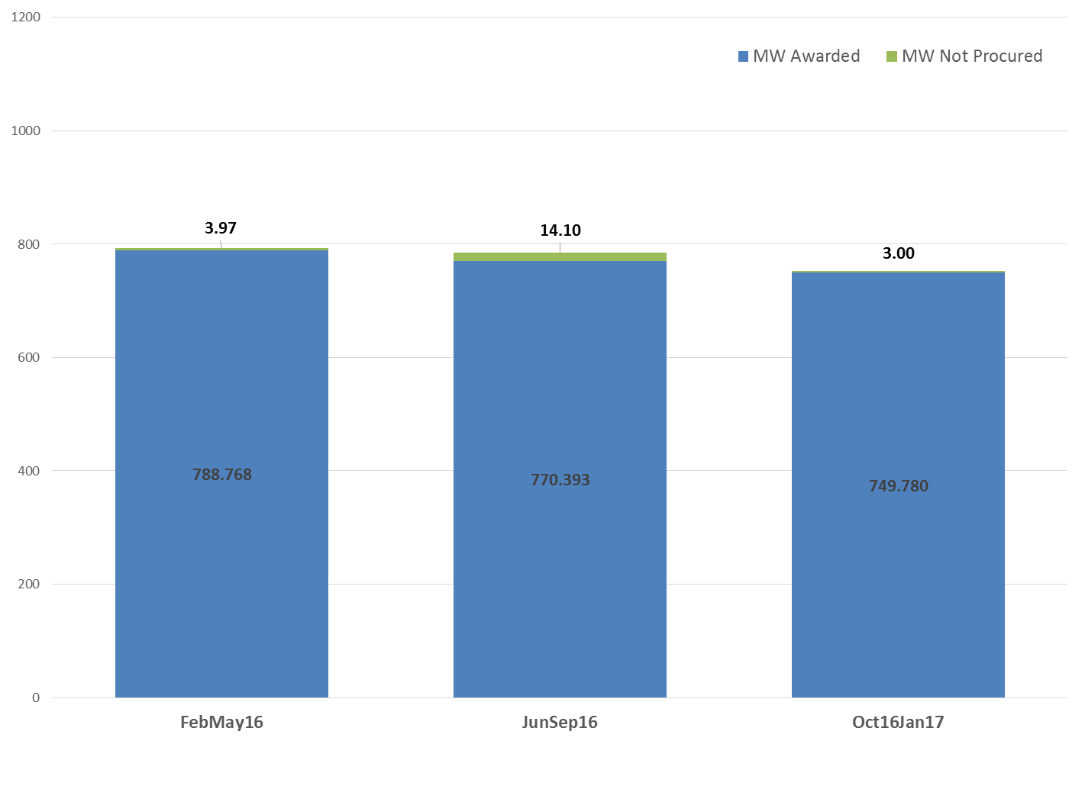
ERS Capacity Procurement Trends (Time Period 6)

Slide 11
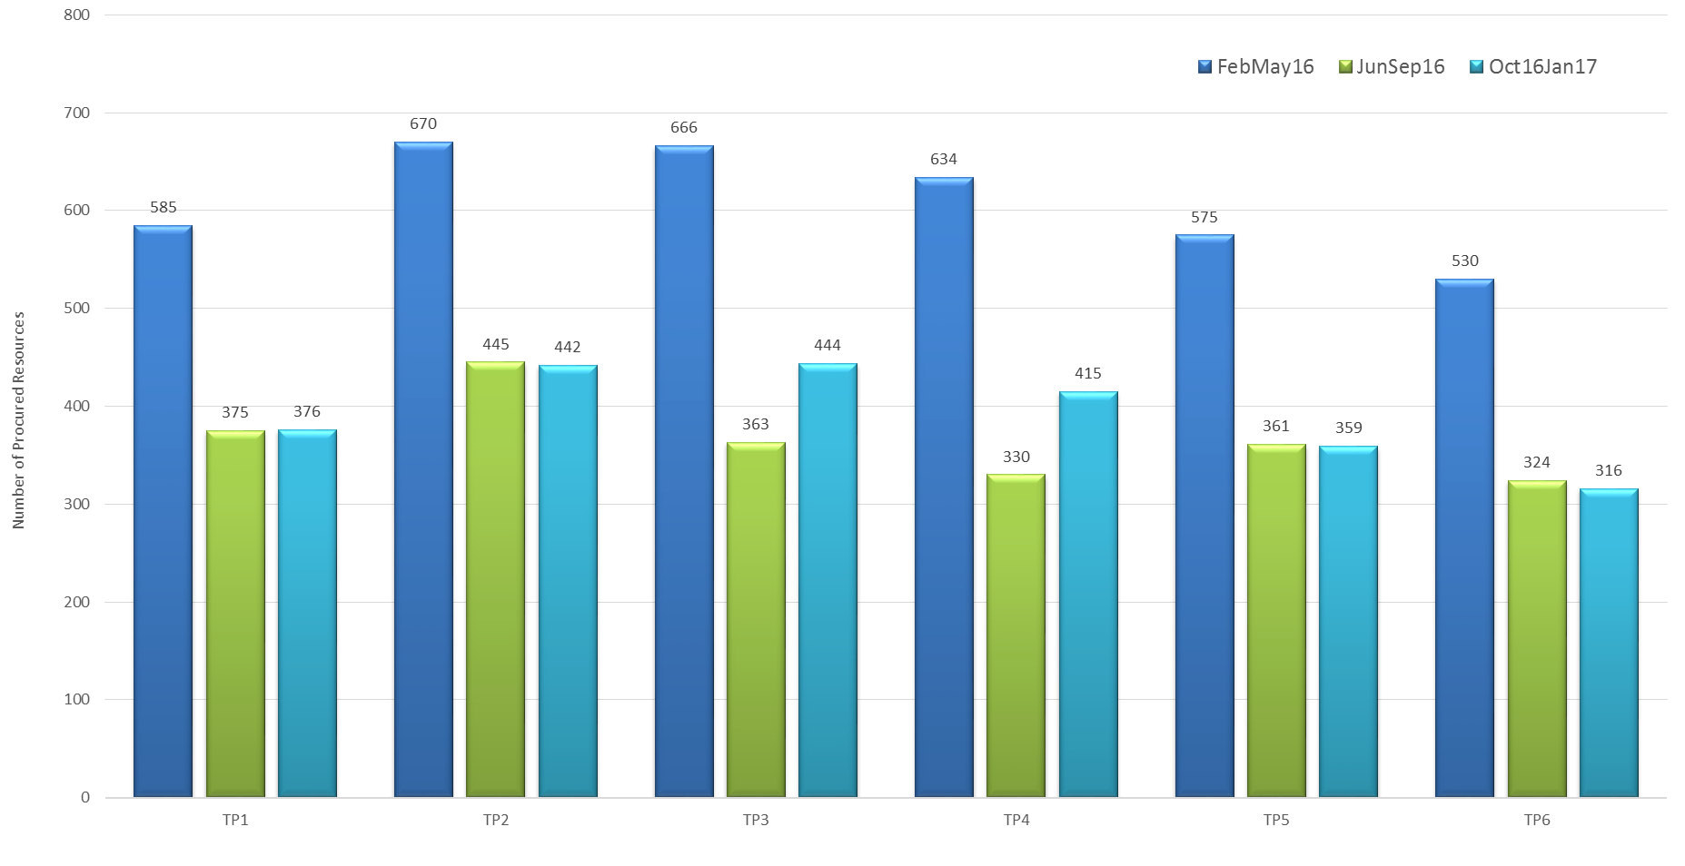
ERS Procurement Trends (Number of Resources)

Slide 12
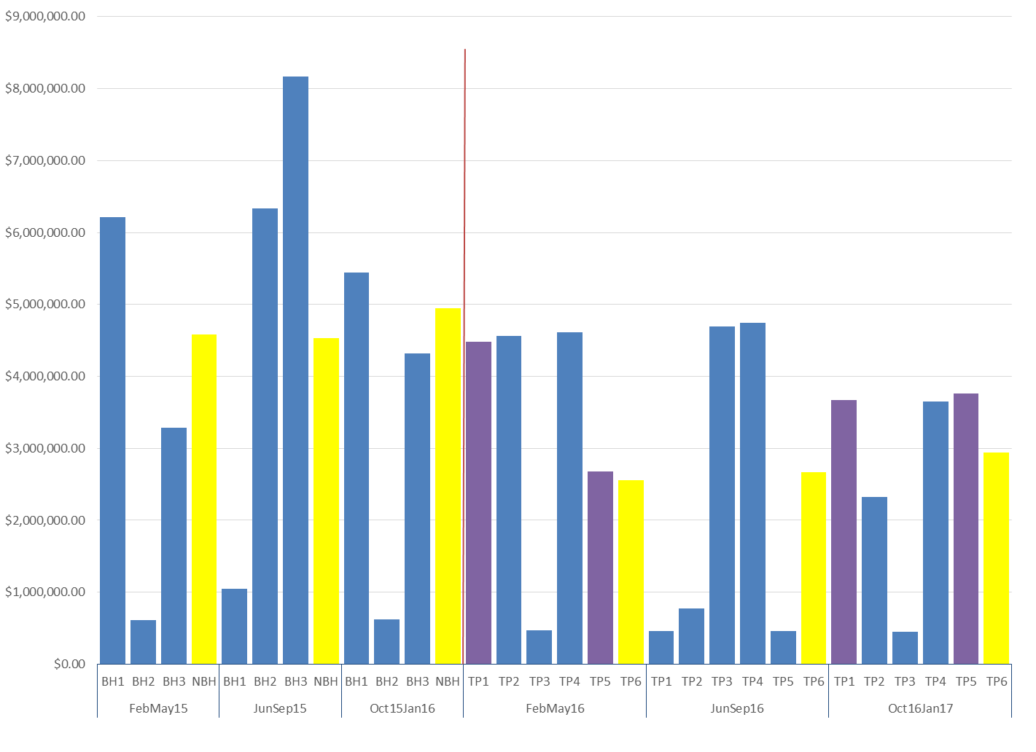
ERS Cost Comparisons per Time Period
Change from 4 time periods to six

Slide 13
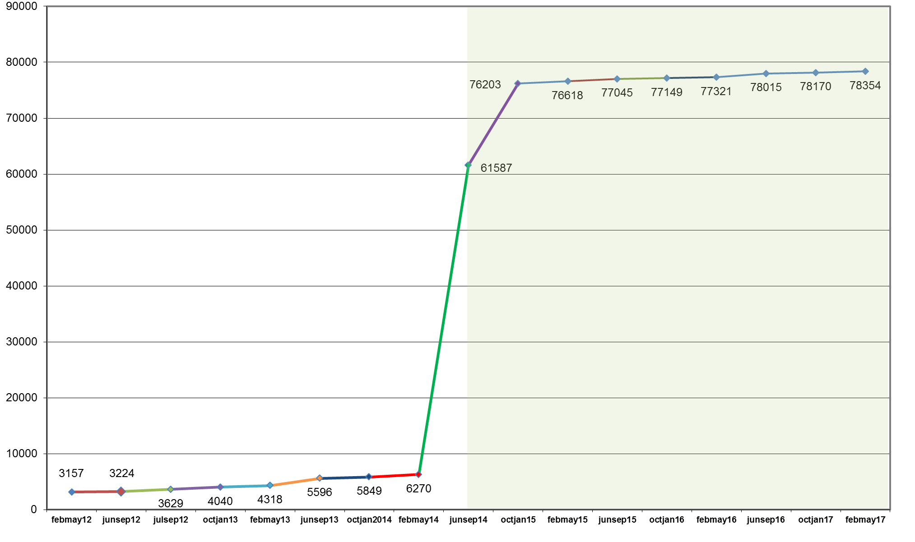
Cumulative Sites (Unique) Participating in ERID Process

Slide 14
Unit Cost ($/MW/hr) vs Time Period Risk Factors

Slide 15
2016 ERS Procurement Results

Slide 16
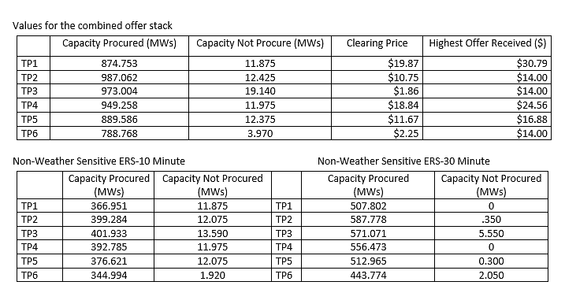
February-May 2016 Standard Contract Term
Final Cost for this Standard Contract Term: $18,970,461.15

Slide 17
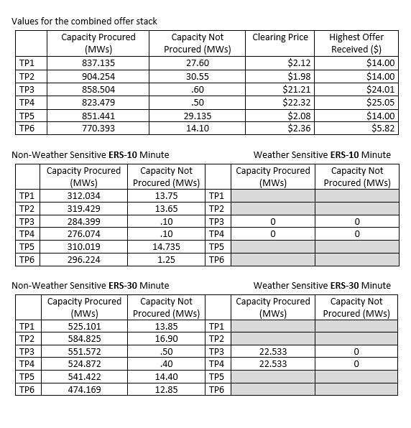
June-September 2016 Standard Contract Term
Final Cost for this Standard Contract Term: $13,372,683.72

Slide 18
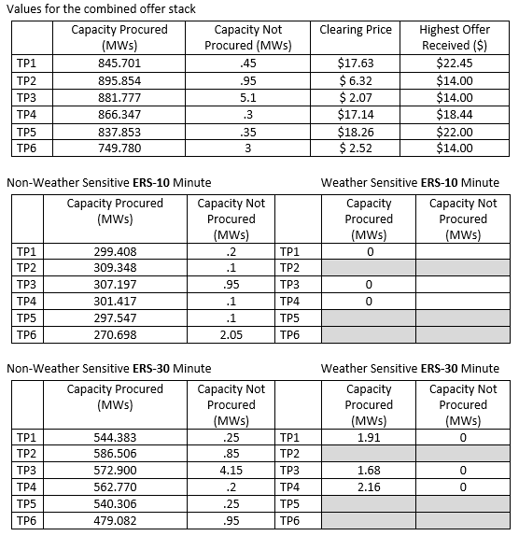
October 2016-January 2017 Standard Contract Term
Awarded Cost for this Standard Contract term: $16,800,291.69

Slide 19
2016 ERS Procurement Overview
Expenditure Limit for 2016 | $50,000,000.00
Amount Spent (Projected) | $49,143,436.56
Unspent (Projected) | $856,563.44
2016 ERS Cap | FebMay16 Total (Final) | JunSep16 Total (Final) | Oct16Jan17 Total (Awarded)
$50,000,000 | $18,970,461.15 | $13,372,683.72 | $16,800,291.69

Slide 20
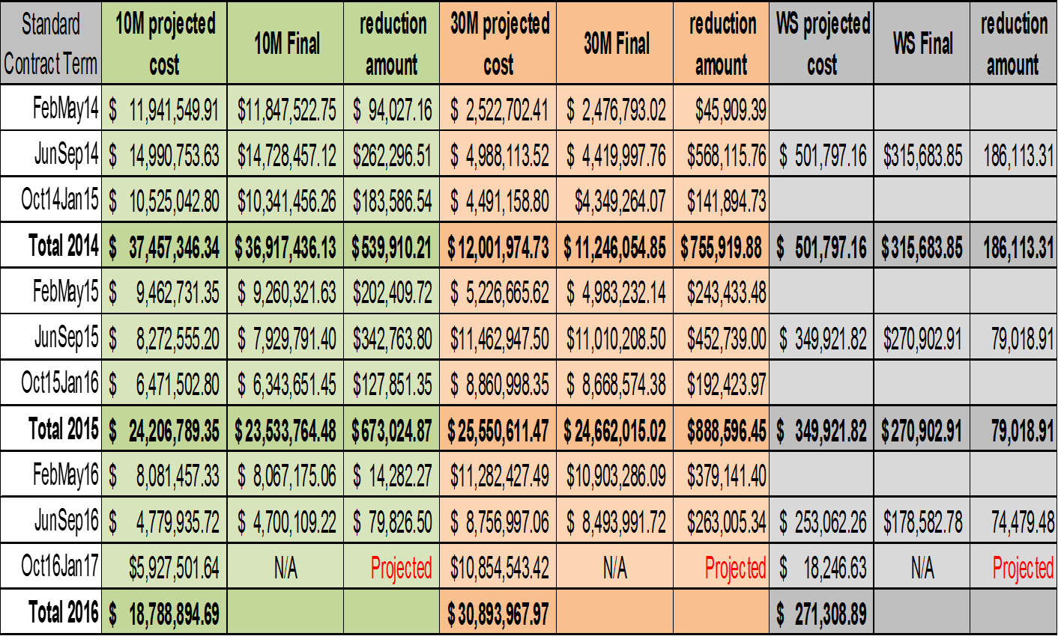
Settlement Summary (3 year look back)
*Payment reductions due to Availability and Testing Results

