Slide 1
Frequency Overshoot Study
PDCWG
ERCOT Staff
03/08/2017

Slide 2
Agenda
Background
Current RRS practice and 50% limit on LRs
Overshoot Studies for the removal of 50% limit of LRs
Notes:
http://www.ercot.com/content/meetings/tac/keydocs/2012/0202/05._2008-2009_LaaRs_Study_Draft04-24-09.doc

Slide 3
NERC BAL-003-1
Effective Date: 4/1/2016
Interconnection Frequency Response Obligation (IFRO)
  Current IFRO is 381 MW/0.1 Hz
Resource Contingency Criteria (RCC) is the largest (N-2) event.
  ERCOT: 2,750 MW
One of the study criteria for Responsive Reserve Service (RRS) is to prevent triggering first step of UFLS
From ERCOT’s study perspective: No firm Under Frequency Load Shed (UFLS) following RCC

Slide 4
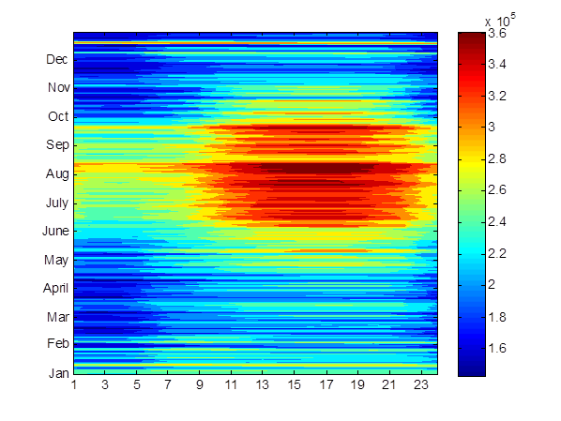
2016 Inertia Review
Inertia Heat-Map
Minimum inertia being observed in 2016 is 142.9 GW.s.

Slide 5
Current RRS Studies
For each case:
Assume only generators required to carry minimum PFR to have active governors.
Trip 2750 MW of generation instantaneously.
Identify minimum Load Resources combined with predetermined minimum PFR to ensure frequency nadir remains at/or above 59.40 Hz.
The steps above are designed for studying unit trip type event to determine minimum quantities of RRS.

Slide 6
Current RRS Studies (Cont.)
 | Case1 | Case2 | Case3 | Case4 | Case5 | Case6 | Case7 | Case8 | Case9 | Case10 | Case11 | Case12 | Case13
Inertia (GW∙s) | 100 | 119.5 | 135.5 | 152 | 177 | 201.5 | 229.5 | 255.5 | 278 | 296.5 | 315.5 | 332 | 350
PFR Requirement (no LRs) | 7350 | 5200 | 4700 | 3750 | 3370 | 3100 | 3040 | 2640 | 2640 | 2240 | 2280 | 2140 | 2140
LRs /PFR | 2.35:1 | 2.2:1 | 2.0:1 | 1.5:1 | 1.4:1 | 1.3:1 | 1.25:1 | 1.13 :1 | 1.08:1 | 1.0:1 | 1.0:1 | 1.0:1 | 1.0:1
PFR Min | 1150 | 1150 | 1150 | 1150 | 1150 | 1150 | 1150 | 1150 | 1150 | 1150 | 1150 | 1150 | 1150
LRs | 2638 | 1841 | 1740 | 1699 | 1586 | 1500 | 1512 | 1319 | 1380 | 1090 | 1130 | 990 | 990
Combined Total | 3788 | 2991 | 2890 | 2849 | 2736 | 2650 | 2662 | 2469 | 2530 | 2240 | 2280 | 2140 | 2140

Slide 7
Why remove 50% limit on LR ?
The 50% limit on LRs providing RRS today is based on the high frequency overshoot concern post LRs activation.
The study assumed only limited number of governors to be active. All online generators would provide governor response, including WGRs for high frequency overshoot.
The study results show 50% limit can be removed as long as generators are required to carry minimum PFR to have active governors.

Slide 8
Identify Minimum Generation Loss to Trigger LRs on UFR at 59.70 Hz
985 MW Generation Loss
All Governors Included
 | Inertia | Load | Wind | PFR Needed | LR Needed
*Case1 | 100GW.s | 24.4GW | 9.7GW | 1150 | 2638

Slide 9
Frequency Overshoot
985 MW Generation Loss
Governor Response:
All online units Including 80 % wind

Slide 10
Minimum RRS Requirement (MW) in 2017
RRS with 50% limit
RRS w/o 50% limit
 | 50% limit | W/O 50% limit | Difference
Averaged Hourly RRS Requirement (MW) | 2617 | 2581 | 36

Slide 11
How much RRS can Load Resources can provide in 2017
LRs with 50% limit
LRs w/o 50% limit
 | 50% limit | W/O 50% limit | Difference
Hourly Average (MW) | 1308 | 1431 | 123
Maximum (MW) | 1404 | 1585 | -
Minimum (MW) | 1150 | 1150 | -

Slide 12
In Summary
Minimum 1150 MW of RRS has to come from Generators. Any RRS quantities beyond 1150 MW can be provided by any Generation and or Load Resources. Therefore, limit on Load Resources providing RRS can be removed.
With these changes, the maximum RRS that LRs can provide without 50% limit for 2017 is 1585 MW instead of 1404 MW with 50% limit.
On an average LRs without 50% limit can provide 123 MW more RRS than that with 50% limit.

Slide 13
Questions?

