Slide 1
Planning Geomagnetic Disturbance Task Force (PGDTF) Meeting Material
March 16, 2017
Omar A. Urquidez
PGDTF Chairman

Slide 2
2017 PGDTF Goals
R1 PGRR Approval
Target: ROS Vote at April Meeting & Board Approval at June Meeting
NERC Deadline July 1, 2017
PGDTF Contact List
GIC Model Completion & Review
Assessment/Model Building Timeline Recommendation
Procedure Manual Update
Vulnerability Assessment Scope/Criteria Recommendation
Corrective Action Plan development and “approval” process Recommendation

Slide 3
Schedule for Creating GIC System Model
12/31/2016 – TSP Data for 345 kV System Based on 2021 Summer Peak Case Released on 10/15/2016 Provided to ERCOT.
3/31/2017 – TSP Data for 138 kV and 69 kV Systems and Update to 345 kV System Data Based on 2021 Summer Peak Case Released on 10/15/2016 Due to ERCOT.
6/30/2017 – REs’ Updated RARF with GIC System Model Data Due to ERCOT.
6/1/2017 – ERCOT Provides First Pass of GIC System Model for Review to TSPs and REs.
7/1/2017 – TSPs and REs Provide Changes to GIC System Model to ERCOT.
Subsequent Model Review Passes Will be Scheduled as Needed.
1/1/2018 – Complete 2021 Summer Peak and 2021 Minimum GIC System Models Using July 2017 SSWG 2021 Summer Peak and 2021 Minimum Base Cases.

Slide 4
PGRR057 posted on 02-06-2017
02-22-2017
03-22-2017
04-06-2017
04-27-2017
06-13-2017

Slide 5
Questions Regarding GIC Model
1. Should all substations be modeled so that each branch calculation can be made, or is it only necessary to model stations containing a high side wye grounded transformer or shunt device?
Yes. Modeling each substation will produce a more accurate calculation of the GICs.
2. If stations that do not contain high side wye-grounded transformers or shunt devices need to be modeled, is the station grounding resistance needed or just its latitude and longitude?
If substation has no grounded connection, then resistance data will not be used. So let PSSE assume the default data for those substations. For every substation you need to provide its latitude and longitude.

Slide 6
Questions Regarding GIC Model
3. If you provide a Transmission Line Model with only BUSI, BUSJ, CKT, RBRN = 0, INDVP = 0 and INDVQ = 0 to identify a pipe-type underground transmission line, will the program convert the ac power flow resistance to a dc resistance?
Yes. For both transformers and transmission lines, if you do not provide dc resistance, dc resistance is calculated from power flow data (ac).
4. If you provide no other Transmission Line Models except for the underground lines, will the resistance for all other lines from the ac base case be automatically converted to dc resistance?
Yes

Slide 7
Data Validation Topics
GIC Data File Creation
Bus Assignments to Stations
All buses assigned
Physically located non-electrically connected buses
TSP-RE connected stations
Sanity checks
Coordinates
DC Resistance range values
Vector Groups

Slide 8
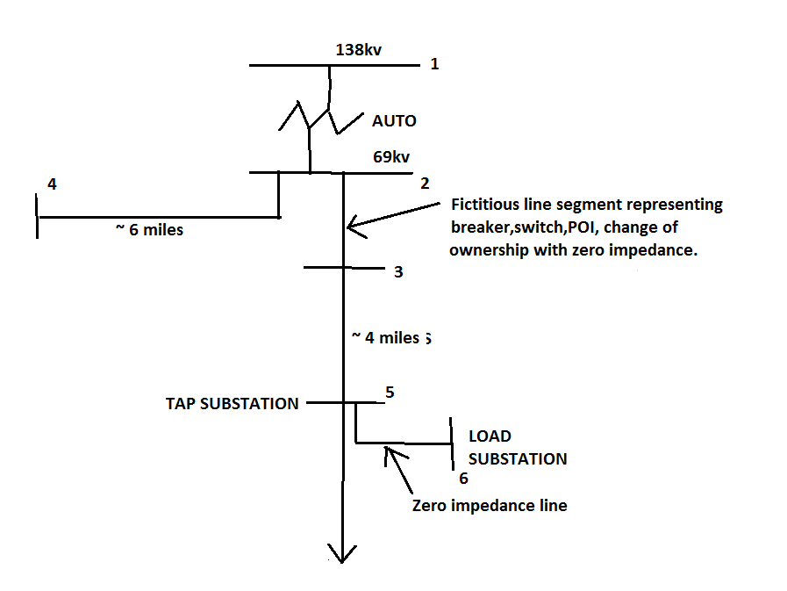
Example

Slide 9
PDGTF Implementation Plan to meet NERC Requirements
PDGTF Implementation Plan to Meet the Requirements of NERC TPL-007-1
R5
Determine GIC Flow Information to be used for the transformers thermal assessment
To be completed by
07/01/2018
Enforceable as of 01/01/2019
R3
Determine System Steady State Voltage Criteria for System Performance
Per Table 1.
To be completed by
07/01/2018
Enforceable as of 01/01/2022
R7
Corrective Action
Plan
To be completed by
TBD
Enforceable as of
01/01/2022
R1
Identify Individual and Joint Responsibilities
To be completed by 07/01/2017
Enforceable as of 07/01/2017
R2
Develop System Models and GIC System Models
To be completed by 01/01/2018
Enforceable as of 07/01/2018
R4
Complete GMD Vulnerability Assessment every 60 month
To be completed by
TBD
Enforceable as of 01/01/2022
R6
Perform Thermal Assessment for Transformers Experiencing ≥75 A GIC
To be completed by
07/01/2019
Enforceable as of 01/01/2021

Slide 10
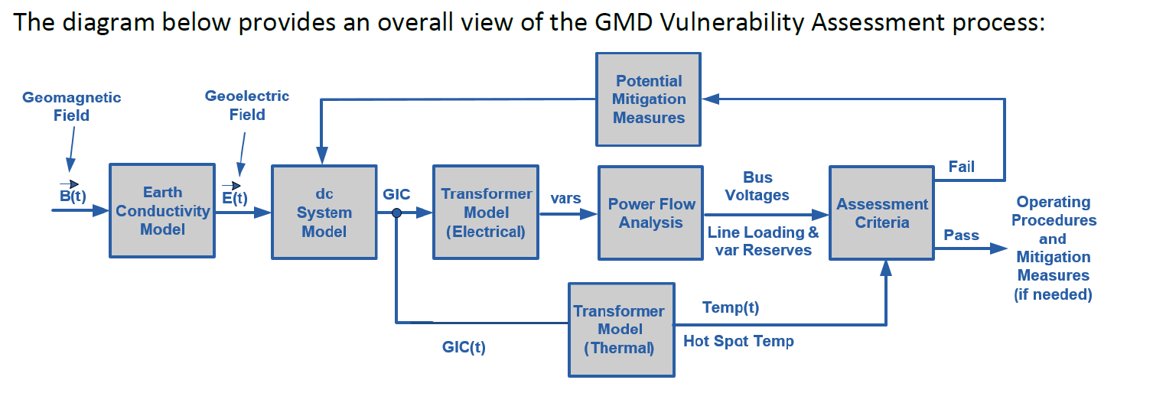
Vulnerability Assessment Process Overview
Preliminary CAP
R7
R6

