Slide 1
Far West Texas Transmission Project -
ERCOT Independent Review Update
March 21, 2017

Slide 2
Overview
AEPSC and Oncor jointly submitted Far West Texas Project (FWTP) for Regional Planning Group review. This is a Tier 1 project that is estimated to cost $ 423 million.
Proposed for 2021 to 2022 timeframe
Addresses oil and gas related development
Voltage Collapse
Loss of Load
Short-Circuit Strength & System Protection
Provides Operational Flexibility
Provides options for 345 kV expansion

Slide 3
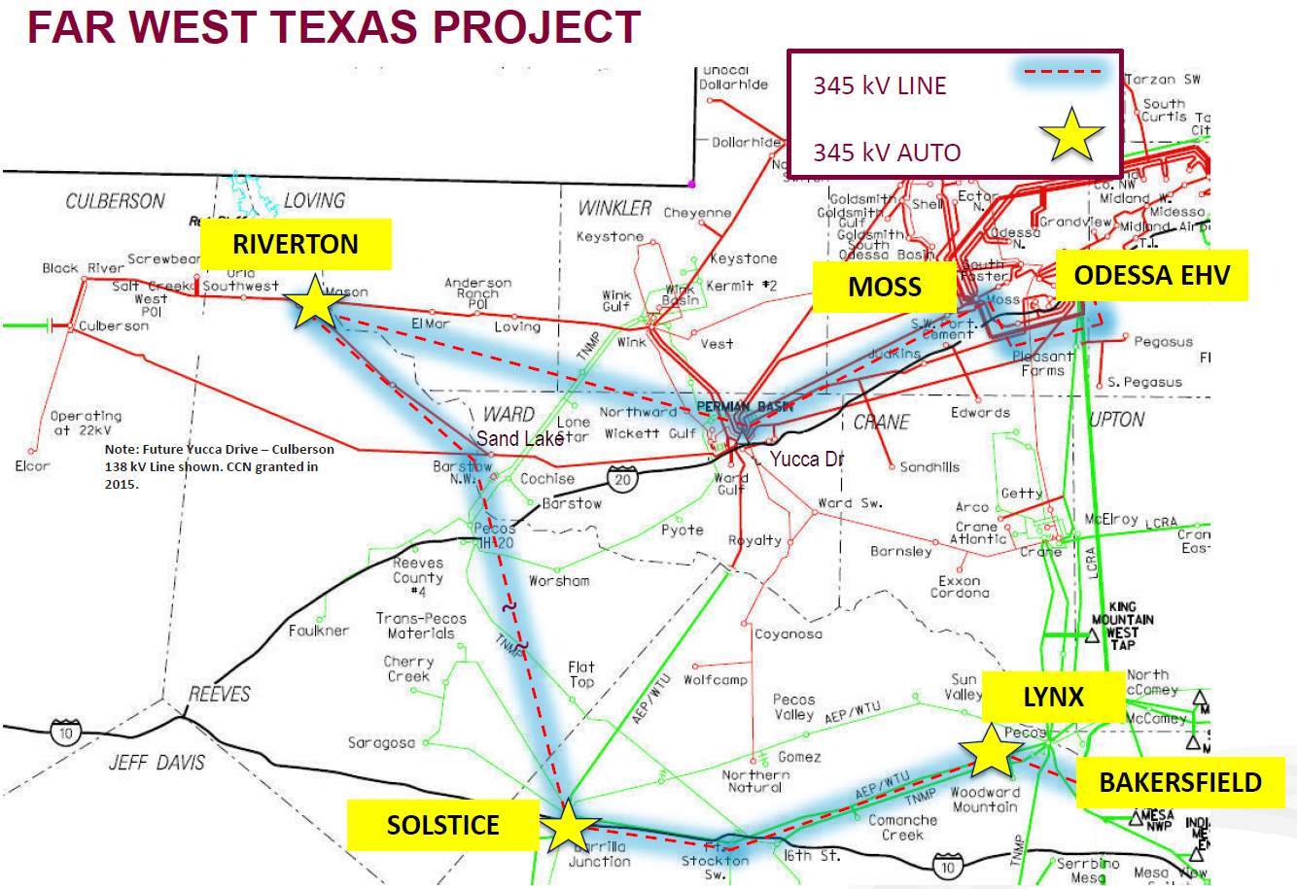
Far West Texas Project
Source: AEP/ONCOR RPG submittal on 21-Apr-2016 (http://www.ercot.com/calendar/2016/4/21/81733-RPG)

Slide 4
EIR Study Status
Initial Study Case - preliminary findings
Steady-State violations Pecos County for No Solar Case
Dynamic stability issues identified in the Culberson loop area under N-1 conditions
Study Base Case Changes
Significant load increases (contracts signed)
Initial Study Case added 254 MW Load, latest augments by 134 MW. Total 388 MW over RTP case.
Changes to non-conforming load identified in Pecos and Reeves Counties
Following discussions with Oncor and AEP, ERCOT accepted the model changes and agreed to update the base cases (March 2017)

Slide 5
Next Steps
Complete Re-study with the updated base case
Evaluate project alternatives
Sensitivity Analysis
Higher Culberson Loop Load
PGRR0042-Generator additions with Signed Interconnection Agreements that DO NOT meet Planning Guide Section 6.9 criteria in study region
Tentative Timeline
EIR update to RPG – April 2017
Complete the EIR review, present findings to RPG and TAC – May 2017
Recommendation to ERCOT BOD – June 2017

Slide 6
?

