Slide 1
Economic Transmission Planning under transmission outage conditions
Sandeep Borkar
March 2017
PLWG Meeting

Slide 2
Agenda
Background and Motivation
Proposed Methodology
Observation and Next steps

Slide 3
Background and Motivation
Some of the highest congestion costs in the ERCOT system are driven by Transmission Outages
In 2013, Brattle identified Transmission Outage related savings as one of the “missing” economic benefits of transmission projects
Transmission Outages are a ‘fact-of-life’ in any Electric Transmission System
Current economic transmission planning practices fail to capture ‘all’ the benefits of transmission investment

Slide 4
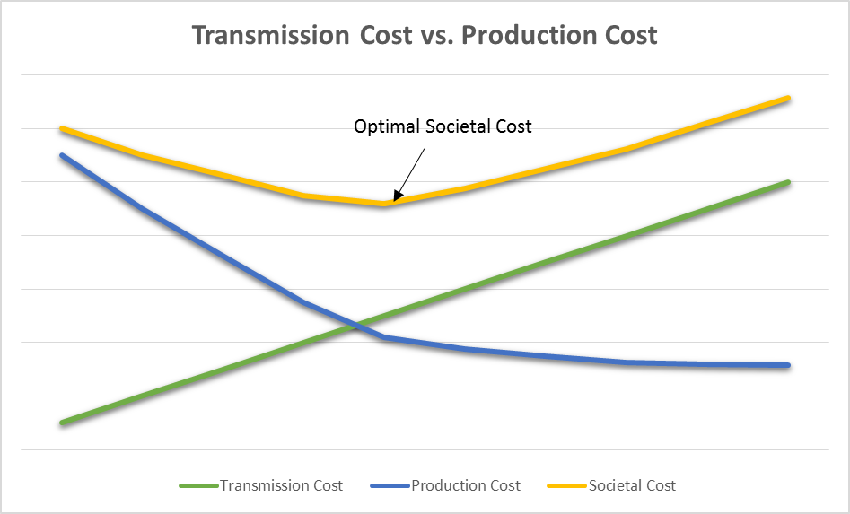
Economic Planning: Minimize Societal Cost
Levelized cost $
Time

Slide 5
2016 – Top 15 Constraints
Outage-Related Congestion
Index | Constraint | Congestion Rent ($)
1 | North to Houston Import | $64,141,507
2 | Meadow 345/138 kV Transformer | $47,958,057
3 | Fort Worth-West Denton 138 kV Line | $29,740,294
4 | Loma Alta-Los Fresnos 138 kV Line | $26,946,998
5 | Lower Rio Grande Valley Import Limit | $21,736,088
6 | Morris Dido-Rosen Heights Tap 138 kV Line | $15,045,333
7 | Panhandle Export Limit | $12,289,182
8 | Morris Dido-Eagle Mountain 138 kV Line | $10,484,213
9 | Carrollton Northwest-Lakepointe 138 kV Line | $10,437,559
10 | Jim Christal-West Denton 138 kV Line | $10,434,358
11 | Eagle Mountain 345/138 kV Transformer | $10,252,471
12 | Javelina-Molina 138 kV Line | $9,644,364
13 | Hockley-Betka 138 kV Line | $8,004,064
14 | La Palma-Villa Cavazos 138 kV Line | $7,870,782
15 | Bellaire-San Felipe 138 kV Line | $7,119,923

Slide 6
Challenges
The scope, schedule and duration of the outage is highly uncertain to take a deterministic approach
Impact and probability of outages are different for each season
The traditional probabilistic approach of a ‘Monte-Carlo simulation’ is not feasible

Slide 7
Proposed Methodology (Overview)
Identify Outages to simulate
Simulate seasonal outages to determine PC savings from the project under outage conditions
Prorate seasonal savings based on expected duration and frequency of occurrence
During project evaluation:

Slide 8
Proposed Methodology (Expanded)
$$\left[Total PC Savings\right]=\left[{Annual PC Savings}_{Basecase}\right]×(1−Pr\left(out\right))+ \left[ Annual Expected PC {Savings}_{out}\right]$$
Where,
$$Annual Expected PC {Savings}_{out}$$
$$=\sum_{O=i}^{n}{\left[\sum_{Season=1}^{4}{\left[{Savings}_{ seasonal out}\right]×\frac{Avg outage duration}{Total \# of hrs in season }×(\# of occurrences/season)}\right]}$$
# of occurrences/season= $\frac{\# of outages occurrences in a season}{\# of circuits}$
$Pr\left(out\right)$ =$\frac{\# of outage occurrences per year}{\# of circuits}×\# of outages simulated×\frac{Avg. outage duration per year (hours)}{8760}$
Avg outage duration = 7 days or 168 hours
Average duration is approximate to be replaced by numbers derived from analysis of historical outage data.

Slide 9
Proposed Methodology (Expanded)
Outage 1
PC savings from a project with outages simulated for each season
Expected PC savings under outages
Expected PC savings calculated based on probability of occurrence and average duration
+
basecase PC savings (de-weighted for outages)
PC savings for a Seasonal outage
=
Expected PC savings from an outage in a given season
Total PC savings from the project
Outage 3
Notes:
This graphic should explain the methodology better. These three block s on he left hand side are production cost simulations for each outages. Three outages are considered for this example. The green blocks represent the PC savings due to the outage modeled for entire season. Now, the outages will never be out for exactly the whole season in every season. The red bar shows the expected PC savings calculated by adjusting the seasonal savings with probability of outage occurrence and average duration of the outage for a given season.
Now we move to the left hand side. This shows the 8760 hour window. The red, purple and yellow bars show the expected PC savings if the outages are taken. The orange bar shows the traditional PC savings after adjusting for the outage occurrence.

Slide 10
PC Savings calculation for a sample project
Basecase savings PC₀ | 40.00
Savings with Outage 1 PC₁ | 4.02
Savings with Outage 2 PC₂ | 2.35
outage occurrence per year per circuit Pr | 1.30
Total PC Savings PC₀ * (1 - Pr * #out * avg. dur / 365) + PC₁ + PC₂ | 44.38

Slide 11
Observations
This methodology allows consideration of a ‘reality’ i.e. Transmission Outages in the economic transmission planning process
This methodology is ‘conservative’ - based on a subset of outages
Use cases:
Identify economic projects to relieve transmission outage driven congestion
Additional metric to evaluate transmission project alternatives
Analysis consists of 8 seasonal simulations per outage in addition to the 2 annual PC simulations

Slide 12
Next Steps
Seek feedback from PLWG and address any comments or concerns
Fine tune outage probability statistics
Benchmark statistics v/s TO or NERC TADS data
Address double-circuit outage probabilities

Slide 13
Questions
?

Slide 14
ERCOT Nodal Protocols §3.11.2, Planning Criteria, Paragraph (5)
“To determine the societal benefit of a proposed project, the revenue requirement of the capital cost of the project is compared to the expected savings in system production costs resulting from the project over the expected life of the project. Indirect benefits and costs associated with the project should be considered as well, where appropriate. The current set of financial assumptions upon which the revenue requirement calculations is based will be reviewed annually, updated as necessary by ERCOT, and posted on the Market Information System (MIS) Secure Area.”

Slide 15
Probability of Occurrence of Line Outages
Year | Fall | Spring | Summer | Winter | Annual
2011 | 193 | 328 | 132 | 167 | 820
2012 | 180 | 169 | 72 | 165 | 586
2013 | 301 | 274 | 209 | 223 | 1007
2014 | 297 | 310 | 209 | 245 | 1061
2015 | 197 | 219 | 119 | 133 | 668
Occurrence/Year | 194.67 | 216.67 | 123.50 | 155.50 | 690.33
Number of circuits | 671 | 671 | 671 | 671 | 671
Occurrence/Circuit/Year | 0.29 | 0.32 | 0.18 | 0.23 | 1.03
Winter: Dec, Jan, Feb Summer: Jun, Jul, Aug, Sep
Spring: Mar, Apr, May Fall: Oct, Nov
Statistics based on 345-kV line data available in ERCOT OS with a status of Planned (PL, M1, M2, M3, UE, RS)

Slide 16
Proposed Methodology (Expanded)
During project evaluation:
Identify top transmission outages with largest impact
(based on highest OTDF, operating experience, and historical outage data)
With each outage modeled for an entire season, determine PC savings from the transmission project
Determine Expected PC savings from the Project – after accounting for Average outage duration and seasonal probabilities
Repeat above process for rest of the outages and determine Total Expected PC Savings under outage condition
Calculate total economic benefits from a transmission project (Traditional PC savings + Expected PC Savings under outage conditions)
Evaluate Benefits to Cost ratio using ERCOT Economic Criteria

Slide 17
ERCOT Nodal Protocols §3.11.2, Planning Criteria, Paragraph (4)
“For economic projects, the net economic benefit of a proposed project, or set of projects, will be assessed over the project’s life based on the net societal benefit that is reasonably expected to accrue from the project. The project will be recommended if it is reasonably expected to result in positive net societal benefits.”

Slide 18
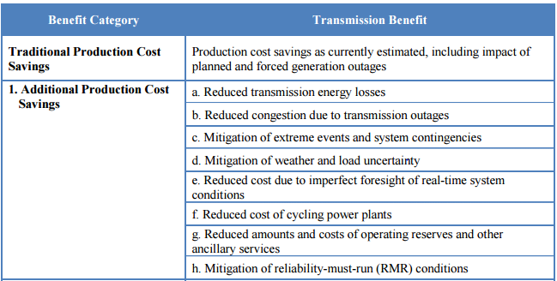
Benefits of Transmission Investment
Source: Recommendations for enhancing ERCOT’s Long-term Transmission Planning Process, The Brattle Group

