Slide 1
2018 LTSA Kickoff
Sandeep Borkar
March, 2017
RPG Meeting
Notes:
Welcome to

Slide 2
Agenda
2018 LTSA Kickoff
Changes to scope
Schedule

Slide 3
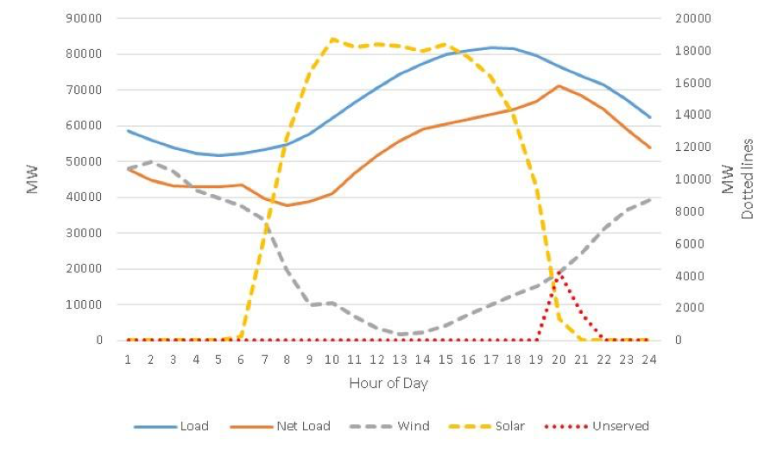
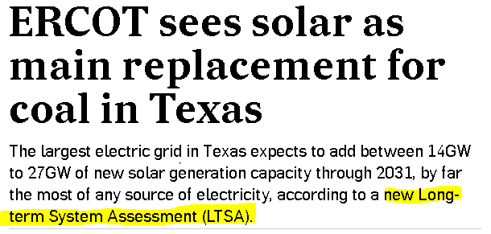

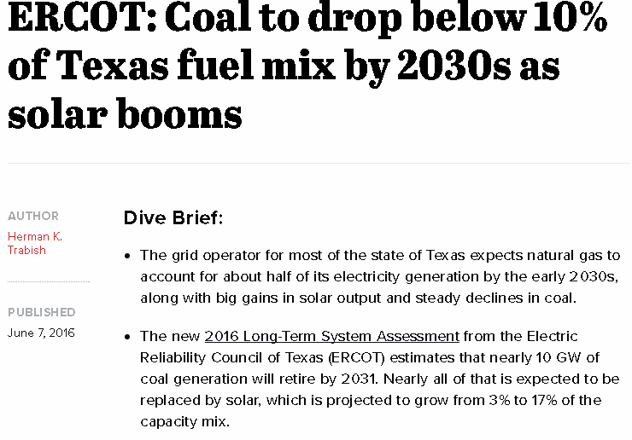
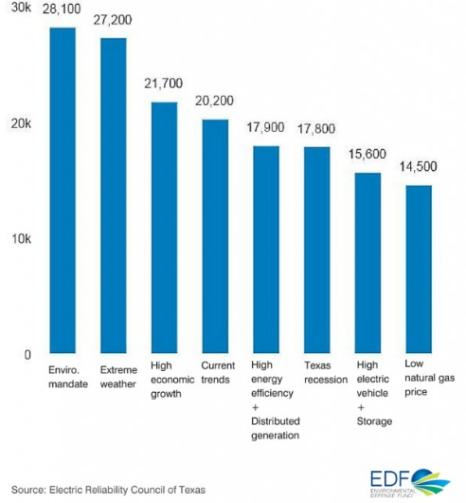
LTSA in the news!!
-Recharge
-The Sierra Club
-EDF
-Utility Dive

Slide 4
2018 LTSA: The process
Scenario Development
Review trends and forecasts
Expert presentations with focus on key drivers for current LTSA
Load forecasting
Develop 8760-hour load forecasts for each scenario with normal weather assumptions
Generation Expansion
Identify amount of generation added and retired by technology based on scenario description
Finalize scenario descriptions and assumptions for current LTSA
Develop 90th percentile summer peak forecast for each scenario
Identify potential sites for new generation
Transmission Analysis
Build start cases based on the LTSA Scope and scenario descriptions
Perform reliability analysis
Perform economic analysis
Identify transmission projects to address economic and reliability needs

Slide 5
2018 LTSA: What’s new?
Fewer scenarios – deeper analysis
  Limit scenario development to four scenarios
  Focused on diversity in assumptions
  Run sensitivities for scenarios selected
Frequent updates at RPG
  Encourage RPG to provide feedback on study results

Slide 6
2018 LTSA Schedule (tentative)
Task | Date
Draft LTSA Scope | March 2017
LTSA Workshop | June 2017 RPG Meeting
Finalize scenarios | July 2017 RPG Meeting
Current Trends Gen expansion and Load forecasting complete | 4th Quarter 2017
Current Trends transmission basecase ready | 4th Quarter 2017
Gen expansion and Load forecasting complete | 1st Quarter 2018
Transmission Expansion Complete | 2nd Quarter 2018

Slide 7

Next steps
2018 LTSA Scope review and feedback
LTSA Workshop

Slide 8
Questions
Sandeep Borkar
sandeep.borkar@ercot.com
512.248.6642
?

