Slide 1
Inverter Disconnects During Transmission Disturbances
James Merlo, Vice President, Reliability Risk Management
Member Representatives Committee
February 8, 2017

Slide 2
Case Study: Blue Cut Fire
On August 16, 2016, the Blue Cut Fire caused thirteen 500 kV line faults and two 287 kV line faults
All of these faults cleared normally, with roughly the same fault clearing time and magnitude
Four of the faults caused a loss of photovoltaic (PV) generation
No qualified events but Entities volunteered to work with the ERO to understand the occurrences

Slide 3
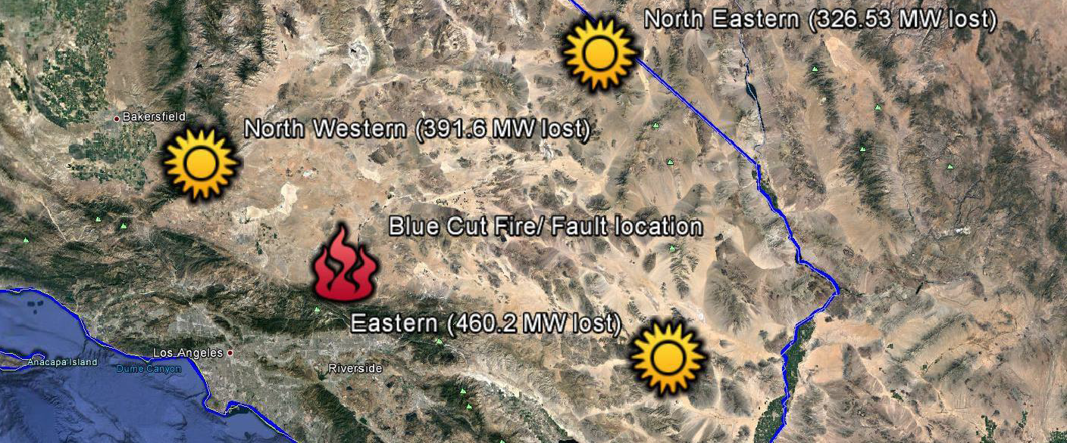
Blue Cut Fire Event #1

Slide 4
Inverter Properties
Widespread inverter reduction in power output as inverters perceived frequency outside acceptable bounds
Inverters that use the zero crossing of a voltage signal as a reference to calculate frequency are susceptible to significant error if a phase shift is introduced (as may happen when a fault occurs).
Zero crossing time of the voltage waveform shifted significantly during the event.

Slide 5
Inverter Properties
The calculated frequency exceeded 62 Hertz (Hz) at some locations and fell below 57 Hz at others
This results in instantaneous reduction in power output from the inverters
NERC Standards allow asynchronous generating units to trip due to instability in power conversion control equipment
NERC does not provide guidance on how to calculate frequency

Slide 6
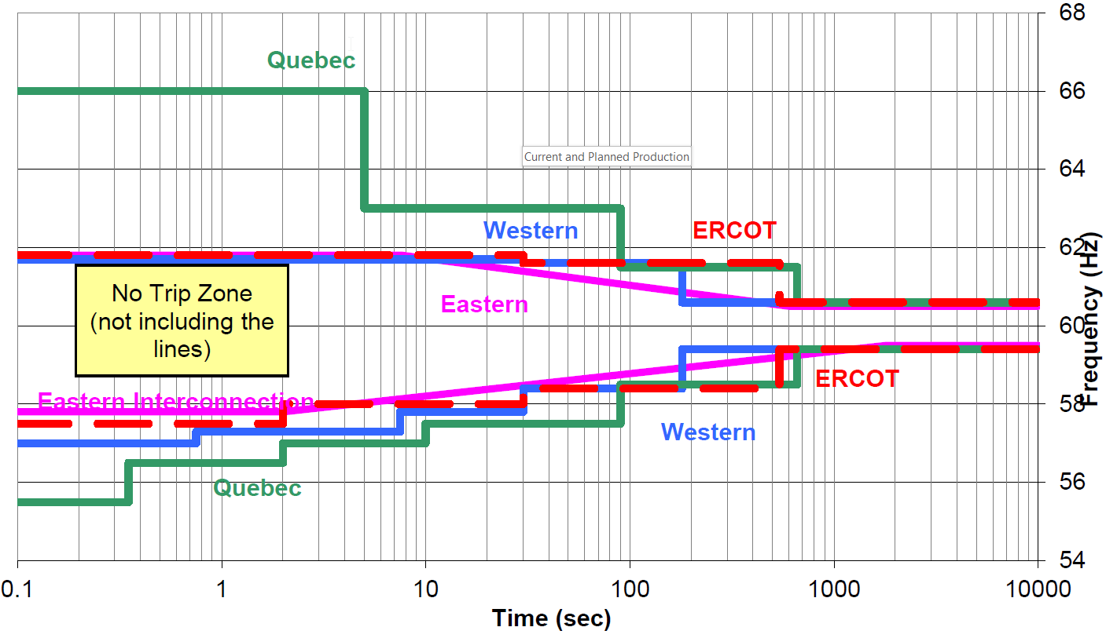
OFF NOMINAL FREQUENCY CAPABILITY CURVE
No Trip Zone

Slide 7
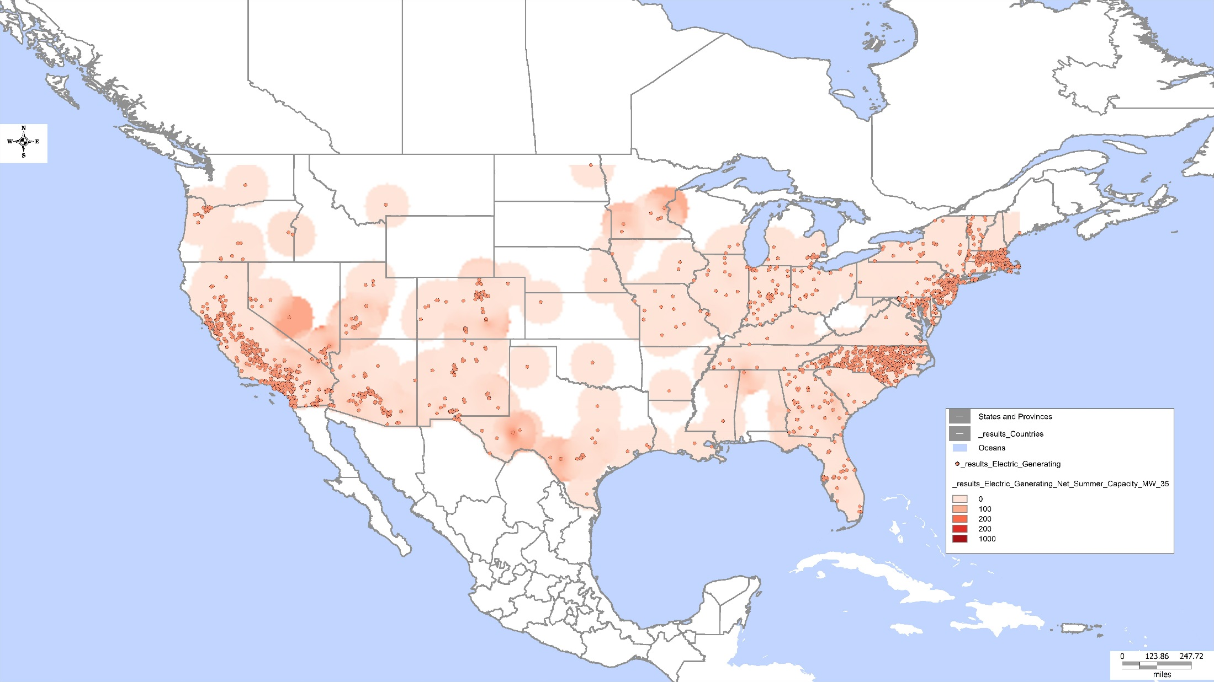
Current Solar Production

Slide 8
Current and Planned Production

Slide 9
Way Forward
NERC task force to further investigate potential causes and solutions to the loss of PV generation as a result of power system faults
Engage inverter manufacturers to share challenges associated with some of the existing frequency and voltage measurement techniques
Develop guidance as information and solutions become available
Notes:
PRC-024-2 standard must be used to set protective devices by Bulk Electric System (BES) PV plants for existing and future (BES) PV interconnections

Slide 10
Questions and Answers

