Slide 1
Storage Technologies
Austin Rosel
ERCOT
March 8, 2017

Slide 2
Energy Storage Background
Energy Storage Modeling and Settlements was initiated by PUCT rule, PUCT Project 39917
ERCOT market rules were initiated with NPRR 461
Rules were written to consider multiple types of storage technologies
Batteries
Flywheels
CAES (Compressed Air Energy Storage)
Pumped storage
Electro chemical capacitors
Thermal energy storage

Slide 3
Energy Storage Guiding Principles
An energy storage resource has the option of receiving wholesale storage load treatment.
Wholesale Storage Load is defined in NPRR461 as – “Energy that is separately metered from all other Facilities to charge a technology that is capable of storing energy and releasing that energy at a later time to generate electric energy”.
Load for an energy storage Load Resource must be separately metered to be considered wholesale storage load
Storage facility energy that is re-generated is treated in the same manner as traditional generation. The re-generated energy can self-serve associated Load behind the same POI at the generation site and/or be valued as an injection to the ERCOT system.

Slide 4
Energy Storage Guiding Principles, Cont’d
Wholesale storage load is exempt from charges and credits based on Load Ratio Share or per MWH basis
Wholesale storage load will not be included in the ERCOT 4CP calculations.
Wholesale storage load pricing shall be based on the LMP at the electrical bus, not the LMP of the Load Zone

Slide 5
Energy Storage Metering
Metering configurations:
will
be based on ERCOT system design and capabilities for accounting for the wholesale storage load and site generation
have separate wholesale storage load metering for each energy storage Load Resource
will NOT
be allowed if they do not conform to a design that allows ERCOT to settle the site

Slide 6
Energy Storage Data Aggregation
Data Aggregation processes:
wholesale storage load
will
be included to determine total UFE
will NOT
be assigned Unaccounted for Energy (UFE)
be included in Adjusted Metered Load (AML)
be included in ERCOT 4CP calculations
be included in TRE fee calculations
have transmission and/or distribution losses added

Slide 7
Energy Storage Settlement
Settlement processes:
wholesale storage load
will
be settled by QSE and Settlement Point
be settled through Real-Time Energy Imbalance at a Resource Node
be settled using an energy-weighted price at the bus (ESR load is LMP weighted average by telemeter ESR load)
will NOT
be included in any Load-shared charges and credits
be settled using a Load Zone Settlement Point Price

Slide 8
Current Energy Storage Resources
Batteries:
There are currently four batteries receiving Energy Storage Resource settlement
CAES:
There a few CAES projects in the works, but none are confirmed or operational

Slide 9
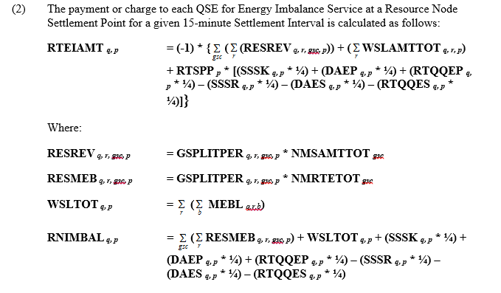
RTEIAMT at Resource Node Settlement - 6.6.3.1(2)

Slide 10
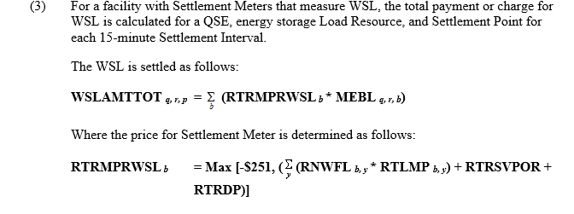
WSLAMTTOT - 6.6.3(3)
Always <= 0

Slide 11
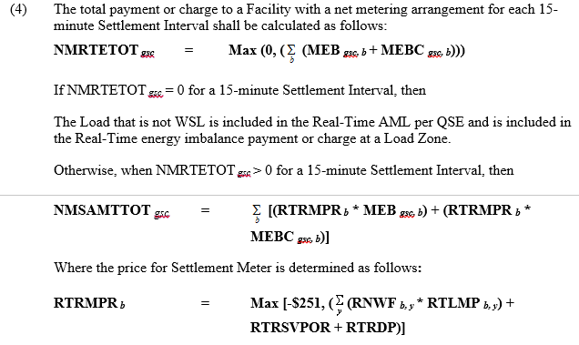
RTEIAMT at Resource Node Settlement - 6.6.3(4)
Can be + or -

Slide 12
Supplemental Info
http://www.ercot.com/calendar/2012/11/2/33277-RCWG
esr_generation_metering_discussions_ver_5 00

