Slide 1
PDCWG Report to ROS
Chair: Percy Galliguez, Brazos Electric Power Cooperative, Inc.
Vice Chair: Lei Ye, Austin Energy
ROS
March 2nd, 2017

Slide 2
Report Overview & Notes
Report Overview
  Meeting Minutes
  BAL-001-TRE-1 FMEs & IMFR
    0 FMEs in the month of February
    BAL-001-TRE-1 Unit Performance Report now includes Solar resources.
  Frequency Control Report

Slide 3
Meeting Minutes
PDCWG Meeting 2/8/17
  Regulation & Frequency Control Reports
  GREDP Performance Analysis
  MOD-026-1 & MOD-027-1 Discussion
    NOGRR Proposal/Review Status
  TRE/NERC Retirement of BAL-004
  Reviewed Frequency Events
    1/6/2017 23:58:52
      Loss of 731MW
      1125 MW/0.1HZ Response
      3 of 21 Generation Resources providing RRS had less than 75% of their expected Initial Primary Frequency Response.
      3 of 21 Generation Resources providing RRS had less than 75% of their expected Sustained Primary Frequency Response
    1/10/2017 15:13:18
      Loss of 404MW
      641 MW/0.1HZ Response
      4 of 27 Generation Resources providing RRS had less than 75% of their expected Initial Primary Frequency Response.
      5 of 27 Generation Resources providing RRS had less than 75% of their expected Sustained Primary Frequency Response
    1/23/2017 21:50:20
      Loss of 796MW
      2095 MW/0.1HZ Response
      0 of 22 Generation Resources providing RRS had less than 75% of their expected Initial Primary Frequency Response.
      0 of 22 Generation Resources providing RRS had less than 75% of their expected Sustained Primary Frequency Response

Slide 4
Frequency Measurable Events Performance
February 2017

Slide 5
Frequency Measurable Events
There were 0 FMEs in February

Slide 6
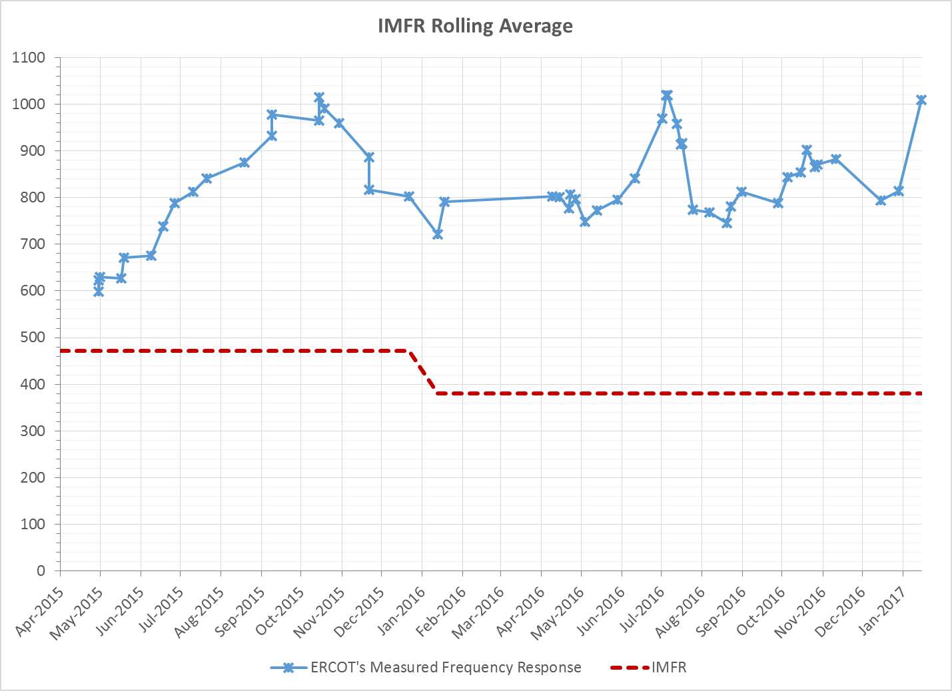
Interconnection Minimum Frequency Response (IMFR) Performance
IMFR Performance currently 1009.57 MW/0.1Hz

Slide 7
Frequency Control Report
February 2017

Slide 8
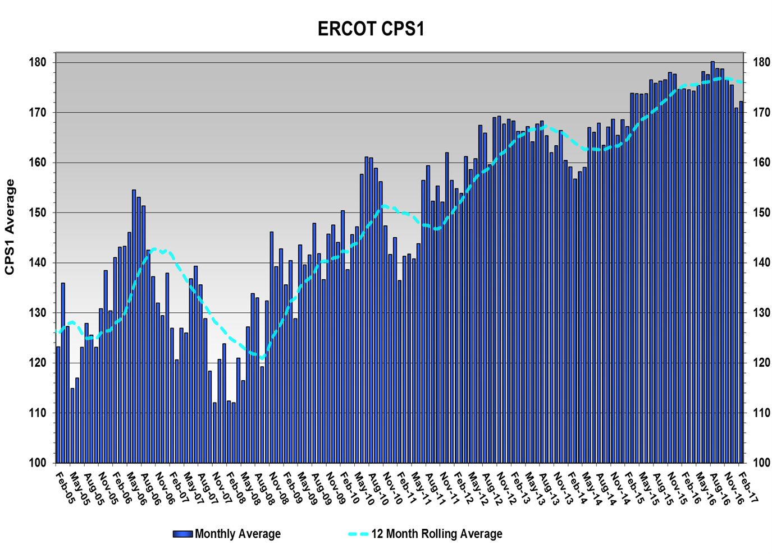
CPS1 Performance
CPS1 12 Month Rolling Average = 176.10%

Slide 9
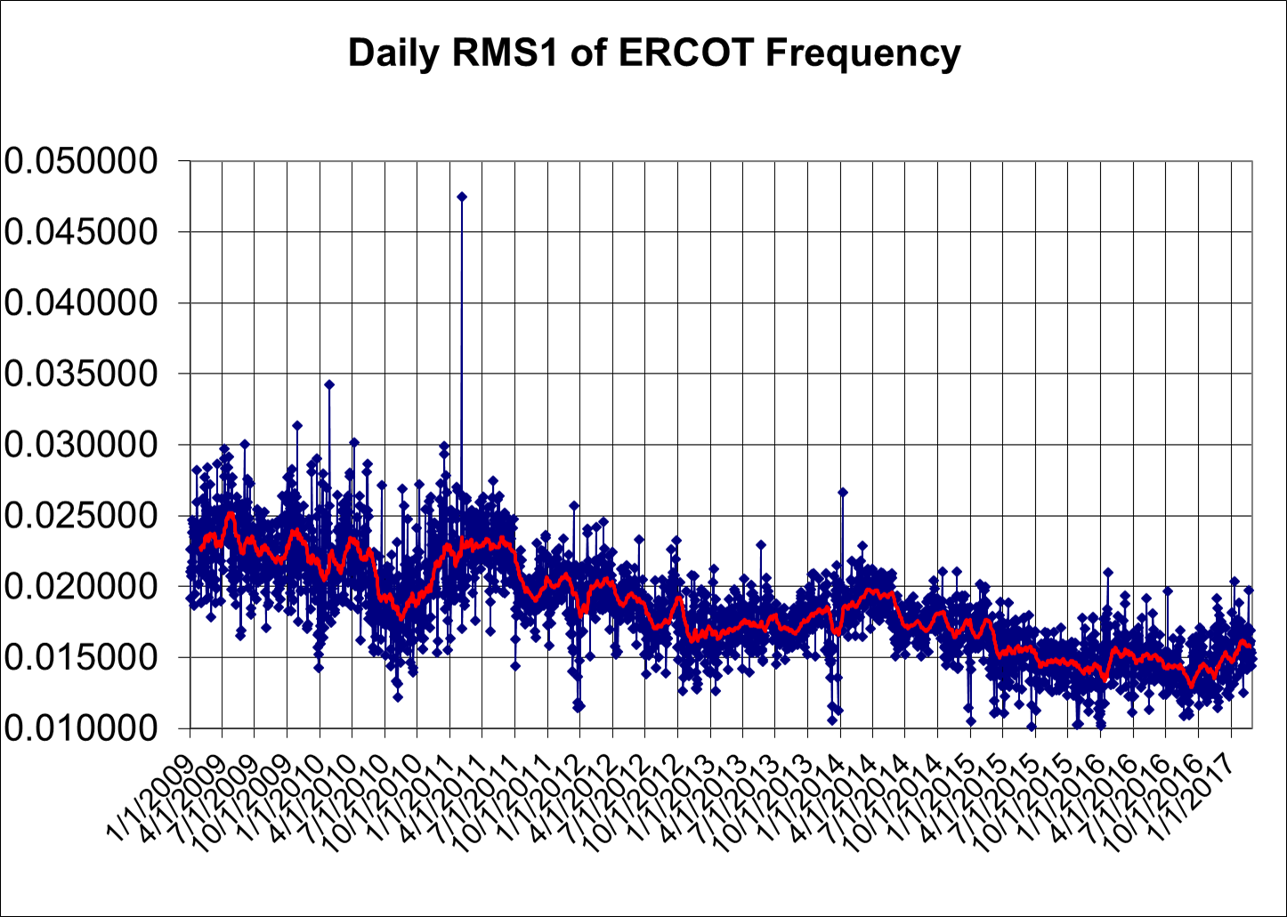
RMS1 Performance of ERCOT Frequency

Slide 10
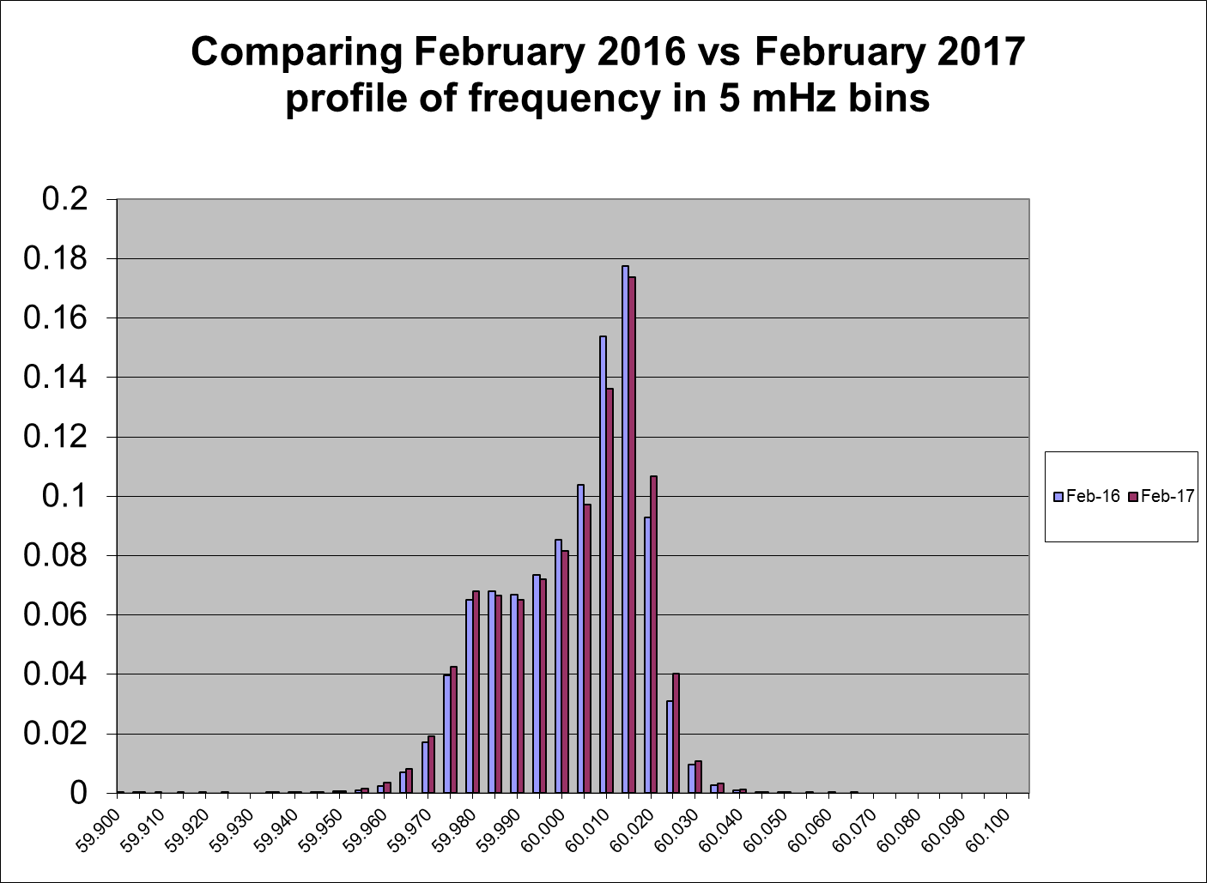
Frequency Profile Analysis

Slide 11
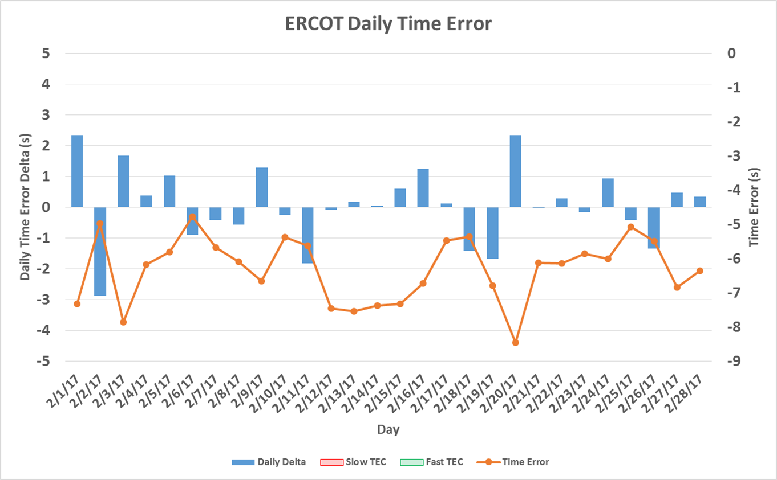
Time Error Corrections
There were no Time Error Corrections (TEC) in February
Notes:
TEC occurred on 12/03/2016 at 23:30. Time Error was 30.06

Slide 12
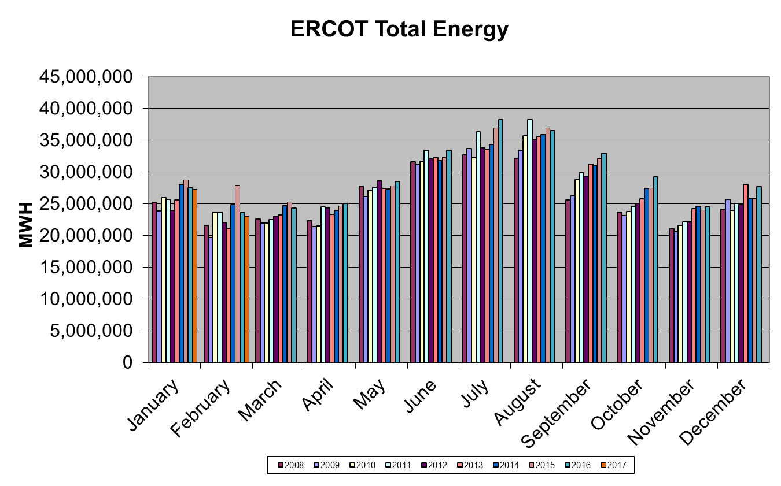
Wind Generation Performance

Slide 13
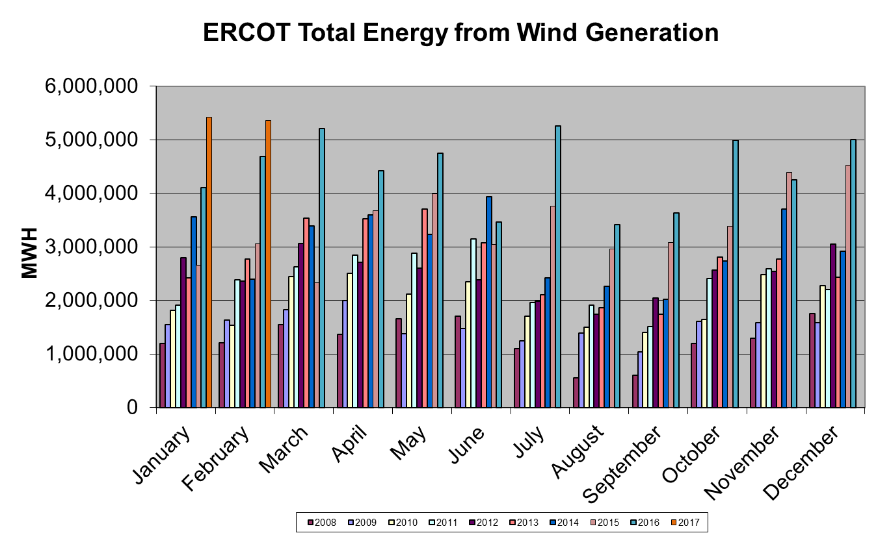
Wind Generation Performance

Slide 14
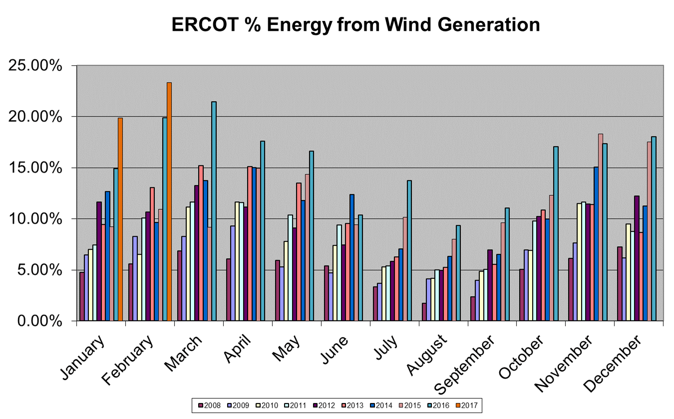
Wind Generation Performance

Slide 15
Questions?

