Slide 1

2017
Inadvertent Switch & Customer Rescission
Market Training

Slide 2
need new oneAntitrust Admonition
ERCOT strictly prohibits Market Participants and their employees who are participating in ERCOT activities from using their participation in ERCOT activities as a forum for engaging in practices or communications that violate the antitrust laws. The ERCOT Board has approved guidelines for members of ERCOT Committees, Subcommittees and Working Groups to be reviewed and followed by each Market Participant attending ERCOT meetings. If you have not received a copy of these Guidelines, an electronic version is available at http://www.ercot.com/about/governance/index.html. Please remember your ongoing obligation to comply with all applicable laws, including the antitrust laws.
Disclaimer
All presentations and materials submitted by Market Participants or any other Entity to ERCOT staff for this meeting are received and posted with the acknowledgement that the information will be considered public in accordance with the ERCOT Websites Content Management Operating Procedure.

Slide 3
Agenda
Antitrust Admonition – KATHY/DEBBIE
Welcome & Introductions- KATHY/DEBBIE
Inadvertent Gain/Loss (IGL) Overview – TOMAS / SHERI review slides
  Causes of IAS & Impacts to customer experience
  Prevention of IAS
Customer Rescission Walkthrough – JIM – SHERI review slides
IAS Resolution Process Walkthrough – TOMAS/MONICA review slides
Reconciliation & Verification Process- CORDE
ERCOT Live Demonstration- ERCOT / CAROLYN to make list
Market Reporting & Closing – SHERI / TOMAS review slides
Adjourn

Slide 4
Presenters
Overview & Market Challenge - John Schatz, TXUE
IAS Process Walkthrough - Tomas Fernandez, NRG
Reconciliation & Verification Process- Corde Nuru, CenterPoint Energy
Customer Rescission - Jim Lee, AEP Texas
IAS Live Demo – Tammy Stewart/Dave Michelsen/Catherine Minors/Farrah Cortez/Marianne Host, ERCOT

Slide 5
Future Training Information
Retail Market Training Task Force
For information on future retail market training please subscribe to the following list_serve:
http://lists.ercot.com/scripts/wa-ERCOT.exe?SUBED1=RMTTF&A=1
Or visit ercot.com > about ERCOT > News and Publications > click on the ‘email list manager’ for a complete list of all notification groups
Future Training Topics:
  Retail Market 101 Training
  MarkeTrak Subtypes:
    Usage & Billing
    DEV LSE
    Bulk Inserts
  Switch holds
  Transaction Flows

Slide 6
Inadvertent
Gain/Loss (IGL)
Overview

Slide 7
What is an IGL?
An Inadvertent Gain/Loss (IGL) is an unauthorized change of a customer’s Retail Electric Provider
Commonly referred to as either an Inadvertent Gain (IAG) or Inadvertent Loss (IAL), an inadvertent situation occurs when a customer or a premise is changed to a REP that is different than their expected REP of choice.
When resolving IGL issues, the ultimate goal is to return the Customer to their REP of choice in a quick and efficient manner with minimal inconvenience to the Customer.

Slide 8
Reference Documents
PUCT Subst. Rule §25.495, Unauthorized Change of Retail Electric Provider
ERCOT Retail Market Guide Section 7.3, Inadvertent Gain Process
MarkeTrak User’s Guide
Notes:
APPENDIX MATERIAL????

Slide 9
Reference Documents
ERCOT Retail Market Guide
http://www.ercot.com/mktrules/guides/retail/current
7.3 Inadvertent Gain Process
  7.3.1 Escalation Process
  7.3.2 Competitive Retailer’s Inadvertent Gain Process
    7.3.2.1 Buyer’s Remorse
    7.3.2.2 Prevention of Inadvertent Gains
    7.3.2.3 Resolution of Inadvertent Gains
    7.3.2.4 Valid Reject/Unexecutable Reasons
    7.3.2.5 Invalid Reject/Unexecutable Reasons
    7.3.2.6 Out-of-Sync Conditions
    7.3.2.7 No Losing Competitive Retailer of Record
  7.3.3 Charges Associated with Returning the Customer
  7.3.4 Transmission and/or Distribution Service Provider Inadvertent Gain Process
    7.3.4.1 Inadvertent Dates Greater than 150 days
    7.3.4.2 Inadvertent Order is Pending
    7.3.4.3 Third Party has Gained Electric Service Identifier (Leapfrog Scenario)
    7.3.4.4 Transmission and/or Distribution Service Provider Billing
  7.3.5 Customer Rescission after Completion of a Switch Transaction
    7.3.5.1 Additional Valid Reasons for Rejection of a Rescission-based Issue

Slide 10
Reference Documents
Retail Market Guide Section 7.3 Inadvertent Gain Process
Guidelines for ensuring that inadvertently gained ESI IDs are returned to the Losing REP in a quick and efficient manner with minimal inconvenience to the Customer as required by PUC Subst. Rule 25.495 Unauthorized Change of Retail Electric Provider
Escalation Process:
Each Market Participant is responsible for it’s own compliance with the PUCT rules and RMG procedures & timelines.
Each Market Participant shall maintain and update escalation contacts within the MarkeTrak Rolodex
MarkeTrak will send escalation emails to the escalation contacts whenever an issue has remained in a ‘New’ or ‘Pending’ state for more than 3 calendar days

Slide 11
Reference Documents
MarkeTrak User Guide
http://www.ercot.com/content/services/client_svcs/mktrk_info/MarkeTrak%2520User%2520Guide[1]%20(2).zip
2.1 Day to Day Issues – Inadvertent Gain
2.1.1 Required Fields for Inadvertent Gain
2.1.2 Definition of Inadvertent Gain
2.1.3 Submitting an Inadvertent Gain
2.1.4 Submitting a Customer Rescission Issue
2.1.5 Redirect Fees Subtype

Slide 12
How does an IGL occur?
An Inadvertent Gain or Loss can occur under various circumstances:
Incorrect information provided by the Customer during enrollment – service address or ESI ID
Incorrect information entered by the REP during enrollment
Unauthorized enrollments – slamming
Confusing enrollment processes by REPs

Slide 13
Who does an IGL impact?
Customer
Gaining REP
TDU
Losing REP
ERCOT

Slide 14

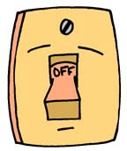
How is the market impacted?
Poor customer experience
Worst customer experience
Customer confusion
Delayed billings
PUCT complaints
Lights Out in Error situation (LOIE)

Slide 15

-important-Cost Implications
Costs to the market
  IAG fees
    TDSPs may charge Gaining CRs an IAG fee
    CRs internal business practices will dictate if IAG fees are passed to the customer
    For a customer rescission, there will be no fees to the customer
  Consumption costs – Date of Loss (DOL)
    Rescission reinstatement date is automatically set at DOL + 1, Gaining CRs shall not pass these charges to the customer
    IAG reinstatement date is driven by the Losing CR and is set at a minimum of DOL + 1 to Date of MT submission +10, Gaining CRs may choose to pass these charges to the customer
  Redirect fees
    Keep in mind, all TDSPs do not have MVI fees
    Losing CRs should only submit redirect fee MarkeTraks if costs apply
  Lost sales – sales may not be realized
  Resource commitments – staff to process MTs

Slide 16


Slide 17
Common IGL Issues/
Best Practices

Slide 18
IGL Issues- Inappropriate Move Out (MVO) Transaction
ISSUE
PROPOSAL/SOLUTION
MVOs are incorrectly being submitted for IGL situations.
  Examples:
  Losing CR MT agents are indicating customer no longer resides at premise and for Gaining CR to issue a MVO for IGL resolution
  To correct an error
  Customer does not occupy premise
  Customer wants to “cancel” service
CRs shall not issue MVOs for ESI IDs while the MarkeTrak IAG/IAL process is in progress.
Best Practices:
  Ensure agent understanding of flow of transactions
  Ask probing questions to ensure proper customer action is taken. (i.e. “Do you currently live here?”)
Notes:
FORMAT SLIDES TO GROUP ISSUE WITH PROPOSED SOLUTIOION FOR CLARITY

Slide 19
IGL Issues – 3rd Party Transactions
ISSUE
PROPOSAL/SOLUTION
“Broken” IGLs
  3rd party transaction has occurred, nullifying the IAG MarkeTrak.
    Gaining CR is left with charges they may not be able to recover.
Utilize the applicable market approved process to regain a lost ESI ID
Best Practices:
  Identify IGLs in progress for ESI IDs by:
    Flagging within your own system the ESI IDs to ensure subsequent transactions are not submitted to the market until the IGL is completed
    Identifying IGLs on daily basis by utilizing ERCOT MarkeTrak reporting.

Slide 20
IGL Issues – Non-timely resolution
ISSUE
PROPOSAL/SOLUTION
MTs and/or Escalated MTs are not receiving responses in a timely manner
    Expected level of performance:
      Initial Response – 10 calendar days
      Updating the issue thereafter – 7 calendar days
      Per 7.3.2.3.1 “Reinstatement Date” , The Backdate MVI must be sent No later than 12 days after the submittal of the Inadvertent MarkeTrak
Market participants should update their “rolodex” with the appropriate escalation contacts
    Best practice #1: Designate one of the contacts as a departmental mailbox.
    Best Practice #2: Audit the Rolodex list on Quarterly basis.
Notes:
CLARIFY THIS SLIDE – DOES NOT FLOW WELL.

Slide 21
IGL Issues – Back-dated Move-Ins (BDMVIs)
ISSUE
PROPOSAL/SOLUTION
Experiencing delays with submitting BDMVIs
  Increases risk for a 3rd party transaction to occur
Regain date on BDMVI does not match the regain date agreed within the MT by the Losing CR
  Gaining CR responsible for additional consumption
  Best Practices:
    BDMVIs should be submitted as soon as discovering that the TDSP has transitioned the MT issue to “ready to receive”
    Regain date should match the agreed upon date within the IAG MT and shall be within 12 days of the MT submission per RMG 7.3.2.3.1(4)

Slide 22
IGL Issues – No Current Occupant
ISSUE
PROPOSAL/SOLUTION
Losing REP responds to an IGL indicating “their customer no longer occupies the premise” and attempts to ‘unexecute’ the IAG MT issue.
  “Customer no longer occupies the Premise” is NOT a valid reason for unexecuting MT (RMG 7.3.2.5 Invalid Reject/Unexecutable Reasons)
  Losing REP must regain ESI ID and initiate a “current occupant” process and regain customer
    Reference: PUCT Subst. R. 25.489(i)

Slide 24
BREAK

Slide 25
Inadvertent Gain (IAG)
MarkeTrak
Walkthrough

Slide 26
Inadvertent Gain
  An inadvertent issue begins upon the discovery of an Inadvertent Gain or Move-In transaction submission. Upon identification of an Inadvertent Gain or Move-in, the CR will check the transaction status via the ERCOT MIS.
    If transaction Status is pending, and the Inadvertent CR is the submitting CR, then the CR will cancel their submitting transaction either by submitting an EDI cancel transaction or by submitting a Cancel with Approval MarkeTrak issue.
    For other Status types or if the CR was not the submitter of the transaction, the CR will log a MarkeTrak Inadvertent issue.
    CR’s will work together in a manner outlined in Section 7.2 of the Retail Market Guide (RMG) to determine appropriate resolution.
    If the CR/TDSP resolution requires a backdated move-in being generated by the Original CR, then the date should be at least the Gaining CR start date plus 1 day to avoid creating transaction business process exceptions at ERCOT and the TDSP.
    The submitter should include any details, Customer name and/or meter number, which may expedite resolution of the issue.

Slide 27
Inadvertent Gain
  ERCOT’s Receipt of Inadvertent Gain Issue
    Confirm the pending or actual change of CR relationship.
    Assign CR2 and the TDSP to the MarkeTrak issue.
    ERCOT will transition the MarkeTrak issue to the parties involved with CR2 as the Responsible MP.
    CR2 is responsible for selecting Begin Working to transition the item into a State of In Progress.
    The Original CR must wait for the TDSP to select Ready to Receive prior to sending the EDI to regain the account.
  Examples of Invalid Inadvertent Gain Issues where ERCOT will select Invalid IAG and populate the Invalid IAG Reason field with the reason the issue could not be worked:
    Invalid ESI ID
    Wrong or Invalid Tran ID
    Invalid Order Type (order something other than MVI or Switch)
    Submitter selected Gaining and is not the Gaining CR
    Submitter selected Losing and is not the Losing CR
    ESI ID was De-Energized prior to completion of MVI
    The Losing and Gaining CR are the same
    Losing CR has left the Market
    Gaining CR has left the Market
    Order was Cancelled – No IAG
    Other

Slide 28
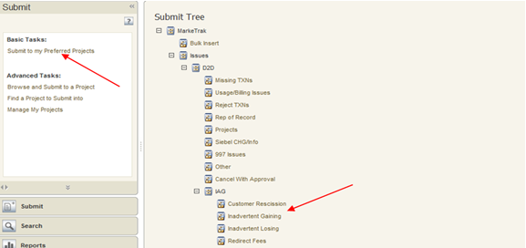
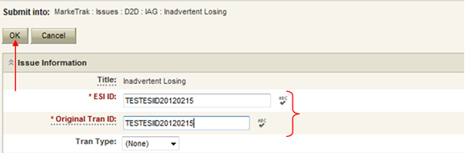
Inadvertent Gain
  Submitting an Inadvertent Gain – CR Submits as the Gaining CR
    From the Submit Tree, select IAG – Inadvertent Gaining
    CR1 (Gaining/Original CR) will enter all required information.
      ESIID
      Original Tran ID – The original tran id of the other CR’s enrollment. (BGN06 of the 814_06).

Slide 29
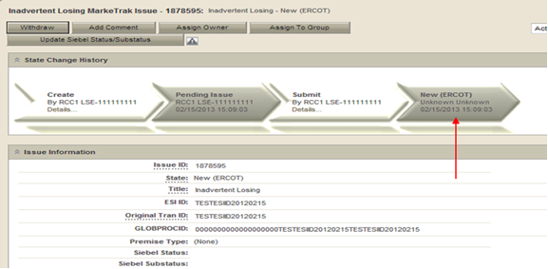
Inadvertent Gain
  CRITICAL: The Comments field is technically optional; however, not providing the required information referenced in RMG Section 7.3.2(1) could result in a delay of issue resolution. Please include any additional information in this box.
        Customer Name (Always)
        Meter Number (If available)
        Any other pertinent information that will help expedite resolution
    Select OK to create the IAG – Inadvertent Gaining MarkeTrak Issue. The issue enters the state of New (ERCOT) and is visible only by the Submitting CR and ERCOT.
    The Submitting CR has the option to Withdraw the issue at this point
    ERCOT will select Begin Working to provide the Gaining CR Start Date, if the Gaining CR is still the rep of record (Gaining CR ROR), assign CR2 (Gaining CR) and TDSP. ERCOT will then select “OK” to move the issue to CR2 (Gaining CR).

Slide 30
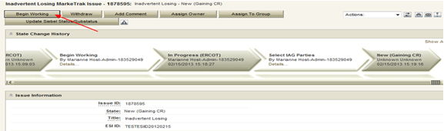

Inadvertent Gain
    CR2 (Losing CR) will select Begin Working and Issue details and Investigate Market Conditions to determine the appropriate regain date.
    If CR2 (Losing/Original CR) determines that an Inadvertent Gain has NOT taken place, they have the option to select “Unexecutable” to stop the Inadvertent Gain process. Invalid IAG Reason is required, enter one of the following:
      3rd party CR involved
      Authorized Enrollment Confirmed
      Duplicate Issue
      Other (should require comments)

Slide 31
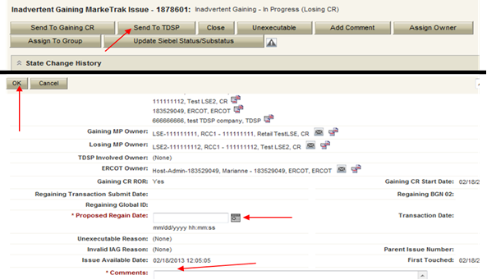
Inadvertent Gain
    If CR2 (Losing/Original CR) determines they will need more information from CR1 (Gaining CR), then they will need to select Send to Gaining CR. This transition allows both CR’s to talk back and forth while transitioning the issue back and forth before a resolution is made.
    If CR2 (Losing/Original CR) determines that an Inadvertent Gain has taken place, they will select Send to TDSP, enter the proposed regain date, add comments and select “OK” to move the issue to the TDSP. A validation will occur on the Proposed Regain Date: Validate that the date is less than “Submit Date” + 10 days. If not the following error message will be displayed “Proposed Regain Date is greater than 10 Calendar days from the submittal of MarkeTrak Issue, please update with valid Proposed Regain date.”

Slide 32
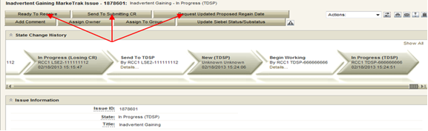
Inadvertent Gain
    The TDSP will select Begin Working, investigate the issue details, then select one of the following:
      Ready to Receive – The TDSP would select this transition to send the issue back to CR1 (Losing/Original CR). It is extremely important that CR1 (Losing/Original CR) wait for the TDSP to select Ready to Receive indicating TDSP’s systems have been prepared to receive the Original MP’s transaction before the EDI is actually sent. If not, the EDI will be rejected at the TDSP.
      Send To Submitting CR – The TDSP would select this transition if they needed further information from CR1 (Losing/Original CR).
      Request Updated Proposed Regain Date – The TDSP would select this transition if they do not agree with the proposed regain date that was provided. They would suggest a new date and send the issue back to CR1 (Losing/Original CR).

Slide 33
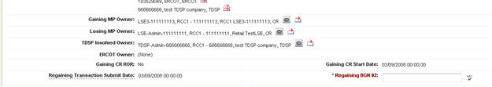
Inadvertent Gain
    CR2 (Losing/Original CR) will select Begin Working then select Provide Regaining BGN 02. CR2 (Losing/Original CR) will provide the Regaining BGN02 and then select “OK”. When the regaining transactions process into ERCOT’s registration system, the Regaining Transaction Submit Date, Regaining BGN Requested Date and Regaining BGN Priority Code will be auto-populated on the MarkeTrak issue.
    All parties should continue to monitor MIS and internal systems for the successful delivery and completion of the EDI transaction being sent by CR1 (Losing/Original CR) to the Market to regain a premise and resolve the associated Inadvertent Gain MarkeTrak issue.
    Once the regaining transaction has been successfully sent to the Market by CR2 (Losing/Original CR), Siebel will automatically:
      Check Regaining Transaction Siebel Status every 30 minutes using the BGN 02 from the new initiating transaction
      Update the issue with the current Regaining Transaction Siebel Status
      Assign the state of Complete with the Submitting MP as the Responsible Party once the Regaining Transaction Siebel Status is Complete.
      Issues remaining in a state of ‘Regaining Transaction Submitted (PC)’ for 14 calendar days will be transitioned by MarkeTrak to a state of ‘New (Losing CR Re-Submit)’ with the following comment: “Regaining Transaction has been idle for too long. Please review and re-submit transaction.”

Slide 34
Key Things to Remember
Provide as much information when opening Inadvertent Gain/Loss MarkeTrak in order to help facilitate quick resolution to the issue.
  Suggested Information includes:
  Customer Name (Always)
  Meter Number (If available)
  Any other pertinent information you may have that is crucial to help resolve issue.
  Regain date should be:
  Date of Loss (DOL) + 1
  Date of Loss (DOL) less than or equal to 10 days from date MT was submitted

Slide 35
Key Things to Remember:
Valid Reject/Unexecutable Reasons
7.3.2.4 Valid Reject/Unexecutable Reasons
(1) The losing CR may reject the return of an inadvertently gained ESI ID from the gaining CR for one of the following reasons only:
(a) A new transaction has completed in the market, including, but not limited to the following transactions:
(i) The 814_16, Move In Request; or
(ii) The 814_01, Switch Request.
(b) Duplicate Inadvertent Gaining issue in MarkeTrak for the same Customer on the same ESI ID.
(c) Losing CR has confirmed Customer’s intent to change REPs.

Slide 36
Key Things to Remember:
Valid Reject/Unexecutable Reasons
7.3.2.4 Valid Reject/Unexecutable Reasons (Con’t)
(2) The gaining CR may reject returning an inadvertently gained ESI ID to the Losing CR for one of the following reasons only:
(a) A new transaction has completed in the market, including, but not limited to the following transactions:
(i) The 814_16 transaction; or
(ii) The 814_01 transaction.
(b) Duplicate Inadvertent Losing issue in MarkeTrak for the same Customer on the same ESI ID;
(c) Gaining CR has confirmed Customer’s intent to change REPs:
(i) Gaining CR has a valid enrollment with the same Customer and provides the Customer name, service address and meter number (if available) in the comments section of the MarkeTrak issue.
(d) Customer has successfully completed an enrollment regarding the same ESI ID and the Gaining CR has the most recent effective date; or
(e) In cases of Customer rescission, Inadvertent Losing MarkeTrak issue is rejected/unexecuted and a Rescission MarkeTrak issue is created.

Slide 37
Key Things to Remember:
Invalid Reject/Unexecutable Reasons
7.3.2.5 Invalid Reject/Unexecutable Reasons
The losing CR shall not reject the return of an inadvertently gained ESI ID due to:
  (a) Inability to contact the Customer;
  (b) Past due balances or credit history;
  (c) Customer no longer occupies the Premise in question;
  (d) Contract expiration or termination;
  (e) Pending TX SETs; or
  (f) Losing CR serving the Premise under a Continuous Service Agreement (CSA).

Slide 39
LUNCH

Slide 40
Best Practices:
Reconciliation & Verification Process

Slide 41
Reconciliation & Verification
All parties involved in any Inadvertent Gain related MarkeTrak issue should build in some sort of Reconciliation and Verification process.

Slide 42
Reconciliation & Verification
In other words…
In addition to researching that an actual Inadvertent Gain has taken place, also verify the state/status of the actual issue and what action needs to take place from what party.
Verify the current status of the account and research the transactions that may impact the resolution of the issue.
Perform a reconciliation of the transactions sent to the Market to ensure that the transactions are being sent, received and processed successfully as agreed upon by all parties.
Ultimate goal is to return the Customer to their REP of choice quickly and efficiently with minimal inconvenience to the Customer.

Slide 43
CR Reconciliation & Verification
All parties have a role in researching the issues on their end, however for the Losing CR/Original, the following verification process can assist in making the resolution of an Inadvertent Gain MarkeTrak run smoothly when the following checks are performed:
Any Subsequent transactions in the Market?
  Yes – STOP the transaction if possible by submitting an 814_08, Cancel Request (or “Cancel w/Approval” MarkeTrak).
  No – Proceed to the next step
Any Holds?
  Yes – Submit 650_01 to remove any Holds
  No - Proceed to the next step
Proposed Regain Date =< Gaining CR Start Date?
(Proposed Regain Date: no greater than 10 days from MT submittal date)
  Yes – Update “Proposed Regain Date”
  No – Proceed by “Send to TDSP”

Slide 44
TDSP Reconciliation & Verification
When received by the TDSP, the issue goes through a verification process similar to the CR process. Once those preliminary checks are made, the TDSP will go on to perform the following steps:
Check for Permit Requirements and override if any exist
Add ESIID, Original CR and Proposed Regain Date to the TDSP system to allow a backdated MVI and verify loaded correctly
Update MarkeTrak issues with comments indicating readiness
Press the “Ready to Receive” button which will move the issue to a state of New Losing CR (Submit)
Review the Critical Care status of the account

Slide 45
TDSP Reconciliation & Verification
Once the TDSP completes their portion of the research, the issue is sent back to the Losing CR/Original who will send an EDI transaction (Backdated MVI) and thus more verification will need to take place:
Ensure that the MarkeTrak issue is in a State of “New (Losing CR Submit)”
Any Subsequent transactions in the Market?
  Yes – Cancel W/Approval if possible
  No – Proceed
Send EDI for the Proposed Regain Date that the Original CR entered within the issue
Verify the EDI was processed successfully by consulting the ERCOT Market Information System (MIS) as well as any internal systems used for verifying transactions.

Slide 46
Final CR Reconciliation & Verification
The backdated MVI can be verified as successful per the receipt of an 814_05 Accept
Add the Regaining BGN information into the MarkeTrak issue only after verifying that it was successfully received
DO NOT click the “Send to TDSP” transition as this will prevent the issue from Auto-completion

Slide 48
Customer Rescission
Walkthrough

Slide 49
Right of Rescission
PUCT Subst. Rule 25.474(j) - Right of Rescission
A REP shall promptly provide the applicant with the terms of service document after the applicant has authorized the REP to provide service to the applicant and the authorization has been verified. For switch requests, the REP shall offer the applicant a right to rescind the terms of service without penalty or fee of any kind for a period of three federal business days after the applicant's receipt of the terms of service document. The provider may assume that any delivery of the terms of service document deposited first class with the United States Postal Service will be received by the applicant within three federal business days. Any REP receiving an untimely notice of rescission from the applicant shall inform the applicant that the applicant has a right to select another REP and may do so by contacting that REP. The REP shall also inform the applicant that the applicant will be responsible for charges from the REP for service provided until the applicant switches to another REP. The right of rescission is not applicable to an applicant requesting a move-in.

Slide 50
Right of Rescission
In other words…
Applicable to Switch requests only, not Move-Ins.
After receiving the Terms of Service, Customer is allowed three (3) federal business days to rescind without penalty or fees.
    If Customer requests rescission outside of the 3 federal business day window, it is no longer a Customer Rescission and will be considered an Inadvertent Switch.
Ultimate goal is to return the Customer to their REP of choice quickly and efficiently with minimal inconvenience to the Customer.

Slide 51
Rescission vs. Inadvertent Switch
Strongly recommended that involved CRs share as much information as possible at the onset of issue creation to aid in resolution of Customer Rescission issue quickly and efficiently (e.g. Customer Name, Meter #, etc.)
Although Customer Rescission is part of the Inadvertent Switch ‘family’ within the MarkeTrak tool, resolution of a Customer Rescission does not follow the same criteria nor follow the same completion timeline.
The research and investigation normally pursued during resolution of an Inadvertent Switch is not utilized when resolving Customer Rescission.
If/when the customer requests rescission (within the 3 federal business day window), the ‘losing’ REP must promptly regain the Customer – no questions asked.

Slide 52
Rescission vs. Inadvertent Switch
Handling of Fees/Charges Associated with IAG vs Rescission:
Fees (if applicable per TDSP Tariffs):
  For a customer rescission, TDSPs may charge CRs a fee; but there shall be no fees passed through to the customer.
  For IAG, TDSPs may charge Gaining CRs an IAG fee; but the CR’s internal business practices will dictate if IAG fees are passed to the customer.
  Consumption (usage) charges:
Rescission reinstatement date is automatically set at DOL + 1, Gaining CRs shall not pass these charges to the customer
IAG reinstatement date is driven by the Losing CR and is set at a minimum of DOL + 1 to Date of MT submission +10, Gaining CRs may choose to pass these charges to the customer

Slide 53
Customer Rescission & RMGRR129
Due to the expeditious nature of Customer Rescission requests, RMGRR129 – Revision to Customer Rescission Completion Timeline was created to provide additional guidelines regarding specific timing and responsibilities for a Competitive Retailer (CR) to complete a Customer Rescission MarkeTrak issue.

Slide 54
RMGRR129 – What are the changes?
Once a Customer Rescission MarkeTrak (MT) issue has been submitted, the losing CR has two (2) business days to agree to the Customer Rescission MT issue.
Once the Transmission and/or Distribution Service Provider (TDSP) has updated the MT issue to “Ready to Receive”, the losing CR has another two (2) business days to send a backdated 814_16, Move-In Request.

Slide 55
Customer Rescission Walkthrough
Only the gaining CR in a rescission scenario may utilize the rescission-based MarkeTrak process to initiate reinstatement of a customer to its original CR.
In order for an issue to be submitted through this subtype, it must be submitted on or before the twenty-fifth (25th) calendar day following ERCOT’s established First Available Switch Date (FASD).
Should a matter of rescission need to be resolved, but a Customer Rescission issue has not been submitted for this purpose within the specified timeframe the two CRs should work to resolve this issue through the Inadvertent Gaining subtype.

Slide 56
Rescission Walkthrough – Gaining CR
The Gaining CR selects the Submit tab.
From the Submit Tree, select Customer Rescission.
Note: The submitter should include any details (ex. customer name) in the comments section which may expedite resolution of the issue.

Slide 57
Rescission Walkthrough – Gaining CR
The following fields must be populated:
ESI ID
Original Tran ID

Slide 58
Rescission Walkthrough - Validations
ERCOT validates ESI ID, submission timeframe and valid originating transaction.
Upon passing validation, MarkeTrak issue is created and ERCOT updates the issue with the following information:
      Losing CR Name and Duns
      TDSP Name and Duns
      Gaining CR ROR = Y or N
      Gaining CR Start Date
      Regain Date – auto populated by ERCOT.
      (Gaining CR Start Date +1 calendar day)
MarkeTrak issue is assigned to the state of ‘New (Losing CR)’ with the Losing CR as the Responsible Party.
[Starts the 2 BD clock for Losing CR to Agree]
Losing CR user selects ‘Begin Working’.

Slide 59
Rescission Walkthrough – Losing CR
MarkeTrak issue is assigned to the state of ‘In Progress (Losing CR)’ with the Losing CR as the Responsible Party.
Losing CR selects ‘Send to TDSP’.
[Implies “Agreement” & ends the 2 BD clock]

Slide 60
Rescission Walkthrough – TDSP
Issue is in a state of ‘New (TDSP)’ with TDSP as Responsible MP.
TDSP selects ‘Begin Working’.
Issue is in a state of ‘In Progress (TDSP)’ with TDSP as Responsible MP.

Slide 61
Rescission Walkthrough - TDSP
TDSP selects ‘Ready to Receive’
[Starts the 2 BD clock for Losing CR to submit BDMVI]

Slide 62
Rescission Walkthrough – Losing CR
Issue is in a state of ‘New (Losing CR Submit)’ with the Losing CR as Responsible MP.
Losing CR selects ‘Begin Working’.
Issue is in a state of ‘In Progress (Submit Regaining)’ with the Losing CR as Responsible MP.

Slide 63
Rescission Walkthrough – Losing CR
Losing CR selects ‘Provide Regaining BGN02’.

Slide 64
Rescission Walkthrough – Losing CR
Losing CR populates all required information:
      Regaining Transaction Submit Date
      Regaining BGN 02

Slide 65
Rescission Walkthrough - Resolution
Issue is in a state of ‘Regaining Transaction Submitted (PC)’ with the Gaining (Submitting CR) as Responsible MP.
Once the regaining transaction (Backdated 814_16 MVI) has been successfully sent by (Losing/Original CR), Siebel will automatically:
      Check Regaining Transaction Siebel Status every 30 minutes using the BGN 02 from the new initiating transaction.
      Update the issue with the current Regaining Transaction Siebel Status.
The issue will move to a state of ‘Complete’ with the Submitting MP as the Responsible Party once the Regaining Transaction Siebel Status is Complete.
[Ends the 2 business day clock for the Losing CR]

Slide 67
BREAK

Slide 68
ERCOT LIVE DEMO HERE

Slide 69
Market Challenge

Slide 70
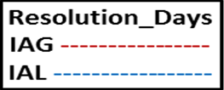
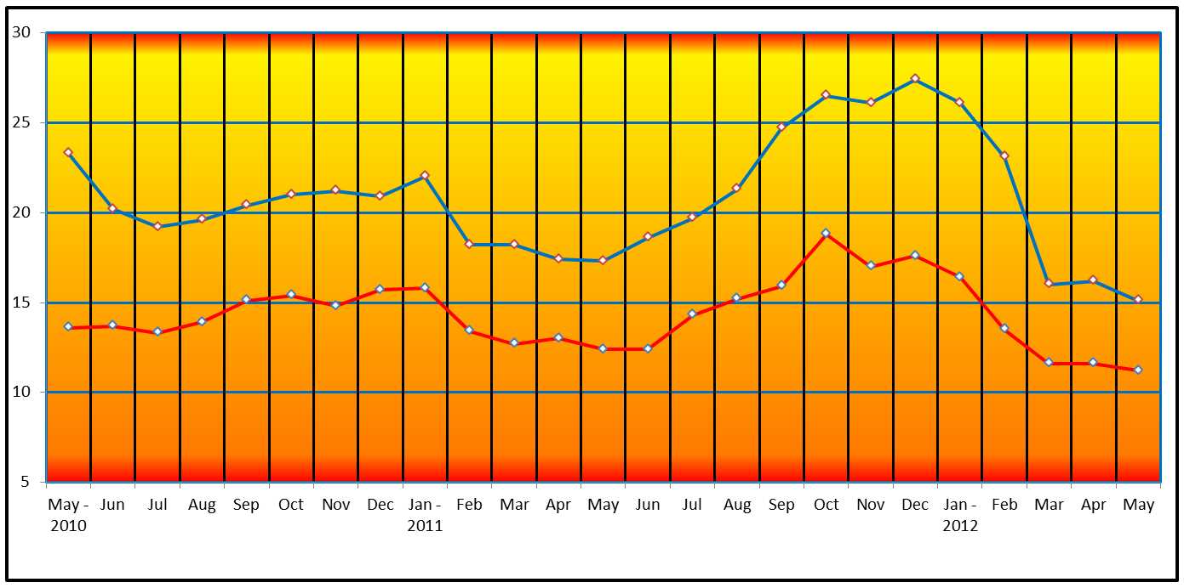
Has the market improved?
Resolution Days – Valid Inadvertent Issues by Close Date – Prior Years

Slide 71
Has the market improved?
Resolution Days: Valid Inadvertent/Rescission Issues by Closed Date

Slide 72

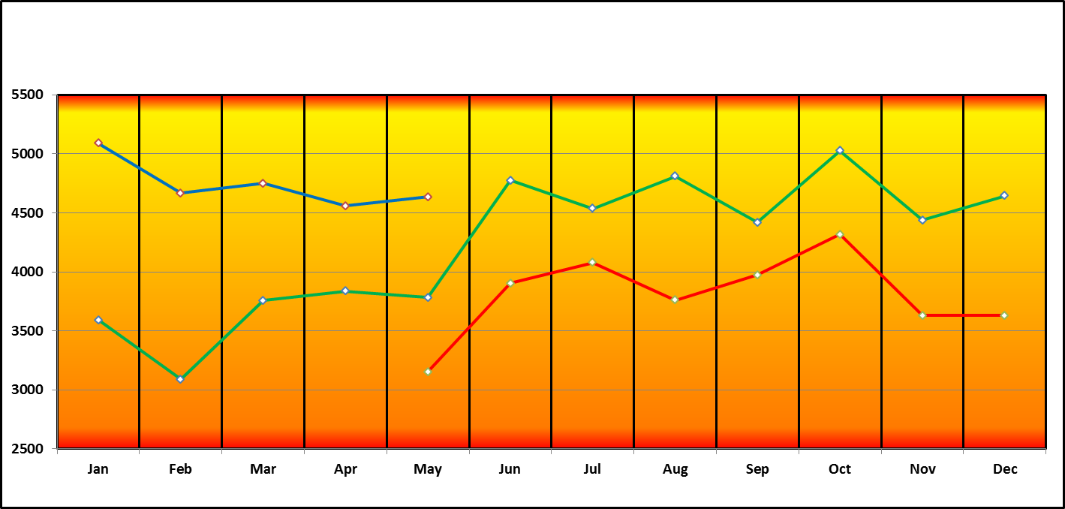
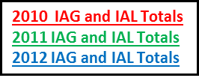
IGLs – Where we have been

Slide 73
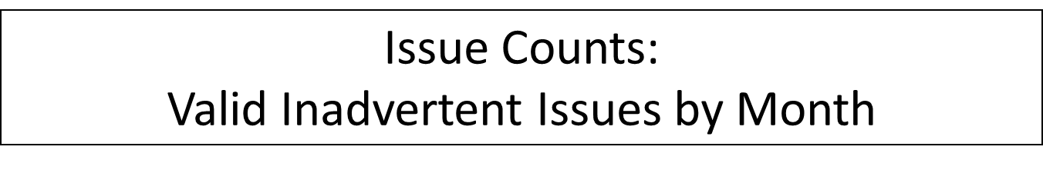
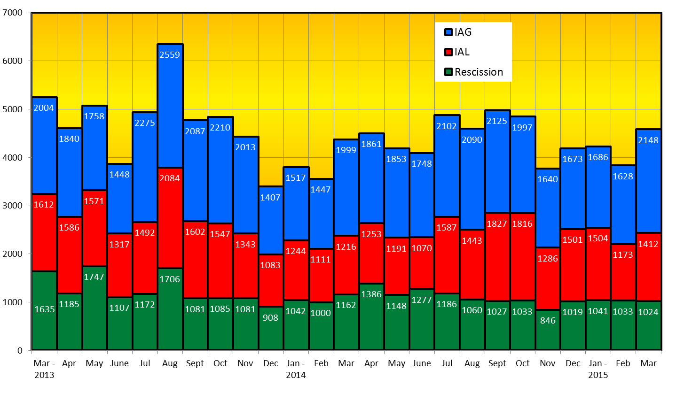

IGLs – Where we are today

Slide 74


Why is this important to the market?
The competitive ERCOT market is mature, and viewed by some as the model to emulate.
Maturity allows the opportunity to refine processes, seek efficiencies, and improve the customer experience.
Bad customer experience
PUCT complaints
Consumes significant resources for REPs, TDSPs, ERCOT, and PUCT

Slide 75

Market Challenge
Let’s clean up the slop !!

Slide 76
Market Challenge
REP actions cause a significant volume of IGLs (e.g., incorrect transactions, sales tactics).
REPs should be willing to be accountable to each other regarding IGLs, working together to drive solutions to the market.
Goals
Collectively, by the end of 2015, reduce IGLs by at least 25% from today’s volume
Speed up the resolution cycle = minimize the customer impact as much as possible

Slide 77
How can we get there…
What can we all do to reduce the number of Inadvertent Gains/Losses in the market?
Analyzing why they occurred – trending, categorizing, and root causing
Execute techniques for preventing them going forward
Streamline management of MarkeTraks
Reporting to measure success

Slide 78
How can we get there…
Analyzing why they occurred…
  Review the data and categorize root causes of the issue, such as:
    Customer issue/error (wrong address)
    Agent issue/error (wrong address)
    System issue (order not processing)
    Error by other REP (losses)
    Back office error
    Web portal error ( house panel esi id vs apartment)
  Each of these root causes may be further broken down and addressed accordingly:
    Coaching, coaching, coaching for offending agents who fail to comply with approved processes (issuance of MVOs to correct errors)
    Internal reporting identifying offending REPs and reaching out to offenders with opportunities to solution gaps in processes
    Education of agents on proper transactions

Slide 79
How can we get there…
Execute techniques for preventing them going forward…
Confirm service address via ERCOT, meter number, etc.
  simply restating prior to authorization of enrollment (Third Party Verification)
  ensure self-service web portals have proper validations (an apartment unit that may inadvertently enroll the house meter)
Alerts on ESI IDs for which an IGL is in progress to ensure improper transactions do not occur to break IGL or create a lights out situation
Issuance of proper transaction – utilize a Cancel w/Approval MT, if applicable, in lieu of an IGL situation
Clear enrollment processes by sales forces
Continued TDSP intervention –TDSP becomes aware of a possible Inadvertent situation and reaches out to impacted REPs
    Names not matching on switch transactions
    Safety net process whereby TDSP will not accept any transactions that do not match date of safety net or MarkeTrak

Slide 80
How can we get there…
Streamline management of MarkeTraks…
Utilize customized MarkeTrak reporting features to organize “your buckets” into the following categories to allow for prioritization of your daily work such as:
  “ready to receive” – will display any MTs requiring BDMVIs
  “unexecuted” – gains – requiring closure
  “unexecuted” – losses – requiring closure
  “begin working” – gains
  “begin working” - losses

Slide 81
Market Challenge
Reporting to measure success…
Performance Measurement Requirements
For each quarter, ERCOT shall report
    The number of inadvertent gains for each REP
    The number of losses due to inadvertent gains for each REP
    The number of rescissions for each REP
    The ratio of inadvertent gains to completed enrollments for the Gaining REP
  SUGGESTION:
  Present quarterly at RMS the top offenders (anonymously)
  with the largest ratio of IAGs to enrollments
2008
Recommendation

Slide 82
Top 10 - IAG Impact by REP (March 2015)
2148 IAG / 1412 IAL / 1024 Recession
Impact

Slide 83
Top 10 - IAG Impact by REP (April 2015)
1786 IAG / 1390 IAL / 1149 Recession
Impact

Slide 84



Market Challenge
How will the market be impacted?
Together we can make it a ...

Slide 86
2015
Inadvertent Switch & Customer Rescission
Market Training
APPENDIX

Slide 87
Process Flow: IAL (Losing)
Process Flow - Inadvertent Losing MarkeTrak Issue
 | Transition | By | State | Owner
 | Create | Submitter (Losing CR) / Original CR | Pending Issue | Submitter (Losing CR) / Original CR
 | â
 | Submit | Submitter (Losing CR) / Original CR | New (Gaining CR) | (Gaining CR) / Inadvertent CR
 | â
 | Assign Owner | (Gaining CR) / Inadvertent CR | New (Gaining CR) | (Gaining CR) / Inadvertent CR
 | â
 | Begin Working | (Gaining CR) / Inadvertent CR | In Progress (Gaining CR) | (Gaining CR) / Inadvertent CR
 | â
 | Agree | (Gaining CR) / Inadvertent CR | New (Losing CR) | Submitter (Losing CR) / Original CR
 | â
 | Begin Working | Submitter (Losing CR) / Original CR | In Progress (Losing CR) | Submitter (Losing CR) / Original CR
 | â
Submitter (Losing CR) / Original CR to Perform Research / Reconciliation / Verification Process: þ Subsequent transactions? Yes - Cancel W/Approval, No - Proceed þ Holds? Yes – Submit 650_01, No - Proceed þ Proposed Regain Date =< Gaining CR Start Date? Yes – Update, No – Proceed Send to TDSP
 | â

Slide 88
Process Flow: IAL (Losing)
 | â
 | Send To TDSP | Submitter (Losing CR) / Original CR | New (TDSP) | TDSP
 | â
 | Begin Working | TDSP | In Progress (TDSP) | TDSP
 | â
TDSP to Perform Research / Reconciliation / Verification Process: þ Subsequent transactions? Yes – Send back to CRs, No - Proceed þ Holds? Yes – Send back to CRs, No - Proceed þ Proposed Regain Date =< Gaining CR Start Date? Yes – Send back to CRs, No – Proceed þ Check for Permit Requirements and override if any exist þ Add ESIID, Original CR and Proposed Regain Date to Safety Net and verify loaded correctly þ Update MarkeTrak issues with comments indicating readiness
 | â
 | Ready To Receive | TDSP | New (Losing CR Submit) | Submitter (Losing CR) / Original CR
 | â
 | Begin Working | Submitter (Losing CR) / Original CR | In Progress (Submit Regaining) | Submitter (Losing CR) / Original CR
 | â

Slide 89
Process Flow: IAL (Losing)
 | â
Submitter (Losing CR) / Original CR to Perform Research / Reconciliation / Verification Process: þ Subsequent transactions? Yes - Cancel W/Approval, No - Proceed þ Send EDI for the Proposed Regain Date that the Original CR entered within the issue þ Verify the EDI was processed successfully by consulting the ERCOT MIS as well as any internal systems used for verifying transactions. þ Add the Regaining BGN information into the MarkeTrak issue only after verifying that it was successfully received þ DO NOT click the Send to TDSP transition as this will prevent the issue from Auto-completion
 | â
 | Provide Regaining BGN02 | Submitter (Losing CR) / Original CR | Regaining Transaction Submitted (PC) | Submitter (Losing CR) / Original CR
 | â
 | Update | ERCOT | Auto Complete | Submitter (Losing CR) / Original CR

Slide 90
Process Flow: IAG (Gaining)
Process Flow - Inadvertent Gaining MarkeTrak Issue
 | Transition | By | State | Owner
 | Create | Submitter (Gaining CR) / Inadvertent CR | Pending Issue | Submitter (Gaining CR) / Inadvertent CR
 | â
 | Submit | Submitter (Gaining CR) / Inadvertent CR | New (Losing CR) | (Losing CR) / Original CR
 | â
 | Assign Owner | (Losing CR) / Original CR | New (Losing CR) | (Losing CR) / Original CR
 | â
 | Begin Working | (Losing CR) / Original CR | In Progress (Losing CR) | (Losing CR) / Original CR
 | â
(Losing CR) / Original CR to Perform Research / Reconciliation / Verification Process: þ Subsequent transactions? Yes - Cancel W/Approval, No - Proceed þ Holds? Yes – Submit 650_01, No - Proceed þ Proposed Regain Date =< Gaining CR Start Date? Yes – Update, No – Proceed Send to TDSP
 | â

Slide 91
Process Flow: IAG (Gaining)
 | â
 | Send To TDSP | (Losing CR) / Original CR | New (TDSP) | TDSP
 | â
 | Begin Working | TDSP | In Progress (TDSP) | TDSP
 | â
TDSP to Perform Research / Reconciliation / Verification Process: þ Subsequent transactions? Yes – Send back to CRs, No - Proceed þ Holds? Yes – Send back to CRs, No - Proceed þ Proposed Regain Date =< Gaining CR Start Date? Yes – Send back to CRs, No – Proceed þ Check for Permit Requirements and override if any exist þ Add ESIID, Original CR and Proposed Regain Date to Safety Net and verify loaded correctly þ Update MarkeTrak issues with comments indicating readiness
 | â
 | Ready To Receive | TDSP | New (Losing CR Submit) | (Losing CR) / Original CR
 | â
 | Begin Working | (Losing CR) / Original CR | In Progress (Submit Regaining) | (Losing CR) / Original CR
 | â

Slide 92
Process Flow: IAG (Gaining)
 | â
(Losing CR) / Original CR to Perform Research / Reconciliation / Verification Process: þ Subsequent transactions? Yes - Cancel W/Approval, No - Proceed þ Send EDI for the Proposed Regain Date that the Original CR entered within the issue þ Verify the EDI was processed successfully by consulting the ERCOT MIS as well as any internal systems used for verifying transactions. þ Add the Regaining BGN information into the MarkeTrak issue only after verifying that it was successfully received þ DO NOT click the Send to TDSP transition as this will prevent the issue from Auto-completion
 | â
 | Provide Regaining BGN02 | (Losing CR) / Original CR | Regaining Transaction Submitted (PC) | Submitter (Gaining CR) / Inadvertent CR
 | â
 | Update | ERCOT | Auto Complete | Submitter (Gaining CR) / Inadvertent CR

Slide 93
Customer Rescission – Exceptions
If the regaining transaction remains in a Siebel status other than Complete in the ERCOT Registration System for greater than five calendar days, the issue will automatically transition back to the Losing CR, and an email generated to notify the Losing CR of the transition.
If the regaining Siebel status is still Scheduled status, the Losing CR should repopulate the regaining BGN field with the same information.
If the Siebel status is blank within the MarkeTrak issue, the Losing CR should verify the status of the regaining transaction and submit/repopulate a new transaction if necessary.
This functionality is to ensure the issue is not closed before the premise has been regained, due to the time restriction on submission of new issues within this subtype.

Slide 94
Customer Rescission – Re-submit

Slide 95
Customer Rescission – Re-submit

Slide 96
Reference Documents
PUCT Subst. Rule §25.495, Unauthorized Change of Retail Electric Provider
ERCOT Retail Market Guide Section 7.3, Inadvertent Gain Process
MarkeTrak User’s Guide
Notes:
APPENDIX MATERIAL????

Slide 97
Reference Documents
PUCT Subst. Rule §25.495. Unauthorized Change of Retail Electric Provider
    http://www.puc.texas.gov/agency/rulesnlaws/subrules/electric/Electric.aspx
Either the original REP (Losing REP) or the switching REP (Gaining REP) shall file a MarkeTrak issue as promptly as possible
Affected REPs, ERCOT, and TDSP shall take all actions necessary to return the customer to the original REP as quickly as possible
Gaining REP shall pay all transmission and distribution charges associated with returning the customer to the Losing REP
Gaining REP shall refund within 5 days all charges paid by the customer for the time period the Losing REP regains and ultimately rebills the customer
The REP that ultimately bills the customer is responsible for the non-bypassable charges and wholesale consumption for the customer
The customer shall pay no more than the price at which the customer would have been billed had the unauthorized switch or move-in not occurred
Notes:
APPENDIX MATERIAL????

Slide 98
Reference Documents
ERCOT Retail Market Guide
http://www.ercot.com/mktrules/guides/retail/current
7.3 Inadvertent Gain Process
  7.3.1 Escalation Process
  7.3.2 Competitive Retailer’s Inadvertent Gain Process
    7.3.2.1 Buyer’s Remorse
    7.3.2.2 Prevention of Inadvertent Gains
    7.3.2.3 Resolution of Inadvertent Gains
    7.3.2.4 Valid Reject/Unexecutable Reasons
    7.3.2.5 Invalid Reject/Unexecutable Reasons
    7.3.2.6 Out-of-Sync Conditions
    7.3.2.7 No Losing Competitive Retailer of Record
  7.3.3 Charges Associated with Returning the Customer
  7.3.4 Transmission and/or Distribution Service Provider Inadvertent Gain Process
    7.3.4.1 Inadvertent Dates Greater than 150 days
    7.3.4.2 Inadvertent Order is Pending
    7.3.4.3 Third Party has Gained Electric Service Identifier (Leapfrog Scenario)
    7.3.4.4 Transmission and/or Distribution Service Provider Billing
  7.3.5 Customer Rescission after Completion of a Switch Transaction
    7.3.5.1 Additional Valid Reasons for Rejection of a Rescission-based Issue

Slide 99
Reference Documents
Retail Market Guide Section 7.3 Inadvertent Gain Process
Guidelines for ensuring that inadvertently gained ESI IDs are returned to the Losing REP in a quick and efficient manner with minimal inconvenience to the Customer as required by PUC Subst. Rule 25.495 Unauthorized Change of Retail Electric Provider
Escalation Process:
Each Market Participant is responsible for it’s own compliance with the PUCT rules and RMG procedures & timelines.
Each Market Participant shall maintain and update escalation contacts within the MarkeTrak Rolodex
MarkeTrak will send escalation emails to the escalation contacts whenever an issue has remained in a ‘New’ or ‘Pending’ state for more than 3 calendar days

Slide 100
Reference Documents
Section 7.3, Inadvertent Gain Process - continued
CRs, both Losing and Gaining Reps, must investigate the matter and provide all necessary/relevant information – customer name, service address, meter number
An untimely rescission is not treated as an inadvertent gain or loss
The IGL process shall not be used to resolve an issue which an authorized enrollment causes a breach of contract between Customer and Losing Rep
Utilize the Cancel w/ Approval MarkeTrak to prevent an IGL if within one Retail Business Day prior to MVI or switch
If future dated MVI or switch and earlier than one Retail Business Day prior to transaction, utilize 814_08 Cancel Request
    814_08 Cancel w/ approval IGL MarkeTrak
    DOT – 1 DOT
    Date of Transition

Slide 101
Reference Documents
Section 7.3, Inadvertent Gain Process - continued
Do not issue a MVO on an ESI ID that was gained in error
Do not issue an Inadvertent Loss MarkeTrak until the Gaining Rep’s transaction has completed
The Losing Rep ultimately determines the reinstatement date
Reinstatement date shall be at the earliest DOL + 1 (Date of Loss) and at the latest 10 days from the date the MarkeTrak was submitted
The Losing Rep shall submit the BDMVI (back-dated move in) 814_16 no later than 12 days after submittal of the MarkeTrak and shall be dated with the ‘proposed regain date’ as agreed in the MarkeTrak
The MT will auto-close if remains untouched for 20 days from the date the TDSP selects ‘Ready to Receive’
Reinstatement date
DOL DOL+1 MT date +10

Slide 102
Reference Documents
Section 7.3, Inadvertent Gain Process - continued
Be mindful of the Valid and Invalid Reject/Unexecutable reasons
Each Rep shall be responsible for all non-bypassable TDSP charges and wholesale consumption costs for the periods that the Rep bills the customer
If a lights out in error situation occurs (the Gaining Rep issues a MVO or DNP) the Losing Rep may submit a Redirect Fee MarkeTrak within 3 Retail Business Days following an 810_02 from the TDSP. Keep in mind, not all TDSPs have MVI fees for standard meters.
TDSP shall not issue billing corrections more than 150 days in the past from the date of receipt of the BDMVI due to settlement issues. Losing Rep must resubmit the BDMVI with a new date.
Leapfrog Scenario – when a legitimate third party transaction has occurred to an inadvertently gained ESI ID or if the BDMVI’s proposed regain date is more than 2 Retail Business Days prior to scheduled transaction, TDSP shall respond this is no longer an inadvertent issue.

Slide 103
Reference Documents
MarkeTrak User Guide
http://www.ercot.com/content/services/client_svcs/mktrk_info/MarkeTrak%2520User%2520Guide[1]%20(2).zip
2.1 Day to Day Issues – Inadvertent Gain
2.1.1 Required Fields for Inadvertent Gain
2.1.2 Definition of Inadvertent Gain
2.1.3 Submitting an Inadvertent Gain
2.1.4 Submitting a Customer Rescission Issue
2.1.5 Redirect Fees Subtype

