Slide 1
Impact of Price Floors on CRR Deration in DAM
Hailong Hui
ERCOT Market Design and Analysis
QMWG
Feb. 27, 2017

Slide 2
Impact of Price Floors on CRR Deration in DAM
There is possibility of over-deration for the CRR settlement in DAM when the price floor is applied
CRR Target Payment is based on final SPPs
Considers the price floor ($-251/MWh) impact
Derated amount is based on shadow price
Doesn’t consider price floor impact
Over deration because
Target Payment_{floored_SPP} – Derated amount <
Target Payment_{original_SPP} – Derated amount

Slide 3
NPRR385 Negative Price Floor
NPRR385 introduced an administrative price floor -$251/MWh for both Real-Time Settlement Point Prices (RTSPPs) and Day-Ahead Settlement Point Prices (DASPPs)
Protocols 4.6.1: The Day-Ahead Settlement Point Price (DASPP) calculations are described in this Section for Resource Nodes, Load Zones, Hubs, and Logical Resource Nodes. For all DASPPs there shall be an administrative price floor of -$251/MWh.
NPRR385 was implemented on Sep. 24, 2013
Deration was not changed for NPRR385

Slide 4
Protocols Sections of CRR Deration Affected by Price floors
Protocols Sections of CRR Deration affected by Price floors
7.9.1.1 Payments and Charges for PTP Obligations Settled in DAM
7.9.1.2 Payments for PTP Options Settled in DAM
7.9.1.5 Payments and Charges for PTP Obligations with Refund Settled in DAM
7.9.1.6 Payments for PTP Options with Refund Settled in DAM
Use 7.9.1.1 PTP Obligation deration as an example

Slide 5
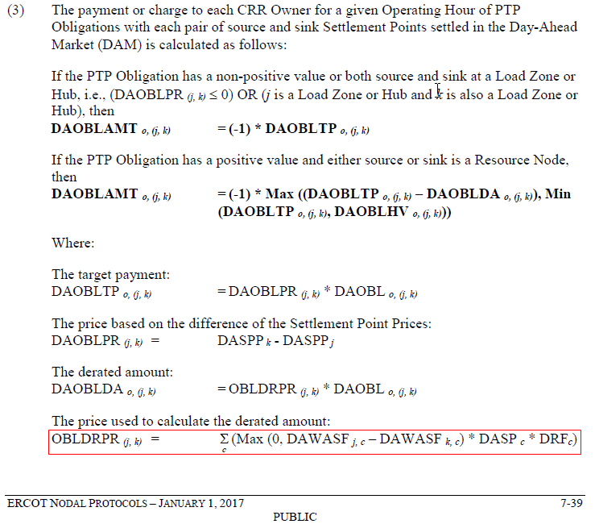
7.9.1.1 Payments and Charges for PTP Obligations Settled in DAM

Slide 6
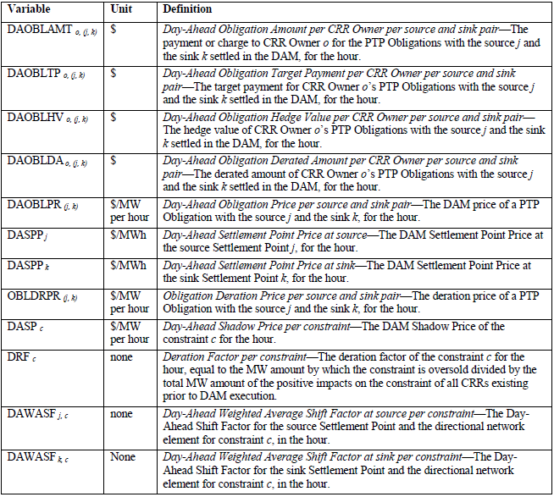
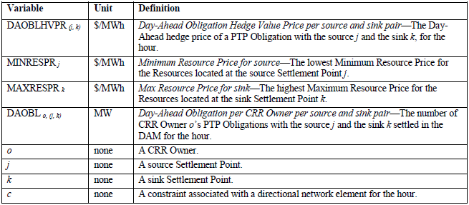
7.9.1.1 Payments and Charges for PTP Obligations Settled in DAM

Slide 7
DAM Price Floor and CRR Deration Example
Input
A CRR owner owns 1MW PTP Obligation from source j to sink k for hour x.
j is a Resource Node and k is a hub
The Resource located at k is coal, Minimum Resource Price for source j (MINRESPR_{j}) =$0/MWh
DASPP_{j}=$-251/MWh, DASPP_{k}=$20/MWh, if no floor applied, DASPP_{j, orig}=$-1000/MWh
c is the only oversold constraint in DAM for hour x
shadow price(DASP_{c})=$2,000/MWHr, deration factor DRF_{c}=0.3
source shift factor DAWASF_{j,c}=0.51, sink shift factor DAWASF_{k,c}=0.01
Calculation
Target Payment (DAOBLTP)=1MW*(DASPP_{k}-DASPP_{j})=$271
The derated amount (DAOBLDA)=1MW*(0.51-0.01)*2000*0.3=$300
Hedge value (DAOBLHV)=1MW*MAX(0, DASPP_{k}-MINRESPR_{j})=MAX(0,20-0)=$20
Obligation Amount(DAOBLAMT)=(-1)*MAX[(DAOBLTP-DAOBLDA),Min(DAOBLTP,DAOBLHV)]=(-1)*MAX[(271-300),MIN(271,20)]=-$20, hedge value set the price in this case
Over-deration: derated amount ($300)>target payment($271). If no price floor, the target payment would be 20-(-1000)=$1,020 which is greater than the derated amount ($300).

