Slide 1
DAM Point-to-Point Obligation (PTP) Bids under Contingency Analysis
Carrie Bivens
February 27, 2017

Slide 2
Agenda
Overview of PTPs
Inconsistent Awards and Settlement
Awarded PTP scenarios
Not Awarded PTP scenarios
Next Steps
Questions
Appendix : Modeling of DAM PTPs in Contingency Analysis

Slide 3
Overview of PTP
A PTP is modeled as a simultaneous injection and withdrawal – a linked bid and offer
PTPs are awarded in DAM when the clearing price in DAM is lower or equal to the price Bid by the QSE
The awarded PTPs are settled on
settlement price SPP_{sink}- SPP_{source}
PTPsource PTPsink
Bid Price
Cleared Price
Settlement Price

Slide 4
Inconsistent Awards and Settlement
  Under certain scenarios involving a contingency that disconnects a Resource Node, the settlement price can diverge from clearing price (Details in the appendix)
Awarded PTP Obligation Bid can be settled at a price higher than the Bid price
Awarded PTP Obligation Bid can be settled at a price higher/lower than clearing price- QSE pays more/less than it should per DAM clearing

Slide 5
PTP awarded - Scenario 0
Bid Price > Cleared Price = Settlement Price
PTP awarded when it is economical
QSE pays below bid price
QSE pays what it should per DAM clearing
Bid Price
Cleared Price
Settlement Price

Slide 6
PTP awarded - Scenario 1
Settlement Price > Bid Price > Cleared Price
PTP awarded when settlement shows it is not economical
QSE pays more than bid price
QSE pays more than it should per DAM clearing
Settlement Price
Bid Price
Cleared Price

Slide 7
PTP awarded - Scenario 2
Bid Price > Settlement Price > Cleared Price
QSE pays below bid price
QSE pays more than it should per DAM clearing
Bid Price
Settlement Price
Cleared Price

Slide 8
PTP awarded - Scenario 3
Bid Price > Cleared Price > Settlement Price
QSE pays less than Bid price
QSE pays less than it should per DAM clearing
Bid Price
Cleared Price
Settlement Price

Slide 9
PTP not awarded - Scenario 1
Settlement Price > Cleared Price > Bid Price
No award inconsistency
Settlement Price
Cleared Price
Bid Price

Slide 10
PTP not awarded - Scenario 2
Cleared Price > Settlement Price > Bid Price
No award inconsistency
Cleared Price
Settlement Price
Bid Price

Slide 11
PTP not awarded - Scenario 3
Cleared Price > Bid Price > Settlement Price
QSE bid not awarded when settlement shows it was economic whereas the optimization process deemed it uneconomic
Cleared Price
Bid Price
Settlement Price

Slide 12
Scenarios
Prices | PTP Awarded? ( Bid > Clearing) | Did QSEs see the price/dispatch inconsistency based on Settlement Price?
Settlement > Bid > Clearing | Yes | Yes
Bid > Settlement > Clearing | Yes | No
Bid > Clearing > Settlement | Yes | No
Settlement > Clearing > Bid | No | No
Clearing > Settlement > Bid | No | No
Clearing > Bid > Settlement | No | Yes

Slide 13
Questions?

Slide 14
Appendix

Slide 15
Overview
A PTP is modeled as a simultaneous injection and withdrawal – a linked bid and offer
Clearing price and SPP difference diverge when
  Under a contingency a settlement point associated with either the PTP’ sink or source is disconnected
  A constraint becomes violated/binding under the contingency
  The shift factor for the connected settlement point is non-trivial
  The constraint remains binding for the final DAM solution

Slide 16
Modeling DAM PTPs in Contingency Analysis
Under contingency analysis a contingency disconnects one of the source/sink settlement points
In order to keep post-contingency power balance, any PTP containing a disconnected settlement point will be ignored in the post-contingency power flow.
PTPsource PTPsink

Slide 17
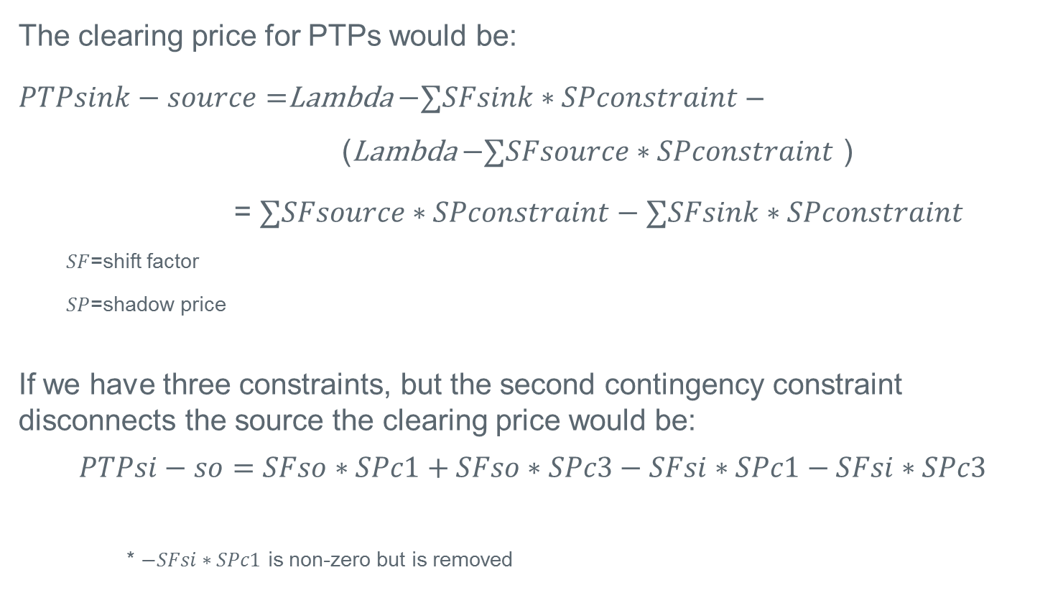
Modeling DAM PTPs in Contingency Analysis
The clearing price for PTPs would be:
$PTPsink−source=$Lambda $−∑SFsink∗SPconstraint$ –
(Lambda $−∑SFsource∗SPconstraint$ )
= $∑SFsource∗SPconstraint−∑SFsink∗SPconstraint$
  $SF$=shift factor
  $SP$=shadow price
If we have three constraints, but the second contingency constraint disconnects the source the clearing price would be:
$$PTPsi−so=SFso∗SPc1+SFso∗SPc3−SFsi∗SPc1−SFsi∗SPc3$$
* $−SFsi∗SPc1$ is non-zero but is removed

Slide 18
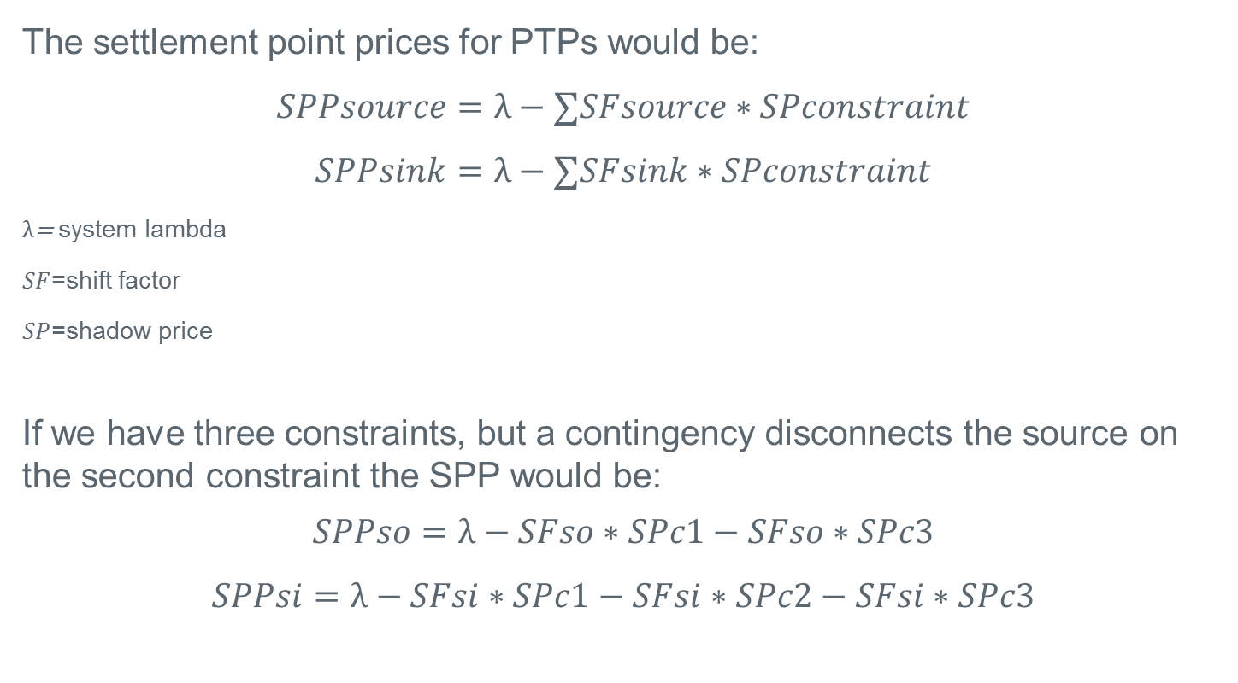
Modeling DAM PTPs in Contingency Analysis
The settlement point prices for PTPs would be:
$$SPPsource=λ−∑SFsource∗SPconstraint$$
$$SPPsink=λ−∑SFsink∗SPconstraint$$
$λ$= system lambda
$SF$=shift factor
$SP$=shadow price
If we have three constraints, but a contingency disconnects the source on the second constraint the SPP would be:
$$SPPso=λ−SFso∗SPc1−SFso∗SPc3$$
$$SPPsi=λ−SFsi∗SPc1−SFsi∗SPc2−SFsi∗SPc3$$

Slide 19
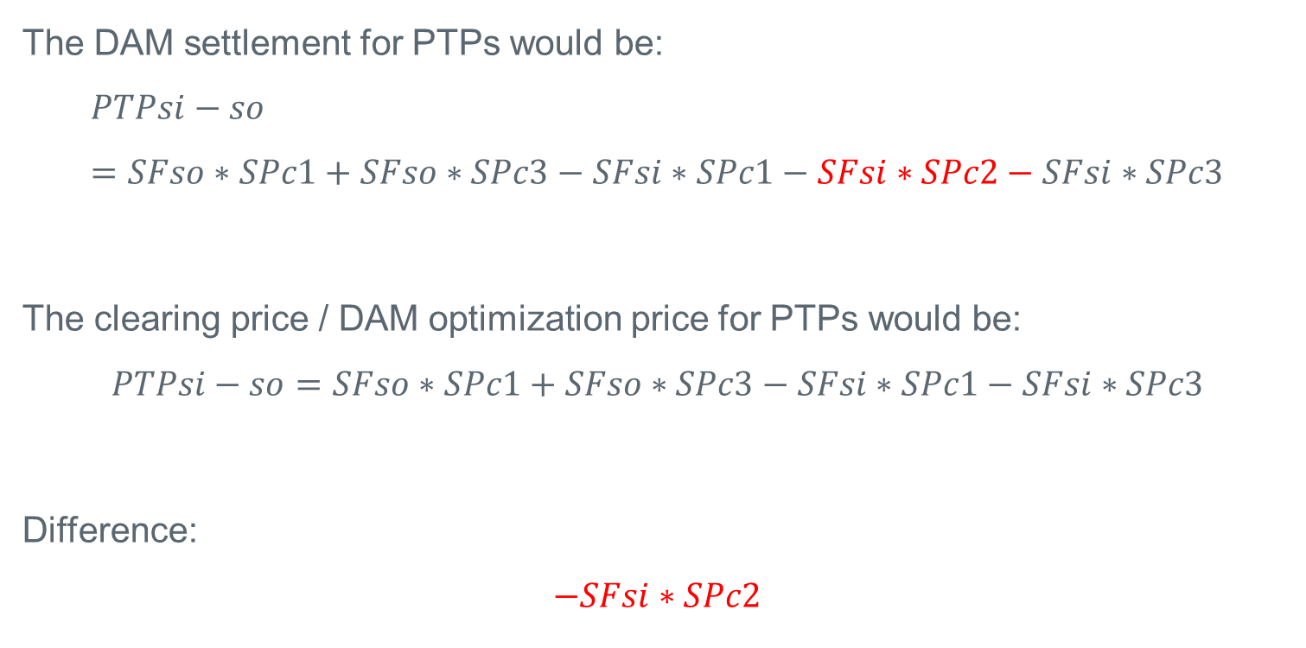
Modeling DAM PTPs in Contingency Analysis
The DAM settlement for PTPs would be:
$$PTPsi−so=SFso∗SPc1+SFso∗SPc3−SFsi∗SPc1−SFsi∗SPc2−SFsi∗SPc3$$
The clearing price / DAM optimization price for PTPs would be:
$$PTPsi−so=SFso∗SPc1+SFso∗SPc3−SFsi∗SPc1−SFsi∗SPc3$$
Difference:
$$−SFsi∗SPc2$$

Slide 20
Modeling DAM PTPs in Contingency Analysis
End result – clearing price diverges from the sinkSPP-sourceSPP
The shift factor/shadow price for the contingency constraint is:
  included when calculating the SPP for source
  NOT included when calculating the SPP for the sink
  NOT included when clearing the PTP and hence not in clearing price

