Slide 1
ERCOT Stakeholder User Personae
February 27, 2017
Notes:
Amy

Slide 2
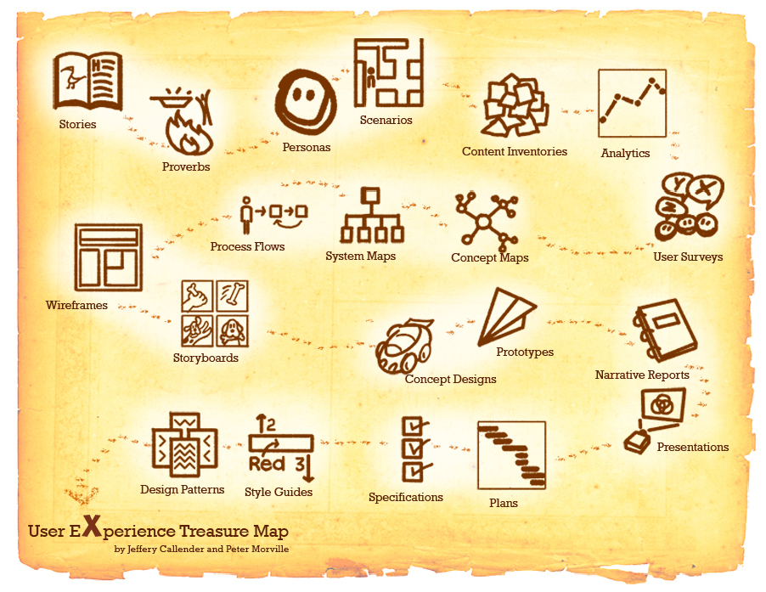
User-Centered Design

Slide 3
What is the first step?
In an effort to understand the needs and goals of users who interact with ERCOT systems, the ERCOT User Experience (UX) team is working to identify a broad spectrum of MPs that can be interviewed to develop user personas.

Slide 4
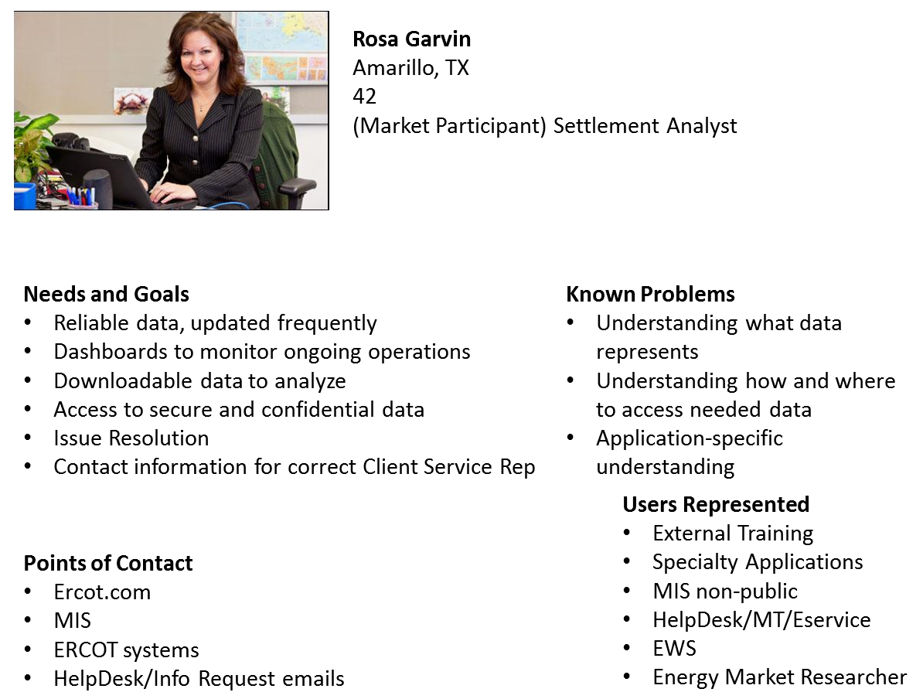
What is a User Persona?

Slide 5
What’s the Ask?
Interview subjects (25-35 MPs) should collectively represent the full span of MP activities and come from different sized companies.
30-60 minute interviews will be conducted over the phone or in person and may be followed up with requests for online feedback.

