Slide 1
Project Update and Summary of
Project Priority List (PPL) Activity
February 9, 2016

Slide 2
Project Update Agenda
Project Portfolio Update p. 3-8
  Recent / Upcoming Project Implementations
  2017 Release Targets
  2017 Project Spending Forecast
  Revision Request Funding Placeholder Status
  Priority/Rank Options for Revision Requests with Impacts
  SCR781 / MP Online – Upcoming Activities
Appendix
  Project Portfolio Gantt Chart p. 9-18
Location of Project Priority List (PPL): http://www.ercot.com/services/projects/index

Slide 3
Recent / Upcoming Project Implementations
2/1/2017 Complete
  NPRR790 – Addition of Phase Angle Limits to the Network Operations Model
Go-Live date is now TBD In Flight
  NMMS Upgrade project
2017 March Release – Week of 3/7/2017 In Flight
  NPRR272 – Definition and Participation of Quick Start Generation Resources
  NPRR649 – Addressing Issues Surrounding High Dispatch Limit (HDL) Overrides
  NPRR753 – Allow AMS Data Submittal Process for TDSP-Read Non-Modeled Gens
  NPRR764 – QSE Capacity Short Calcs Based on 80% Probability of Exceedance (P80)
  NPRR785 – Sync WGR and PVGR COPs with Short Term Wind and PV Forecasts
  RMGRR134 – Allow AMS Data Submittal Process for TDSP-Read Non-Modeled Gens
  RRGRR003 – Modifications to Improve Wind Forecasting
  RRGRR006 – Clarification of Descriptions and Alignment with RARF Forms
  RRGRR007 – Adding Solar Resource Registration Inputs
  RRGRR009 – Adding Voltage Limit Sets, Relay Loadability, MLSE, and GMD Data
  PGRR046 – Addition of Geomagnetically Induced Current (GIC) Model Building Reqs
Note: Projected Go-Live dates are subject to change.
Please watch for market notices as the effective dates approach.

Slide 4
2017 Release Targets – Board Approved NPRRs / SCRs / xGRRs
March 3/7 – 3/9 | May 5/1 – 5/11 | June 6/27 – 6/29 | August 8/29 – 8/31 | October 10/31 – 11/2 | December 12/5 – 12/7
NPRR272 NPRR649 NPRR753 NPRR764 NPRR785 RMGRR134 RRGRR003 RRGRR006 RRGRR007 RRGRR009 PGRR046 NPRR790 | SCR790 NPRR746 NPRR786 NPRR792 PGRR051 | NPRR573 NPRR714 NPRR744 NPRR782 NPRR789 NPRR797 NPRR801 | NPRR758 NPRR775 SCR777 | NPRR778 | SCR789
12 | 5 | 6 | 3 | 1 | 1
E
E
E
E
E
E
E
E
E
E
E
E
E
E
E
E
E
P
P
I
P
P
P
E
NS
E
NS
NS
9/16 – 9/17
(Retail)
5/20 – 5/21
(Retail)
7/15 – 7/16
(Retail)
10/2 – 10/3
(Off-Cycle)
11/11 – 11/12 (Retail)
12/9 – 12/10 (Retail)
2/1
TBD – NMMS Upgrade
2017 TBD Items (and point at which they became “TBD”)
2014 | 2015 | 2016 | 2017
NOGRR084, NPRR664 | None | SCR781 H | None
Go-live dates can differ from Protocol effective dates – Please refer to market notices for more details
APPENDIX
Red Text: New additions and target release changes
Strike-Through Text: Previous target release changes
(a), (b), etc. indicates multiple phases
In-Flight Items Planned for Future Delivery
CMM bundle (Planning):
  By summer 2018: NPRR519, NPRR620,
  NPRR683, NPRR741, NPRR743,
  NPRR755, NPRR760
  TBD: NPRR702
Release targets are subject to change
Project Status Codes: NS = Not Started, I = Initiation, P = Planning, E = Execution, H = On Hold

Slide 5
2017 Project Spending
2017 PPL Budget = $20.5M
“Potential Demand” represents internal ERCOT projects that have not been fully approved

Slide 6
Revision Request Funding Placeholder Status
In 2016 and 2017, ERCOT forecasted $4.0M for Revision Request work
Yearly Revision Request Spending Forecast Summary
Project Status | 2016 | 2017
YTD Actuals | $2.57M | –
Approved – In-Flight / Complete | $2.94M | $1.38M
Approved – On Hold | $0.00M | $0.40M
Approved – Not Started | $0.00M | $0.42M
Remaining Funding | $1.06M | $1.80M
Total Allocation | $4.00M | $4.00M
As of 11/30/2016

Slide 7
Priority / Rank Options for Revision Requests with Impacts
Options for…
Revision Request | Description | Priority | Rank | Comments
NPRR808 | Three Year CRR Auction | TBD | TBD | Need market input on lead time required for market readiness
NPRR810 | Applicability of RMR Incentive Factor on Reservation and Transportation Costs Associated with Firm Fuel Supplies | 2017 | 1930 | Small project that can be added to the end of the project list and worked into the 2017 delivery plan
NPRR812 | Alignment of Currently Published Reports | 2017 | 1940 | Small project that can be added to the end of the project list and worked into the 2017 delivery plan

Slide 8
SCR781 / MP Online – Upcoming Activities
Information gathering Feb 2017
Expect to rename the current MP Online Initiative to “RARF Replacement”
  This project will include SCR781 requirements
Anticipate taking off hold in March
  At that time we will conduct a planning phase to determine key milestones and produce a more detailed execution schedule
Notes:
Starting in February ERCOT will begin evaluating market requirements for MP Online in conjunction with our vision for a modern market participant user application. From this analysis we expect to bring multiple projects into the planning phase around March. Between now and then we also anticipate re-naming the current MP Online initiative “RARF Replacement”. Additionally we will likely launch another project to satisfy the internal objectives/requirements that were established during previous MPOnline projects. This will allow us to move forward with RARF without impeding its progress due to internal requirements”

Slide 9
Appendix
  1/31/2017 Project Gantt
    In-flight items sorted by Project End Date
    “On Hold” projects listed separately
    “Not Started” items sorted by Project Start Date

Slide 10
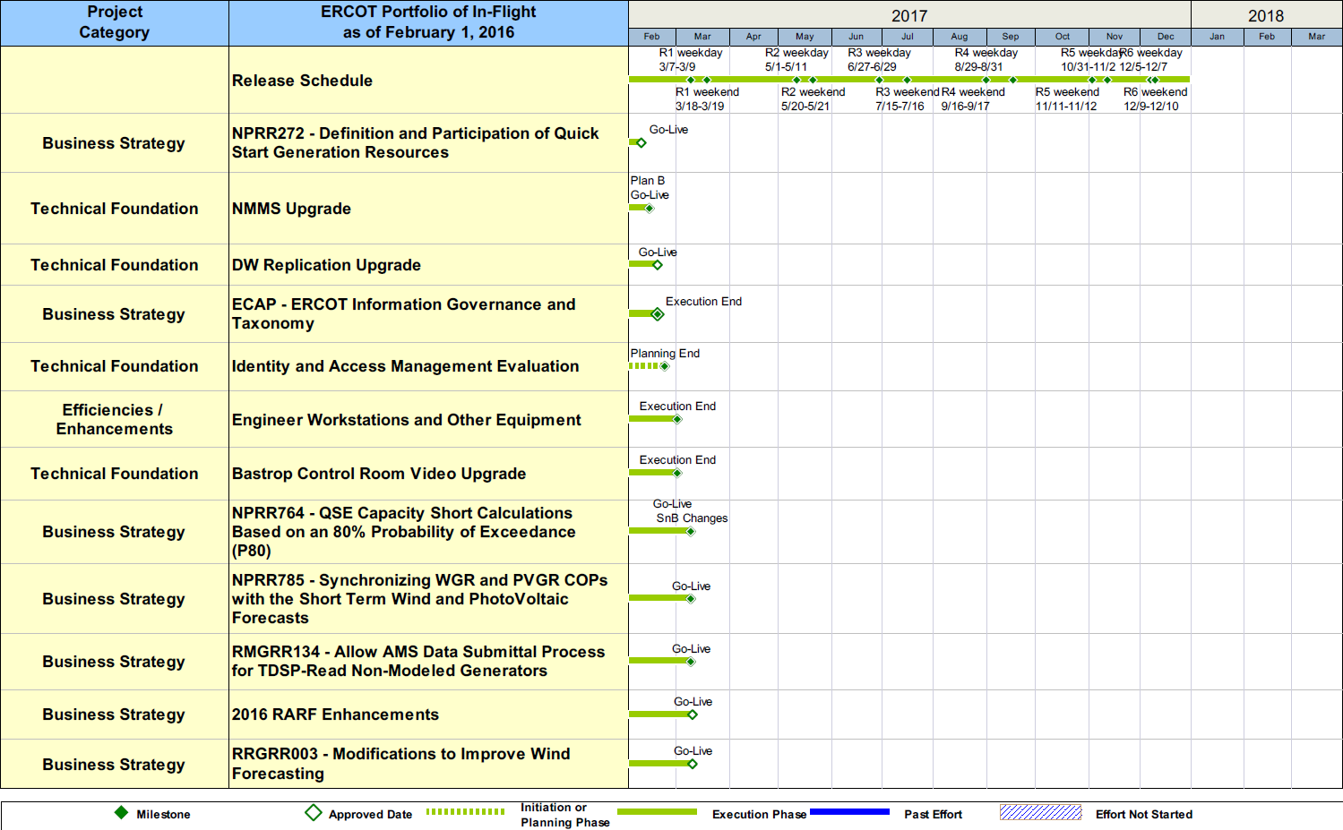
Project Portfolio Status – as of 1/31/2017

Slide 11
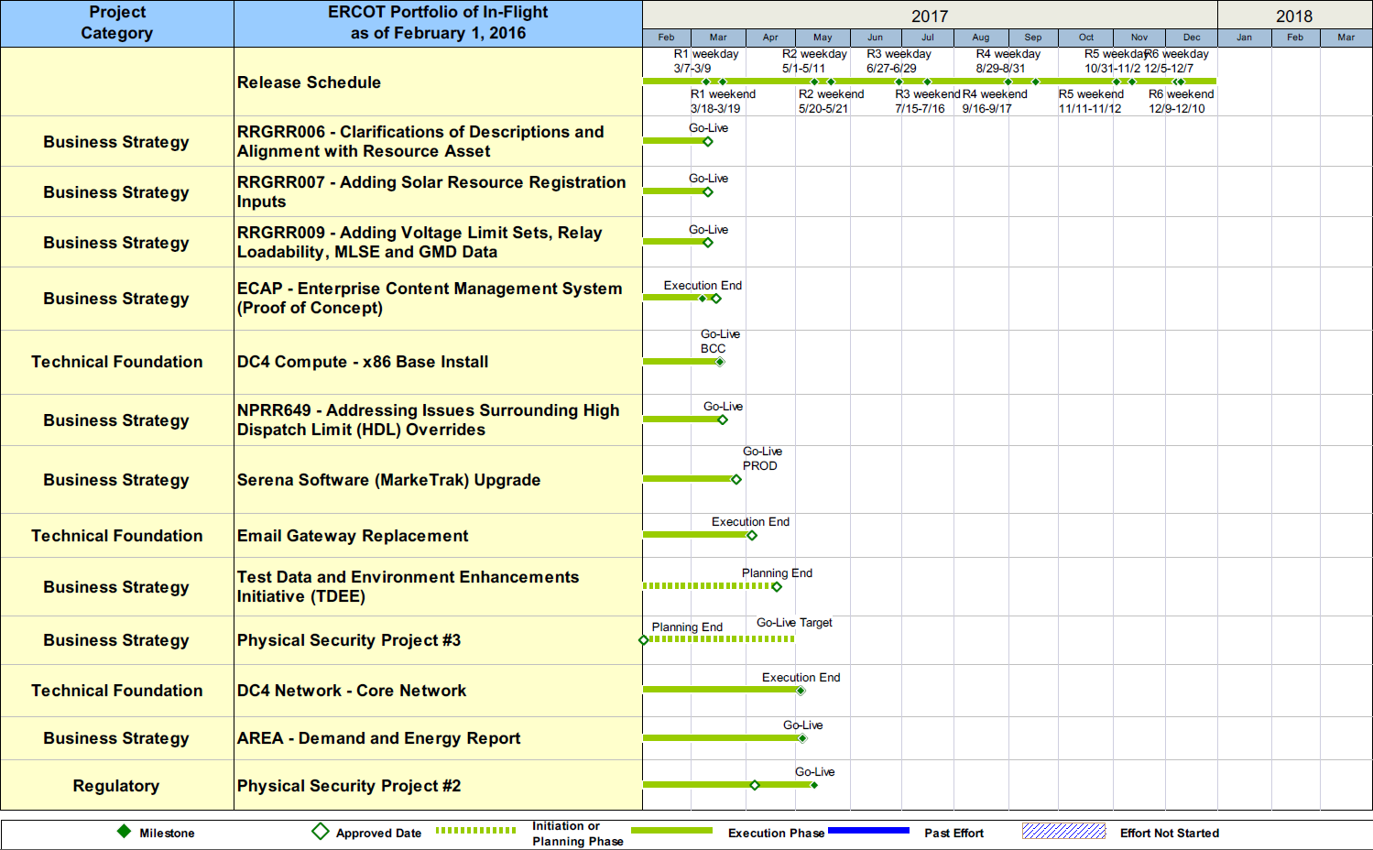
Project Portfolio Status – as of 1/31/2017

Slide 12
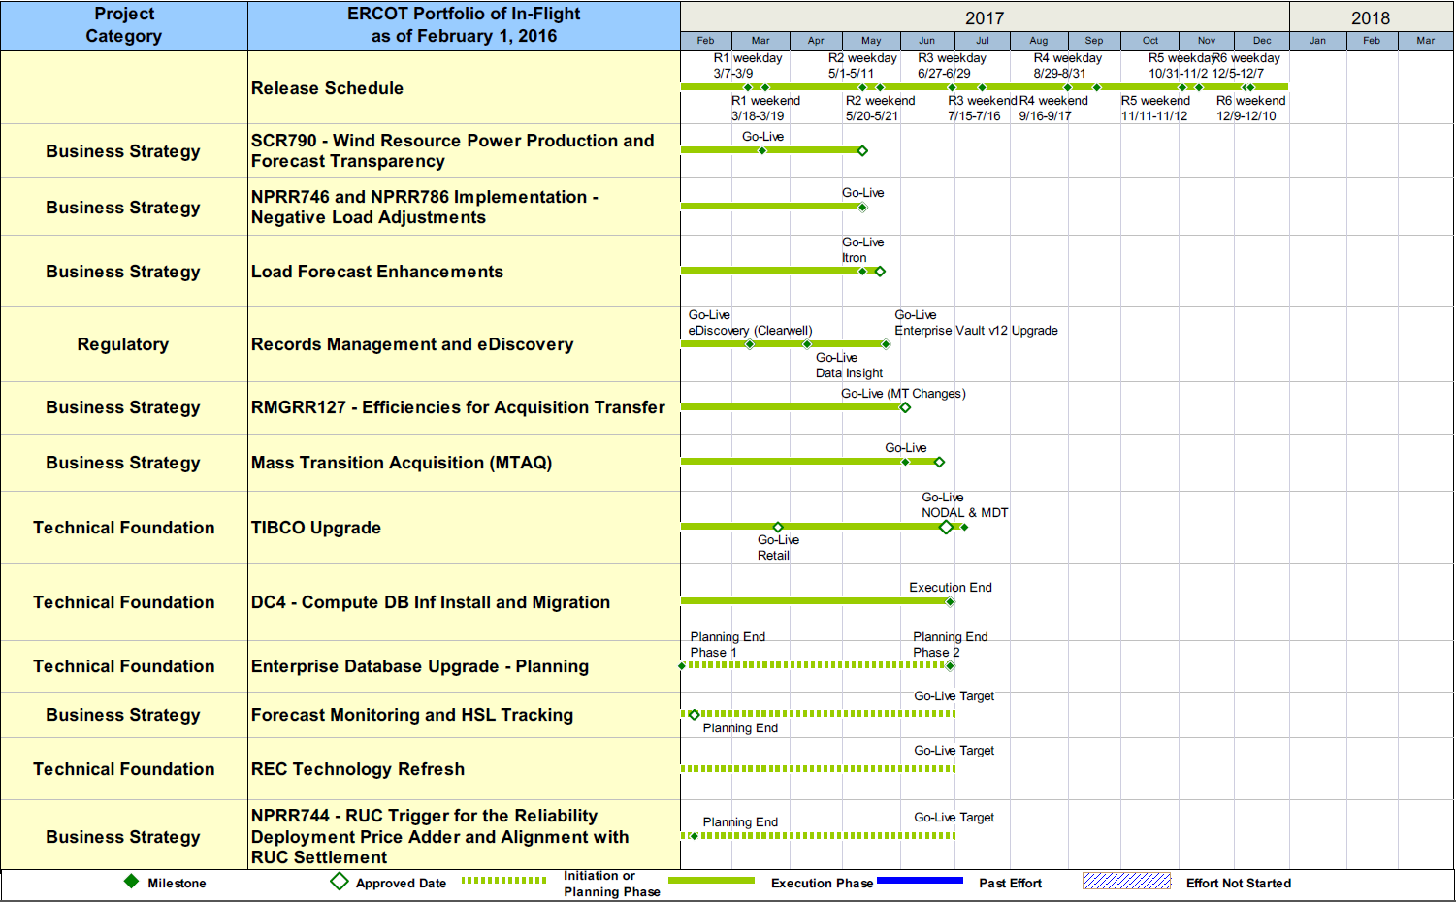
Project Portfolio Status – as of 1/31/2017

Slide 13
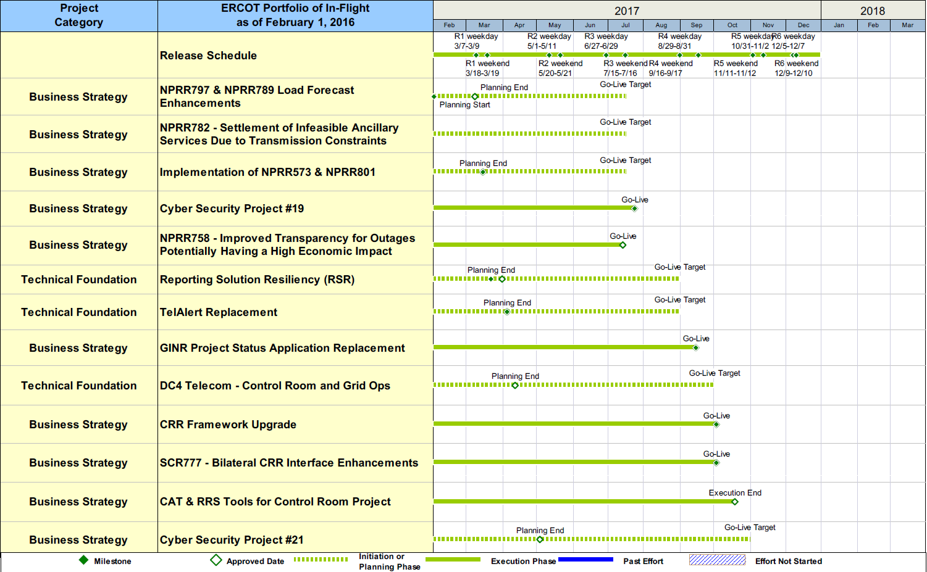
Project Portfolio Status – as of 1/31/2017

Slide 14
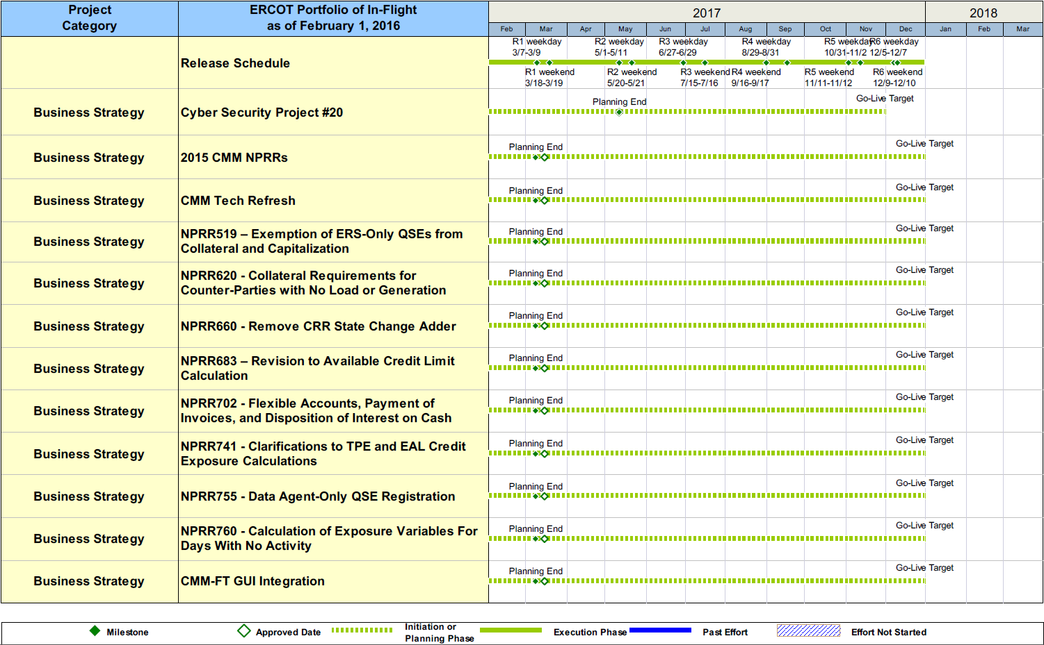
Project Portfolio Status – as of 1/31/2017

Slide 15
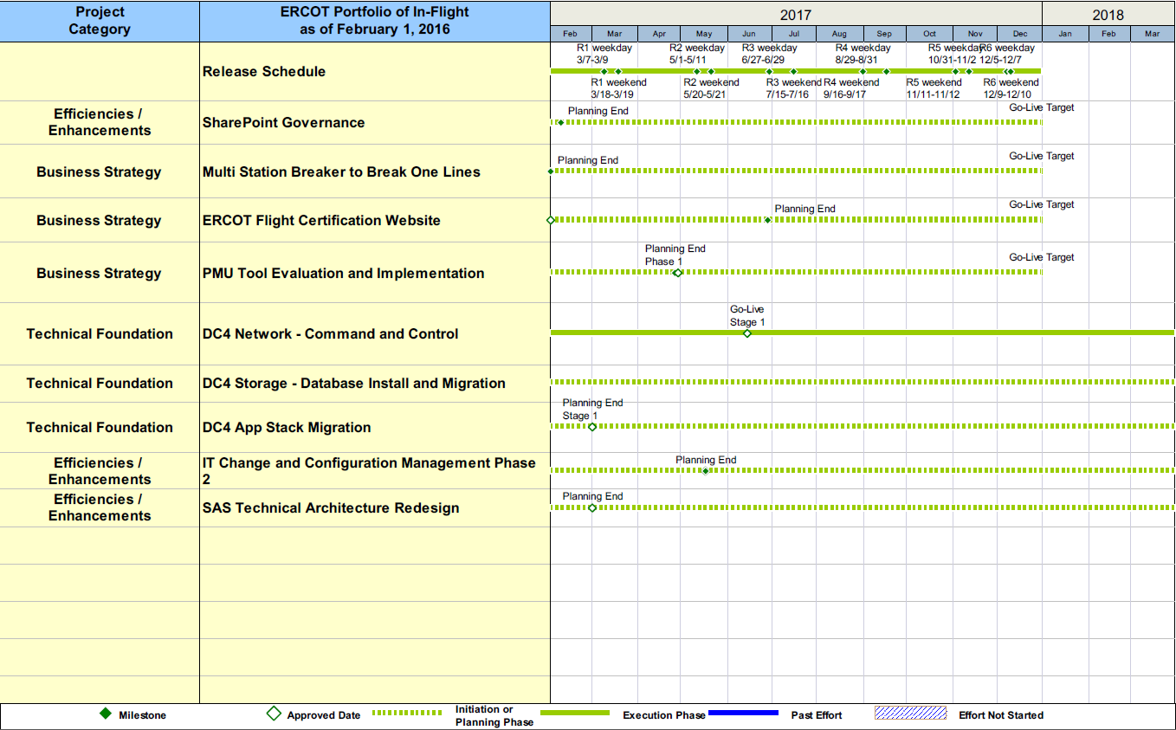
Project Portfolio Status – as of 1/31/2017

Slide 16
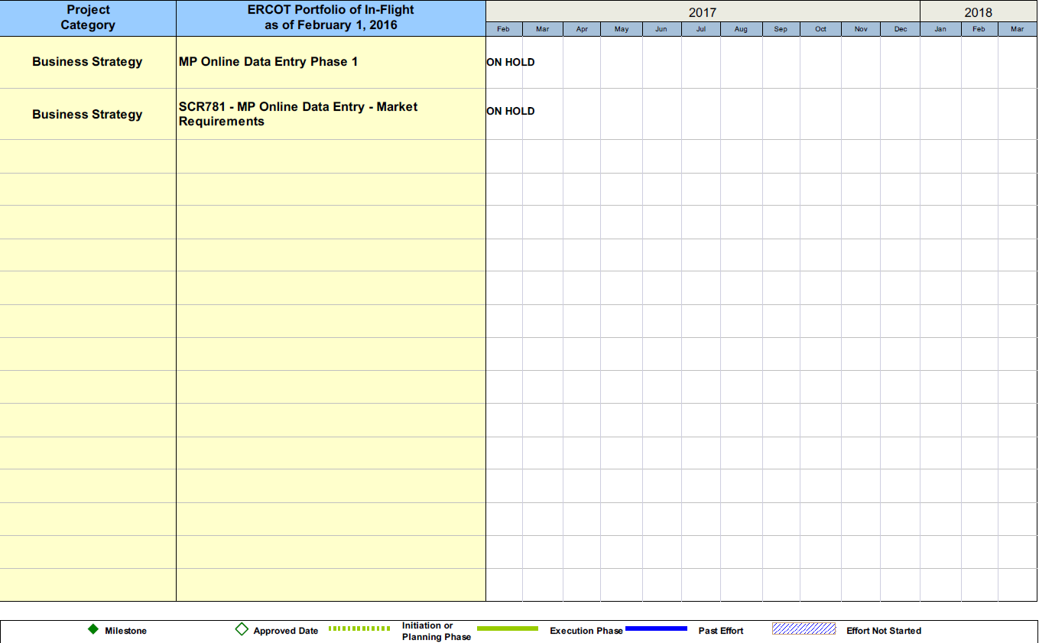
Project Portfolio Status – as of 1/31/2017

Slide 17
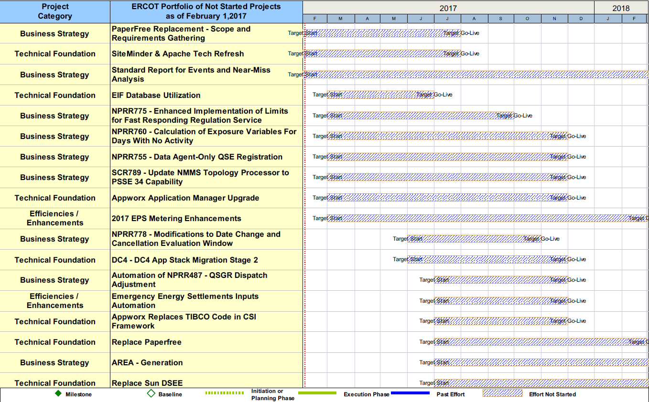
Project Portfolio Status – as of 1/31/2017

Slide 18
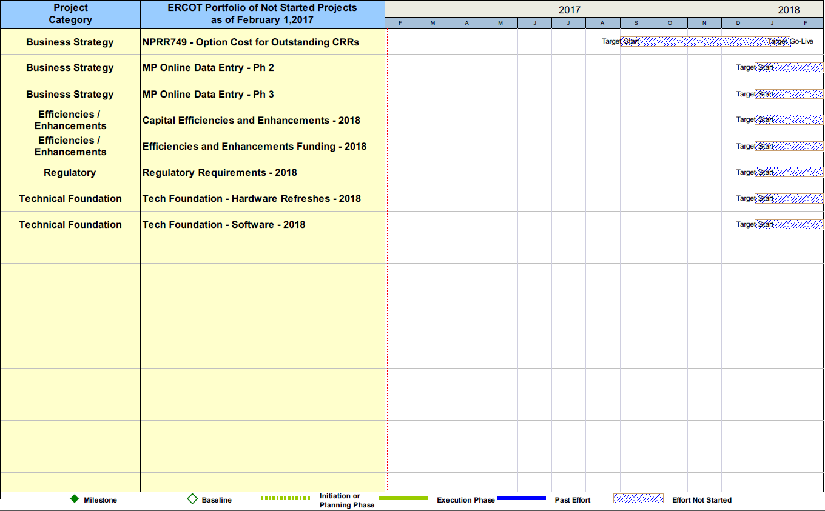
Project Portfolio Status – as of 1/31/2017

