Slide 1
New NDCRC Reactive Test Form Workshop
Yamit Lavi
Grid Analysis, Operations Planning
February 21, 2017

Slide 2
Agenda
Nodal Protocol/Operating Guide References
Why are there Changes
Common Form Issues
Demo
Q&A

Slide 3
Nodal Protocol/Operating Guide References
Nodal Operating Guides
  Section 3.3.2 – Unit Reactive Capability Requirements
Nodal Protocols
  Section 8.1.1.2.1.4 – Voltage Support Service Qualification
Notes:
Lagging Reactive Testing
(a) It is recommended, but not required, that lagging reactive tests be performed when system voltage is within the voltage profile, such as during high load periods.
(b) Lagging tests should meet the following performance criteria:
(i) Lagging Test 1: Test at or above 95% of the unit’s High Sustained Limit (HSL) for at least 15 minutes. IRRs should test at or above 60% of their HSL. Testing acceptance criteria is met if the unit achieved no less than 90% of the unit’s most recent CURL.
(ii) Lagging Test 2: Test at the unit’s HSL for at least one hour. IRRs should test with at least 90% of photovoltaic inverters or wind turbines on-line. Testing acceptance criteria is met if the unit achieved at least 50% of the units CURL for one hour.
(iii) Lagging Test 3: Test at the unit’s normally expected minimum real power output during system light load conditions for at least one minute. IRRs and nuclear units are exempt from this test. Testing acceptance criteria is met if the unit achieved at least 50% of the unit’s CURL.
(3) Leading Reactive Testing
(a) It is recommended, but not required, that leading reactive tests be performed when system voltage is within the voltage profile, such as during low load periods.
(b) Leading tests should meet the following performance criteria:
(i) Leading Test 1: Test at the unit’s normally expected maximum real power output during system light load conditions for at least 15 minutes. IRRs should test at or below 60% of their HSL. Testing acceptance criteria is met if the unit achieved no less than 90% of the unit’s original manufacturer reactive curve or most recent CURL.
(ii) Leading Test 2: Test at the unit’s HSL for at least one minute. IRR units are exempt from this test. Testing acceptance criteria is met if the unit achieved at least 50% of the unit’s CURL.
(iii) Leading Test 3: Test at the unit’s normally expected minimum real power output during system light load conditions for at least one minute. IRRs and nuclear units are exempt from this test. Testing acceptance criteria is met if the unit achieved at least 50% of the unit’s CURL.

Slide 4
Why Are There Changes
New NERC Reliability Standard MOD-25-2
The new test form can be taken from the NDCRC and submitted to NERC/TRE
  Discuss with your TP or the TRE to clarify how the test can be submitted

Slide 5

Common Form Issues
Fields in Bold Text are required
Numerical boxes do not accept text
  Form will crash if text is submitted
High side transformer ratio value needs to be greater than low side
  Still applies if the transformer is not applicable
    Example:
IRR Special Circumstances
  Test 3 for Leading & Lagging grayed out
  Test 2 Leading is not required but, currently, the form still requires numerical data

Slide 6
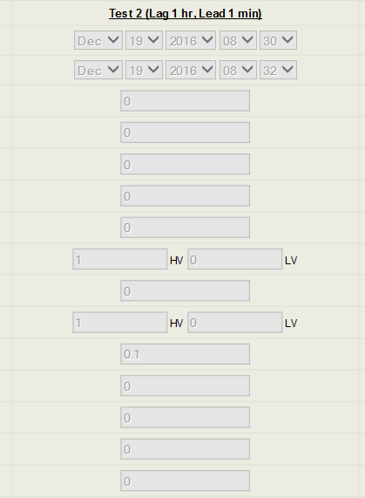
IRR Leading Test 2
Notes:
Submit 0’s or 1’s where applicable

Slide 7
Common Form Issues Cont.
NDCRC will time out after several minutes
  Save the test form periodically
Lagging Test 1 can be any 15 minute period within the duration of Lagging Test 2
Gross MW and MVAR should be measured at the Generator terminals

Slide 8
Demo

Slide 9
Q&A

