Slide 1
February 2017 – May 2017 SCT
ERS Procurement Update to DSWG
Mark Patterson
February 16, 2017

Slide 2
Time Period 1 Procurement
Clearing Price: $20.45
MW Procured: 875.569
MW Not Procured: 0.45
Resources Procured: 385
Resources Not Procured: 3
Expenditure Limit | $4,653,454.51
Amount Spent | $4,565,873.44
Unspent | $87,581.06
 | NWS ERS-10 | NWS ERS-30 | WS ERS-30
MW Procured | 304.071 | 570.588 | 0.91
ERS Generators (Resources) Procured | 9 | 17 | 0
Number of Resources Procured | 128 | 256 | 1

Slide 3
Time Period 2 Procurement
Clearing Price: $11.33
MW Procured: 940.404
MW Not Procured: 1.03
Resources Procured: 454
Resources Not Procured: 5
Expenditure Limit | $4,653,454.51
Amount Spent | $4,528,280.36
Unspent | $125,174.14
 | NWS ERS-10 | NWS ERS-30
MW Procured | 314.139 | 626.265
ERS Generators (Resources) Procured | 9 | 17
Number of Resources Procured | 138 | 316

Slide 4
Time Period 3 Procurement
Clearing Price: $1.96
MW Procured: 921.668
MW Not Procured: 7.56
Resources Procured: 456
Resources Not Procured: 11
Expenditure Limit | $465,345.45
Amount Spent | $460,649.67
Unspent | $4,695.78
 | NWS ERS-10 | NWS ERS-30 | WS ERS-30
MW Procured | 312.787 | 608.201 | 0.68
ERS Generators (Resources) Procured | 9 | 17 | 0
Number of Resources Procured | 136 | 319 | 1

Slide 5
Time Period 4 Procurement
Clearing Price: $19.93
MW Procured: 913.043
MW Not Procured: 0.44
Resources Procured: 424
Resources Not Procured: 3
Expenditure Limit | $4,653,454.51
Amount Spent | $4,640,221.48
Unspent | $13,233.02
 | NWS ERS-10 | NWS ERS-30 | WS ERS-30
MW Procured | 307.631 | 604.502 | 0.91
ERS Generators (Resources) Procured | 9 | 17 | 0
Number of Resources Procured | 133 | 290 | 1

Slide 6
Time Period 5 Procurement
Clearing Price: $12.08
MW Procured: 887.918
MW Not Procured: 0.95
Resources Procured: 374
Resources Not Procured: 6
Expenditure Limit | $2,792,072.70
Amount Spent | $2,735,142.61
Unspent | $56,930.10
 | NWS ERS-10 | NWS ERS-30
MW Procured | 301.799 | 586.119
ERS Generators (Resources) Procured | 9 | 17
Number of Resources Procured | 126 | 248

Slide 7
Time Period 6 Procurement
Clearing Price: $2.27
MW Procured: 800.652
MW Not Procured: 2.15
Resources Procured: 334
Resources Not Procured: 6
Expenditure Limit | $2,616,883.83
Amount Spent | $2,606,266.38
Unspent | $10,617.45
 | NWS ERS-10 | NWS ERS-30
MW Procured | 285.273 | 515.379
ERS Generators (Resources) Procured | 9 | 17
Number of Resources Procured | 121 | 213

Slide 8
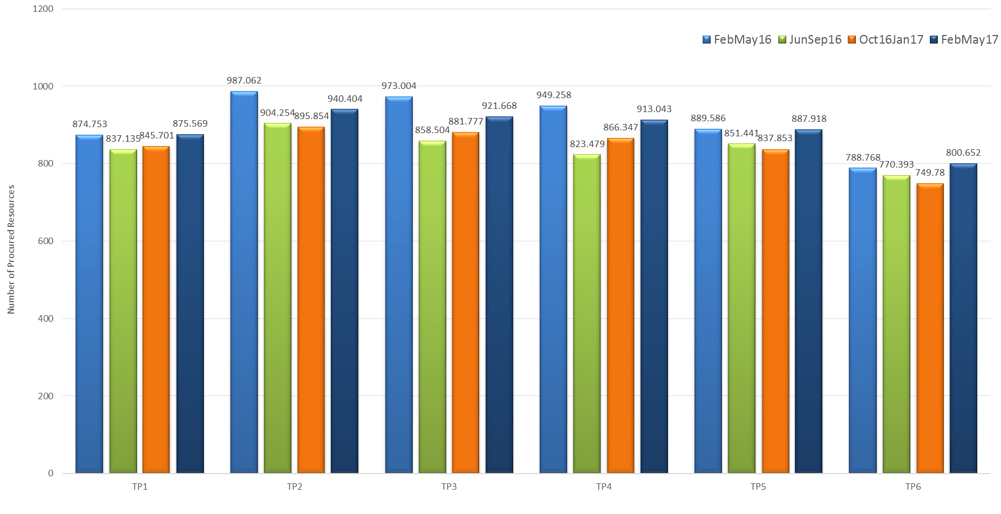
ERS MW Procurement

Slide 9
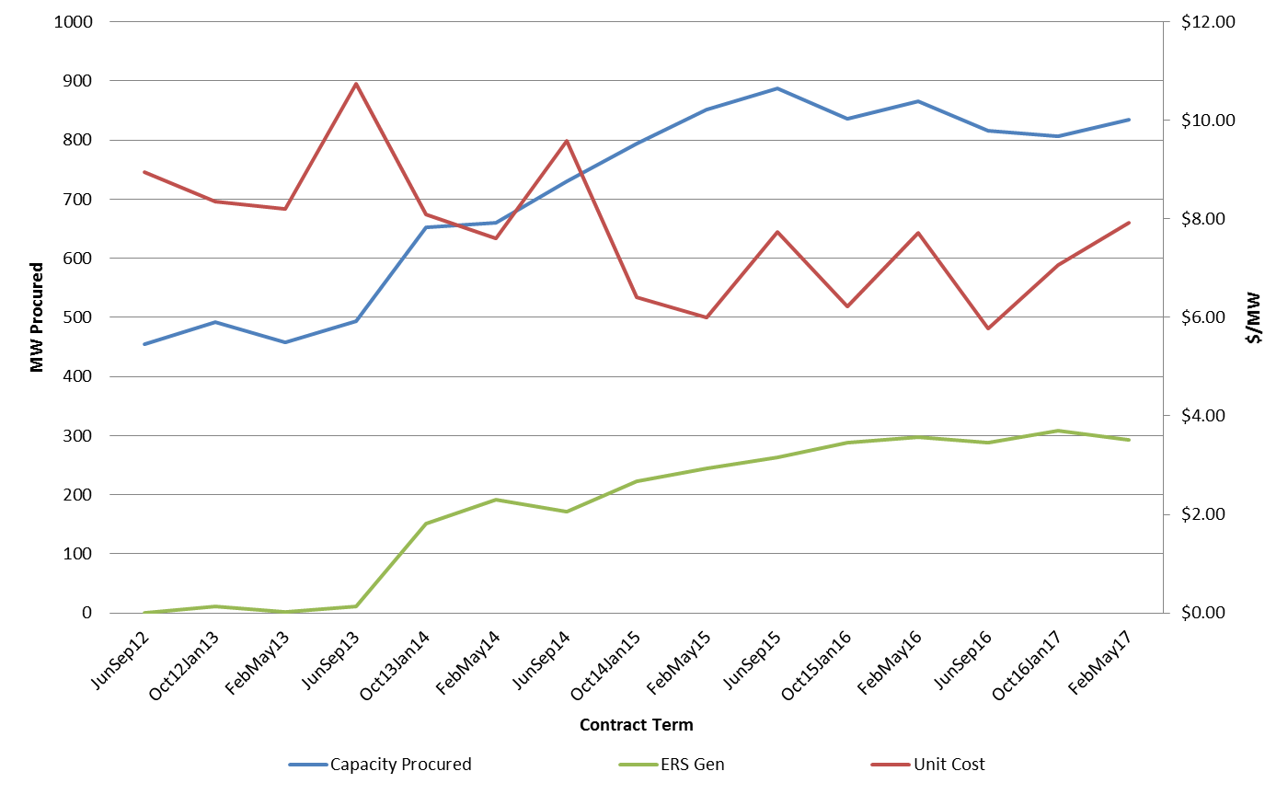
Emergency Response Service (ERS) Trends

Slide 10
Procurement Expenditure Limit Allocation Table

Slide 11
http://www.ercot.com/committee/dswg

