Slide 1
Ancillary Service Enhancements Discussion
QMWG – 01/30/2017
DSWG – 02/16/2017
ERCOT Staff

Slide 2
Items requested at Jan 13, 2017 QMWG meeting
Dynamic study (using the criteria described below) that shows the frequency profile post LRs response in Case 1 (100 GW.s inertia).
LRs on Under-Frequency Relay trigged at 59.70 Hz carrying 2600 MW of RRS
Gen RRS at 1150 MW
Size of unit trip that would cause frequency to hit 59.70 Hz (985 MW)
Information about head-room availability (i.e. ability to respond to frequency overshoot) during low-load and low-wind scenarios
Gen - Low Dispatch Limit (LDL),
Gen - Low Ancillary Service Limit (LASL)
Gen - Low Ancillary Service Limit (LSL)
Limit on Fast Frequency Response (FFR1) as a sub-set of RRS

Slide 3
Identify Minimum Generation Loss to Trigger LRs on UFR at 59.70 Hz
All Governors Included
Notes:
Dynamic study to see what magnitude of unit trip would trigger LRs at 59.70 Hz to respond. Based on the study, 985 MW would be sufficient under a 100 GW.s inertia case to hit 59.70 Hz. At this level our RRS LRs participation is expected to be 2600 MW.

Slide 4
Frequency Overshoot
2000 MW Load Loss
Governor Response:
All online units excluding wind
985 MW Generation Loss
* Assume 80% of Wind Generation Providing Governor Response

Slide 5
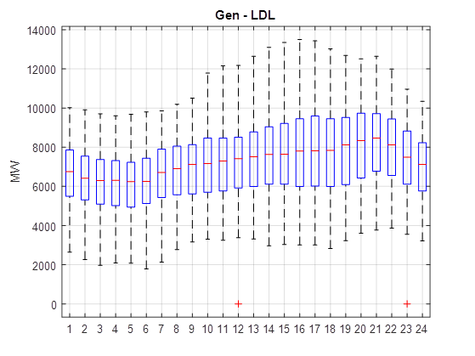
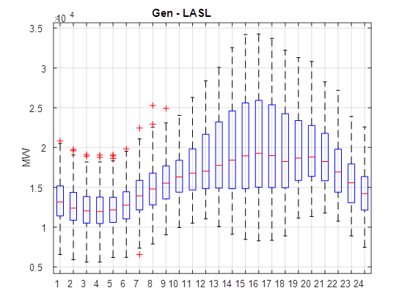
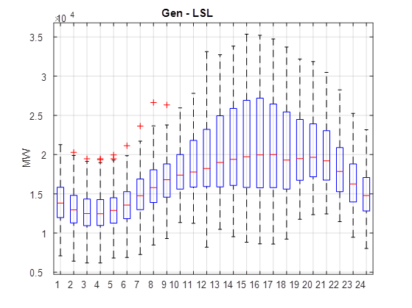
Generation Ramp Down Capability (2016)
Notes:
One of the question we got was, what happens if you rely too much on load when you have really low load and low wind conditions where all the conventional units are sitting at their LSL and they are physically incapable of responding to frequency overshoot.
Minimum Gen-LDL info shows that in 2016, the lower hourly average number was slightly below 1800 MW. This is the amount that can be ramped-down in 5 minutes.
Minimum GEN-LASL was higher than 5000 MW and then minimum Gen-LSL was greater than 6000 MW
The point is really, there is no scenario during the low load and low wind period where all of the conventional generation would be sitting at LSL

Slide 6
Top 5 Hours with Low-Load and Low-Wind in 2016
 | Hourly Load (MW) | Hourly Wind (MW) | Hourly Net-load (MW) | LASL** (MW) | Gen-LDL (MW) | Gen-LASL (MW) | Gen-LSL (MW)
2/15/2016 2:00 | 25942 | 2264 | 23678 | 13434 | 3792 | 9700 | 10003
3/10/2016 2:00 | 25984 | 1607 | 24376 | 13140 | 3275 | 9089 | 9463
3/10/2016 3:00 | 25965 | 1920 | 24045 | 13494 | 3348 | 8692 | 9136
3/12/2016 3:00 | 25743 | 540 | 25203 | 14693 | 3608 | 8161 | 9063
3/12/2016 4:00 | 25792 | 525 | 25267 | 14754 | 2923 | 7150 | 9192
*The minimum hourly load in 2016 is 25,146 MW @ 4:00 AM on 3/27/2016.
** Exclude nuclear units

Slide 7
In Summary
Our studies shows that the 50% limit on Load Resources providing RRS can be removed.
Minimum 1150 MW of RRS has to come from Generators. RRS quantities beyond 1150 MW can be provided by Load Resources.
There is sufficient head-room to respond to a frequency overshoot as seen with 2016 data.

Slide 8
Items requested at Jan 13, 2017 QMWG meeting
3. Limit on Fast Frequency Response (FFR1) as a sub-set of RRS??

Slide 9
FFR1
FFR1 supports frequency at 59.8 Hz instead of 59.7 Hz.
Provide full response in 30 cycles similar to LRs which respond at 59.7 Hz.
Most events would not activate existing LRs which respond at 59.7 Hz. So these LRs will have higher probability of being available for the next event.
After FFR1 responds it can be recalled and be ready for the next event in less than 10 minutes
If deployed, FFR1 can reset in 10 minutes and be ready for the next event whereas existing LRs have 3 hours to reset.
The proposed limit on the next slide is based on studies that indicate that no frequency overshoot (exceeding 60.09 Hz) is expected as long as FFR1 amounts are limited.

Slide 10
FFR1 - Limit
* Assume 1150 MW PFR

Slide 11
Questions?

Slide 12
Overshoot Study Assumptions
Assuming Wind Governors Operating with 5% droop
3Hz Frequency deviation leads to 1 p.u. output change of wind generation
*0.241Hz Frequency deviation leads to 0.0803p.u. output change of wind generation
Wind HSL is at 9700MW
Estimated wind governor response is 9700*0.0803*80%=623 MW
Loss of 2000 MW Load(w/o Wind Governor Response) ≈ Loss of 1377 MW Load (w/ Wind Governor Response)
Inertia Definition:
$$System Inertia= \sum_{i}^{I}{H_{i}×{MVA}_{i}}$$
$I$: Set of all on-line synchronous units
$H_{i}$: Inertia Constant in MW.s/MVA for unit i
${MVA}_{i}$: Machine rating for unit i
* Case1

