Slide 1
ERS Document Changes Associated with New SAS Implementation
DSWG – February 16, 2017

Slide 2
Overview
ERCOT uses SAS as the software system for virtually all of our ERS processing
ERCOT is migrating our SAS platform from the current client/server environment to a grid computing environment
Migration to grid computing environment will be complete prior to the October 2017/January 2018 Standard Contract Term (August 2017)
SAS Grid computing will require modifications for ERCOT in sending outbound submission type workbooks to QSEs
  The DDE functionality ERCOT has been using to create Excel workbooks in SAS during the ERID and Award Notification processes will no longer be available
No changes for test analysis, contract performance, settlement reports
No changes to current incoming submission form. QSE should use the current version of the form posted to the ERS page. (form is subject to change every contract term)
ERCOT will start using a secure exchange method for ERS Resource and Site information
WebEx information

Slide 3
Modifications of ERS File Outbound Formats
With the elimination of DDE, ERS team will have to change all outbound submission type workbooks to column oriented formats
  For ERIDs elimination of ‘Identification’, ‘Contract Hours’, and ‘R’ tabs
  All comments would be eliminated
  ‘Exceptions’, ‘Availability’ and ‘Baseline_Info’ tabs -- no change

Slide 4
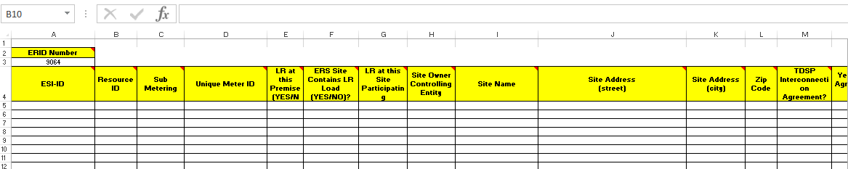
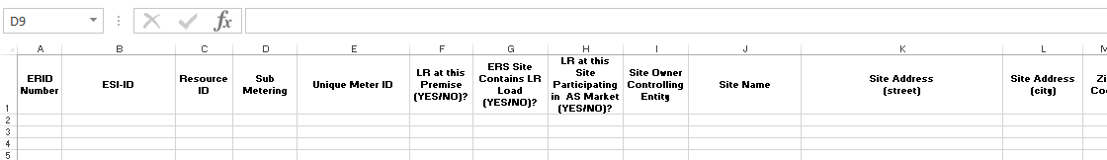
Modifications of ERS File Outbound Formats
EXCEL example of Alt tab in ERID
  Modify the ‘ALT’ tab
    Eliminate the ‘ERID Number’ cells (A2 and A3)
    Insert a column on the left (left of the ESIID column) with title ‘ERID Number’
    Comments (red triangle) and highlighting eliminated
    All other columns remain and stay in same order
Current Site Information
Future Site Information

Slide 5
Modifications of ERS File Outbound Formats
EXCEL example ERID Rtab (continued)
  Split resource tab into two tabs
    Resource Information tab … tab name ‘resource name_RES’
    Site information tab … tab name ‘resource name_SITE’
  Comments (red triangle) and highlighting eliminated
  Drop-down lists eliminated
  Resource Information shifted into column orientation

Slide 6
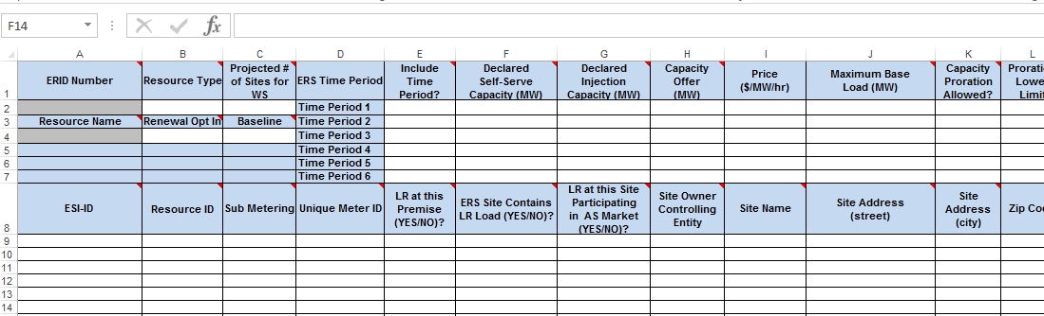
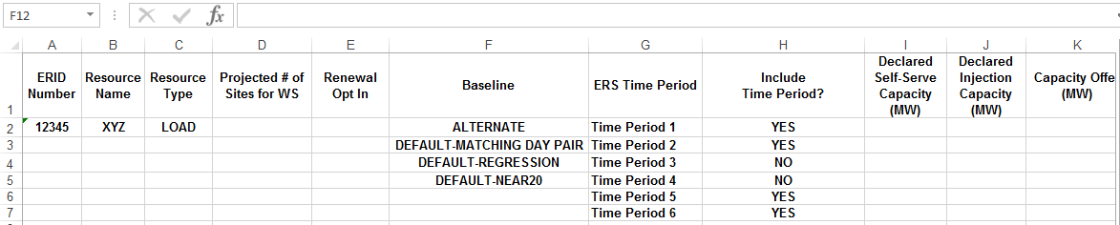
Modifications of ERS File Outbound Formats
EXCEL example ERID (continued)
Current Resource
Info
Future Resource
Info

Slide 7
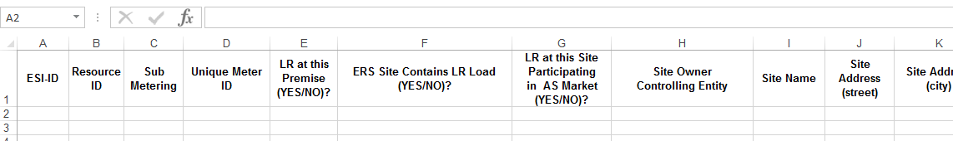
Modifications of ERS File Outbound Formats
EXCEL example ERID (continued)
Current Site Info
Future Site Info

Slide 8
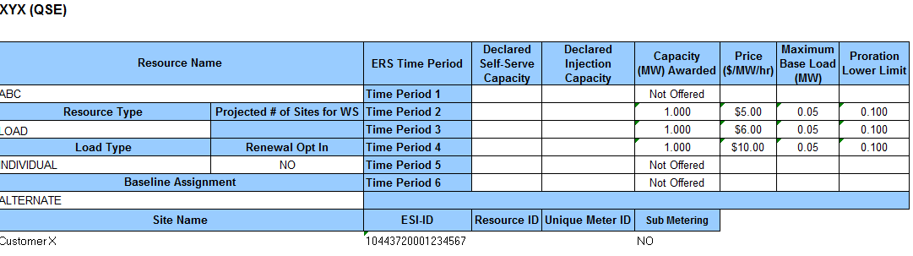
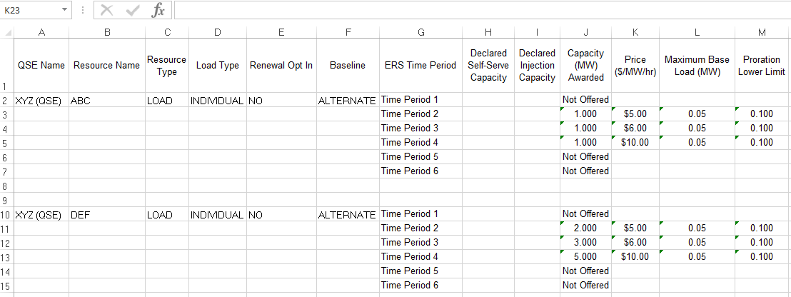
Modifications of ERS File Outbound Formats
EXCEL example Award notice
  Resource Information shifted into column orientation
  Eliminate Site information and highlighting
Current Awards
Notice
(Multiple Tabs)
Future Award Notice
(One Tab)

Slide 9
Secure exchange method

Slide 10
Secure exchange method of ERS Resources and Sites information for email
QSE will send in files containing any confidential information to ERS using the secure exchange method. This applies to:
  ERID submissions
  Offer submissions
  Unavailability/Planned Maintenance/Self Test
  Substitution submission
  Supplemental submission
  Meter Data
Except for items that are posted to the MIS, ERCOT will send out files containing any confidential information to QSE using the secure exchange method.
  ERS WS Control Groups

Slide 11
WebEx – Outbound workbook changes and secure file exchange
Thursday, March 2, 2017 2:00 pm CST
Meeting number (access code): 625 939021
Meeting password: DR030217
QSE’s should have appropriate personal on the call for more details of upcoming changes

Slide 12
Next Steps
March 2, 2017 2:00pm Central Time – WebEx
Beginning June-September 2017 SCT, ERCOT and QSE’s will only send secure exchange files (email with site and resource information)
Beginning June-September 2017 (April 2017) - ERCOT will produce outbound files in both existing and new format (optional for QSE)
Beginning Oct17Jan18 SCT (Aug 2017) – ERCOT will only produce outbound files in new format

Slide 13
Questions?
ON
OFF

