Slide 1
Solar Penetration Impact on Resource Adequacy
Supply Analysis Working Group Meeting, 2/1/2017

Slide 2
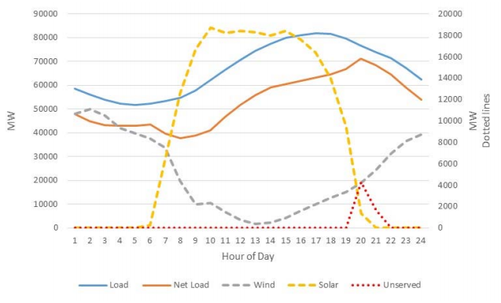
LTSA “Key Findings” Chart – 2031 July Day
Net-peak resource adequacy challenge

Slide 3
Solar PV Interconnection Requests
Cumulative Totals

Slide 4
Capacity, Demand and Reserves (CDR) Report
Resource issues?
Solar penetration growing, but capacity levels relatively small during the five-year CDR time horizon
CDR does not capture supply-side and demand-side responses that would address solar capacity drop-off issues in the long term
Net Peak Load accounting
Load forecast issues?
Disparity between historical rate of distributed solar penetration embedded in load forecast vs. future rate trends

