Slide 1
PDCWG Report to ROS
Chair: Percy Galliguez, Brazos Electric Power Cooperative, Inc.
Vice Chair: Lei Ye, Austin Energy
ROS
February 2nd, 2017

Slide 2
Report Overview & Notes
Report Overview
  Meeting Minutes
  BAL-001-TRE-1 FMEs & IMFR
    3 FMEs in the month of January
    BAL-001-TRE-1 Unit Performance Report now includes Solar resources.
  Frequency Control Report

Slide 3
Meeting Minutes
PDCWG Meeting 1/18/17
  Regulation & Frequency Control Reports
  GREDP Performance Analysis
  MOD-026-1 & MOD-027-1 Discussion
    NOGRR Proposal/Review Status
  Initiated an unofficial subgroup of PDCWG to review and propose changes to BAL-001-TRE-1.
    PDCWG has a list of initial proposals to review.
    Led by Chad Mulholland from NRG
    One initial proposal is reviewing the Ramp Adjustment calculation for PUPFR and PSPFR.
  Reviewed Frequency Events
    12/23/2016 16:54:13
      Loss of 570MW
      627 MW/0.1HZ Response
      7 of 38 Generation Resources providing RRS had less than 75% of their expected Initial Primary Frequency Response.
      7 of 38 Generation Resources providing RRS had less than 75% of their expected Sustained Primary Frequency Response

Slide 4
Frequency Measurable Events Performance
January 2017

Slide 5
Frequency Measurable Events
There were 3 FMEs in January.
  1/6/2017 23:58:52
    Loss of 731 MW
    Interconnection Frequency Response: 1,125 MW/0.1 Hz
    14 of 47 Evaluated Generation Resources had less than 75% of their expected Initial Primary Frequency Response.
    14 of 47 Evaluated Generation Resources had less than 75% of their expected Sustained Primary Frequency Response.
  1/10/2017 15:13:18
    Loss of 404 MW
    Interconnection Frequency Response: 641 MW/0.1 Hz
    19 of 47 Evaluated Generation Resources had less than 75% of their expected Initial Primary Frequency Response.
    20 of 47 Evaluated Generation Resources had less than 75% of their expected Sustained Primary Frequency Response.

Slide 6
Frequency Measurable Events
  1/23/2017 21:50:20
    Loss of 796 MW
    Interconnection Frequency Response: 2,095 MW/0.1 Hz
    3 of 42 Evaluated Generation Resources had less than 75% of their expected Initial Primary Frequency Response.
    5 of 42 Evaluated Generation Resources had less than 75% of their expected Sustained Primary Frequency Response.

Slide 7
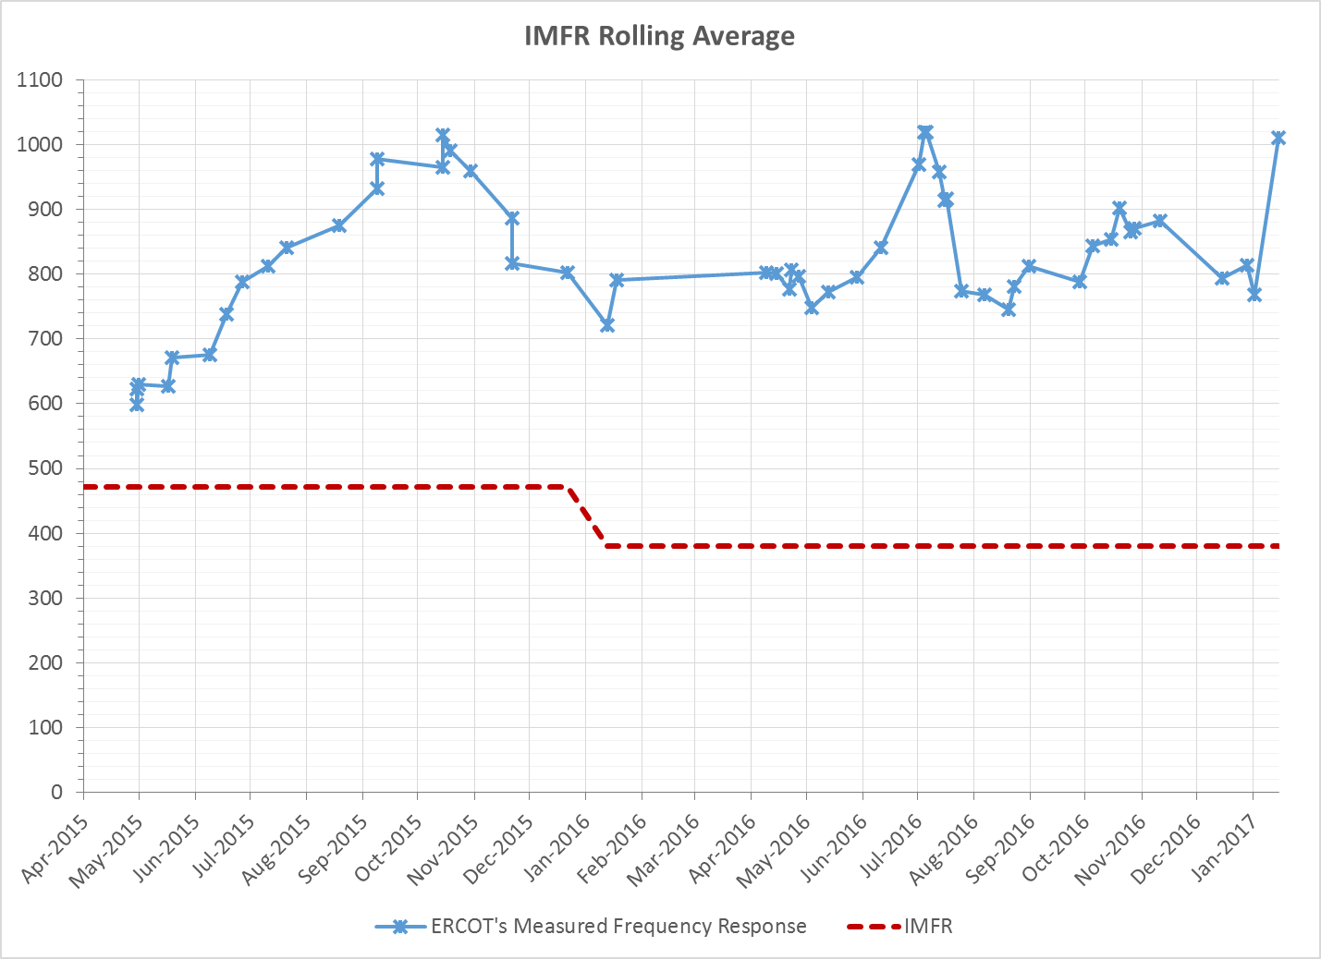
Interconnection Minimum Frequency Response (IMFR) Performance
IMFR Performance currently 1010.23 MW/0.1Hz

Slide 8
Frequency Control Report
January 2017

Slide 9
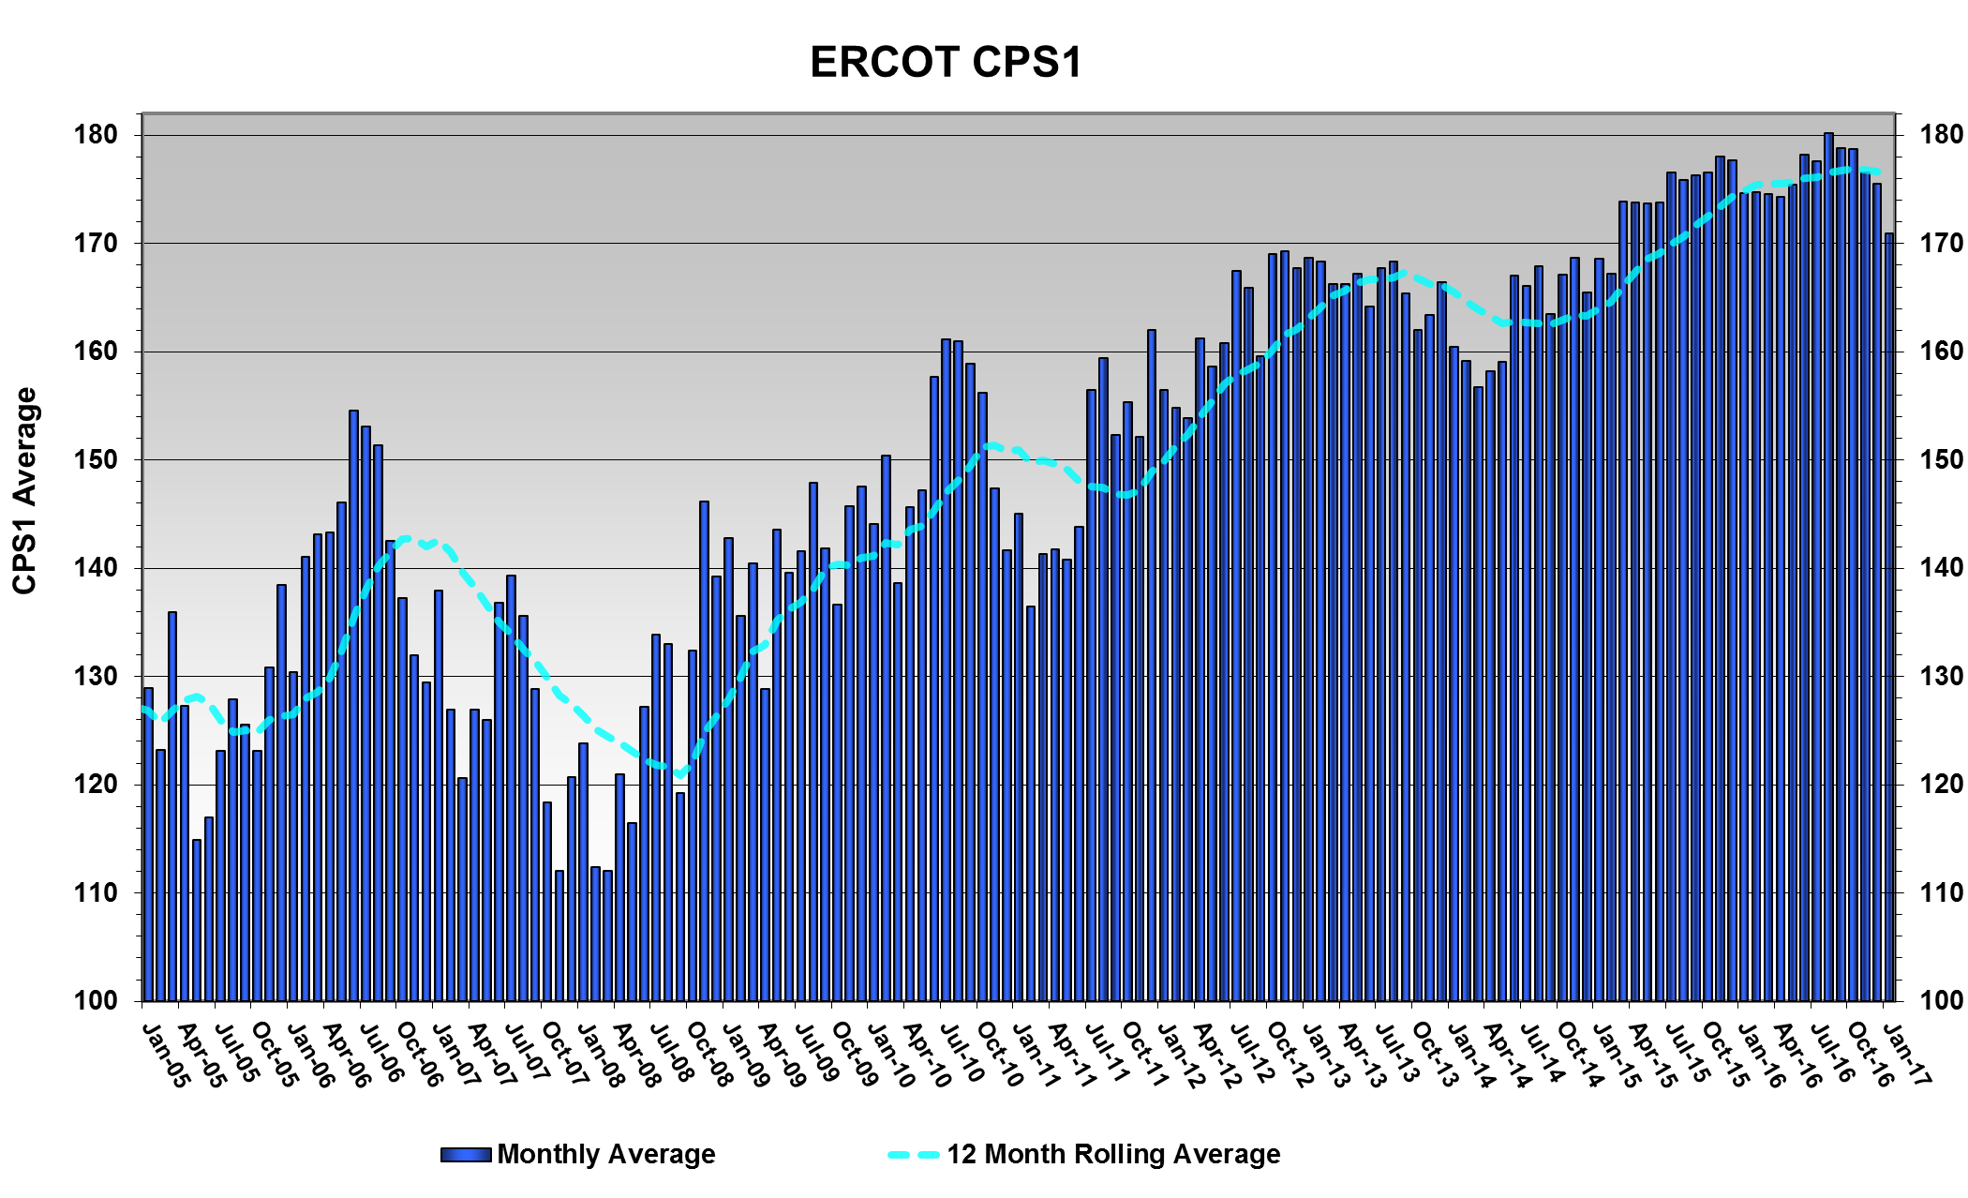
CPS1 Performance
CPS1 12 Month Rolling Average = 176.31%

Slide 10
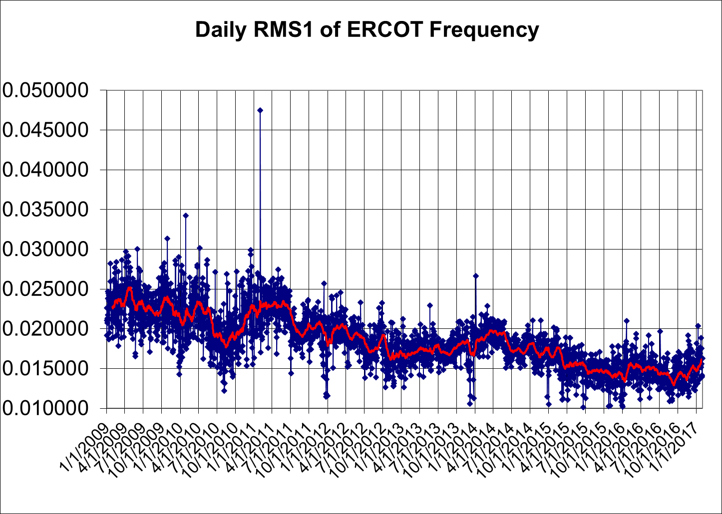
RMS1 Performance of ERCOT Frequency

Slide 11
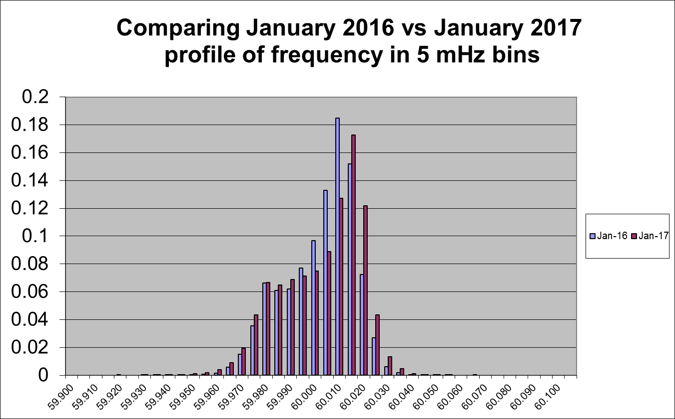
Frequency Profile Analysis

Slide 12
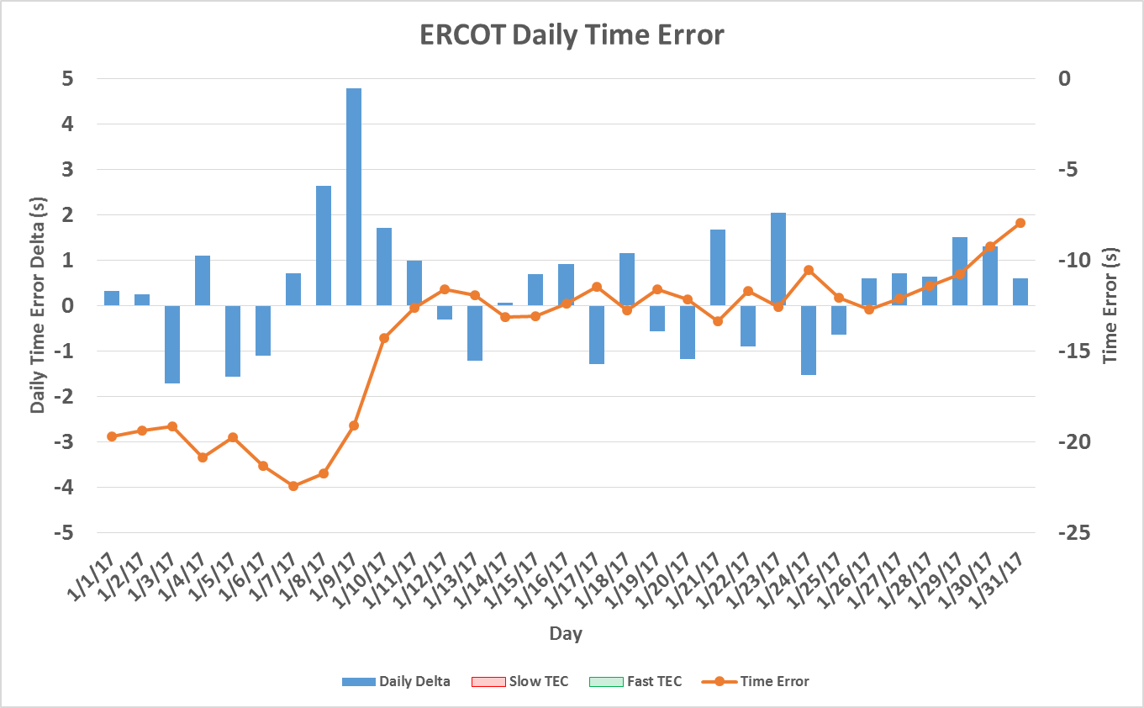
Time Error Corrections
There was no Time Error Corrections (TEC) in January
Notes:
TEC occurred on 12/03/2016 at 23:30. Time Error was 30.06

Slide 13
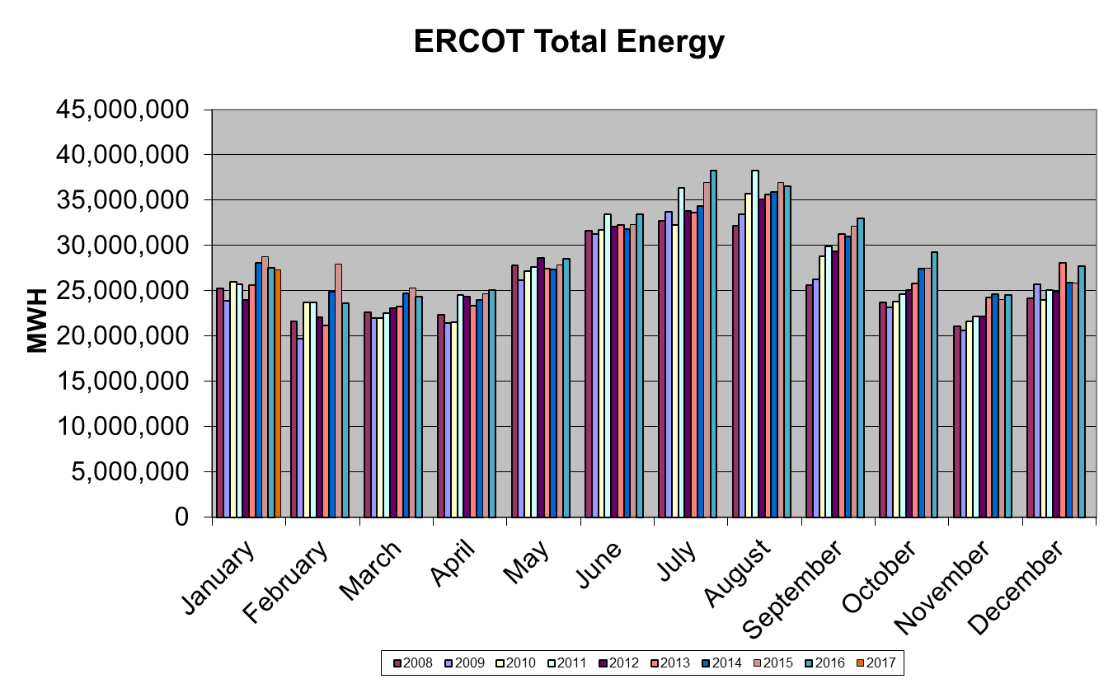
Wind Generation Performance

Slide 14
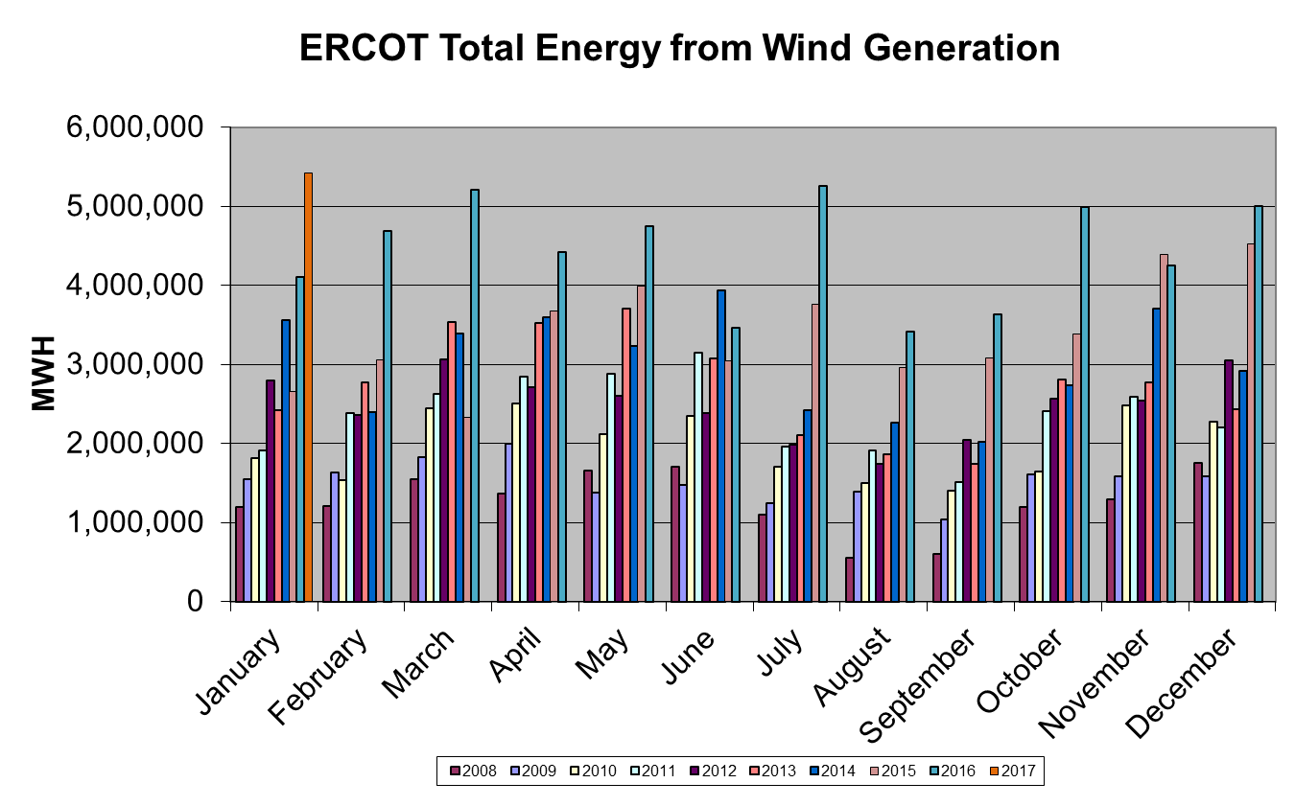
Wind Generation Performance

Slide 15
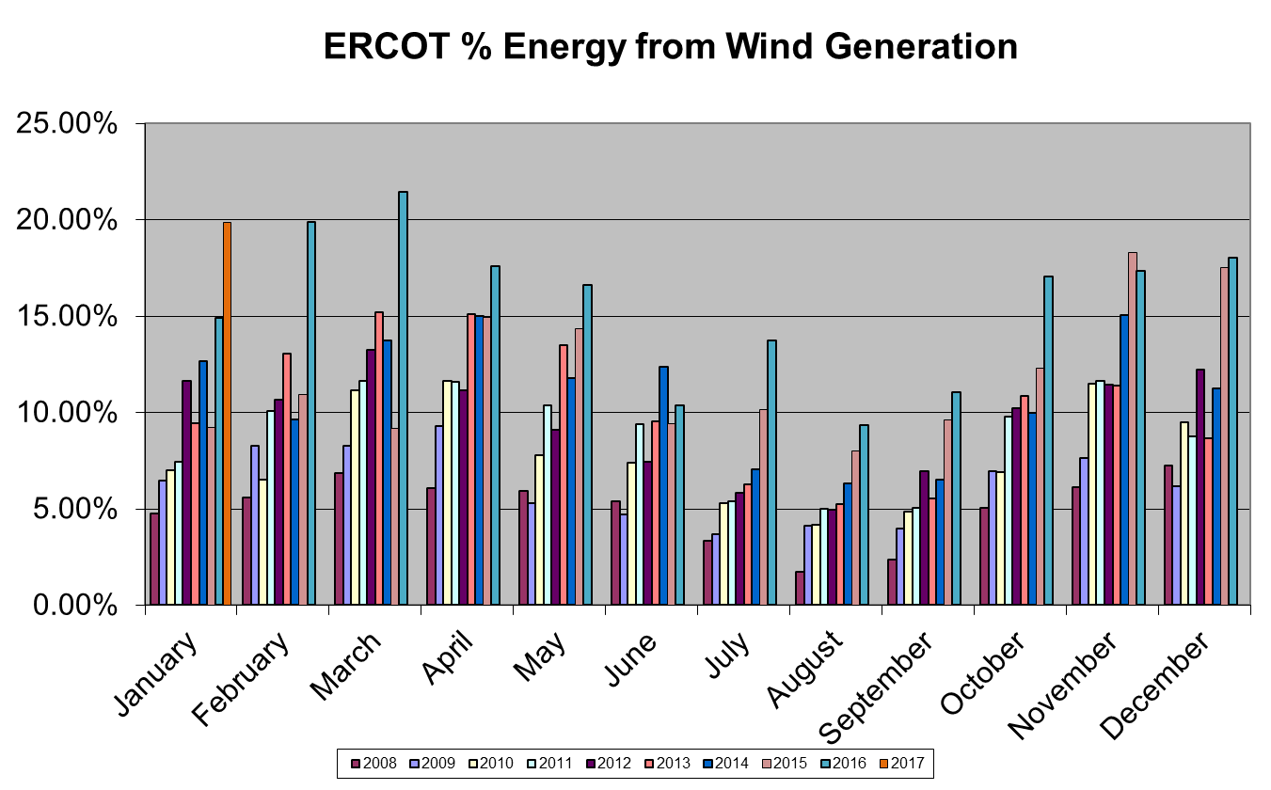
Wind Generation Performance

Slide 16
Questions?

