Slide 1
IAS Stats by REP
As of 02/01/2017
David Michelsen
Manager Retail Operations
Retail Market Subcommittee
02/07/2017

Slide 2
Agenda
November 2016 - IAG/IAL Statistics
Top 10 - November 2016 - IAG/IAL
Top 10 - 12 Month Average IAG/IAL
Explanation of IAG/IAL Stats
Top - 12 Month Average Rescission
Explanation of Rescission Stats
18 Month Running Market Totals
Questions

Slide 3
November 2016 - IAG/IAL Statistics
Total IAG+IAL % of Total Enrollments: 1.14%
IAG/IAL % Greater Than 1% of Enrollments
Total IAG+IAL Count: 1,866
IAG/IAL % Less Than 1% of Enrollments
Total IAG+IAL Count: 1,077
Retail Electric Provider Counts
 | Percent of Enrollments Resulting in IAG/IAL
Enrollment Total | .00% to .25% | .26% to .50% | .51% to .75% | .76% to 1.00%
<= 500 | 1 | 4 | 4 | 2
> 500 and <= 2500 | 2 | 2 | 7 | 5
> 2500 | 1 | 0 | 4 | 4
Retail Market Subcommittee
02/07/17

Slide 4
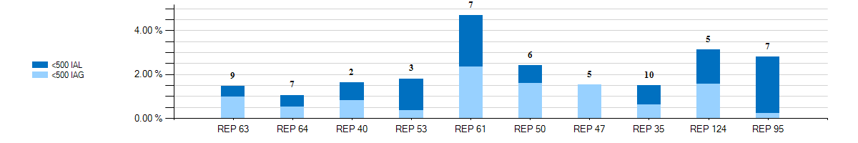
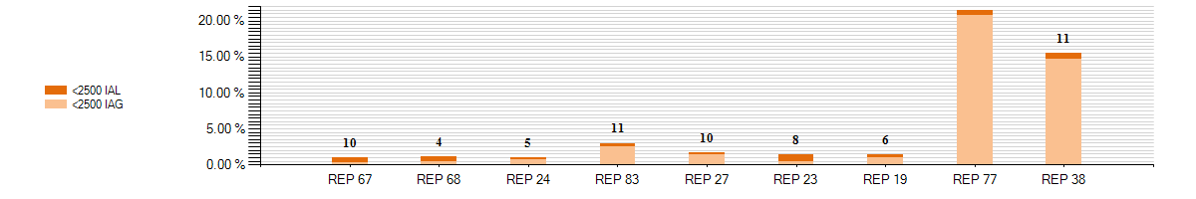
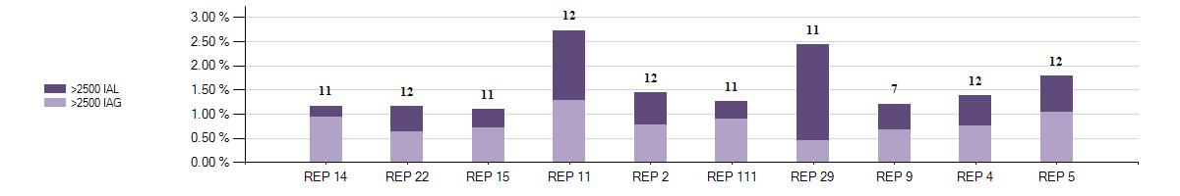
Top 10 - November 2016 - IAG/IAL % Greater Than 1% of Enrollments
With number of months Greater Than 1%
8
Retail Market Subcommittee
02/07/17

Slide 5
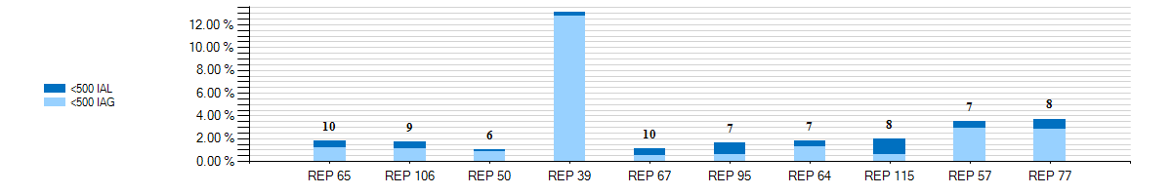
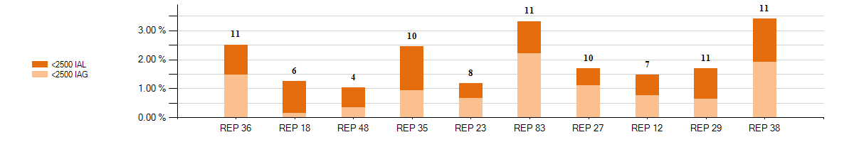
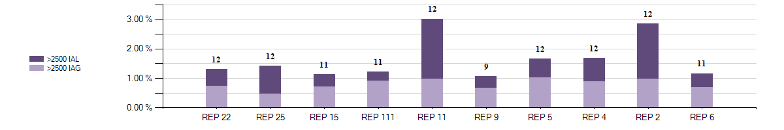
Top 10 - 12 Month Average IAG/IAL % Greater Than 1% of Enrollments thru November 2016 With number of months Greater Than 1%
3
Retail Market Subcommittee
02/07/17

Slide 6
Explanation of IAG/IAL Slides Data
NOTE:
The IAG/IAL totals and percentages in this presentation are calculated using the counts of the Acknowledged Inadvertent Gaining REP Only in both IAG and IAL issues. If the Gaining REP in a submitted IAL issue does not agree they are the Gaining REP, that issue will not be counted. The losing REP is not represented in any of the Totals or Percentages in any data contained in this presentation.
The page 3 chart shows a count of REPs whose IAG/IAL percentage of their total enrollments is below 1%.
  Blue row shows counts of REPs that have less than 500 total enrollments by their percentage ranges
  Orange row shows counts of REPs that have between 500 and 2500 total enrollments by their percentage ranges
  Purple row shows counts of REPs that have greater than 2500 total enrollments by their percentage ranges
Retail Market Subcommittee
02/07/17

Slide 7
Explanation of IAG/IAL Slides Data (Cont)
The page 4 charts show the top 10 REPs whose IAG/IAL percentage of their total enrollments is above 1%.
  The blue chart shows enrollment totals of less than 500 for the month being reported
  The orange chart shows enrollment totals between 500 and 2500 for the month being reported
  The purple charts show enrollment totals of over 2500 for the month being reported
  REPs with the lowest AG/IAL totals start on the left, and move to the highest counts on the right
The page 5 charts show the top 10 REPs whose 12 month average IAG/IAL percentage of their total enrollments is above 1%.
  The blue chart shows enrollment total averages of less than 500 for the month being reported
  The orange chart shows enrollment total averages between 500 and 2500 for the month being reported
  The purple charts show enrollment total averages of over 2500 for the month being reported
  REPs with the lowest IAG/IAL averages start on the left, and move to the highest counts on the right
  Number labels represent the number of months the REP has been over 1% during the 12 month period
Retail Market Subcommittee
02/07/17

Slide 8
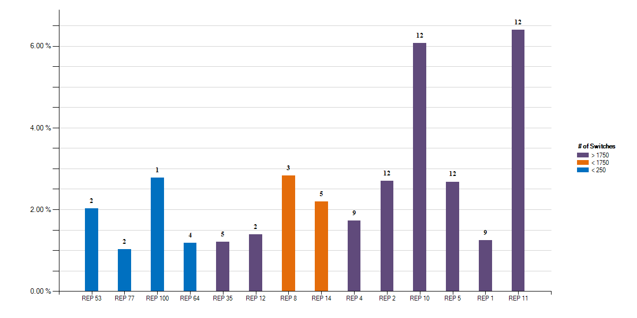
Top - 12 Month Average Rescission % Greater Than 1% of Switches thru November 2016 With number of months Greater Than 1%
Retail Market Subcommittee
02/07/17

Slide 9
Explanation of Rescission Slide Data
The page 8 charts show the top REPs whose 12 month average Rescission percentage of their total Switches is above 1%.
  The blue shades show switch totals of less than 250 for the month being reported
  The orange shades show switch totals between 250 and 1750 for the month being reported
  The purple shades show switch totals of over 1750 for the month being reported
  The REPs with the lowest count of rescission totals start on the left, and move to the highest counts on the right
  Number labels represent the number of months the REP has been over 1% during the 12 month period
Retail Market Subcommittee
02/07/17

Slide 10
18 Month Running Market Totals
 | Enrollments |  |  | IAG, IAL, Rescission |  |  |  |  | Days to Resolution
Month | SWI | MVI | Total | IAG | IAL | Rescission | IAG,IAL,Res Total | Overall % | IAG | IAL | Rescission
2015-06 | 102,661 | 247,089 | 349,750 | 2,023 | 1,557 | 1,120 | 4,700 | 1.34% | 13 | 16 | 11
2015-07 | 91,211 | 263,233 | 354,444 | 2,220 | 1,589 | 888 | 4,697 | 1.33% | 11 | 15 | 10
2015-08 | 81,674 | 248,124 | 329,798 | 1,933 | 1,433 | 820 | 4,186 | 1.27% | 11 | 15 | 11
2015-09 | 70,342 | 229,405 | 299,747 | 1,780 | 1,339 | 860 | 3,979 | 1.33% | 11 | 13 | 9
2015-10 | 65,276 | 215,908 | 281,184 | 1,761 | 1,345 | 842 | 3,948 | 1.40% | 10 | 13 | 8
2015-11 | 52,887 | 181,098 | 233,985 | 1,591 | 1,314 | 785 | 3,690 | 1.58% | 11 | 14 | 10
2015-12 | 61,486 | 189,862 | 251,348 | 1,702 | 1,521 | 755 | 3,978 | 1.58% | 11 | 13 | 9
2016-01 | 63,954 | 193,716 | 257,670 | 1,536 | 1,391 | 1,055 | 3,982 | 1.55% | 9 | 10 | 7
2016-02 | 68,057 | 212,474 | 280,531 | 1,672 | 1,509 | 848 | 4,029 | 1.44% | 9 | 11 | 7
2016-03 | 76,235 | 218,245 | 294,480 | 1,784 | 1,612 | 839 | 4,235 | 1.44% | 8 | 10 | 7
2016-04 | 70,300 | 199,804 | 270,104 | 1,784 | 1,457 | 855 | 4,096 | 1.52% | 8 | 9 | 6
2016-05 | 75,323 | 214,383 | 289,706 | 1,845 | 1,465 | 912 | 4,222 | 1.46% | 8 | 11 | 6
2016-06 | 86,376 | 247,481 | 333,857 | 2,332 | 1,661 | 1,026 | 5,019 | 1.50% | 9 | 11 | 6
2016-07 | 82,923 | 241,844 | 324,767 | 2,148 | 1,320 | 904 | 4,372 | 1.35% | 8 | 11 | 6
2016-08 | 86,656 | 268,781 | 355,437 | 2,183 | 1,383 | 818 | 4,384 | 1.23% | 8 | 12 | 7
2016-09 | 67,323 | 231,999 | 299,322 | 1,832 | 1,221 | 731 | 3,784 | 1.26% | 8 | 11 | 7
2016-10 | 64,452 | 220,958 | 285,410 | 1,798 | 1,135 | 726 | 3,659 | 1.28% | 9 | 12 | 7
2016-11 | 56,202 | 201,714 | 257,916 | 1,869 | 1,074 | 723 | 3,666 | 1.42% | 9 | 13 | 8
Retail Market Subcommittee
02/07/17

Slide 11
IAS Stats by REP
Questions?
Retail Market Subcommittee
02/07/17

