Slide 1
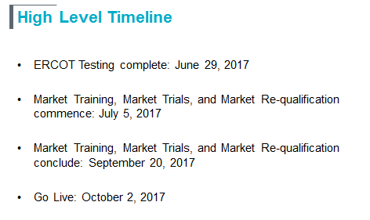
CMWG Update to WMS
CRR Framework Update:

Slide 2
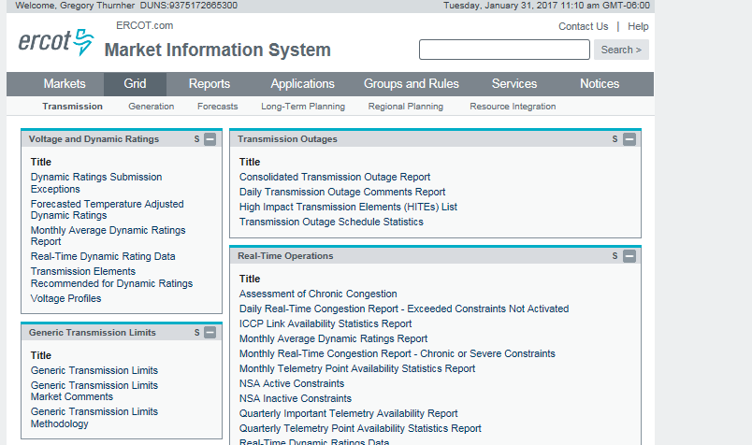
CMWG Update to WMS
Monthly Report on Chronic / Severe Constraints
MIS→Grid→Transmission→Real-time Operations

Slide 3
CMWG Update to WMS
Discussed and verified that GTCs were appropriately modeled (or not modeled) in CRR auction models
Reviewed NPRR 809 ERCOT comments
Considered
Extension of 3 year auction timeline
Effect of eliminating derations
Proposed
New leadership of CMWG in March, potential VC vacancy
CMWG/QMWG Merger to form EWG

