Slide 1
Market Credit Working Group update to the Wholesale Market Subcommittee
2/1/2017

Slide 2
MCWG update to WMS
NPRR811 Two Day Cure Period for Foreign Market Participant Guarantee Agreements.
This Nodal Protocol Revision Request (NPRR) changes the Foreign Market Participant Guarantee Agreement cure period from one to two days.
Timeline of Late Payment and Payment Breach reviewed by ERCOT staff.
Some concerns raise by CWG/MCWG members regarding compliance with CFTC exemption.
Tabled by CWG/MCWG at January meeting.

Slide 3
MCWG update to WMS
Disposition of SCR 785 Update RTL calculation to include Real-Time reserve Price Adder-based components
CWG/MCWG was in consensus that ERCOT should withdraw
Review of Credit Working Group charter and goals
No changes made to charter
Minor edits proposed for goals
Will be reviewed at Feb CWG/MCWG meeting

Slide 4
MCWG update to WMS
Endorsed Seasonal Adjustment Factors for Summer 2017
Effective Date | 2014 | 2015 | 2016 | 2017 Calculated | 2017 Proposed by CWG
1-Jun |  | 115% | 115% | 111% | 110%
1-Jul | 200% | 125% | 125% | 105% | 125%
1-Aug | 300% | 200% | 175% | 193% | 200%
1-Sep | 150% | 100% | 100% | 49% | 100%

Slide 5
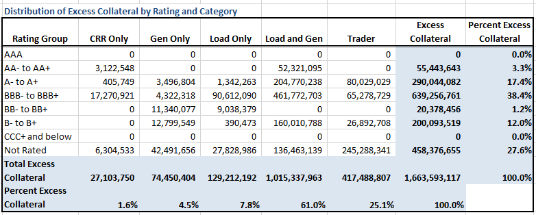
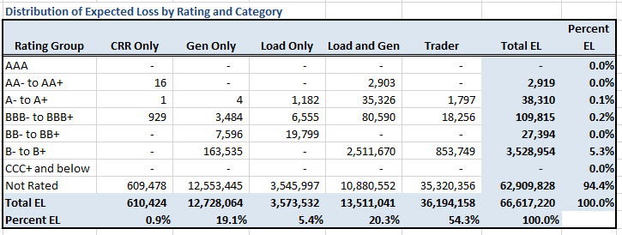
Credit Exposure and Expected Loss

