Slide 1
Analysis of Reliability Must-Run Resource Mitigated Offer Cap Curve Alternatives
David Maggio
Manager, Market Analysis and Validation
January 30th, 2017

Slide 2
Introduction
The information provided in this presentation is a continuation of the discussions that have been occurring at WMS since October ’16
The most recent presentation to WMS can be found at: Presentation to WMS - January '17
At the January ’17 meeting, two requests were made to ERCOT staff
Analyze a new methodology scenario of not having a shift factor cut-off (implemented in practice by having cut-off of 0%)
Begin a draft of potential protocol language that provided words around the concept that WMS has been discussing
This presentation covers both of these items

Slide 3
Additional Scenario Analysis

Slide 4
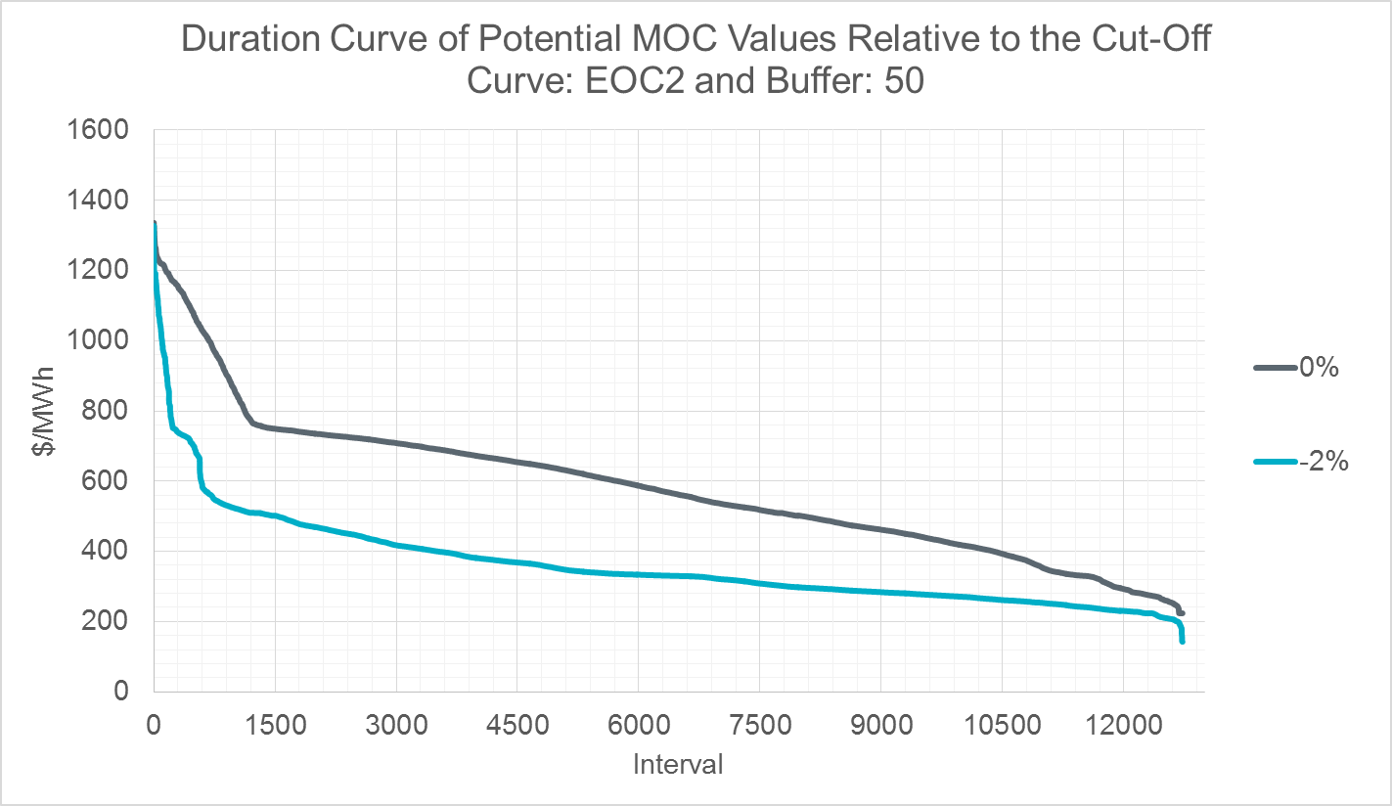
Impact of Changing the Shift Factor Cut-Off
For the graph below, a shift factor cut-off of 0% is compared to the previously presented scenario of a -2% cut-off
The non-RMR offer curve is the SCED Step 2 Energy Offer Curve (EOC2) and the buffer is 50

Slide 5
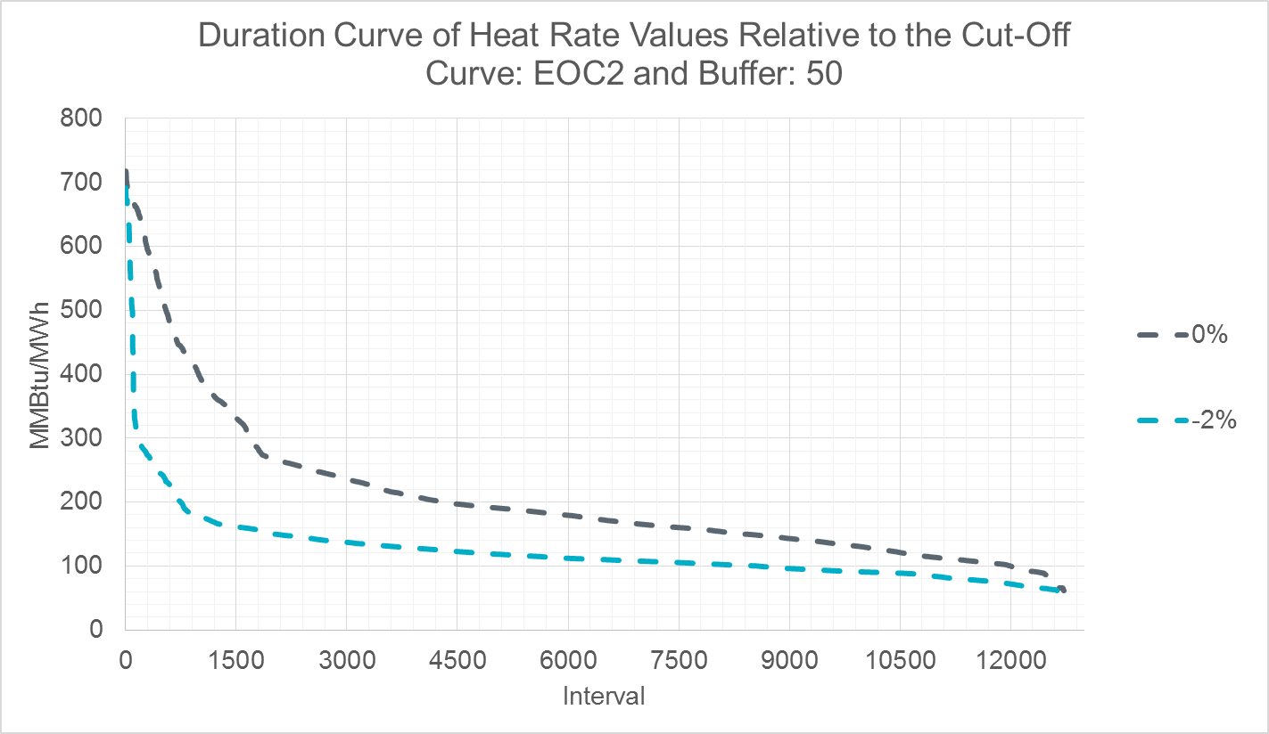
Using the Methodology to Determine a Heat Rate
An implementation option that warrants consideration is using the methodology to determine a heat rate, as opposed to a $/MWh value
The graph below shows the “heat rate” approach results for the same scenarios shown on the previous slide

Slide 6
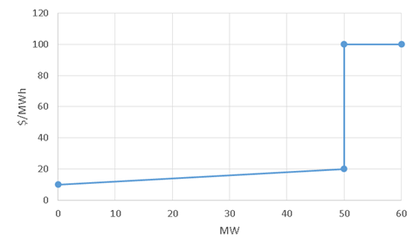
Impact of HSL Price Assumptions
During the most recent round of analysis, a sensitivity to assumptions about the “HSL price” was discovered
Consider the EOC2 below, where the non-RMR Resource’s HSL is 50 MW (which is a break point in the curve):
An assumption must be made about which price point to pick: 20 $/MWh or 100 $/MWh
For the data previously presented at WMS and the slides above, the value picked in the example would have been 100 $/MWh

Slide 7
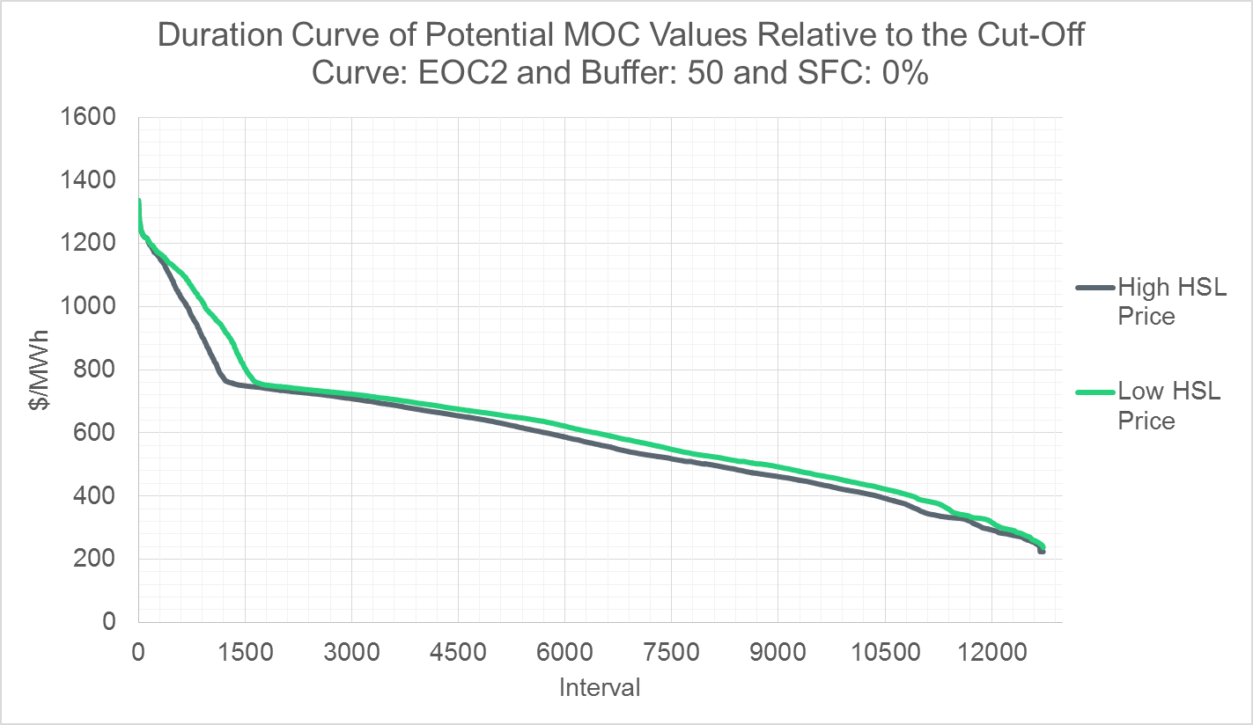
Impact of HSL Price Assumptions cont.
Changing this assumption does have some level of impact on a significant portion of the data points
The graph below looks at this impact for the scenario of using the EOC2, 50, and 0% for the non-RMR Resource offer curve, buffer, and shift factor cut-off, respectively
Similar impacts were observed for a -2% cut-off and for the “heat rate” approach

Slide 8
Statistical Measures
The table below provides some statistical measures for the scenarios discussed today (CURVE: EOC2 and BUFFER: 50)
Statistic | $/MWh Directly - High Price at HSL, where HSL is a Break Point |  | $/MWh Directly - Low Price at HSL, where HSL is a Break Point |  | Heat Rate - High Price at HSL, where HSL is a Break Point |  | Heat Rate - Low Price at HSL, where HSL is a Break Point
 | 0% | -2% | 0% | -2% | 0% | -2% | 0% | -2%
Count of Samples | 12,724 | 12,724 | 12,724 | 12,724 | 12,724 | 12,724 | 12,724 | 12,724
Average | 583 | 363 | 614 | 405 | 207 | 124 | 220 | 139
Standard Deviation | 204 | 136 | 212 | 167 | 117 | 60 | 128 | 83
Maximum | 1,336 | 1,327 | 1,336 | 1,327 | 717 | 692 | 717 | 692
90th Percentile | 760 | 510 | 904 | 571 | 358 | 166 | 419 | 180
75th Percentile | 702 | 411 | 718 | 463 | 231 | 135 | 244 | 144
Median | 568 | 331 | 603 | 362 | 174 | 111 | 182 | 120
25th Percentile | 439 | 277 | 467 | 297 | 137 | 93 | 141 | 101
10th Percentile | 331 | 242 | 349 | 257 | 108 | 79 | 111 | 91
Minimum | 224 | 143 | 237 | 83 | 62 | 48 | 62 | 27

Slide 9
Statistical Measures cont.
The same measures are provided below for the previously performed analysis (data presented to the WMS in January ’17)
Statistic | $/MWh Directly - High Price at HSL, where HSL is a Break Point
 | -2% | -5% | -10% | -15% | -2% | -5% | -10% | -15%
 | EOC2 | EOC2 | EOC2 | EOC2 | MOC | MOC | MOC | MOC
 | 50 | 50 | 50 | 50 | 50 | 50 | 50 | 50
Count of Samples | 12,724 | 12,724 | 12,724 | 12,724 | 12,724 | 12,724 | 12,724 | 12,724
Average | 363 | 205 | 170 | 157 | 449 | 256 | 226 | 225
Standard Deviation | 136 | 119 | 93 | 78 | 213 | 149 | 42 | 42
Maximum | 1,327 | 1,327 | 986 | 798 | 1,235 | 1,144 | 339 | 339
90th Percentile | 510 | 330 | 329 | 237 | 730 | 311 | 306 | 306
75th Percentile | 411 | 243 | 232 | 228 | 592 | 239 | 234 | 234
Median | 331 | 212 | 133 | 133 | 350 | 229 | 227 | 226
25th Percentile | 277 | 129 | 91 | 86 | 306 | 203 | 202 | 202
10th Percentile | 242 | 83 | 80 | 80 | 268 | 170 | 161 | 161
Minimum | 143 | 59 | 54 | 44 | 207 | 151 | 151 | 151

Slide 10
Additional Analysis Comment
There was also some curiosity about which Resources to include in the SCED interval analysis regarding status
A sensitivity was performed looking at the results when Resources with a real-time telemetered status of “OUT” were excluded
This had some impact on the results but it was not significant
The impact on the various statistical measures was less than 1% on average
While not significant in this case, this may be something the group would like to discuss as part of the draft protocol language

Slide 11
Discussion Points in the Draft Protocol Language

Slide 12
Draft Protocol Language
The following are primary points of discussion for the stakeholder groups:
Shift factor cut-off
Offer curve for non-RMR Resources
Buffer value
Study period for the analysis
Frequency of the analysis
Which transmission constraints to include in the analysis
Whether the output of the analysis should be a $/MWh value or a heat rate value

Slide 13
Draft Protocol Language cont.
Additionally, there are secondary points of the language that the stakeholder groups may wish to discuss:
Depending on implementation, sufficient clarity on the implementation for stakeholders (potential use of existing functionality)
Handling of more than one applicable constraint in the same SCED interval within the study period
Handling of insufficient data points (i.e. 0 data points) within the study period
This would be a case where the applicable constraint wasn’t binding during the study period

