Slide 1
OCITF/OCWG Project Update
NPRR 758 Improved Transparency for Outages Potentially Having a High Economic Impact
Leo Castillo – ERCOT Project Manager
January 23, 2017

Slide 2
NPRR758 Improved Transparency for Outages Potentially Having a High Economic Impact
Scope includes:
Create a new Outage Type
Enhancements to OS user interface and the automated submission process
Create a High Impact Transmission Elements (HITE) list upload/validation process
Create an new MIS report and regression testing of existing reports
Progress to date:
Project initiated in September 2016
Business Requirements - Complete
Technical Design - Complete
Testing, Training and Communication Plans - Complete
Secured resources for the next phase of the project - Complete
Developed a detail project schedule through Go-Live - Complete

Slide 3
NPRR758 Improved Transparency for Outages Potentially Having a High Economic Impact
Next Steps:
Code changes (External and Internal)
Integration of all the components
Testing (Functional, Integration, Load and Regression)
Migrating components to MOTE and Market Participants training
Production Readiness
Go-Live (R4 - 8/29 – 8/31)
Stabilization

Slide 4
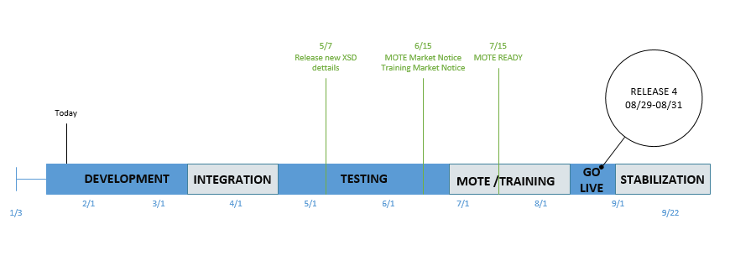
NPRR758 Improved Transparency for Outages Potentially Having a High Economic Impact
Project Timeline:

Slide 5
NPRR758 Improved Transparency for Outages Potentially Having a High Economic Impact
Questions?

