Slide 1
Far West Texas Transmission Project -
ERCOT Independent Review Update
January 24, 2017

Slide 2
Overview
AEPSC and Oncor jointly submitted Far West Texas Project (FWTP) for Regional Planning Group review. This is a Tier 1 project that is estimated to cost $ 423 million.
Proposed for 2021 to 2022 timeframe
Addresses oil and gas related load forecasts
Reliability Issues
Voltage Collapse
Loss of Load
Short-Circuit Strength & System Protection
Provide Operational Flexibility
Provides future upgrade path for Far West Region

Slide 3
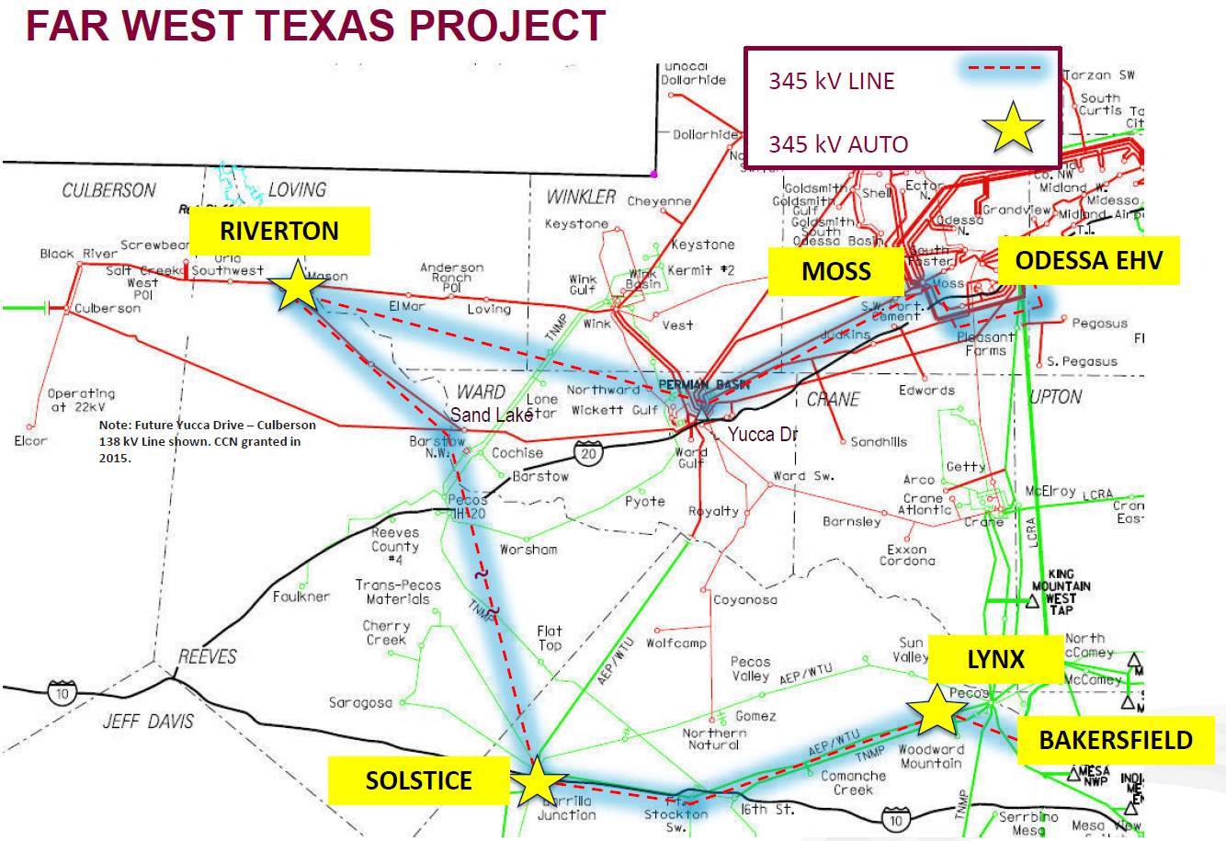
Far West Texas Project
Source: AEP/ONCOR RPG submittal on 21-Apr-2016 (http://www.ercot.com/calendar/2016/4/21/81733-RPG)

Slide 4
Study Assumptions
1. Base Case
Constructed from 16RTP reliability case 16RTP_2021_SUM_WFW
Study Region consists of Far-West and West Weather Zones
Generator additions that meet Planning Guide Section 6.9 criteria in study region were added to the case (2016 October GIS report).
Transmission Projects expected to be in-service within the study region by 2021 at the time of the study were added to the case
Applied 2021 oil and gas related load forecasts
Culberson loop: 426 MW
Barilla Junction Area lines: ~ 511 MW
N-1 SCOPF Dispatch
2. No Solar Case
Base Case with solar units turned off in West and Far west regions (Total available solar ~ 1341 MW)
N-1 SCOPF Dispatch

Slide 5
Steady State Analysis – Preliminary Results
Contingency Analysis was performed on the starting cases
P-1 and P-7 contingencies related to the study region were considered
Voltage deviations, voltage violations and thermal violations were monitored
Notes:
Unsolved contingencies . Look into it.

Slide 6
Preliminary Results – Thermal Violations
Post Contingency thermal violation
Monitor all transmission lines and transformers in study region (excl. GSU)
Use Rate A for Normal Conditions
Use Rate B for Emergency Conditions
Overloaded Element | Zone | kV | Length, in mi | Worst Case Overload, in %
 |  |  |  | Base Case | No Solar Case
Cosden to Big Spring SW - ckt1 | FW | 138 | 1.0 | - | 100.6
Rio Pecos to Woodward 2 - ckt1 | FW | 138 | 1.9 | - | 104.5
Rio Pecos to Woodward 1 tap - ckt1 | FW | 138 | 2.2 | - | 103.8
Woodward 2 to 16th St TNP - ckt1 | FW | 138 | 31.8 | - | 114.0
Woodward 1 tap to Tombstone - ckt1 | FW | 138 | 15.7 | - | 105.1

Slide 7
Preliminary Results – Voltage Violations
Post Contingency voltage deviations > 8% on non-radial load buses
NONE
Post Contingency voltage violation criteria
Monitor all buses 100 kV and above
0.95 < 1.05 Normal
0.90 < 1.05 Emergency
Bus Name | Bus kV | Zone | Base Case | No Solar Case
ALAMITO CREEK | 138 | Far West | - | 0.897
OXY CENTURY TNP | 138 | Far West | - | 0.893
COUNTY RD 101 TNP | 138 | Far West | - | 0.899
Notes:
Incl only far west areas

Slide 8
Preliminary Results - Dynamic Analysis
2022 DWG dynamic data set case for Culberson Loop
2018 HWLL dynamic data set case for the Barilla Junction area
Voltage stability issues identified in the Culberson loop area under N-1 conditions
No stability issues identified in the Barilla Junction area under N-1 conditions

Slide 9
Next Steps
Complete the Steady State and Dynamic stability analysis
Identify and evaluate project alternatives
Sensitivity Analysis
Higher Culberson Loop Load
PGRR0042-Generator additions with Signed Interconnection Agreements that DO NOT meet Planning Guide Section 6.9 criteria in study region
Tentative Timeline
Complete the EIR review – March RPG

Slide 10
?

