Slide 1
2016 LTSA Key Findings
January, 2017
RPG Meeting

Slide 2
Agenda
Key findings
Lessons learned
Next steps

Slide 3
2016 LTSA: Overview
Scenario Development
Industry experts provide input on trends and drivers affecting electric sector
Load Forecast
ERCOT develops load forecast and shape for each scenario
Generation Retirement/ Expansion
ERCOT runs generation retirement and expansion model
Stakeholders develop internally consistent futures (or scenarios) for study
Transmission Expansion
ERCOT performs reliability and economic transmission needs analysis
ERCOT works with TSPs to develop transmission projects to meet identified needs

Slide 4
2016 LTSA: Key Findings
Scenarios
Current Trends
High Economic Growth
Texas Recession
Environmental Mandate
High Efficiency/ High DG
Extended Extreme Weather
Sustained Low Natural Gas Prices
Storage/ Electric Vehicle Adoption
Key Finding 1: Load growth
Key Finding 2: Solar generation
Key Finding 3: Net-load resource adequacy
Key Finding 4: Increased west-to-east power flow
Key Finding 5: Panhandle expansion
Load continued to grow in ERCOT in seven of the eight scenarios.
All scenarios showed a significant amount of solar generation additions and the retirement of coal and natural gas generation.
There may be generation scarcity challenges during the summer in the 8-9 p.m. (20:00-21:00) hours in scenarios with a large amount of solar generation.
A combination of high amounts of solar generation additions in the west and generation retirements in the east could result in a significant increase in west-to-east power flows on the transmission network. This change will result in the need for transmission system improvements in order to reliably accommodate these power flows. This result was seen in all of the studied scenarios, including the High Energy Efficiency/ Distributed Generation scenario, which also saw negative load growth.
Expected continued generation additions in the Panhandle will necessitate transmission improvements in the area. Two 175-MVAR synchronous condensers at Windmill substation were economically justified across all the scenarios studied. In addition, a new 345-kV transmission path out of the Panhandle was found to be economically justified in the Environmental Mandate scenario.

Slide 5
Key finding I: Load growth
Load continues to grow in all but one scenario!!

Slide 6
Key finding II: Solar capacity additions
Generation addition across LTSA scenarios

Slide 7
Key finding II: Solar capacity additions
Amount of solar capacity additions in LTSA scenario range from 14.5 GW to 28 GW
Factors to consider:
All scenarios assumed Tax Credits
All scenarios assumed declining capital costs
Feasibility of such large scale installation
Feasibility of transmission additions to support such rapid growth

Slide 8
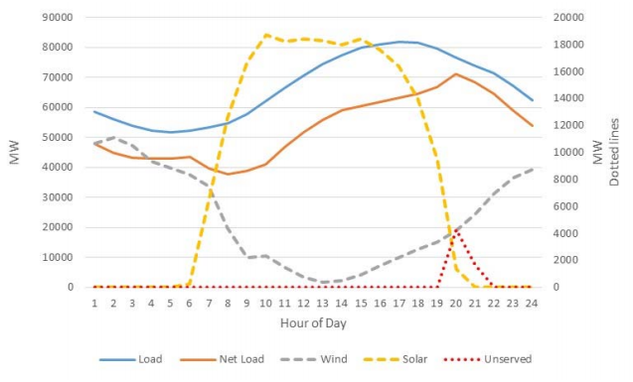
Key finding III: Net-peak resource adequacy challenge
Net-peak resource adequacy challenge

Slide 9
Key finding III: Net-peak resource adequacy challenge
Additional generation needed to offset the drop in solar around 8:00 PM timeframe on days with light wind
The resource adequacy challenge has shifted from its traditional 4:00 PM-5:00 PM time frame
ERCOT may have to revisit its resource adequacy and transmission planning processes to handle this “net-peak” hour challenge!!

Slide 10
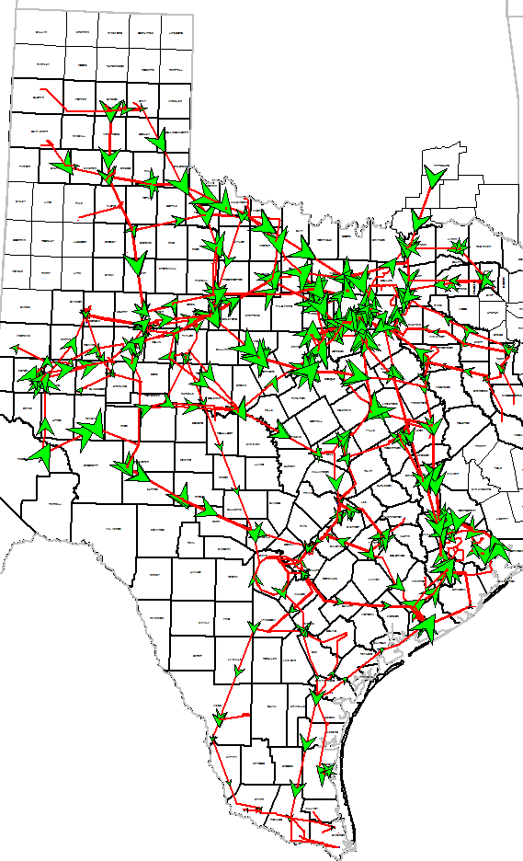
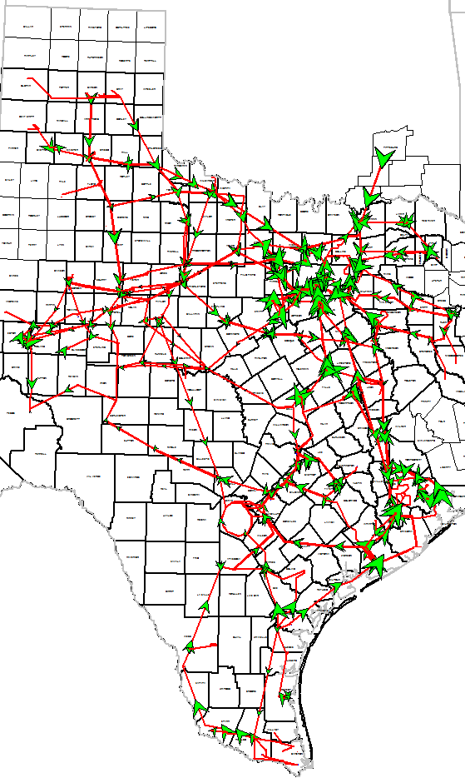
Key finding IV: West-to-east power flows
West-to-east power flows
Summer peak hour
Net-peak hour

Slide 11
Key finding V: Panhandle upgrades
Panhandle region continued to show significant growth in renewables showing consistently high congestion
Two new synchronous condensers were seen to be economical in all scenarios
Environmental Mandate case saw benefits of adding a new 345-kV path out of panhandle (Ogallala – Long Draw double-circuit)
Detailed dynamic study is required to study the impact of new solar and wind in the area.

Slide 12
LTSA process improvements
Load forecasting process incorporated the impact of roof-top PV
Significant insight into new topics such as impact of Electric Vehicle adoption, large scale impact of DG and EE, and challenges around the net-peak time frame
Improved interactions with TDSPs through out LTSA

Slide 13
Lessons learned
Regional Haze assumptions had a strong influence on all scenarios – acknowledge such strong drivers and develop alternate scenarios without these drivers
Low solar capital costs – consider feasibility of adding such large amounts of solar
Oil & Gas – consider the potential for growth in a particular sector even though the current circumstances do not indicate that

Slide 14
Next steps
Kick off 2018 LTSA
Kick off a Long-term stability study

Slide 15
Question
?

Slide 16
References
2016 LTSA Report : (http://www.ercot.com/content/wcm/lists/89476/2016_Long_Term_System_Assessment_for_the_ERCOT_Region.pdf)
2016 LTSA Scenario Summary: (http://www.ercot.com/content/wcm/key_documents_lists/108900/2016_LTSA_Summary.pptx)

