Slide 1
Compliance Monitoring and Enforcement Report Lindley Ellisor

Slide 2
CMEP and Most Violated Standards
What are the common standards most violated in 2015 and 2016 throughout NERC?
How does Texas RE’s Most Violated Standards List compare to all of NERC?
Do we have any “Most Violated” standards that are not on the ERO/Regional Monitoring lists?
Do you want to get more involved?
2

Slide 3
Most Violated Standards in NERC in 2015 and 2016
CIP-003
CIP-004
CIP-005
CIP-006
CIP-007
FAC-008
PRC-005
TOP-002
VAR-002
3

Slide 4
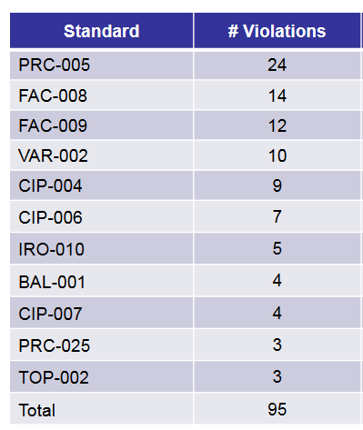
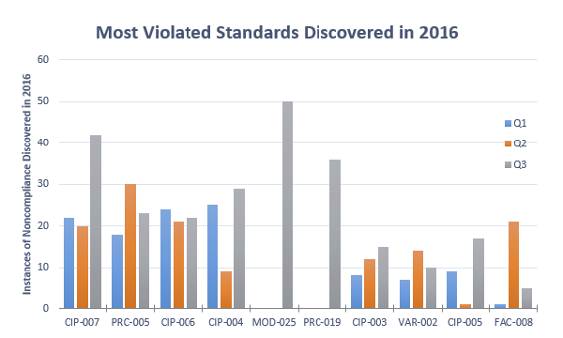
NERC Q1-Q3 2016 Results Combined with Texas RE 2016 Results
Pulled from NERC CMEP Report Q3, 2016
Pulled from MRC December 2016 Report
4

Slide 5
Most Violated Standards 2016
Texas RE Violations Account for 1/2-1/4* of ALL Violations for these Standards
*Estimated due to lack of NERC Q4 Statistics

Slide 6
Most Violated Standards 2016
All Violations Occurred in Q3, when Standards went into Effect

Slide 7
ERO Risk Elements from 2016 CMEP
FAC-008
FAC-014
IRO-005
PER-005
PRC-001
PRC-004
PRC-005
TOP-006
TOP-007
TPL-001
CIP-002
CIP-005
CIP-006
CIP-007
CIP-014
COM-002
EOP-001
EOP-002
EOP-010
FAC-003
Out of the 10 Most Violated Standards in the Texas RE Region, 4 are on this list
Texas RE had entities Self-Certify to 2 of the Standards
Texas RE had entities submit Periodic Data Submittals for 2 of the Standards on the list
7

Slide 8
Regional Risk Elements 2016 CMEP
Regional Risk Elements
Most Violated Standards
Critical Voltage Support
Operational Communications
SOL/IROL Management
SPS Management
UFLS Management
UVLS Management
IRO-010
TOP-002
VAR-002

Slide 9
ERO Risk Elements from 2017 CMEP with Most Violated from 2016 Highlighted
CIP-002
CIP-005
CIP-006
CIP-007
CIP-014
COM-002
EOP-001
Replaced by EOP-011 on 04/01
EOP-002
Replaced by TOP-002 on 04/01
EOP-010
FAC-003
FAC-008
FAC-014
IRO-005
Replaced by IRO-002 on 04/01
PER-005
PRC-001
PRC-004
Changes versioning on 04/02
PRC-005
TOP-006
Replaced by TOP-001 on 04/01
TOP-007
Replaced by TOP-001, and IRO-001 on 04/01
TPL-001

Slide 10
Regional Risk Elements 2016 vs. 2017 CMEP
2016
2017
Critical Voltage Support
Operational Communications
SOL/IROL Management
SPS Management
UFLS Management
UVLS Management
Critical Voltage Support
Facility Ratings
Operational Communication
SOL/IROL Management
SPS Management
UFLS Management
UVLS Management

Slide 11
Do you Want to Get More Involved?
Attend the Member Representatives Committee (“MRC”)
NERC Initiatives
FERC Audits
NERC Activities
Program Area Quarterly Reports
Committee and Working Group Updates
Keep attending the NSRS/NRWG Meetings!
11

Slide 12
Questions or Concerns?
Lindley Ellisor
Senior Compliance Analyst
(512) 982-5725
(512) 636-1681 cell
lellisor@crosstexas.com

