Slide 1
2016 LTSA Summary
January, 2017
RPG Meeting

Slide 2
Table of Contents
Scenario Development
Load Forecasting and Generation Expansion
Transmission Expansion

Slide 3
Scenario Development

Slide 4
2016 LTSA scenarios
Scenario | Description
Current Trends | Trajectory of what we know and is knowable today (e.g., LNG export terminals, Texas growth, low natural gas and oil prices)
High Economic Growth | Significant population and economic growth from all sectors of the economy (affecting load from residential, commercial and industrial)
Texas Recession | Significant reduction in economic activity in Texas
Environmental Mandate | On top of current regulations, aggressive action on mitigating environmental impacts in the energy sector has occurred. Federal or higher Texas renewable standards
High Efficiency/High DG | Reduced net demand growth due to increase in distributed solar and higher building and efficiency standards
Extended Extreme Weather | Extreme weather conditions exist for an extended period impacting water-intensive generating resources.
Sustained Low Natural Gas Prices | Low domestic gas prices continue for the entire period.
Storage/Electric Vehicle Adoption | High penetration of electric vehicles and large amounts of residential and utility-scale storage

Slide 5
2016 LTSA scenario drivers
Drivers | Brief description
Economic Conditions | The US and Texas economy, regional and state-wide population, oil & gas, and industrial growth, LNG export terminals, urban/suburban shifts, financial market conditions and business environment
Environmental Regulations and Energy Policies | Environmental regulations including air emissions standards (e.g., ozone, MATS, CSAPR), GHG regulations, water regulations (e.g., 316b), and nuclear safety standards; energy policies include renewable standards and incentives (incl. taxes/financing), mandated fuel mix, solar mandate, and nuclear relicensing.
Alternative Generation Resources | Capital cost trends for renewables (solar and the wind), technological improvements affecting wind capacity factors, caps on annual capacity additions, storage costs, other DG costs, and financing methods.
Natural Gas and Oil Prices | Gas prices are a function of total gas production, well productivity, LNG exports, industrial gas demand growth, and oil prices. Oil prices are dependent on global supply and demand balance, the spread of horizontal drilling technologies. Oil and gas prices will affect drilling locations within Texas.
Government Regulations/Policy/Mandates | New policies around resource adequacy, transmission build out, interconnections to neighboring regions and cost recovery
Technology | Improvements in technologies resulting in more efficient turbines, or higher capacity factor intermittent resources
End-Use/New Markets | End-use technologies, efficiency standards and incentives, demand response, changes in consumer choices, DG growth, increase interest in micro grids
Weather and Water Conditions | May affect load growth, environmental regulations and policies, technology mix, average summer temperatures, frequency of extreme weather events, water costs

Slide 6
2016 LTSA scenario drivers
Category | Speaker | Topic
Technology | Michael Goggin, AWEA | Cost and capabilities of future wind technologies
 | Colin Meehan, First Solar | Solar growth trends
End Use | Michele Allen, Walmart | Demand side management at big retail stores
 | Dr. Varun Rai, Lyndon B. Johnson School of Public Affairs | Adoption of residential rooftop PV
 | Mike Legatt, ERCOT | Impact of growth in Electric vehicle on the price of storage
Environmental Regulations | Susana Hildebrand, EFH | Environmental regulations: Overview
 | Dana Lazarus, ERCOT | Environmental regulations impacting ERCOT region
Oil and Gas | Gurcan Gulen-Bureau of Economic Geology | Oil and gas growth — impact on other industries
Modeling in LTSA | Doug Murray, ERCOT | Modeling data and sources currently available to ERCOT
 | Calvin Opheim, ERCOT | Load forecasting for LTSA Scenarios
Texas Economy | Tom Currah, Texas Comptroller of Public Accounts | Texas Economy

Slide 7
1. Scenario: Current Trends
Economic Growth
Migration to TX along I-35 corridor
Lower Growth in south and west Texas
Industrial growth in Houston, I-35
Average GDP growth in line with long-term average US GDP growth rate~1.5% load growth – high growth in near term then tapering off in long-term
LNG growth based on permits existing – may be 2 new LNG plants
Oil production rates drop to those seen in recent projections
Story:
Same old, same old. The recent population and economic growth in Texas continues in the near future, however the recent decline of the oil and gas sector has impacted growth in the west and south Texas especially in areas near the oil and gas plays. World oil prices are low enough to keep oil production low in the short-term, while also keeping domestic natural gas prices relatively low. With low gas prices, several LNG export terminals are built between 2014 and 2024. Modest wind growth continues based on economics without production tax credits. Capital costs for solar continues to decline at the current rate for 3-4 more years. No required reserve margin is set for ERCOT and the environmental regulations continues to be moderate, with no explicit federal carbon tax or required national cap and trade, but greenhouse gas emissions become regulated beyond 2016. however CSAPR and Regional Haze rules may be mandated in the near future.
Technology
No breakthroughs – steady modest cost improvements
New DC ties
Government policy/mandate
No reserve margin set for ERCOT
Maintain energy-only market
Economic retirements continues based on economics
Increased DC-tie capacity with neighboring region
Environmental Regulation
Impact of Regional HAZE and CSAPR are seen in the near future
CSAPR Hybrid
Greenhouse gas regulation set with flexibility
No other major changes in environmental regulations – no CPP impacts
Alternative Generation
Total wind capacity of 20K to 25K generation added by 2017
Solar capability addition limit:1000 MW/ year
Wind capacity addition limit: 3,000 MW/yr
Capacity factor wind – rely on historical data from ERCOT
Capital cost wind ~$1755/kW
Capital cost solar ~4.4% reduction/year continues for 3 to 4 years
Overall renewable growth driven by economic entry
No production tax credit beyond 2013
No change to existing investment tax credit policy
End-Use
Increased need for ancillary services
Increase penetration of demand response
Increasing distributed generation
Implications for ERCOT:
Continued modest economic and therefore load growth in Texas.
Reduction in oil production and population across the state leads fewer transmission needs
Continued increased renewables especially solar leading to reliability (inertia) issues
Weather / Water
No drought situation, but water supply continues to be a concern to existing and new generators.
No specific increase in electricity consumption due to drought conditions.
Gas/Oil Prices
Sustained low oil and gas prices

Slide 8
2. Scenario: High Economic Growth
Economic Conditions
High Texas GSP growth ~5%/year
High population growth (2.5%/yr)
Pro-business environment
Industrial growth concentrated in Houston, I-35 corridor, Midlands/Odessa, Lower Rio Grand Valley
Higher LNG exports than under Current Trends
Capital is available to support new generation and transmission
Story:
Higher natural gas prices increase drilling activity and lead to higher economic growth than under Current Trends.
Growth occur throughout Texas driven in large part by oil and gas sector and related upstream and downstream industries.
Texas economy continues to outpace US economic growth.
Increased immigration to Texas shows continued accelerated load growth.
Alternative generation responds to higher natural gas fueled generation. Rising incomes leads to higher adoption rates of technology relative to current trends.
Technology
Smarter appliances with an increase in efficiency and price responsive
Automated price responsive demand response is greater than Current Trends
Gen Resource Adequacy Standards
No mandated reserve
Consider additional ancillary services
Environ. Regs/Energy Policy
Continued modest environmental regulations, no significant changes from assumptions under Current Trends
U.S. more focused on developing domestic energy sources
Implications for ERCOT:
High load growth
High urban growth
High industrial growth, concentrated through I-35 corridor, Midlands/Odessa, Lower Rio Grand Valley and oil and gas rich areas
Potential challenges with generation portfolios keeping pace with load profile changes
End-Use
Growth of household income however, more energy-efficient new homes
Overall efficiency gains are similar as under Current Trends
Higher distributed generation than current trends
Alt. Gen. Resources
Renewables are economic and growth occur due to higher gas prices
More technological improvement than under Current Trends for renewables and storage
Cap on annual wind capacity growth
Weather / Water
Same as Current Trends
Oil/Gas Prices
Higher (but still relatively low) gas prices than under Current Trends (~$6/7 or use EIA’s high forecast)
Higher oil prices than under Current Trends

Slide 9
3. Scenario: Clean Power Plan
Economic Conditions
Moderate economic growth
Same LNG exports than under Current Trends
Population growth same as under Current Trends Increase in industrial production of alternative energy and efficiency-related technologies
Story:
Nationwide, including Texas, implementation of CPP results in expected
Higher electricity prices drive more adoption of energy efficiency and customer-sited solar PV.
Uncertain development of new nuclear & geothermal
Natural Gas Prices
Same as Current Trends
Same amount of LNG exports as under Current Trends
Technology
Same as current trends
Some improvement in efficiency of gas and renewable incorporation of storage.
Environmental Regs / Energy Policies
CPP implementation in Texas ~ 40% CO2 reductions assume also proceed with other rules such as Haze, NAAQS etc.
Transmission Regs
Same as Current Trends
Implications for ERCOT:
Lower peak and overall end use
Challenge in matching generator w/ load
Reserve & integrate issues
Potential need for new ancillary services to provide faster & flexible resources
End – Use Customers / Policies
Continued stringent building code – 10% improvement every 3 years
Alt. Generation Resources
Continued PTC/ITC through 2020, reducing over time
Continued decrease capital costs for solar: 3-5% /yr
Wind capacity factors increase due to technological improvements
Cap on annual wind generation
Increased development of storage due to cost reductions for batteries & compressed air
More financing mechanism are available; e.g.: real estate investment trusts, property-assessed clean energy financing, and others
Weather & Water
Same as Current Trends

Slide 10
4. Scenario: Texas Recession
Economic Conditions
Net population growth in Texas ~negative to zero
Urbanization with growth concentrated in the major cities
No industrial growth
Capital for new generation difficult to obtain
Little to no GDP growth or net load growth
Story:
Low energy prices threaten the Texas economy. Load growth is limited, resource expansion is limited to gas-fired plants and continued subsidized renewables. Stimulus programs help create incentives for consumers to replace old appliances and increase conservation. Coal plants that rely on coal by rail retire due to lower energy margins. Conditions similar to but less impactful than 1980’s recession.
Technology
Less spending one energy efficient appliances??
Limited growth of new technologies that are still high costs, such as storage
Environ. Regs. / Energy Policy
Continuing modest environmental regulations, no significant changes from assumptions under Current Trends
Government incentives continue for high efficiency appliances
Same as Current Trends??
Gen Resource Adequacy Standards
Retiring of coal plants due to low energy margins
System inertia issues increase
No reserve margin mandate??
Alt Gen Resources
Lower oil/gas prices
Limited development of wind and solar due to low energy prices
Nuclear re-licensing
Slower solar cost decline due to reduced global demand
Implications for ERCOT:
Slow load growth
Growth in urban areas greater than in rural areas
Counties with oil and gas economies shrink at a faster rate
Limited generation development, predominantly gas-fired, subsidized renewables
Import/export issues between urban areas will need to be addressed
Stability issues continue to increase due to low system load
End - Use
Customers are more cost conscious, thus more conservation – less disposable income
Low load growth due to increased efficiency and changed customer behavior
Gas/Oil Prices
Lower prices (~$1/mmbtu lower than assumptions under Current Trends)
Less oil exploration and production
No LNG development
Weather / Water
Same as under Current Trends – no drought conditions, but limited water supply for new generation

Slide 11
5. Scenario: Extended extreme weather scenario
Economic Conditions
Slow down in population and economic growth with higher impacts on localities with water intensive industry
Increased food, water and electricity prices
Productivity and job losses in agriculture
Potential negative impact on oil & gas extraction
Impact on local economy, lower economic growth than national average
Story:
The rate of population and economic growth moderately declines, due to sustained multi-year drought conditions.
Sustained drought conditions impact water-intensive generation resources (nuclear/coal/steam units), and lead to significant increase in renewables and storage, dry cooling on thermal generation], and transmission expansion over those in Current Trends.
More energy consumption per capita, however there is less economic growth
Less tourism
Technology
More efficient appliances, HVAC
Less water intensive generation
Gen Res Adequacy Standards
Mandated reserve margin and increased operating reserves
Demand response plays a larger role than in Current Trends
Increase in transmission due to policy/ regulatory changes resulting from drought
Environmental Regs / Energy Policies
Required drought management plans and water conservations
Stringent requirements on power generation water use leads to dry cooling
Tax breaks for drought resistant generation
Other environmental regs are same as Current Trends
Alt. Generation Resources
Continued investments in renewables, storage, and dry-cooling with continued federal PTC/ITC continues
Development of co-location desalination and power plants
Renewable costs same as Current Trends
Implications for ERCOT:
Derating units due to water resource limitations and generation retirements lead to challenges in meeting demand
Potential need for new ancillary services to meet the needs of integrating new renewable energy generation
Seriously consider more interconnections outside ERCOT.
End – Use Customer / Policies
Increase the development of demand-side management tools
increases EE penetration beyond those in the Current Trends
Greater market penetration of time-of-use rates and water smart devices
Natural Gas and Oil Prices
Moderate increase in natural gas prices relative to in Current Trends [$1 – 2/MMBtu]
Moderate impact on local oil production, but prices are set internationally. at the same price as Current Trends
Weather & Water
More drought than in the Current Trends
Extreme high and low temperatures
Hot summers
Limited water supply – water rights restricted

Slide 12
6. Scenario: High Efficiency/Distributed Generation
Economic
Same as under Current Trends
Additional growth in clean technologies
Story:
Economic growth good enough to allow new investments in efficiency and distributed generation. Customers increase acceptance of EE/DG technologies which leads to widespread market adoption
Technology
Accelerated price reductions of solar, storage, high SEER HVAC, Lighting and Controls
Gen Resource Adequacy
Same as under Current Trends
No reserve margin mandate however expectations is that increased load resources participation helps meet system need
Environ. Regs/Energy Policy
Increase stringency in building codes, with more net zero buildings
Government provides more incentives for building retrofits to increase efficiency
Increase in appliance standards increase
More attractive DR programs/pricing
Environmental regs same as current trends
End – Use
More high efficiency homes and buildings built due to enhanced building codes
Efficiency gains are above those under Current Trends, results in 30% reduction in energy usage in homes and buildings relative to pre-2006
Increased time of use + price-responsiveness
Higher installation DG
Higher DR participation
More options for microgrids, smart appliances, etc.
Alt. Gen. Resources
Capital cost for wind and solar technologies and CHP decrease faster than under Current Trends
Improved storage technology and lower cost
Implications for ERCOT:
Lower net load growth compared to under Current Trends
More market-based programs for demand response
Widespread distributed generation creates some operational challenges
Lower capital cost of renewable generation
Gas Price / Oil Price
Moderate to Higher gas prices (4$-5$/mmbtu) than under Between Current Trends and High economic growth scenario: also higher resulting wholesale electricity prices
Weather / Water
Same as Current Trends

Slide 13
7. Scenario: Sustained low natural gas prices
Economic Conditions
Oil and gas sector gets impacted with sustained load natural gas prices
However, lower gas prices stimulates growth in manufacturing industry
Story:
Gas prices continues to stay in the 2-4$ range due to improvements in extraction technology and low global energy prices
Electricity prices stay low which could lead to early retirements , transmission constraints and more volatile energy prices.
Technology
Efficiency improvements for gas plants and other generation types
Environmental Regulations
Moderate regulation on oil & gas drilling activity
Other environmental regulations are same as in Current Trends
Resource Adequacy Standards
As some plants become uneconomic, leading to pressure for market mechanisms
Implications for ERCOT:
Slowdown in load growth in the oil and gas region however the non-energy industrial sector sees strong growth
Tighter reserve margin with unit retirements
Seasonal mothballing of plants a possibility
Need for transmission due to unit retirements and load growth in the industrial sector
End - Use
Less likely to have EE and DG growth
Alternative Generation
Slight slowdown on renewable roll out due to reduced NG prices
PTC/ITC same as current trends
Natural Gas Prices
Natural gas priced stay low $2-4/MMBtu
Weather / Water
Same as Current Trends

Slide 14
8. Scenario: High storage/electric vehicle adoption
Economic Conditions
GDP growth slightly higher than under Current Trends
Population growth ~2.3%/yr
Pro-business environment
Story:
Storage development close to loads
Electric vehicle developed for longer range while battery cost continues to decline faster than expected.
Proliferation of roof-top PV + Storage application results in flattening and shitting of loads.
Electric vehicle charging has a potential of ‘birthday cake’ effect showing spikes of demand during the shoulder hours.
Technology
More spending on EE and energy storage
More charging infrastructures
Faster charging
Longer range Electric Vehicles
Gen Res Adequacy Standards
Same as under Current Trends
No reserve mandate
Environm. Regs / Energy Policy
Modest environmental regulation, same as in under Current Trends
Impact of Regional HAZE and CSAPR are seen in the near future
CSAPR Hybrid
Greenhouse gas regulation set with flexibility
No other major changes in environmental regulations – no CPP impacts
Implications for ERCOT:
Flat load shape – higher energy usage but net reduction and shifting of peak load and hour
High urban growth due to growth in infrastructures used for electric vehicle charging and battery swapping centers
More residential PV with storage
End - Use
Motivate high energy efficiency at a higher rate than current trends.
Storage developed close to loads
Flat load shape at the transmission delivery site
More residential PV
Alt. Gen Resources
High penetration of storage coincident with higher penetration of wind and PV
Renewable – wind and solar growth same as current trends
Weather / Water
Same as under Current Trends
Gas Prices / Oil Prices
Same as Current Trends

Slide 15
Load Forecasting and
Generation Expansion

Slide 16
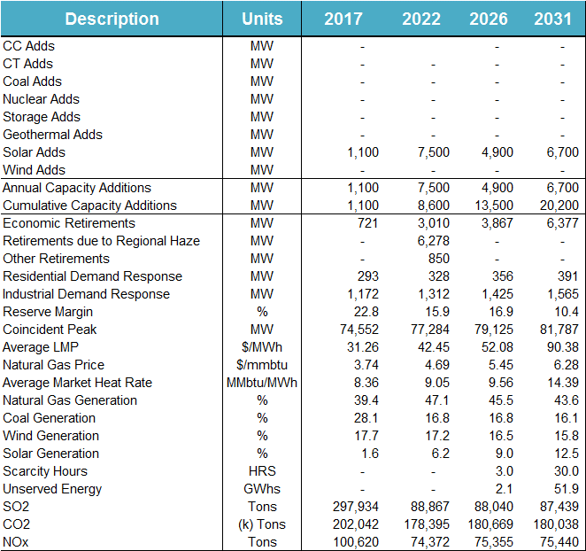
Current Trends scenario summary

Slide 17
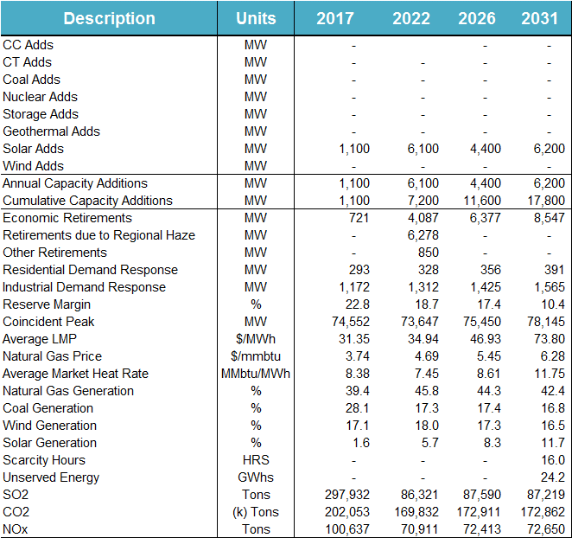
Texas Recession scenario summary

Slide 18
High Economic Growth scenario summary

Slide 19
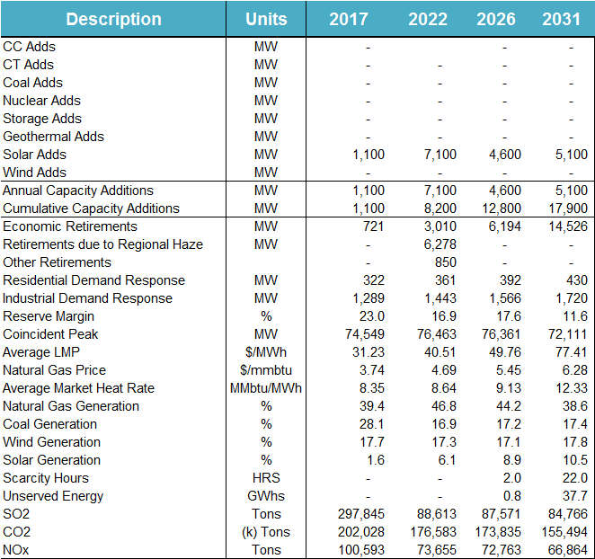
High Economic Efficiency – Distributed Generation scenario summary

Slide 20
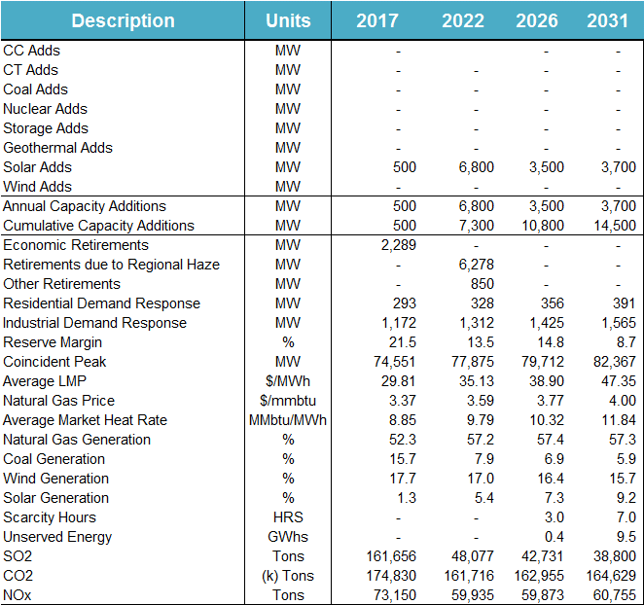
Sustained Low Natural Gas scenario summary

Slide 21
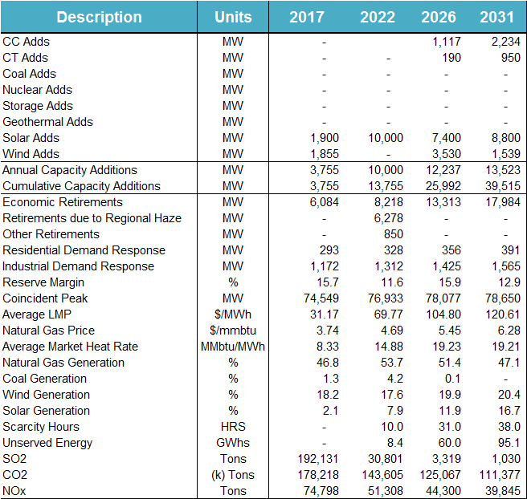
Environmental Mandate scenario summary

Slide 22
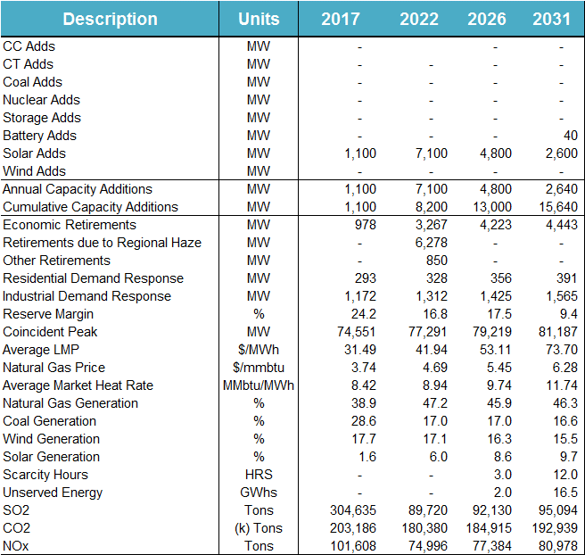
High Storage/Electric Vehicle Adoptions scenario summary

Slide 23
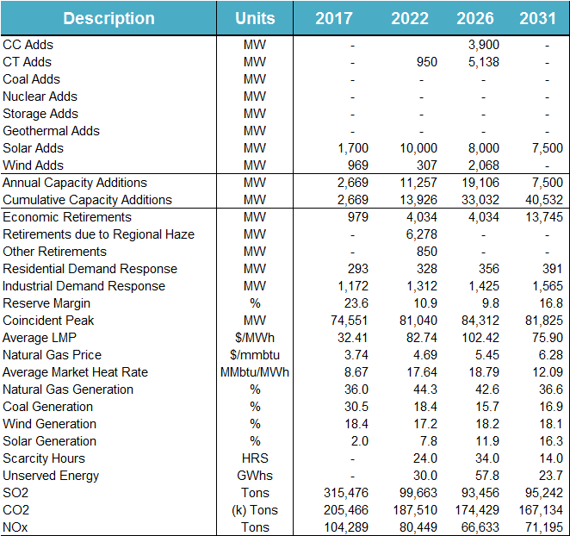
Extended Extreme Weather scenario summary

Slide 24
Transmission Expansion

Slide 25
Scenario selected for Transmission Expansion
 | Current Trends |  | Environmental Mandate |  | High EE and DG
 | 2026 | 2031 | 2026 | 2031 | 2026 | 2031
CC Adds | - | - | 1117 | 3351 | - | -
CT Adds | - | - | 190 | 1140 | - | -
Net Solar Adds [a] | 10800 | 16160 | 15440 | 22480 | 10240 | 14320
Net Wind Adds [b] | - | - | 733 | 1077 | - | -
Net Gen Additions | 10800 | 16160 | 17480 | 28048 | 10240 | 14320
Gen Retirements | 9981 | 12469 | 19388 | 24045 | 12288 | 20680
Net Generation Change | 819 | 3691 | -1908 | 4003 | -2048 | -6360
DC Tie Adds | - | - | 2000 | 2000 | - | -
SVCs Added (MVAr) | 400 | 1147 | 1965 | 4920 | 0 | 200
Load (90th Percentile) [c] | 83980 | 86055 | 83788 | 85351 | 75605 | 73805
Losses | 2.49% | 2.89% | 4.12% | 5.53% | 2.22% | 2.75%

Slide 26
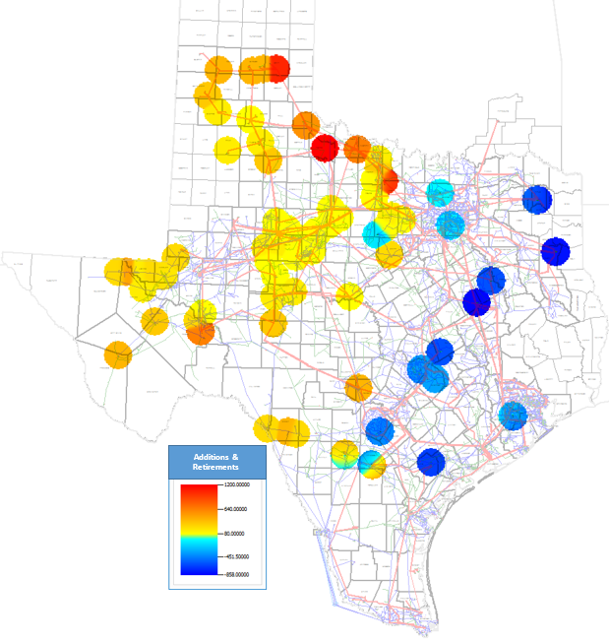
Generation additions and retirement in Current Trends (2031)

Slide 27
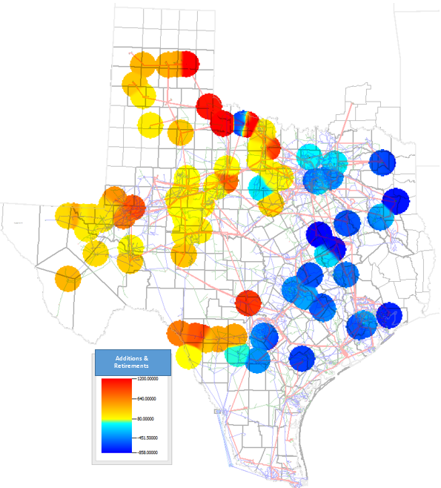
Generation additions and retirement in Environmental Mandate scenario (2031)

Slide 28
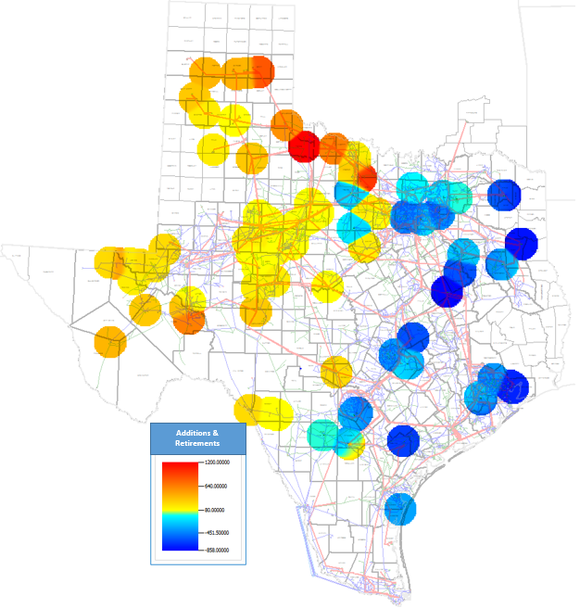
Generation additions and retirement in High Energy Efficiency – Distributed Generation scenario (2031)

Slide 29
Generation additions and retirement in High Energy Efficiency – Distributed Generation scenario (2031)

Slide 30
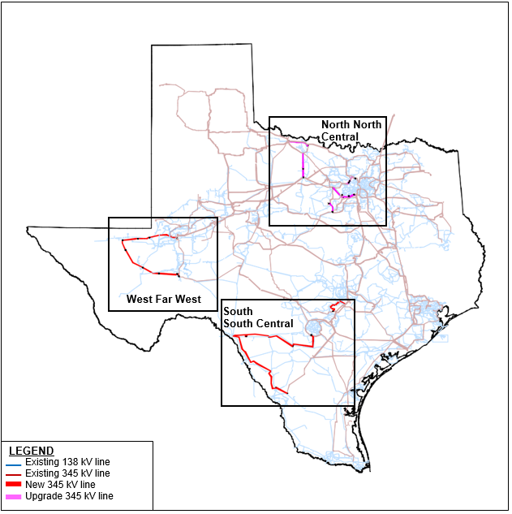
Transmission upgrades (Current Trends)

Slide 31
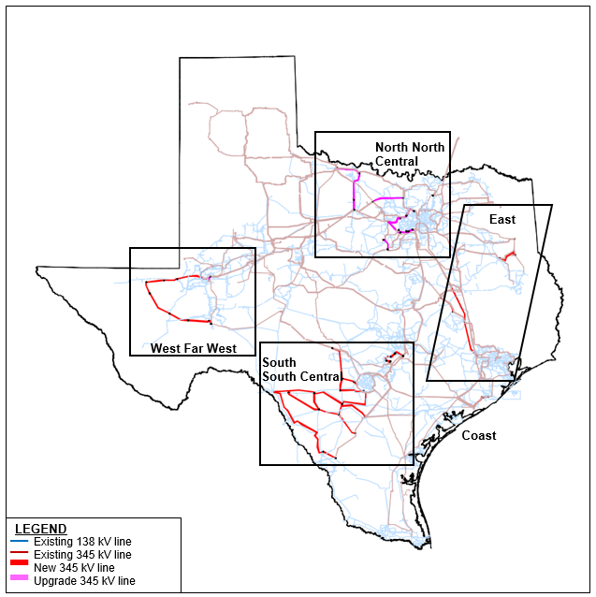
Transmission upgrades (Environmental Mandate)

Slide 32
Reliability upgrades (Current Trends)
Project Index | Project Description | 2026 | 2031
NC2 | Alliance to Roanoke 345-kV line upgrade | X | X
NC3 | Benbrook Switch to Sycamore Creek 345-kV line upgrade | - | X
NC4 | Bowman Switch to Garvey Road Switch 345-kV line upgrade | - | X
NC7 | Garvey Switch Road to Graham SES 345-kV line upgrade | X | X
NC8 | Graham SES to Parker Switch 345-kV double circuit upgrade | - | X
NC9 | Hicks Switch to Alliance 345-kV line upgrade | X | X
NC10 | Hicks Switch to Roanoke Switch 345-kV line upgrade | X | X
NC11 | Liggett Switch to Norwood Switch 345-kV line upgrade | - | X
NC14 | Parker Switch to Benbrook Switch 345-kV double circuit upgrade | - | X
NC15 | Riley to Fisher Road Switch 345-kV line upgrade | - | X
NC16 | Roanoke Switch to Lewisville Switch 345-kV line upgrade | - | X
NC17 | Venus Switch to Britton Road 345-kV line upgrade | X | X
NC18 | Wolf hollow to Mitchell Bend 345-kV line upgrade | X | X
NC19 | Webb to Britton Road 345-kV line upgrade | - | X
NC20 | Rocky Creek to Everman 345-kV line upgrade | - | X
NC21 | Everman to Kenandale 345-kV line upgrade | - | X
NC22 | Webb to Cedar Hill Switch 345-kV line upgrade | - | X
NC23 | Sycamore Creek to Everman Switch 345-kV line upgrade | - | X
NC24 | Carrolton Northwest auto transformer ) upgrade | X | X
NC25 | Lewisville New Tap Project | - | X
NC27 | Roanoke Switch to Roanoke Switch 345-kV bus tie breaker upgrade | X | X
FW1 | Upgrade WFW Alamito Creek Southern Loop | X | X
FW2 | Upgrade the 138kV line from Wink to Cheyenta Tap to Dollarhide to Andrews County South | X | X
SC3 | Cico - Comfort 138-kV line rebuild | - | X
SC4 | --Winchester new 345-kV substation. --Winchester 345/138-kV auto addition. --Winchester to Fayetteville 138-kV line rebuild. | - | X

Slide 33
Reliability upgrades (Environmental Mandate)
Project Index | Project Description | 2026 | 2031
NC1 | Alliance to Roanoke 345-kV line upgrade | X | X
NC2 | Benbrook Switch to Sycamore Creek 345-kV line upgrade | X | X
NC3 | Bowman Switch to Garvey Road Switch 345-kV line upgrade | X | X
NC4 | Garvey Switch Road to Graham SES 345-kV line upgrade | X | X
NC5 | Graham SES to Parker Switch 345-kV double circuit upgrade | X | X
NC6 | Hicks Switch to Alliance 345-kV line upgrade | X | X
NC7 | Hicks Switch to Roanoke Switch 345-kV line upgrade | X | X
NC8 | Roanoke Switch to Lewisville Switch 345-kV line upgrade | X | X
NC9 | Parker Switch to Benbrook Switch 345-kV double circuit upgrade | X | X
NC10 | Riley to Fisher Road Switch 345-kV line upgrade | X | X
NC11 | Wolf hollow to Mitchell Bend 345-kV line upgrade | X | X
NC12 | Rocky Creek to Everman 345-kV line upgrade | X | X
NC13 | Sycamore Creek to Everman Switch 345-kV line upgrade | X | X
NC14 | Carrolton North West auto transformer ) upgrade | X | X
NC15 | Highland Tap Project | X | X
NC16 | Parker Switch to Hicks Switch 345-kV line upgrade | X | X
NC17 | Roanoke Switch to Lewisville345-kV line upgrade | - | X
NC18 | Roanoke Switch to Roanoke Switch 345-kV bus tie breaker upgrade | X | X
NC19 | West Roanoke Project |  | X
NC20 | Parker Switch to Eagle mountain 345-kV line upgrade | - | X
NC21 | Jacksboro to West Krum 345-kV line upgrade | - | X
NC22 | Fisher Road Switch to Bowman 345-kV line upgrade | - | X
NC23 | Benbrook Switch 345-kV bus tie breaker upgrade | - | X
NC24 | Benbrook auto transformer ) upgrade | - | X
NC25 | Brazos/Oncor Project | - | X
NC26 | Bowman auto transformer upgrade | - | X
NC27 | Roanoke Switch to Roanoke Switch 345-Kv bus tie breaker upgrade | - | X
NC28 | Jack County Auto Transformer#2 Addition | X | X
NC29 | Liggett Switch to Norwood Switch 345-kV line upgrade | - | X
NC30 | Venus Switch to Britton Road 345-kV line upgrade | - | X
FW1 | Upgrade WFW ALMC Southern Loop | X | X
FW2 | Implement proposed Far West Project with some modification | X | X
FW3 | Upgrade the 345kV transmission line from Midland Odessa to Odessa EHV Switch | - | X
FW4 | 345kV Midland East to Midland County Northwest Switch terminal upgrade | - | X
FW5 | 345kV Falcon Seaboard to Morgan Creek SES terminal upgrade | - | X
FW6 | 345kV Morgan Creek SES to Gasconades Creek terminal upgrade | - | X
FW13 | Add a second 345/138/13.8kV 3-Windings transformer at Midland County Northwest Switch station | - | X
W1 | Mountain Home 345/138-kV auto addition | X | X

Slide 34
Reliability upgrades (Environmental Mandate)
Project Index | Project Description | 2026 | 2031
S1 | --Howard - Moore - Uvalde - Brackettville - Asherton - North Laredo Switch - Lobo 345-kV line additions --Trumbo - Loxley - Pleasanton - Big Foot - Moore - Downie Switch - Uvalde 138-kV line rebuilds. --Hamilton - Maverick - Eagle Highway Tap - Escondido - Rosita Creek - Pueblo - West Conoco - Dimmit - Bevo - Asherton - Catarina - Piloncillo - North Laredo Switch 138-kV line rebuilds. --Howard 345-kV substation --Brackettville - West Batesville - Palo Duro - Fowlerton 345-kV line additions --Uvalde - West Batesville 345-kV line addition --Uvalde - West Batesville 138-kV line rebuild | X | X
S2 | San Miguel - Moore - Palo Duro 345-kV line additions | - | X
SC1 | --Hays Energy - McCarty Lane - Canyon - Turnersville - new substation east of Turnersville 345-kV line additions --At the new substation east of Turnersville, tap the Gilleland Creek to Clear Springs 345-kV line --Hays Energy 345/138-kV auto addition --McCarty Lane - Ranch Road 138-kV line rebuilds --Canyon - Rohr - Goforth -Turnersville 138-kV line rebuilds | X | X
SC2 | --Lytton - new substation east of Turnersville 345-kV line addition --McCarty Lane 345/138-kV auto addition | - | X
SC3 | --Mountain Home - Medina County - Cagnon and Medina County - Hondo Creek - Howard 345-kV line additions --Medina County 345-kV substation addition --Hondo Creek 345-kV substation addition --If double circuit tower construction is utilized, and depending on the routing of the new 345-kV lines, various underlying 138-kV facilities can be upgraded. | - | X
SC4 | Cico - Comfort 138-kV line rebuild | X | X
SC5 | Howard 345/138-kV auto addition | - | X
SC6 | --Winchester new 345-kV substation. --Winchester 345/138-kV auto addition. --Winchester to Fayetteville 138-kV line rebuild. | - | X
SC7 | --Wirtz - Flat rock - Paleface - Marshall Ford 138-kV line rebuilds --Starke - Paleface - Bee Creek 138-kV line rebuild | X | X
C1 | Upgrade South Texas Project - Dow/Jones Creek 345-kV line to 2812 MVA | X | X
E1 | Upgrade Singleton - Zenith 345-kV line to 2988 MVA | X | X
E2 | Upgrade Stryker Creek 345/138-kV Transformer | - | X
E3 | Upgrade Jewett South to Singleton 345-kV line to 2988 MVA Upgrade Jewett North to Singleton 345-kV line to 2988 MVA | X (a) | X (a,b)
E4 | Upgrade Twin Oak to Jack Creek 345-kV line to 2988 MVA | - | X

Slide 35
Reliability upgrades (High Energy Efficiency –Distributed Generation)
Project Index | Project Description | 2026 | 2031
NC1 | Alliance to Roanoke 345-kV line upgrade | - | X
NC2 | Benbrook Switch to Sycamore Creek 345-kV line upgrade | - | X
NC3 | Bowman Switch to Garvey Road Switch 345-kV line upgrade | - | X
NC4 | Garvey Switch Road to Graham SES 345-kV line upgrade | - | X
NC5 | Hicks Switch to Alliance 345-kV line upgrade | - | X
NC6 | Hicks Switch to Roanoke Switch 345-kV line upgrade | - | X
NC7 | Liggett Switch to Norwood Switch 345-kV line upgrade | - | X
NC8 | Parker Switch to Benbrook Switch 345-kV double circuit upgrade | - | X
NC9 | Venus Switch to Britton Road 345-kV line upgrade | - | X
NC10 | Wolf hollow to Mitchell Bend 345-kV line upgrade | - | X
NC11 | Webb to Britton Road 345-kV line upgrade | - | X
NC12 | Roanoke Switch to Roanoke Switch 345-kV bus tie breaker upgrade | - | X
NC13 | Highland Tap Project | - | X
S1 | --Hamilton - Maverick - Eagle Highway Tap - Escondido - Rosita Creek - Pueblo - West Conoco - Dimmit - Bevo - Asherton 138-kV line rebuilds. --Hamilton - Brackettville - Odlaw Switchyard - Asphalt Mines - Uvalde - West Batesville - Asherton 138-kV line rebuilds. | X | X
SC1 | --Hays Energy - McCarty Lane - Canyon - Turnersville - new substation east of Turnersville to Lytton 345-kV line additions --At the new substation east of Turnersville, tap both the Hutto to Zorn and the Gilleland Creek to Clear Springs 345-kV lines --Existing 138-kV line between Turnersville and Lytton to be reconfigured to operate as 345-kV --Turnersville 345/138-kV auto addition --McCarty Lane - Ranch Road 138-kV line rebuilds --Canyon - Rohr - Goforth -Turnersville 138-kV line rebuilds | - | X
SC2 | Paleface - Marshall Ford 138-kV line rebuild | - | X

Slide 36
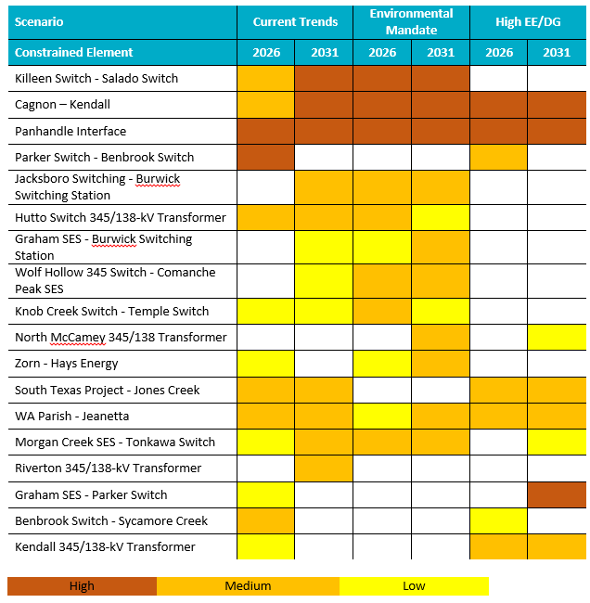
Most congested elements from two or more scenarios

Slide 37
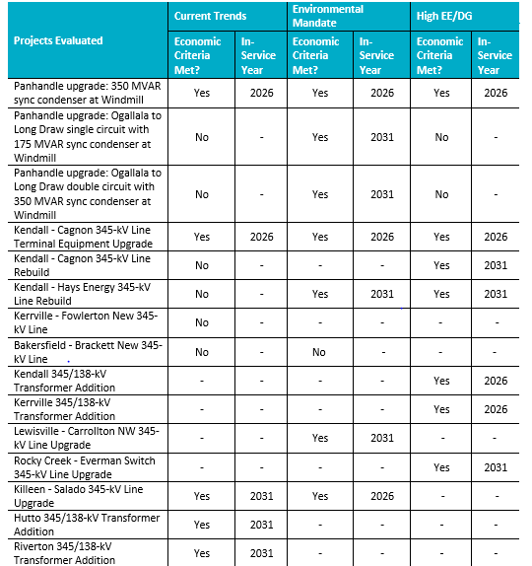
Economic projects evaluated in 2016 LTSA

