Slide 1
Project Update and Summary of
Project Priority List (PPL) Activity
January 19, 2016

Slide 2
Project Update Agenda
Project Portfolio Update p. 3-8
  Recent Project Implementations
  Upcoming Project Implementations
  2016 Release Results
  2017 Release Targets
  2016 Project Spending
  Revision Request Funding Placeholder Status
  Priority/Rank Options for Revision Requests with Impacts
Appendix
  Project Portfolio Gantt Chart p. 9-18
Location of Project Priority List (PPL): http://www.ercot.com/services/projects/index

Slide 3
Recent Project Implementations
2016 December Release – Week of 12/6/2016 Complete
  NPRR713 – Reactive Power Testing Requirements
  NPRR754 – Revise Load Distribution Factors Report Posting Frequency
  NOGRR147 – Reactive Power Testing Requirements
  SCR787 – Maintain NDCRC Data For Generator Transfer Between Resource Entities
  SCR788 – Addition of Integral ACE Feedback to GTBD Calculation
2016 December Retail Release – Weekend of 12/10/2016 Complete
  RMGRR127 – Efficiencies for Acquisition Transfer
  RMGRR140 – Efficiencies for Acquisition Transfer Process
  SCR786 – Retail Market Test Environment

Slide 4
Upcoming Project Implementations
2/1/2017 In Flight
  NPRR790 – Addition of Phase Angle Limits to the Network Operations Model
2/13/2017 In Flight
  NMMS Upgrade project
2017 March Release – Week of 3/7/2017 In Flight
  NPRR272 – Definition and Participation of Quick Start Generation Resources
  NPRR649 – Addressing Issues Surrounding High Dispatch Limit (HDL) Overrides
  NPRR753 – Allow AMS Data Submittal Process for TDSP-Read Non-Modeled Gens
  NPRR764 – QSE Capacity Short Calcs Based on 80% Probability of Exceedance (P80)
  NPRR785 – Sync WGR and PVGR COPs with Short Term Wind and PV Forecasts
  RMGRR134 – Allow AMS Data Submittal Process for TDSP-Read Non-Modeled Gens
  RRGRR003 – Modifications to Improve Wind Forecasting
  RRGRR006 – Clarification of Descriptions and Alignment with RARF Forms
  RRGRR007 – Adding Solar Resource Registration Inputs
  RRGRR009 – Adding Voltage Limit Sets, Relay Loadability, MLSE, and GMD Data
Note: Projected Go-Live dates are subject to change.
Please watch for market notices as the effective dates approach.

Slide 5
2016 Release Results – Board Approved NPRRs / SCRs / xGRRs
February 2/2 – 2/4 | April 4/12 – 4/14 | June 6/21 – 6/23 | August 8/30 – 9/1 | September 9/26 – 9/30 | December 12/6 – 12/8
NPRR588 NPRR615 NPRR686(b) | NPRR419 NPRR728 COPMGRR040 | NPRR515 NPRR617 NPRR700 NPRR719 NPRR742 NPRR745 VMCRR008 EMS Upgrade | NPRR662 NPRR712(a) RMGRR126 RMGRR137 | NPRR219 SCR783 NOGRR050 NOGRR143(a) NPRR712(b) NOGRR143(b) NPRR495 NPRR736 NPRR770 | NPRR713 NPRR754 NOGRR147 SCR787 SCR788 RMGRR127 RMGRR140 SCR786
3 | 3 | 7 | 4 | 9 | 8
11/1 – 11/3
5/1
7/23 – 7/24
(Retail)
12/10 – 12/11 (Retail)
6/16
EMS Upgrade “Chill”
Go-live dates can differ from Protocol effective dates – Please refer to market notices for more details
APPENDIX
Red Text: New additions and target release changes
Strike-Through Text: Previous target release changes
(a), (b), etc. indicates multiple phases
Release targets are subject to change
NPRR686(b) – Solar portion
Project Status Codes: NS = Not Started, I = Initiation, P = Planning, E = Execution, H = On Hold

Slide 6
2017 Release Targets – Board Approved NPRRs / SCRs / xGRRs
March 3/7 – 3/9 | May 5/1 – 5/11 | June 6/27 – 6/29 | August 8/29 – 8/31 | October 10/31 – 11/2 | December 12/5 – 12/7
NPRR272 NPRR649 NPRR753 NPRR764 NPRR785 RMGRR134 RRGRR003 RRGRR006 RRGRR007 RRGRR009 NPRR790 | SCR790 NPRR746 NPRR786 NPRR792 RMGRR134 | NPRR573 NPRR714 NPRR744 NPRR758 NPRR782 NPRR789 NPRR797 NPRR801 | NPRR758 NPRR775 SCR777 | NPRR778 | SCR789
11 | 4 | 7 | 3 | 1 | 1
E
E
E
E
E
E
E
E
E
E
E
E
P
P
E
H
P
P
NS
I
I
NS
E
NS
E
NS
NS
9/16 – 9/17
(Retail)
10/2 – 10/3
(Off-Cycle)
11/11 – 11/12 (Retail)
12/9 – 12/10 (Retail)
5/20 – 5/21
(Retail)
7/15 – 7/16
(Retail)
2/1
2/13 – NMMS Upgrade
2017 TBD Items (and point at which they became “TBD”)
2014 | 2015 | 2016 | 2017
NOGRR084, NPRR664 | None | SCR781 H | None
Go-live dates can differ from Protocol effective dates – Please refer to market notices for more details
APPENDIX
Red Text: New additions and target release changes
Strike-Through Text: Previous target release changes
(a), (b), etc. indicates multiple phases
In-Flight Items Planned for Future Delivery
CMM bundle (Planning): NPRR519, NPRR620, NPRR683, NPRR702, NPRR741, NPRR743, NPRR755, NPRR760
Release targets are subject to change
Project Status Codes: NS = Not Started, I = Initiation, P = Planning, E = Execution, H = On Hold

Slide 7
2016 Project Spending
2016 PPL Budget = $22.5M
“Potential Demand” represents internal ERCOT projects that have not been fully approved

Slide 8
Revision Request Funding Placeholder Status
In 2016 and 2017, ERCOT forecasted $4.0M for Revision Request work
Yearly Revision Request Spending Forecast Summary
Project Status | 2016 | 2017
YTD Actuals | $2.57M | –
Approved – In-Flight / Complete | $2.94M | $1.38M
Approved – On Hold | $0.00M | $0.40M
Approved – Not Started | $0.00M | $0.42M
Remaining Funding | $1.06M | $1.80M
Total Allocation | $4.00M | $4.00M
As of 11/30/2016
Each year, an additional $400k is held in reserve in the event the $4M allocation is insufficient

Slide 9
Priority / Rank Options for Revision Requests with Impacts
Options for…
Revision Request | Description | Priority | Rank | Comments
PGRR052 | Stability Assessment for Interconnecting Generation | 2017 | 1900 | ROS previously recommended a Rank of 2000 due to the initial target effective date of 1/1/2018 Revised effective date of 8/1/2017 requires an earlier project start

Slide 10
Appendix
  12/31/2016 Project Gantt
    In-flight items sorted by Project End Date
    “On Hold” projects listed separately
    “Not Started” items sorted by Project Start Date

Slide 11
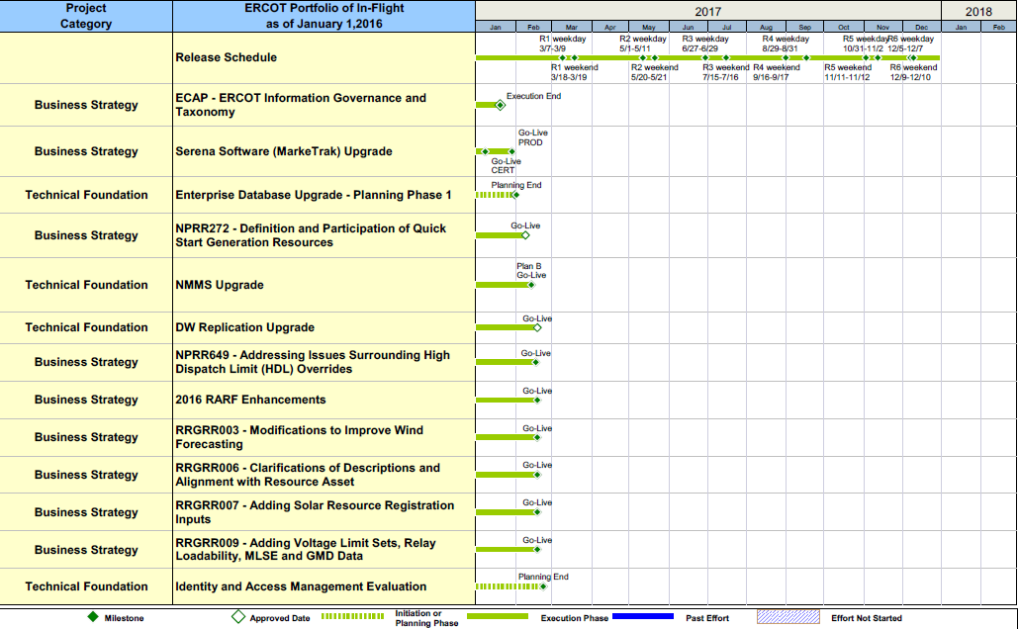
Project Portfolio Status – as of 12/31/2016

Slide 12
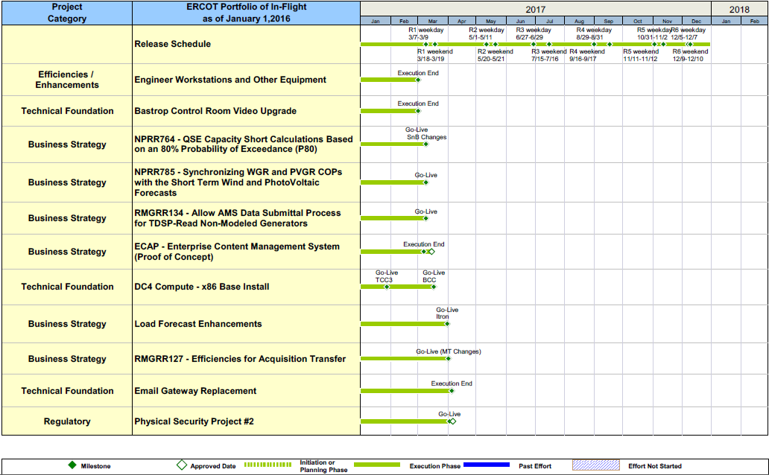
Project Portfolio Status – as of 12/31/2016

Slide 13
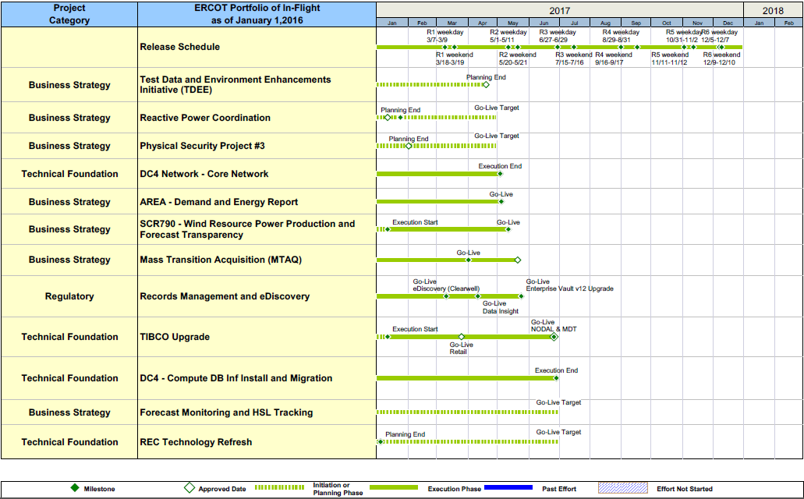
Project Portfolio Status – as of 12/31/2016

Slide 14
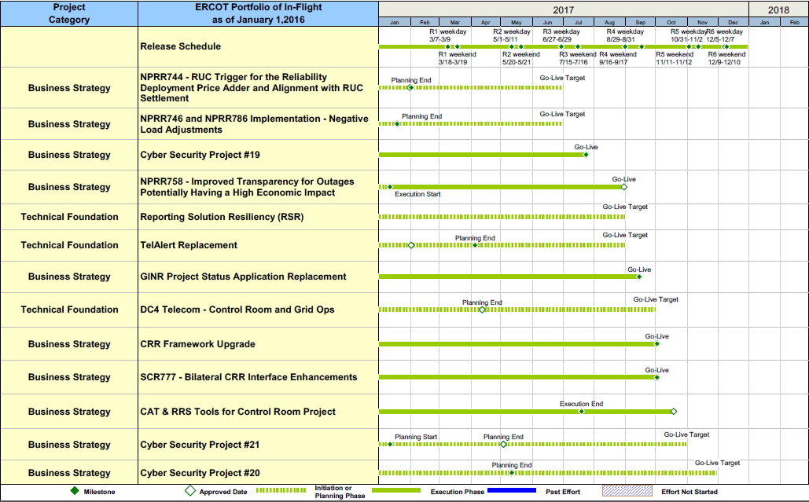
Project Portfolio Status – as of 12/31/2016

Slide 15
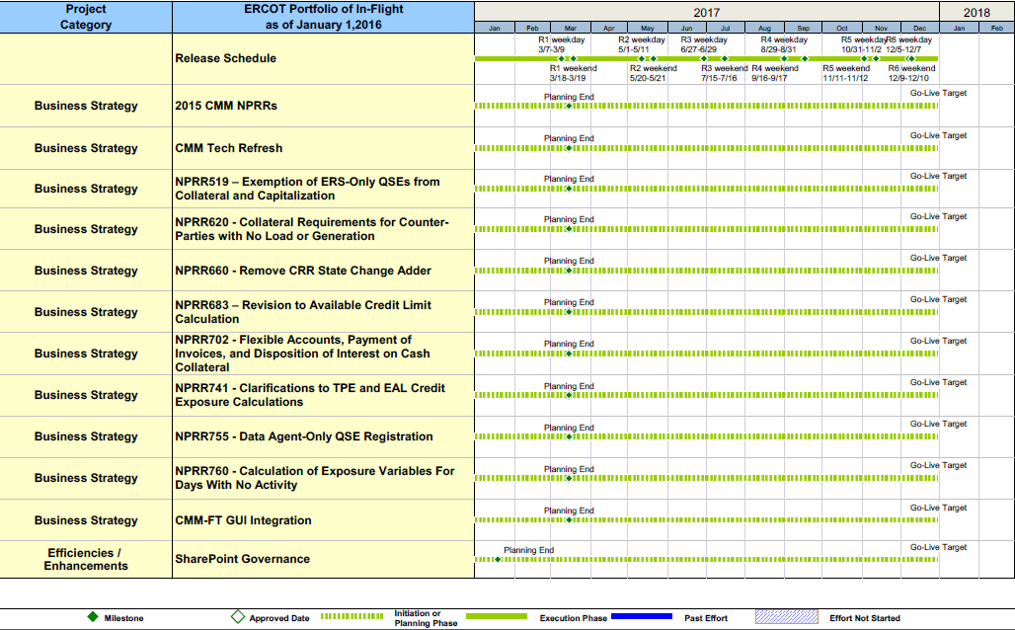
Project Portfolio Status – as of 12/31/2016

Slide 16
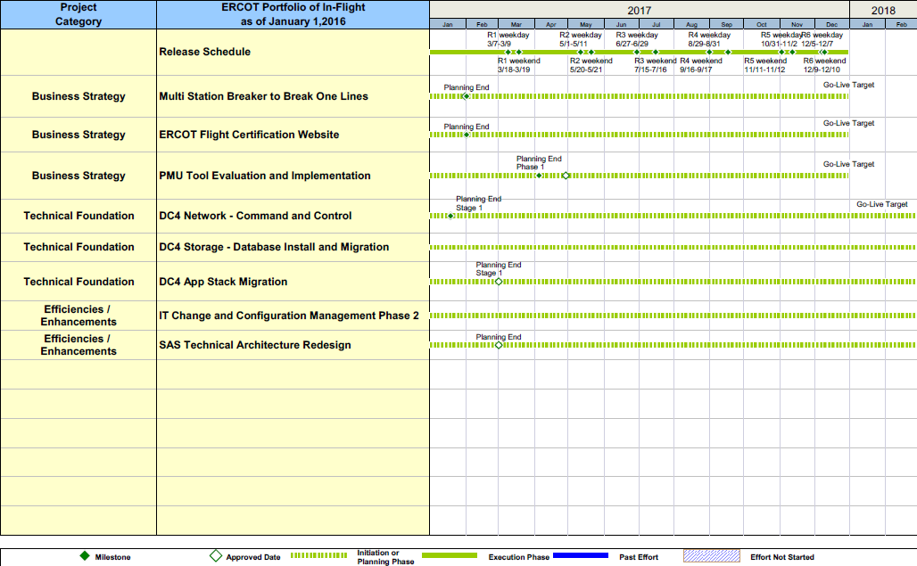
Project Portfolio Status – as of 12/31/2016

Slide 17
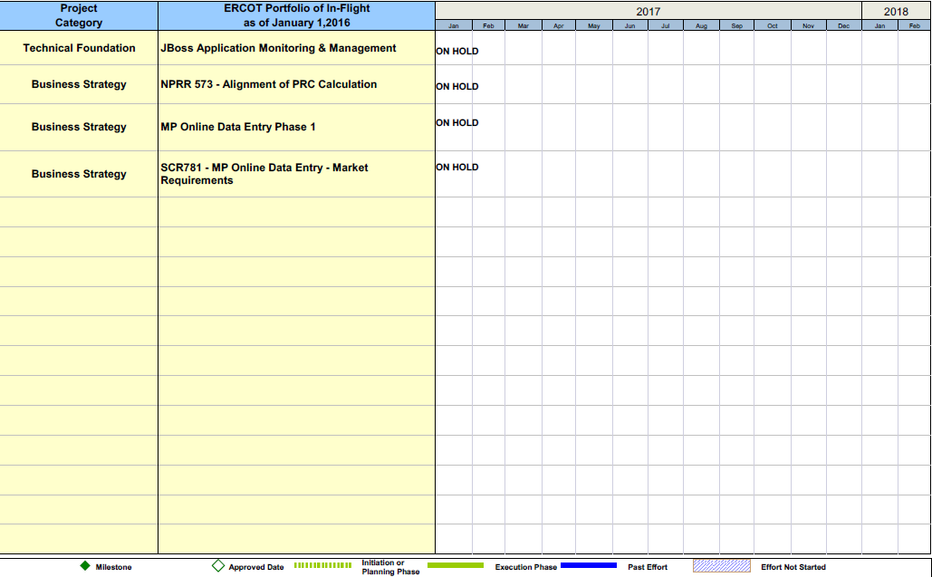
Project Portfolio Status – as of 12/31/2016

Slide 18
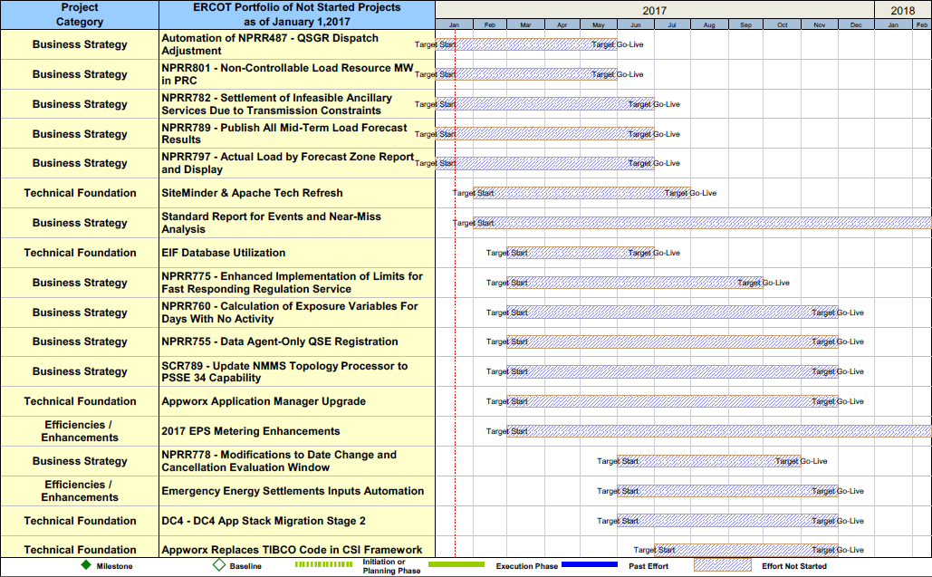
Project Portfolio Status – as of 12/31/2016

Slide 19
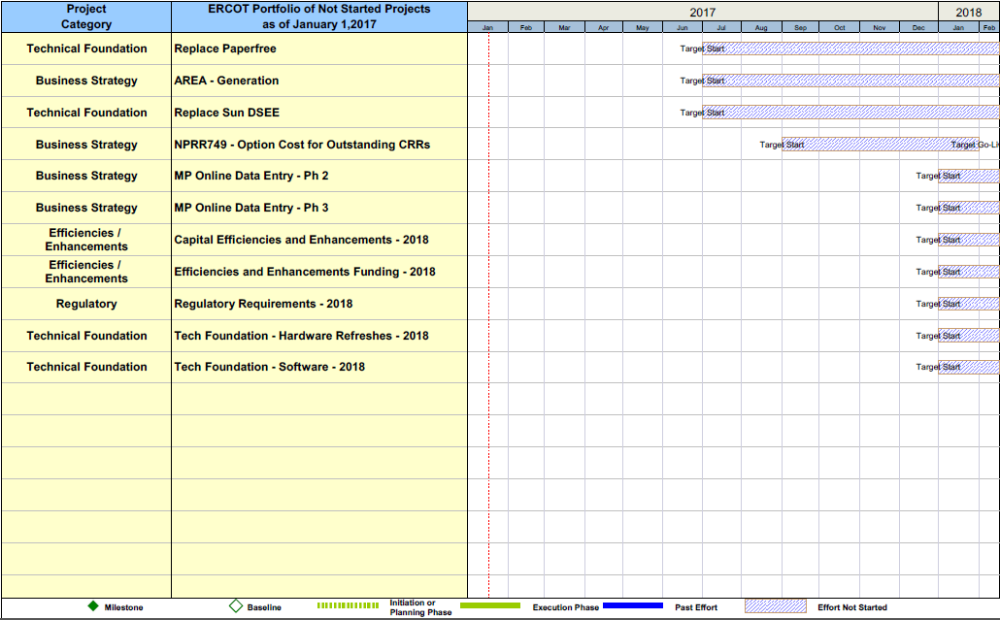
Project Portfolio Status – as of 12/31/2016

