Slide 1
Ancillary Service Enhancements Discussion
QMWG
ERCOT Staff
01/13/2017

Slide 2
Items requested at 11/14/2016 QMWG meeting
Study to facilitate discussions about removal of 50% limit on Load Resources providing RRS
2016 Load Resources aggregated RRS bids
2016 RRS Quantities without 50% limit on Load Resources

Slide 3
Studies for RRS Quantities
The steps used for determining minimum quantities of RRS are,
  Assume only generators required to carry minimum RRS have active governors (roughly 12 to 20).
  Trip 2750 MW of generation
  Incrementally increase the RRS to ensure Frequency remained above 59.40 Hz (UFLS threshold)
The 50% limit on LRs providing RRS is based on the high frequency overshoot post LRs activation. To determine the limit on LRs, we use the same case, trip 1375 MW and observe how high frequency will overshoot.
  The fundamental problem with this approach in studying the high frequency overshoot is that in reality all the generators online would provide governor response. Consequently, frequency overshoot would be less severe and below the 60.60 Hz threshold.
  To validate this we observed the frequency overshoot by simulating loss of 200 MW load with governor response from all online units.

Slide 4
Frequency Overshoot (Loss of Generation)
PFR (MW) | 1150
FFR (MW) (59.7Hz,0.42s) | 2600
Inertia (GW∙s) | 100
Note : This overshoot reflects frequency only if generators providing RRS are allowed to respond.

Slide 5
Frequency Overshoot (Loss of Load)
PFR (MW) | All Online Units Included
FFR (MW) (59.7Hz,0.42s) | 0
Case1 Inertia (GW∙s) | 100
Case2 Inertia (GW∙s) | 119.5
Note : Assume 80% of Wind Generation Providing Governor Response

Slide 6
In Summary
ERCOT’s studies show that the 50% limit can be removed.
Minimum 1150 MW of RRS has to come from Generators, RRS quantities beyond 1150 MW can be provided by LRs.
Note that it as has been discussed in meetings prior, there may be a potential need to change the Non-Spin Reserve from 30 minutes to 10 minutes after the 50% limit on Load Resources is removed.
  Changing NSRS to 10 minute will ensure Primary Frequency Response (RRS from generation) is restored quickly once frequency has recovered.
  Most of the Non-Spin today is carried by QSGRs and Online Resources but there is no guarantee the Resources providing Non-spin will continue to be available earlier than 30 minutes

Slide 7
RRS Offers from Load Resources (MW)
 | Minimum | Maximum | Average
January | 1,465.5 | 1,750.6 | 1,631.2
February | 1,408.7 | 1,797.9 | 1,670.0
March | 1,298.3 | 1,770.0 | 1,625.8
April | 1,390.9 | 1,824.9 | 1,571.4
May | 1,306.9 | 1,675.0 | 1,455.2
June | 1,142.7 | 1,698.0 | 1,575.4
July | 1,386.0 | 1,832.3 | 1,712.8
August | 1,361.8 | 1,801.2 | 1,685.1
September | 1,187.5 | 1,778.8 | 1,637.2
October | 1,317.9 | 1,772.7 | 1,552.8
November | 1,340.8 | 1,822.1 | 1,753.6
December | 1,258.6 | 1,843.8 | 1,674.4

Slide 8
Load Resource Self-Arrangement (MW)
 | Minimum | Maximum | Average
January | 244.6 | 321.3 | 282.5
February | 237.6 | 321.5 | 286.6
March | 217.3 | 331.9 | 290.9
April | 234.5 | 297.9 | 262.8
May | 217.8 | 299.5 | 250.9
June | 156.9 | 287.0 | 246.3
July | 161.0 | 285.2 | 252.1
August | 229.5 | 370.1 | 332.3
September | 161.8 | 346.1 | 298.1
October | 283.2 | 381.0 | 326.2
November | 319.5 | 442.1 | 387.3
December | 315.8 | 430.6 | 376.9

Slide 9
RRS Quantities without 50% Limit

Slide 10
2016 Load Resource Participation in RRS Market

Slide 11
Daily RRS Requirement in 2016
 | 50% limit | W/O 50% limit | Difference
Annual RRS Requirement (MWh) | 23,988,565 | 23,492,369 | 496,196 (2.1%)

Slide 12
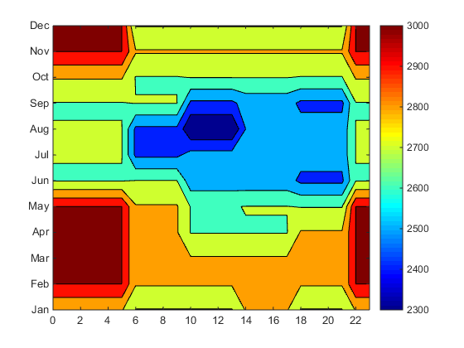
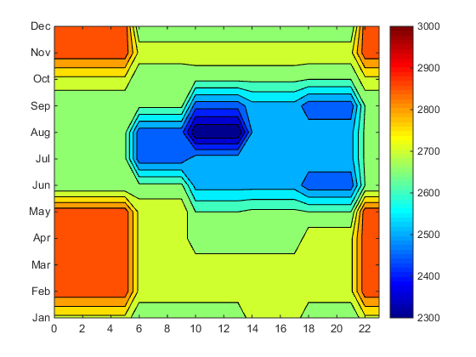
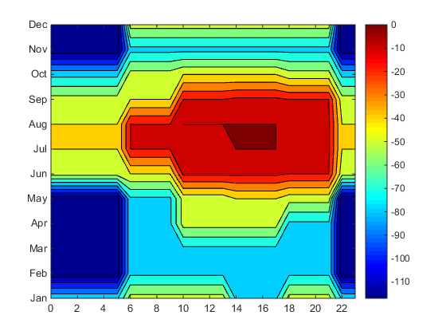
Minimum RRS Requirement (MW) in 2016
RRS with 50% limit
RRS w/o 50% limit
RRS w/o 50% limit- RRS with 50% limit

Slide 13
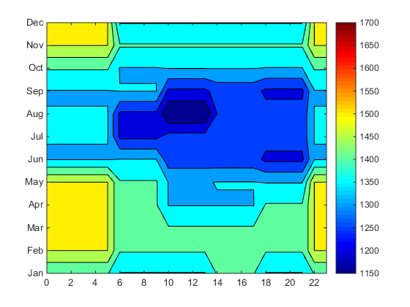
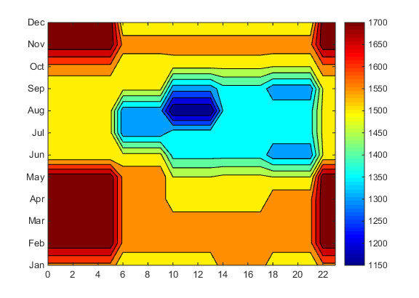
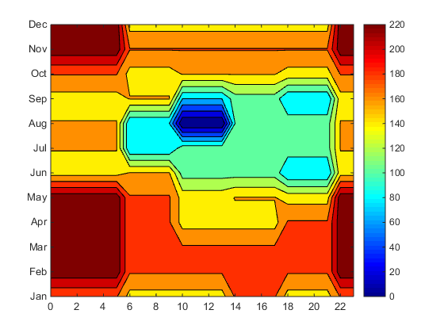
Minimum FFR Requirement (MW) in 2016
FFR with 50% limit
FFR w/o 50% limit
FFR w/o 50% limit- FFR with 50% limit

Slide 14
Daily RRS Requirement in 2017
 | 50% limit | W/O 50% limit | Difference
Annual RRS Requirement (MWh) | 22,915,380 | 22,604,105 | 311,275 (1.4%)

Slide 15
Minimum RRS Requirement (MW) in 2017
RRS with 50% limit
RRS w/o 50% limit
RRS w/o 50% limit- RRS with 50% limit

Slide 16
Minimum FFR Requirement (MW) in 2017
FFR with 50% limit
FFR w/o 50% limit
FFR w/o 50% limit- FFR with 50% limit

Slide 17
Questions?

