Slide 1
NERC 2016 Probabilistic Assessment Study Results
Supply Analysis Working Group Meeting, 1/17/2017
Pete Warnken

Slide 2
Study Background
NERC Probabilistic Assessment (ProbA) study conducted every two years
Purpose of ProbA study is to calculate annual and monthly probabilistic reliability metrics based on reported NERC 2016 Long Term Reliability Assessment (LTRA) resources and loads
  Evaluation or determination of target reserve margins is not within the study scope

Slide 3
Study Background
Metrics include
  Loss of Load Hours (LOLH) per year
  Expected Unserved Energy (EUE) per year (MWhs)
  EUE/Net Energy for Load
Simulations conducted for two study years: 2018 and 2020
NERC requested both a base study and load sensitivity study

Slide 4
Study Background
Load sensitivity study:
  For 2018, peak load and energy scaled up by 2%
  For 2020, peak load was scaled up by 4% and energy scaled up by 2%
Astrapé Consulting performed the 2016 study using their Strategic Energy & Risk Valuation Model
2016 LTRA data closely matches May 2016 CDR

Slide 5


Study Results - Annual
Results for 2018 simulation year
Results for 2020 simulation year

Slide 6
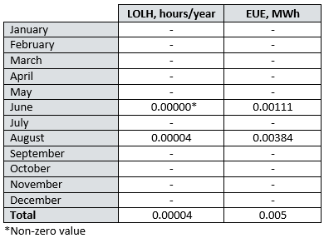
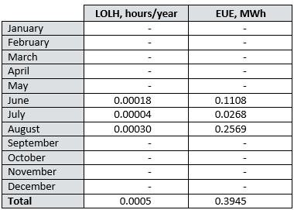
Study Results - Monthly
Results for 2018 simulation year
Results for 2020 simulation year
Occurrence of non-zero values in June driven by the 2012 weather year used to produce the load forecast; the second highest annual peak load from 2002 through 2014 occurred in June 2012.

Slide 7
Assumptions & Methods
Transmission Topology
Demand Uncertainty
  Modeled 13 historical load shapes (2002-2014) along with five economic load forecast error multipliers (range from 0.96 to 1.04)
  Total of 65 full-year load scenarios modeled

Slide 8
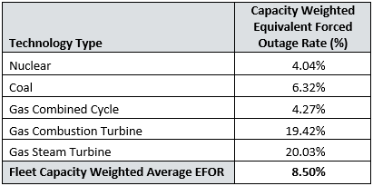
Assumptions & Methods
Outage Modeling
  Astrapé developed generating unit Time-to-Fail and Time-to-Repair distributions using ERCOT-supplied outage data
  Full and partial unit outages represented in the modeling
  Monte Carlo draws resulted in the following aggregate EFORs:

Slide 9
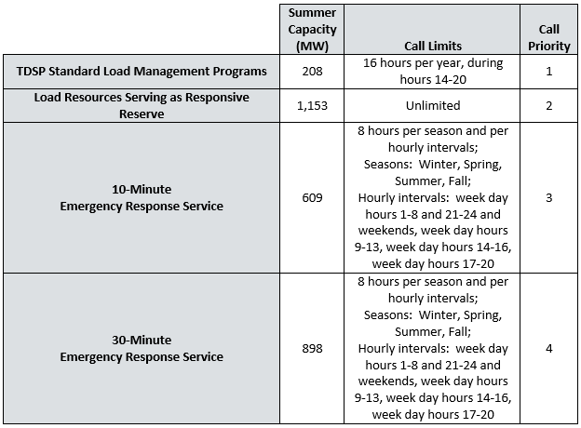
Assumptions & Methods
Model sheds load to maintain 500 MW of regulation reserves and 500 MW of spinning reserves
Load Resources:

Slide 10
Next Steps
ERCOT ProbA study report (submitted to NERC) available on SAWG meeting Webpage; not seeking comments – for your information only
NERC’s Reliability Assessment Subcommittee to review NERC draft report and submit comments by January 20
Public release of NERC ProbA report in March 2017

