Slide 1
SMT Update To AMWG
DEC 2016

Slide 2
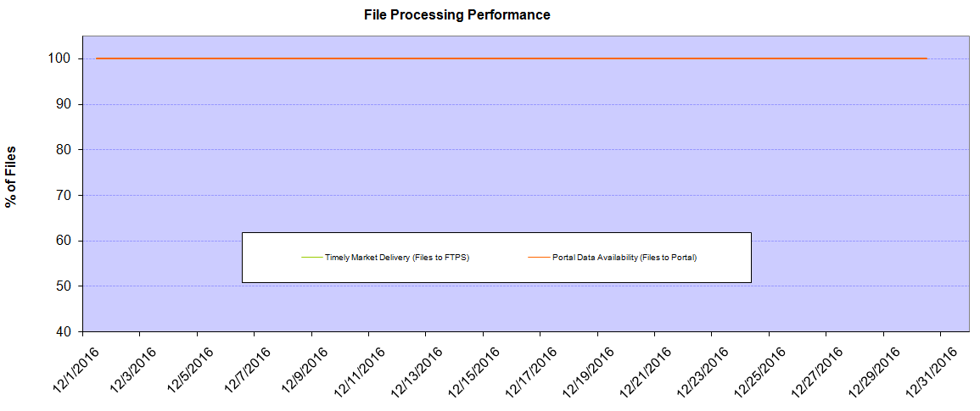
Monthly SMT Data Timelines AMWG CR 2014 002 End to End File Processing Completeness – DEC 2016
% Timely Market Delivery - % of files posted to market (FTPS) by 11:00pm out of # of files received by SMT by 11:00pm.
% Portal Data Availability - % of files loaded to the database for data availability on portal by 6:00am next day for the files received by 11:00pm
* A LSE file includes usage data for up to 50,000 ESIIDs.
Observed Anomalies:
2

Slide 3
SMT API and FTPS Services Availability – DEC 2016
The service availability is measured as a percentage of number of minutes the service was available out of the total number of minutes in a month, excluding planned outages.
Observed Anomalies:
25 Jan 2016: Services were unavailable for 19 hours due to storage configuration issue
07 Mar 2016: API Services were unavailable for 7hours due to Oracle archiver issue.
Notes:
3

Slide 4
SMT Number of Accounts by Type AMWG CR 2014 009 – December 2016
Registered Users | ONC | CNP | AEPN | AEPC | TNMP | TOTAL
Active Residential Accounts | 41818 | 25617 | 1878 | 5431 | 2751 | 77495
Active Residential English Accounts | 41593 | 25425 | 1873 | 5305 | 2741 | 76937
Active Residential Spanish Accounts | 225 | 192 | 5 | 126 | 10 | 558
Non Active Residential Accounts | 20938 | 14162 | 1694 | 3722 | 835 | 40972
Total Residential Accounts | 62756 | 39779 | 3572 | 9153 | 3586 | 118467
TDSP User | 322 | 36 | 12 | 18 | 1 | 389
TDSP Admin | 4 | 4 | 4 | 4 | 3 | 19
Small Business User | 122 | 56 | 1 | 4 | 5 | 188
Small Business Admin | 2790 | 1519 | 83 | 302 | 119 | 4946
Total Agreements (Includes Active and Pending) | 593 | 556 | 2 | 6 | 23 | 1180
Energy Data Agreements (Includes Active and Pending) | 593 | 307 | 2 | 6 | 23 | 931
Han Device Agreements (Includes Active and Pending) | 0 | 248 | 0 | 0 | 0 | 248
Han Service Agreements (Includes Active and Pending) | 0 | 1 | 0 | 0 | 0 | 1
IN SMT
ESI IDs | 3512276 | 2439640 | 198182 | 862553 | 244464 | 7257115
Meters | 3449373 | 2439563 | 198972 | 862788 | 244069 | 7194765
HAN Devices | 3700 | 4731 | 140 | 292 | 29 | 8892
Acknowledgement | 0 | 0 | 0 | 0 | 0
Pending | 0 | 1 | 0 | 0 | 0
Meter Ready | 13 | 3 | 43 | 110 | 17
Provisioned | 3687 | 4727 | 97 | 182 | 12
HAN Messages (MTD) | 0 | 0 | 0 | 0 | 0 | 0
HAN Messages (YTD) | 0 | 0 | 0 | 0 | 0 | 0
HAN Messages (Cumulative) | 380 | 7405 | 0 | 0 | 0 | 7785
Simple Text Messages | 140 | 2930 | 0 | 0 | 0
Load Control Messages | 100 | 2658 | 0 | 0 | 0
Pricing Messages | 96 | 53 | 0 | 0 | 0
Cancellation Messages | 44 | 1764 | 0 | 0 | 0
Supplemental – (Friends)
Total Agreements | 1815 | 1383 | 78 | 89 | 60 | 3425
Accepted Agreements | 768 | 531 | 35 | 29 | 19 | 1382
Pending Agreements | 2 | 0 | 0 | 0 | 0 | 2
Revoked Agreements | 316 | 270 | 10 | 8 | 6 | 610
Expired Agreements | 691 | 551 | 31 | 52 | 35 | 1360
Terminated Agreements | 36 | 31 | 2 | 0 | 0 | 71
 | TDSPs | REP | Small Business | Regulatory | Third Party
Registered Entities | 5 | 114 | 4797 | 2 | 123
Registered Users | 389 | 996 | 188 | 8 | 28
Registered Admins | 19 | 184 | 4813 | 4 | 131
HAN Messages Sent By | 344 | 7417

Slide 5
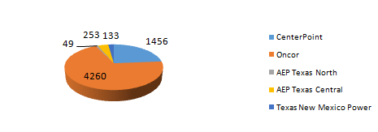
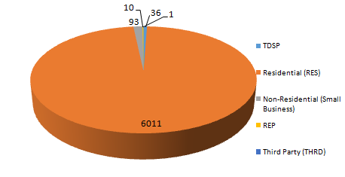
SMT ODR Details – DEC 2016
Total ODR Requests TDSP wise statistics:
Total ODR Requests User type statistics:

