Slide 1
SMT Update To AMWG
NOV 2016

Slide 2
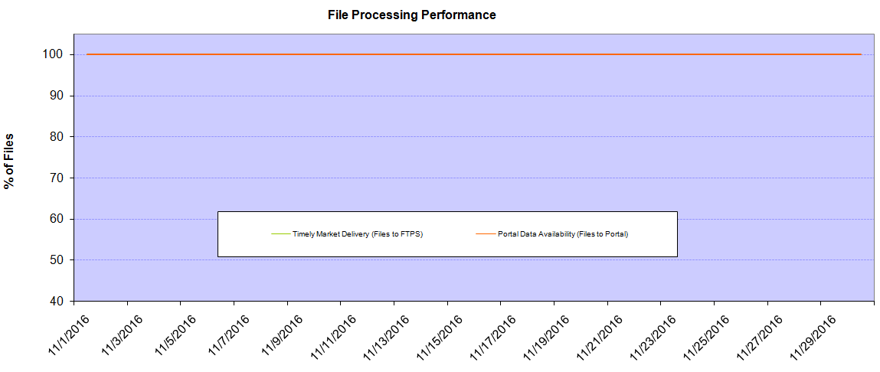
Monthly SMT Data Timelines AMWG CR 2014 002 End to End File Processing Completeness – NOV 2016
% Timely Market Delivery - % of files posted to market (FTPS) by 11:00pm out of # of files received by SMT by 11:00pm.
% Portal Data Availability - % of files loaded to the database for data availability on portal by 6:00am next day for the files received by 11:00pm
* A LSE file includes usage data for up to 50,000 ESIIDs.
Observed Anomalies:
2

Slide 3
SMT API and FTPS Services Availability – NOV 2016
The service availability is measured as a percentage of number of minutes the service was available out of the total number of minutes in a month, excluding planned outages.
Observed Anomalies:
25 Jan 2016: Services were unavailable for 19 hours due to storage configuration issue
07 Mar 2016: API Services were unavailable for 7hours due to Oracle archiver issue.
Notes:
3

Slide 4
SMT Number of Accounts by Type AMWG CR 2014 009 – November 2016
Registered Users | ONC | CNP | AEPN | AEPC | TNMP | TOTAL
Active Residential Accounts | 41363 | 25562 | 1875 | 5455 | 2745 | 77000
Active Residential English Accounts | 41149 | 25368 | 1870 | 5329 | 2734 | 76450
Active Residential Spanish Accounts | 214 | 194 | 5 | 126 | 11 | 550
Non Active Residential Accounts | 20567 | 13886 | 1669 | 3645 | 803 | 4020
Total Residential Accounts | 61930 | 39448 | 3544 | 9100 | 3548 | 117203
TDSP User | 349 | 36 | 12 | 18 | 1 | 416
TDSP Admin | 4 | 4 | 4 | 4 | 3 | 19
Small Business User | 122 | 56 | 1 | 4 | 5 | 188
Small Business Admin | 2754 | 1505 | 81 | 297 | 118 | 4885
Total Agreements (Includes Active and Pending) | 551 | 549 | 2 | 6 | 20 | 1128
Energy Data Agreements (Includes Active and Pending) | 551 | 300 | 2 | 6 | 20 | 879
Han Device Agreements (Includes Active and Pending) | 0 | 248 | 0 | 0 | 0 | 248
Han Service Agreements (Includes Active and Pending) | 0 | 1 | 0 | 0 | 0 | 1
IN SMT
ESI IDs | 3507462 | 2434857 | 198078 | 861573 | 243744 | 7245714
Meters | 3444059 | 2434789 | 198870 | 861796 | 243367 | 7182881
HAN Devices | 3718 | 4779 | 139 | 289 | 29 | 8954
Acknowledgement | 0 | 0 | 0 | 0 | 0
Pending | 0 | 2 | 0 | 0 | 0
Meter Ready | 6 | 0 | 43 | 110 | 18
Provisioned | 3712 | 4777 | 96 | 179 | 11
HAN Messages (MTD) | 1 | 0 | 0 | 0 | 0 | 1
HAN Messages (YTD) | 58 | 8 | 0 | 0 | 0 | 66
HAN Messages (Cumulative) | 380 | 7405 | 0 | 0 | 0 | 7785
Simple Text Messages | 140 | 2930 | 0 | 0 | 0
Load Control Messages | 100 | 2658 | 0 | 0 | 0
Pricing Messages | 96 | 53 | 0 | 0 | 0
Cancellation Messages | 44 | 1764 | 0 | 0 | 0
Supplemental – (Friends)
Total Agreements | 1802 | 1383 | 77 | 89 | 60 | 3411
Accepted Agreements | 765 | 531 | 35 | 29 | 19 | 1379
Pending Agreements | 0 | 0 | 0 | 0 | 0 | 0
Revoked Agreements | 312 | 270 | 10 | 8 | 6 | 606
Expired Agreements | 689 | 551 | 30 | 52 | 35 | 1357
Terminated Agreements | 36 | 31 | 2 | 0 | 0 | 69
 | TDSPs | REP | Small Business | Regulatory | Third Party
Registered Entities | 5 | 114 | 4739 | 2 | 117
Registered Users | 416 | 994 | 188 | 8 | 26
Registered Admins | 19 | 184 | 4755 | 4 | 125
HAN Messages Sent By | 344 | 7417

Slide 5
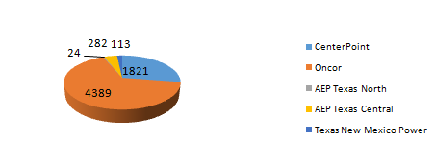
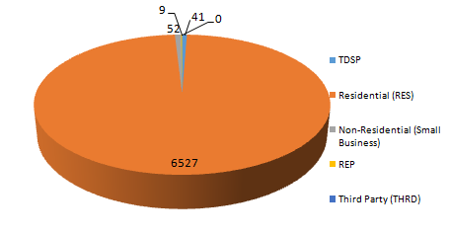
SMT ODR Details – NOV 2016
Total ODR Requests TDSP wise statistics:
Total ODR Requests User type statistics:

