Slide 1
Day Ahead Make Whole Adjustments due
to Ancillary Infeasible MW in Real-Time
Follow up to NPRR782 III
Austin Rosel
ERCOT
January 13, 2017

Slide 2
NPRR782 Impacts on DAM Make Whole
NPRR782 introduced a clawback mechanism for infeasible Ancillary services.
A QSE incurs a clawback charge equal to the infeasible MW times the DAM clearing price for the Ancillary Service.
This is a possible reduction in a payment that is used to offset Day Ahead Guaranteed Costs used in the Day Ahead Make Whole Payment.
The potential lost Make Whole is not accounted for in NPRR782.

Slide 3
Day Ahead Make Whole Payment
DAASREV is essentially reduced due to the Ancillary Services clawback introduced in NPRR782.
It’s possible the reduction could cause the resource to not be made whole in DAM.

Slide 4
Frequency of Infeasible AS
NPRR782 will introduce new systemization to declare and capture AS infeasible amounts.
No “hard data” exists on historical AS infeasible occurrences as they will be recorded after NPR782.
Approximately 6 events a year based on estimates.

Slide 5
Day-Ahead Make Whole Insufficiency
Infeasible MW clawback charge
QSE has infeasible MW in Real-Time.
QSE charged infeasible MW quantity times Day-Ahead price of the Ancillary Service (regardless of whether or not the QSE sold Ancillary Services in the Day-Ahead).
Day-Ahead make whole insufficiency calculation
Check to make sure AS infeasible type was awarded in Day-Ahead.
Day-Ahead make whole payment is re-calculated in Real-Time with reduced Ancillary Services revenues considered.
The re-calculated Day-Ahead make whole payment is used to calculate an adjusted make whole payment. This adjustment amount may change subject to a Real-Time revenue and AS imbalance offsets amount (next page).
$$RTM Offset=−1∗\{\max\left(0,RTMG−HASL1\right)∗RTSPP −(Cost)+$$
$\left[HASL2 −\max\left(HASL1, RTMG\right)\right]∗RTRSVPOR\}$

Slide 6
Real-Time Revenue Offset
Real-Time revenue offset
HASL is calculated when the infeasible MW were declared by ERCOT.
HASL is converted to MWh for the 15 minute settlement interval and any RTMG that is greater than the HASL is multiplied by the Real-Time Settlement Point Price.
The Revenues calculated in the bullet point above are used to reduce any Day-Ahead Make Whole adjustment payments.
Additional Energy Revenue used to offset DAM MW adjustment
HASL2
HASL1

Slide 7
Real-Time Revenue Offset
Real-Time revenue offset
Costs of operating above the original HASL are estimated and the offset amount is reduced by those costs.
Costs are estimated as the costs between the HASL (or similarly LSL) and the RTMG on the Energy Offer Curve.
Cost above HASL1
$/MWh
LSL
HASL1
RTMG
HSL
MW

Slide 8
Ancillary Service Imbalance Offset
Ancillary Service Imbalance revenue offset
The increased HASL could increase AS Imbalance Payments to the QSE that could be used to offset the Day-Ahead Make whole adjustment payment.
The HASL calculated when the infeasible MW were declared by ERCOT is used to calculate the additional revenues similarly to the previous slide.
HASL2
HASL1
Additional AS imbalance revenue used to offset DAM MW adjustment
ERCOT needs to have further discussions in regards to infeasibility and Online Non-Spin due to the fact the capacity is not held behind the HASL for SCED dispatch.

Slide 9
Interval Allocation
The DAM Make Whole payment is calculated on a block basis, a contiguous block of DAM committed hours is evaluated as a whole to see if revenues cover costs. The adjustment will be calculated the same way.
If the hour with infeasible MW does not overlap a DAM committed block then the infeasible clawback amount is allocated directly to that hour.
If one or more hours with infeasible MW overlaps a DAM committed block then the infeasible clawback amount is allocated on a pro-rata basis based on infeasible MW.

Slide 10
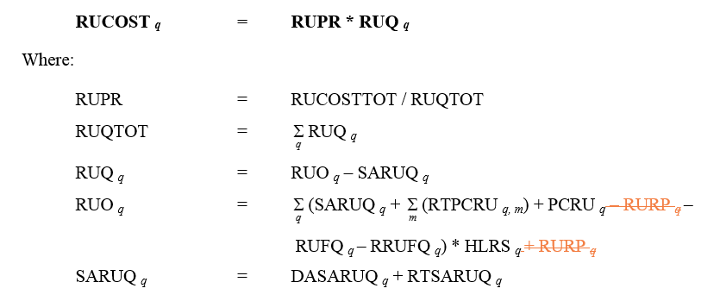
Allocation of Charges and excess Revenue
Allocation of charges and payments.
Excess revenues from the claw back and charges to keep a Resource whole for the adjustment are allocated per the methodology in NPRR782.
NPRR782 takes the claw back amounts and uses them to reduce the total AS costs in NP6.7.4, Adjustments to Cost Allocations for Ancillary Services Procurement.

Slide 11
Next Steps
Does QMWG want this concept presented to WMS?
Does QMWG have a recommendation for WMS?

