Slide 1
Credit Exposure and Expected Loss update
Spoorthy Papudesi
ERCOT Credit
January 18, 2017

Slide 2
Agenda
Inputs and assumptions
Exposure and collateral distributions
Expected loss estimates
Observations

Slide 3
Credit Exposure and Expected Loss update
Inputs and Assumptions:
Only Active Counter-Parties are included
Counter-Parties are classified by rating and market activity
TPE and collateral balances used are averages for November and December 2016
Negative excess collateral shown is due to the adjustment to remove unsecured credit
Counter-Parties that are subsidiaries of, or guaranteed by, rated entities are given the parent/guarantor’s rating, adjusted down one notch
Recovery Rate (RR) is assumed 0
Non-rated Counter-Parties are assigned the same PD as CCC

Slide 4
Credit Exposure and Expected Loss update
Inputs and Assumptions:
Exposure at Default (EaD) is assumed to be equal to TPE
TPE will typically exceed invoice exposure, so this is a conservative metric. It should be viewed as a relative indicator of credit portfolio risk, not a forecast for losses or uplift
Probabilities of Default (PD) are from “Global Corporate Average Cumulative Default Rates By Rating Modifier (1981-2015)”, from S&P publication “2015 Annual Global Corporate Default Study And Rating Transitions”
Expected Loss (EL) computed as follows;
EL = EaD * PD * LGD
Where: Loss Giver Default (LGD) = (1-Recovery Rate)
Recovery Rate is conservatively assumed at “0” as at the time of default, CP may be under stress and would have used up all funds

Slide 5
Credit Exposure and Expected Loss update
Inputs and Assumptions:
Assumed 1 year Probabilities of Default

Slide 6
Credit Exposure and Expected Loss update
Exposure and Collateral Distributions

Slide 7
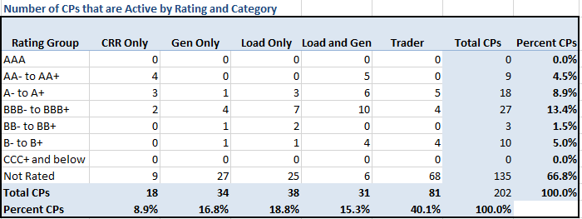
Credit Exposure and Expected Loss update
Active Counter-Parties distribution by rating and category

Slide 8
Credit Exposure & Expected Loss update
Average Total Potential Exposure distribution

Slide 9
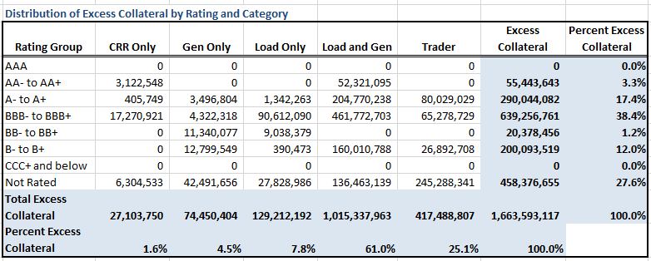
Credit Exposure & Expected Loss update
Average Excess Collateral distribution

Slide 10
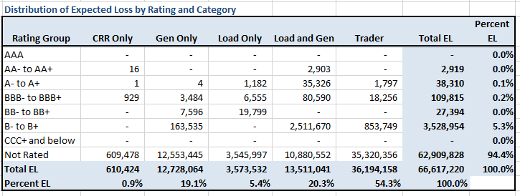
Credit Exposure & Expected Loss update
Expected Loss distribution

Slide 11
Credit Exposure and Expected Loss update
Summary statistics by market category

Slide 12
Credit Exposure and Expected Loss update
Summary statistics by rating group

Slide 13
Credit Exposure and Expected Loss update
Change from Oct 2016 to Dec 2016 *
The PD rates increased by 1.3%, 1.24% and 0.84% for Counter-Parties rated B, B- and CCC/NR respectively.
Number of active Counter-Parties has increased from 197 to 202.
Market-wide TPE has decreased from 308 million to 262 million while market-wide Excess Collateral has increased from 1,469 million to 1,663 million.
TPE of Load and Gen category has decreased by 1.8% while the excess collateral increased by 1.6%.
TPE of Gen only category has increased by 1.9%.
Expected Loss for the rating group ‘B- to B+’ increased by 3.6%.
*Numbers presented are averages of Sep-Oct and Nov-Dec

Slide 14
Credit Exposure and Expected Loss update
Questions

