Slide 1
PDCWG Report to ROS
Chair: Percy Galliguez, Brazos Electric Power Cooperative, Inc.
Vice Chair: Stewart Rake, Luminant
ROS
January 12th, 2017

Slide 2
Report Overview & Notes
Report Overview
  Meeting Minutes
  BAL-001-TRE-1 FMEs & IMFR
    1 FME in the month of December
  Frequency Control Report

Slide 3
Meeting Minutes
PDCWG Meeting 12/14/16
  Regulation & Frequency Control Reports(New ACE Integral)
  GREDP Performance Analysis
  MOD-026-1 & MOD-027-1 Discussion
    NPRR Proposal/Review Status with ERCOT Input Provided
  ERCOT Inertia Background Presentation
  Reviewed Frequency Events
    11/5/2016 17:56:24
      Loss of 830MW
      783 MW/0.1HZ Response
      1 of 25 Generation Resources providing RRS had less than 75% of their expected Initial Primary Frequency Response.
      1 of 25 Generation Resources providing RRS had less than 75% of their expected Sustained Primary Frequency Response
    11/19/2016 12:30:13
      Loss of 467MW
      791 MW/0.1HZ Response
      2 of 21 Generation Resources providing RRS had less than 75% of their expected Initial Primary Frequency Response.
      3 of 21 Generation Resources providing RRS had less than 75% of their expected Sustained Primary Frequency Response

Slide 4
Frequency Measurable Events Performance
December 2016

Slide 5
Frequency Measurable Events
There was 1 FME in December.
  12/23/2016 16:54:13
    Loss of 570 MW
    Interconnection Frequency Response: 627 MW/0.1 Hz
    7 of 38 Evaluated Generation Resources had less than 75% of their expected Initial Primary Frequency Response.
    7 of 38 Evaluated Generation Resources had less than 75% of their expected Sustained Primary Frequency Response.

Slide 6
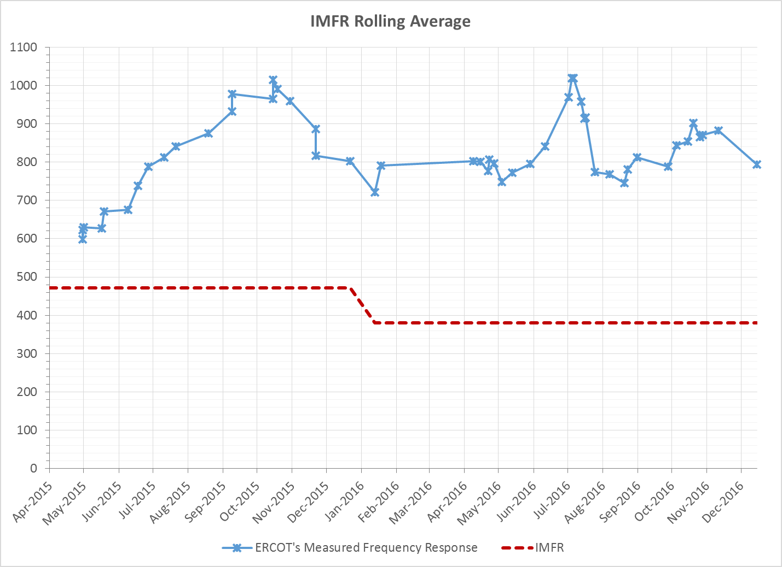
Interconnection Minimum Frequency Response (IMFR) Performance
IMFR Performance currently 793.55 MW/0.1Hz

Slide 7
Frequency Control Report
December 2016

Slide 8
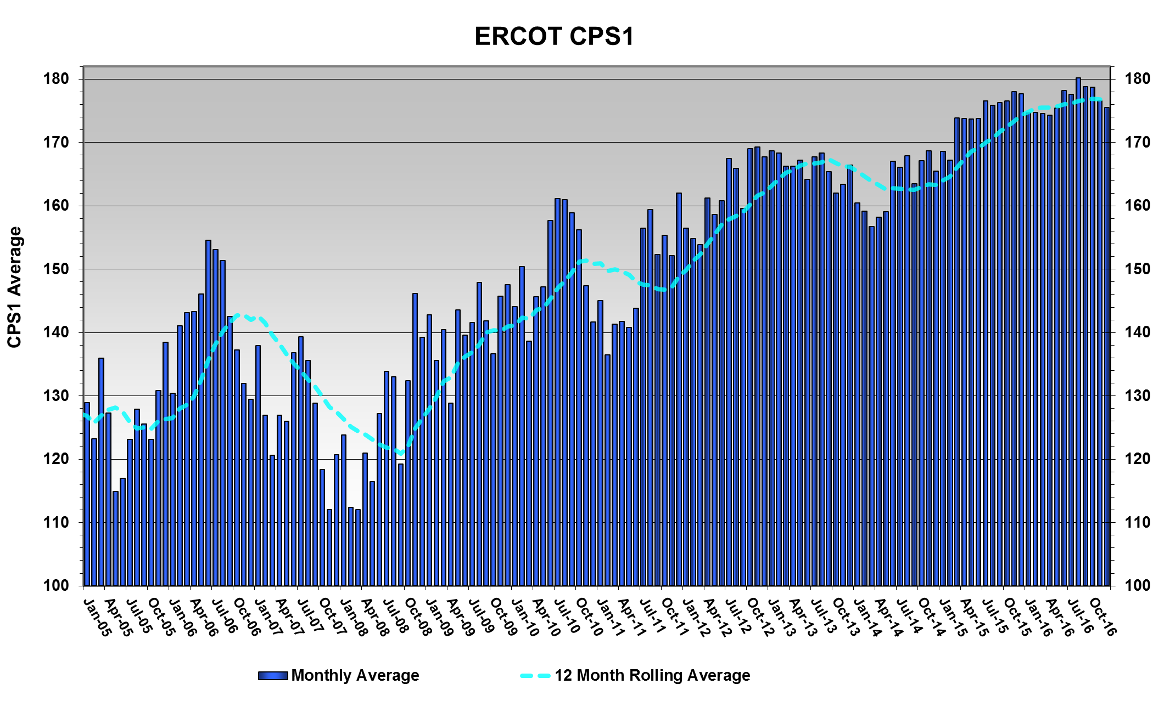
CPS1 Performance
CPS1 12 Month Rolling Average = 176.62%

Slide 9
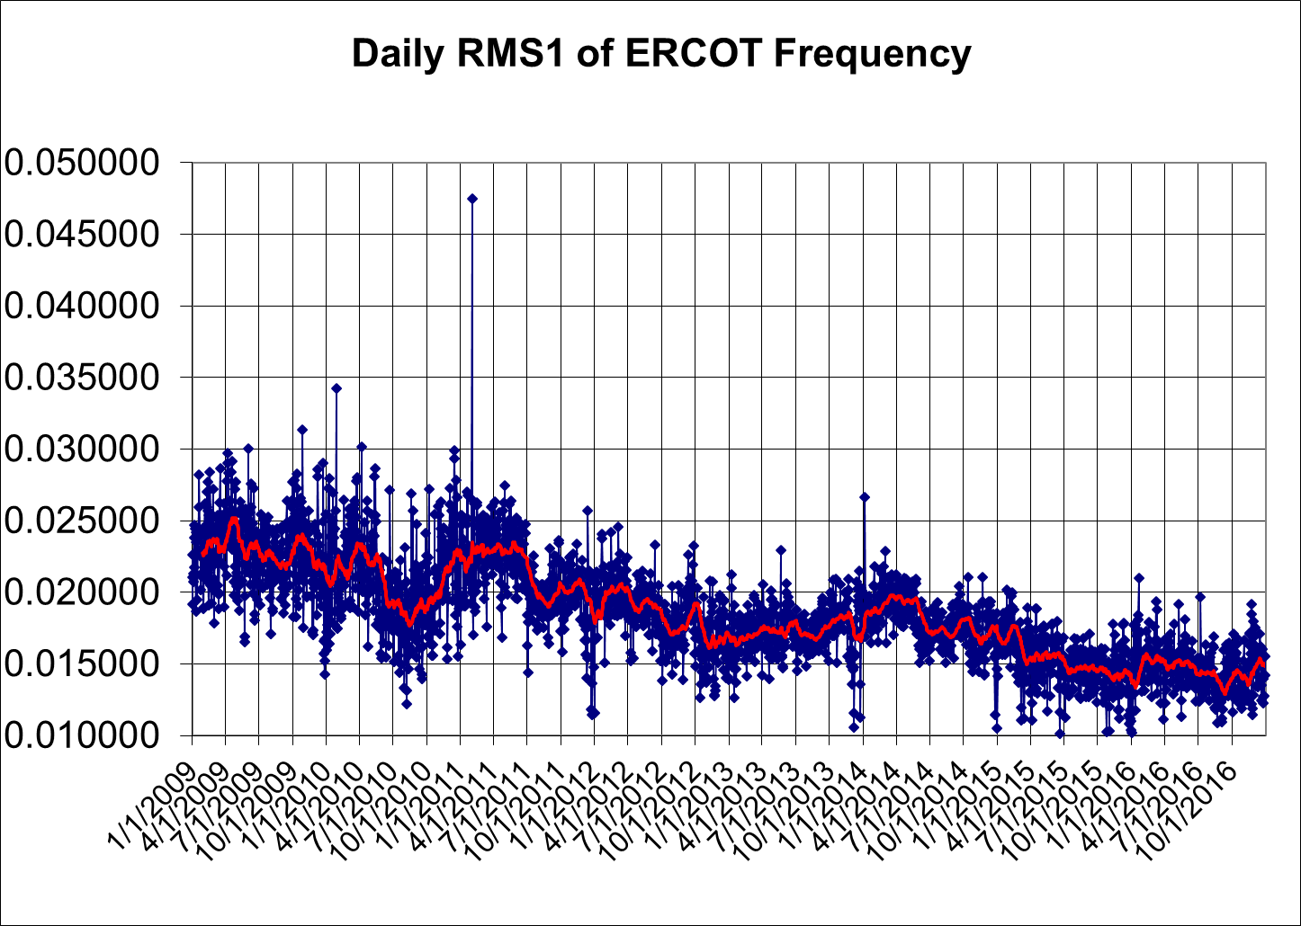
RMS1 Performance of ERCOT Frequency

Slide 10
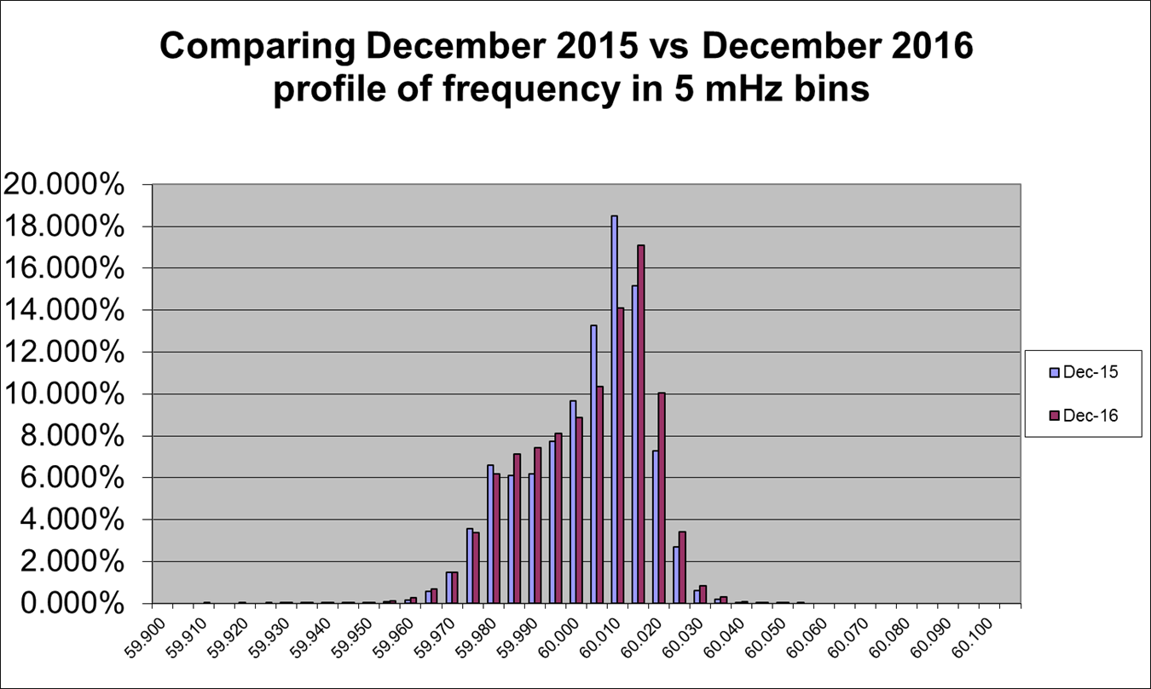
Frequency Profile Analysis

Slide 11
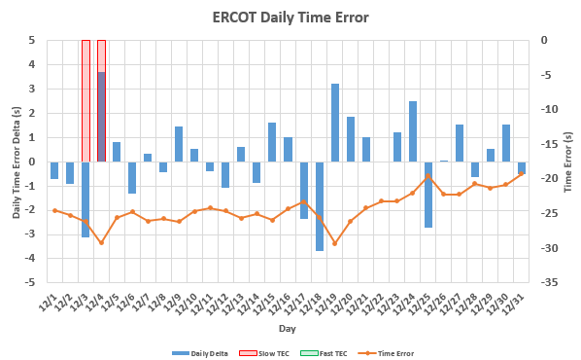
Time Error Corrections
There was 1 Time Error Corrections (TEC) in December.
Notes:
TEC occurred on 12/03/2016 at 23:30. Time Error was 30.06

Slide 12
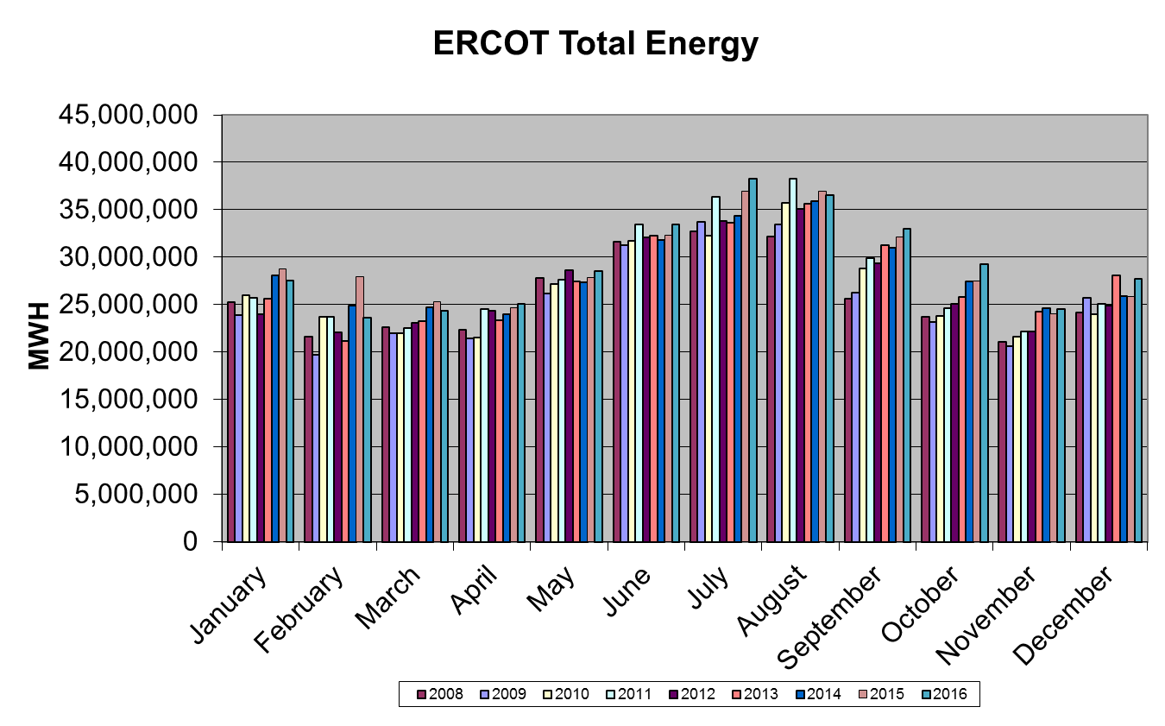
Wind Generation Performance

Slide 13
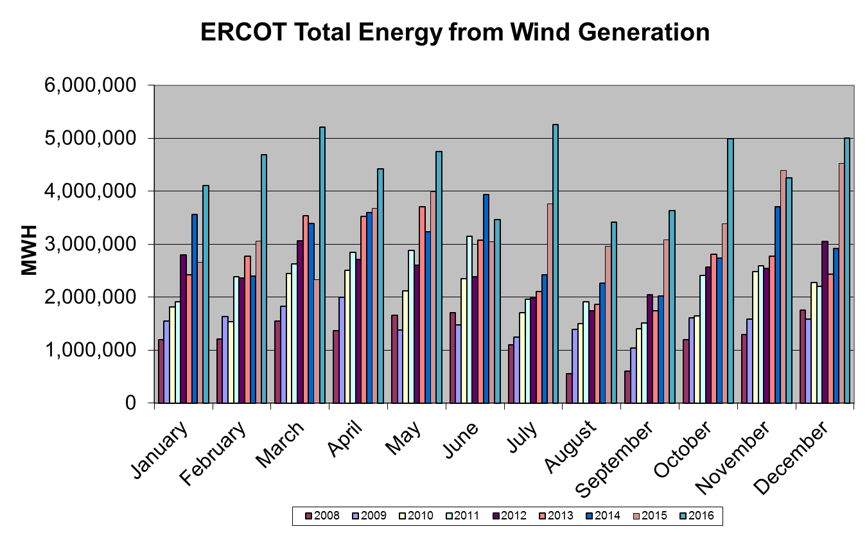
Wind Generation Performance

Slide 14
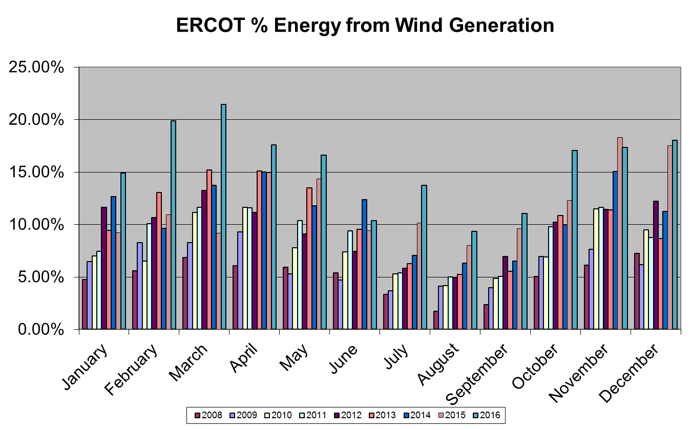
Wind Generation Performance

Slide 15
Questions?

