Slide 1
Emerging Technologies Working Group update to the Wholesale Market Subcommittee
01/10/2017

Slide 2
ETWG update to WMS
ERCOT Unregistered DG Report, Review
ARPA-E, Emerging Tech Research:
DSO simulation Platform
Transmission Topology Control / Line Switching
Gas-electric Coordination / Co-optimization
Micro-PMU Applications
Other Business

Slide 3
ETWG update to WMS: ERCOT Unregistered DG Report

Slide 4
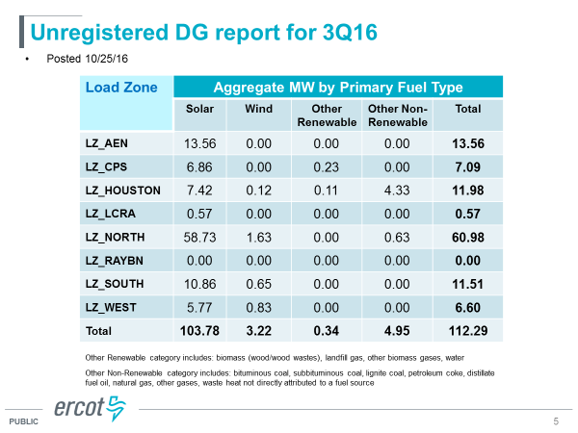
ETWG update to WMS: ERCOT Unregistered DG Report

Slide 5
ETWG update to WMS: ARPA-E, Emerging Tech Research
There were four different presentations on the research that ARPA-E is doing.
Distribution System Operator (DSO) Simulation Studio
Transmission Topology Optimization Software
Gas-Electric Co-Optimization (GECO)
Micro-Synchrophasors for Distribution System

Slide 6
ETWG update to WMS: ARPA-E, Emerging Tech Research
Distribution System Operator (DSO) Simulation Studio

Slide 7
ETWG update to WMS: ARPA-E, Emerging Tech Research
Distribution System Operator (DSO) Simulation Studio

Slide 8
ETWG update to WMS: ARPA-E, Emerging Tech Research
Transmission Topology Optimization Software

Slide 9
ETWG update to WMS: ARPA-E, Emerging Tech Research
Transmission Topology Optimization Software

Slide 10
ETWG update to WMS: ARPA-E, Emerging Tech Research
Gas-Electric Co-Optimization (GECO)

Slide 11
ETWG update to WMS: ARPA-E, Emerging Tech Research
Gas-Electric Co-Optimization (GECO)

Slide 12
ETWG update to WMS: ARPA-E, Emerging Tech Research
Micro-Synchrophasors for Distribution System

Slide 13
ETWG update to WMS: Other Business
ETWG Chair and Vice Chair Nominations:
Chair: Hugo Mena
Vice Chair: Michael Legatt

Slide 14
ETWG update to WMS: Next Meetings
February 7, Tuesday, 9:30-12:00
March 7, Tuesday, 9:30-12:00

