Slide 1
SAWG Update to WMS
January 11, 2017
Brandon Whittle

Slide 2
Report Releases
CDR December Update Released
http://www.ercot.com/gridinfo/resource
Nominations for new Chair
Housekeeping

Slide 3
MIRTM – Update
ERCOT will present findings at Jan 17 SAWG
WMS will be asked to opine soon after

Slide 4
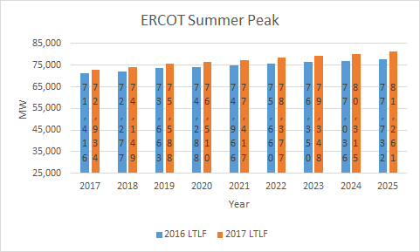
LTLF Increase
Primary increases in South Central and North Central
Increases consistent with observed model error in 2016 Peak Review (PLWG 9/21/16)
Freeport is the only bulk load addition modeled, consistent with 2016 LTLF; i.e. Lubbock and Rayburn not considered.
Source – ERCOT LTLF Presentation to 11-17-16 SAWG
Notes:
http://www.ercot.com/content/wcm/key_documents_lists/81127/PLWG_09-21-2016_updated.pptx

Slide 5
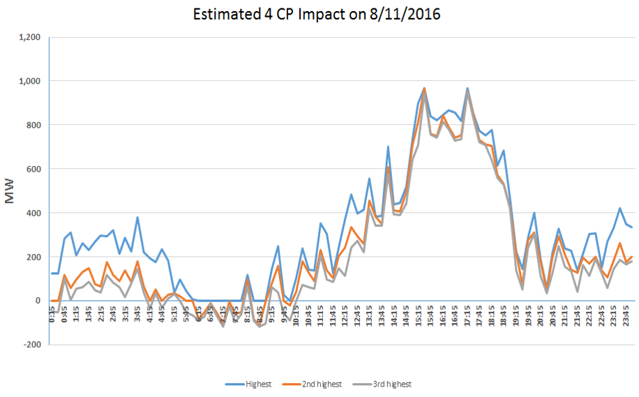
Conservative Estimate
Does not include impacts from the NOIEs
Does not include the impacts from other non-transmission (distribution) premises
Both of the above have significant weather sensitive loads which makes the estimate of 4 CP more difficult
Requires a different technique(s) to quantify their 4 CP impact
Source – ERCOT LTLF Presentation to 11-17-16 SAWG

Slide 6
Next Meeting – January 17, 2017
Expected Agenda Items
MIRTM Conclusions Review
Nominations for 2017-2020 Chair

