Slide 1
Analysis of Reliability Must-Run Resource Mitigated Offer Cap Curve Alternatives
David Maggio
Manager, Market Analysis and Validation
January 11th, 2017

Slide 2
Introduction
During the November meeting, the WMS made requests for ERCOT to analyze several different implementation options for determining the Mitigated Offer Cap (MOC) curve for a Reliability Must-Run (RMR) Resource
These options were to be founded on the general methodology of basing the RMR Resource MOC curve on the last dispatchable non-RMR Resource
This presentation will share the results of that analysis and compare the various options
The presentation discussed during the October and November WMS meeting is provided in Appendix C for easy reference

Slide 3
Refresher on the Analysis Assumptions
In order to provide a comparison of the different options:
Used Green Bayou Unit 5 (GBY5) as the sole RMR Resource
Focused on Real-Time Market (RTM) constraints in which transmission elements SNGZEN98_A or SNGZEN99_A were the constrained element
These constraints have a max. shadow price of 4,500 $/MWh
Analyzed each Security-Constrained Economic Dispatch (SCED) interval separately, for intervals in which a constraint with SNGZEN98_A or SNGZEN99_A was binding (active in SCED with a shadow price greater than 0)
Data analyzed from Nodal Go-Live through mid-November, 2016

Slide 4
Calculation Methodology
For each SCED interval:
For all non-RMR Resources with a shift factor < SFC, calculate a value = (CURVE for that Resource)/Abs(Shift factor for that Resource for the specified constraint)
If the value < Constraint max. shadow price, then set to value
Else, set to null (Resources that cannot be dispatched by SCED are ignored)
Set SP_{u} as the maximum of the values determined in step 1
Set SP_{max} as the minimum of:
SP_{u} + BUFFER
Constraint max. shadow price – 1 $/MWh
Set the RMR Resource MOC as SP_{max} x Abs(RMR Resource shift factor for the specified constraint)

Slide 5
Requested Options
The following options were requested during the November meeting:
Variable | Description | Values
SFC | Shift Factor Cut-off in % for non-RMR Resources | -2, -5, -10, and -15
CURVE | Offer Curve to use for the non-RMR Resources | Price at HSL for the SCED Step 2 Energy Offer Curve (EOC2) and the MOC curve (MOC)
BUFFER | Buffer amount in $/MWh to add to the SP_{u} value | 1 and 50
Results are compared to an estimated generic MOC using recent, average data for Resources with the same fuel type as the RMR Resource scaled according to the FIP for the Operating Day (“Generic” for the graphs)

Slide 6
Flow Diagram
Historical Constraint Data including Shift Factors
Mitigated Offer Cap Curve for the RMR Resource
Mitigated Offer Cap Curves
Historical Non-RMR Resource Curves
Energy Offer Curve Mitigation
Constraint Competitiveness Test Results
SCED Step 1
Transmission Constraints and Shift Factors
SCED Step 2
Dispatch Instructions
Energy Offer Curves
Pricing
Resource Limits

Slide 7
Interval Level Data
SCED interval level data for the various variable combinations is embedded below for individuals to review:

Slide 8
Comparison of Options Relative to the Shift Factor Cut-off

Slide 9
Comparison Relative to Shift Factor Cut-Offs

Slide 10
Comparison Relative to Shift Factor Cut-Offs

Slide 11
Comparison Relative to Shift Factor Cut-Offs

Slide 12
Comparison Relative to Shift Factor Cut-Offs

Slide 13
Comparison Relative to Shift Factor Cut-Offs
A key for reading the box plots can be found in Appendix B

Slide 14
Comparison Relative to Shift Factor Cut-Offs
General observations from the analysis for the shift factor cut-off options
Using a more negative shift factor cut-off results in lower RMR Resource MOC values
This makes sense given that you are reducing the number of non-RMR Resources considered to a smaller and smaller pool as the cut-off is made more negative
The biggest, cumulative decrease in the RMR Resource MOC values occurs between the shift factor cut-off options of -2% and -5%
The change in shift factor cut-off between -5%, -10%, and -15% made a more significant difference under the SCED Step 2 EOC option

Slide 15
Comparison of Options Relative to the Non-RMR Resource Curves

Slide 16
Comparison Relative to Non-RMR Resource Curves

Slide 17
Comparison Relative to Non-RMR Resource Curves

Slide 18
Comparison Relative to Non-RMR Resource Curves

Slide 19
Comparison Relative to Non-RMR Resource Curves

Slide 20
Comparison Relative to Non-RMR Resource Curves
A key for reading the box plots can be found in Appendix B

Slide 21
Comparison Relative to Non-RMR Resource Curves
General observations from the analysis for the non-RMR Resource curves
Using the Mitigated Offer Cap curves resulted in duration curves that varied less across the analyzed intervals
This was particularly true for the cases in which the shift factor cut-off was more negative
The Mitigated Offer Cap curves are more stable and less impacted by specific system conditions and participant behavior
Outside of the extremes of the duration curves, use of the Mitigated Offer Cap curves tended to result in values that were overall higher than those using the SCED Step 2 Energy Offer Curves
This may not be true for any specific interval

Slide 22
Comparison of Options Relative to the Buffer Value

Slide 23
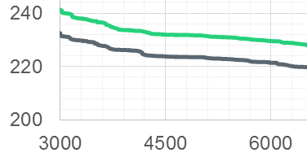
Comparison Relative to the Buffer Value

Slide 24
Comparison Relative to the Buffer Value
A key for reading the box plots can be found in Appendix B

Slide 25
Comparison Relative to the Buffer Value
General observations from the analysis for the buffer value
The change in buffer value from 1 to 50 $/MWh resulted in an average shift in the RMR Resource MOC value of ~8 $/MWh
This was true regardless of which shift factor cut-off or non-RMR Resource curve was used
This observation is line with expectations:
Change in SP_{max} ~= change in BUFFER
Change in RMR MOC = change in SP_{max} x Abs(RMR Resource shift factor for the specified constraint)
If average RMR Resource shift factor is ~-18% and the change in BUFFER is 49 $/MWh, this equates to a change in the RMR Resource MOC value of ~8 $/MWh

Slide 26
Comparison Relative to Changes in Fuel Index Price
Following the last WMS meeting, there was also interest in looking at the potential impact of changes in the Fuel Index Price on the RMR Resource MOC value
To analyze this, historic value were scaled using the following method:
Scaled MOC Value = (Operating Day Fuel Index Price/2.53 $/MMBtu) * MOC Value
2.53 $/MMBtu was taken from the EIA website for Henry Hub week ending 11/16/16
Based on the observations and depending on the specific implementation approach, periodic updates to adjust for changes in fuel index prices may warrant consideration

Slide 27
Comparison Relative to Changes in Fuel Index Price

Slide 28
Additional November WMS Discussion and Requests

Slide 29
Non-RMR Resources Setting the Value
A graph on the following slide will look at the number of distinct Resources setting the SP_{u} value for the various variable combinations
Individual configurations of the same Combined Cycle Resource are counted as distinct Resources
Some combinations have a larger count due to multiple Resources setting the same SP_{u} value for the same SCED interval
There were more of these cases for the SFC values nearer zero
The cases where the MOC was used had less variability as to which Resource set the SP_{u} value
For example, only two distinct Resources set the value for the case with SFC at -10%, CURVE at MOC, and BUFFER at 1

Slide 30
Non-RMR Resources Setting the Value
38 36 74 79 2 2 28 73
Count of distinct Resources for each case
Only the values for a BUFFER value of 1 are shown, as the results did not differ between the two BUFFER values

Slide 31
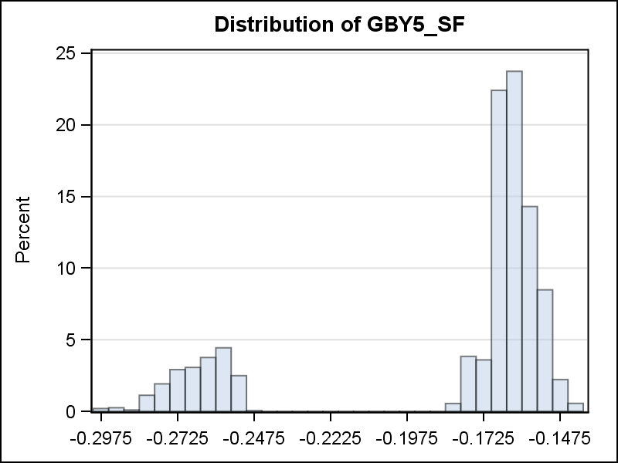
List of Production Shift Factors
Two sets of shift factors from SCED are embedded below to generally cover the spectrum of real-time shift factors that are observed for this constraint
June 16, 2016 18:00 – A case in which the shift factor for the RMR Resource is -16.7%
June 22, 2016 18:00 – A case in which the shift factor for the RMR Resource is -28.1%
Distribution of GBY5 Shift Factors

Slide 32
Implementation Options
Points for discussion on potential implementation:
A proposal with less frequent updates will likely have less implementation impact
The RMR MOC values resulting from use of non-RMR MOCs had less variability and may be a better fit for a proposal with less frequent updates
Less frequent updates could result in more time periods in which a RMR Resource is not the last “dispatchable” Resource
However, this isn’t guaranteed even in a case in which the value is being updated each SCED interval
A simple approach may be to use this type of analysis to determine a proxy Resource that the RMR Resource would be dispatched after by SCED
The price of the proxy Resource could vary across time with changes in fuel prices

Slide 33
Appendix A
Illustrative Examples

Slide 34
Example 1
Resource information -
Resource | Shift Factor | EOC2 | MOC | EOC2/ABS (Shift Factor) | MOC/ABS (Shift Factor)
RMR | -16% | - | - | - | -
A | -17% | 235 | 240 | 1382.35 | 1411.76
B | -14.9% | 190 | 330 | 1275.17 | 2214.77
C | -8% | 200 | 200 | 2500.00 | 2500.00
D | -3% | 75 | 120 | 2500.00 | 4000.00

Slide 35
Example 1
Results for Different Cases with BUFFER = 1
SFC | CURVE | SPu | Resource Setting SPu Value | SPmax | RMR MOC
-15% | EOC2 | 1382.35 | A | 1383.35 | 221.34
-10% | EOC2 | 1382.35 | A | 1383.35 | 221.34
-5% | EOC2 | 2500.00 | C | 2501.00 | 400.16
-2% | EOC2 | 2500.00 | C and D | 2501.00 | 400.16
-15% | MOC | 1411.76 | A | 1412.76 | 226.04
-10% | MOC | 2214.77 | B | 2215.77 | 354.52
-5% | MOC | 2500.00 | C | 2501.00 | 400.16
-2% | MOC | 4000.00 | D | 4001.00 | 640.16

Slide 36
Example 2
Resource information -
Resource | Shift Factor | EOC2 | MOC | EOC2/ABS (Shift Factor) | MOC/ABS (Shift Factor)
RMR | -16% | - | - | - | -
A | -17% | 235 | 240 | 1382.35 | 1411.76
B | -15.1% | 190 | 330 | 1258.28 | 2185.43
C | -8% | 200 | 200 | 2500.00 | 2500.00
D | -3% | 130 | 120 | 4333.33 | 4000.00

Slide 37
Example 2
Results for Different Cases with BUFFER = 1
SFC | CURVE | SPu | Resource Setting SPu Value | SPmax | RMR MOC
-15% | EOC2 | 1382.35 | A | 1383.35 | 221.34
-10% | EOC2 | 1382.35 | A | 1383.35 | 221.34
-5% | EOC2 | 2500.00 | C | 2501.00 | 400.16
-2% | EOC2 | 4333.33 | D | 4334.33 | 693.49
-15% | MOC | 2185.43 | B | 2186.43 | 349.83
-10% | MOC | 2185.43 | B | 2186.43 | 349.83
-5% | MOC | 2500.00 | C | 2501.00 | 400.16
-2% | MOC | 4000.00 | D | 4001.00 | 640.16

Slide 38
Appendix B
Key for using Box Plots

Slide 39
Key for Using Box Plots

Slide 40
Appendix C
Previous presentation shared during the October and November WMS Meetings

Slide 41
Analysis of Mitigated Offer Cap Curve Proposals for Reliability Must-Run Resources
David Maggio
Manager, Market Analysis and Validation
October 17, 2016

Slide 42
Introduction
During the September meeting, ERCOT offered to bring back analysis comparing proposals for setting the Mitigated Offer Cap (MOC) curves for Reliability Must-Run (RMR) Resources
2 approaches were analyzed and compared with the proposal under Nodal Protocol Revision Request (NPRR) 784, Mitigated Offer Caps for RMR Units

Slide 43
Analysis Assumptions
In order to provide a comparison of the different approaches:
Used Green Bayou Unit 5 (GBY5) as the sole RMR Resource
Focused on Real-Time Market (RTM) constraints in which transmission elements SNGZEN98_A or SNGZEN99_A were the constrained element
These constraints have a max. shadow price of 4,500 $/MWh
Analyzed each Security-Constrained Economic Dispatch (SCED) interval separately, for intervals in which a constraint with SNGZEN98_A or SNGZEN99_A was binding (active in SCED with a shadow price greater than 0)

Slide 44
Approach 1 Methodology
For each SCED interval:
For all non-RMR Resources with a shift factor < -.02, calculate a value = (Highest point on the MOC curve for that Resource)/Abs(Shift factor for that Resource for the specified constraint)
Set SP_{u} as the maximum of the values determined in step 1
Set SP_{max} as the minimum of:
SP_{u} + 50 $/MWh
Constraint max. shadow price – 1 $/MWh
Set the RMR Resource MOC as SP_{max} x Abs(RMR Resource shift factor for the specified constraint)

Slide 45
Approach 2 Methodology
For each SCED interval:
For all non-RMR Resources with a shift factor < -.02, calculate a value = (Highest point on the Step 2 Energy Offer Curve (EOC) for that Resource)/Abs(Shift factor for that Resource for the specified constraint)
If the value < Constraint max. shadow price, then set to value
Else, set to null (Resources that cannot be dispatched by SCED are ignored)
Set SP_{u} as the maximum of the values determined in step 1
Set SP_{max} as the minimum of:
SP_{u} + 50 $/MWh
Constraint max. shadow price – 1 $/MWh
Set the RMR Resource MOC as SP_{max} x Abs(RMR Resource shift factor for the specified constraint)

Slide 46
NPRR 784
For comparing these approaches to the proposal under NPRR 784, we again focused on GBY5 and constraints in which SNGZEN98_A or SNGZEN99_A were the constrained element
Determined the least negative shift factor that GBY5 had that helped the constraint (-0.14077)
Set the RMR Resource MOC as the Abs(-0.14077) x Constraint max. shadow price (~633 $/MWh)

Slide 47
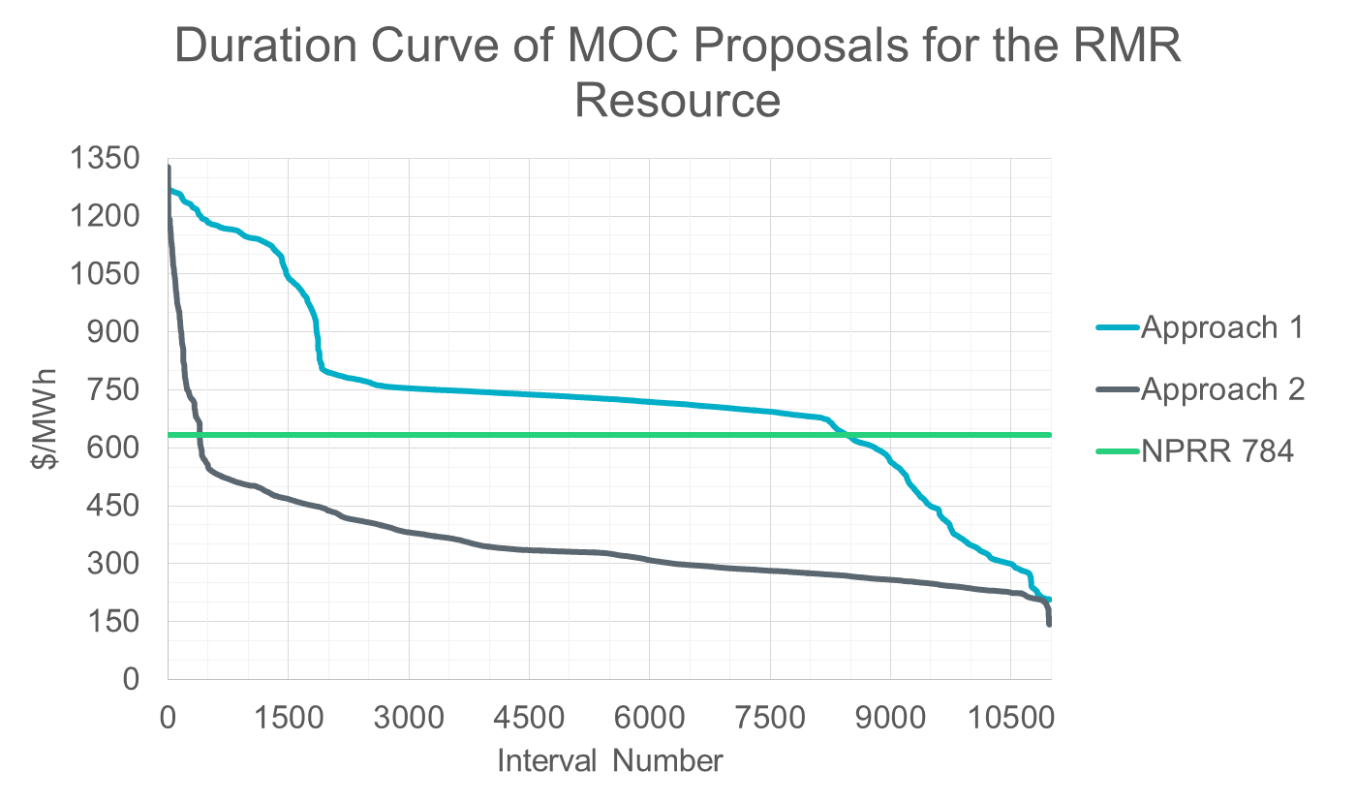
Approach Comparison – Since Go-Live

Slide 48
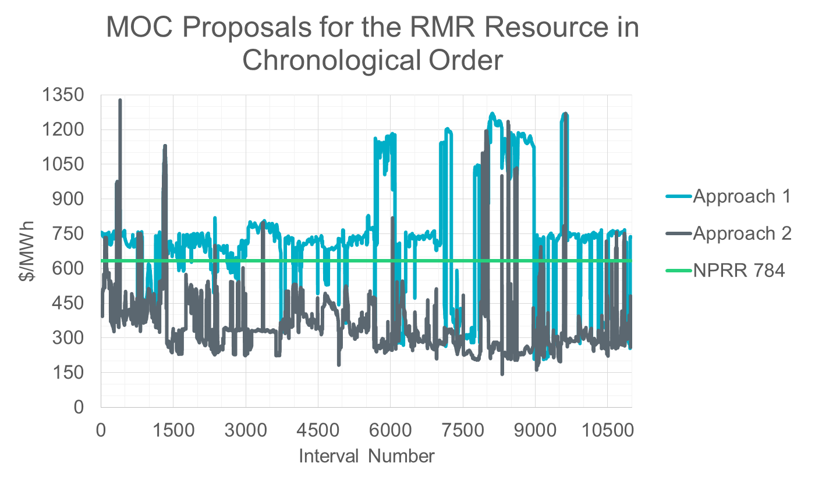
Approach Comparison – Since Go-Live

Slide 49
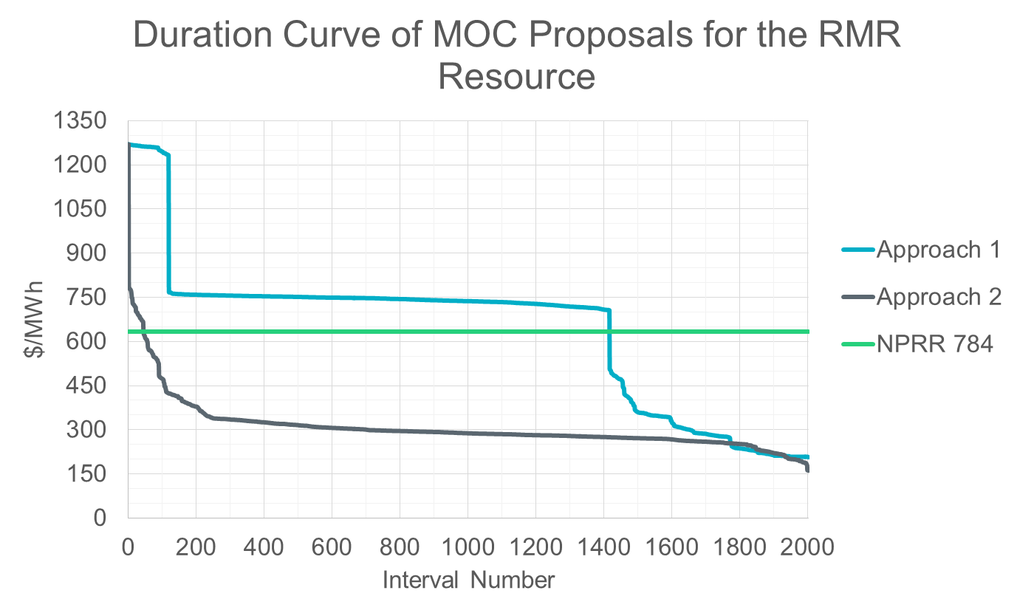
Approach Comparison – 2016 Only

Slide 50
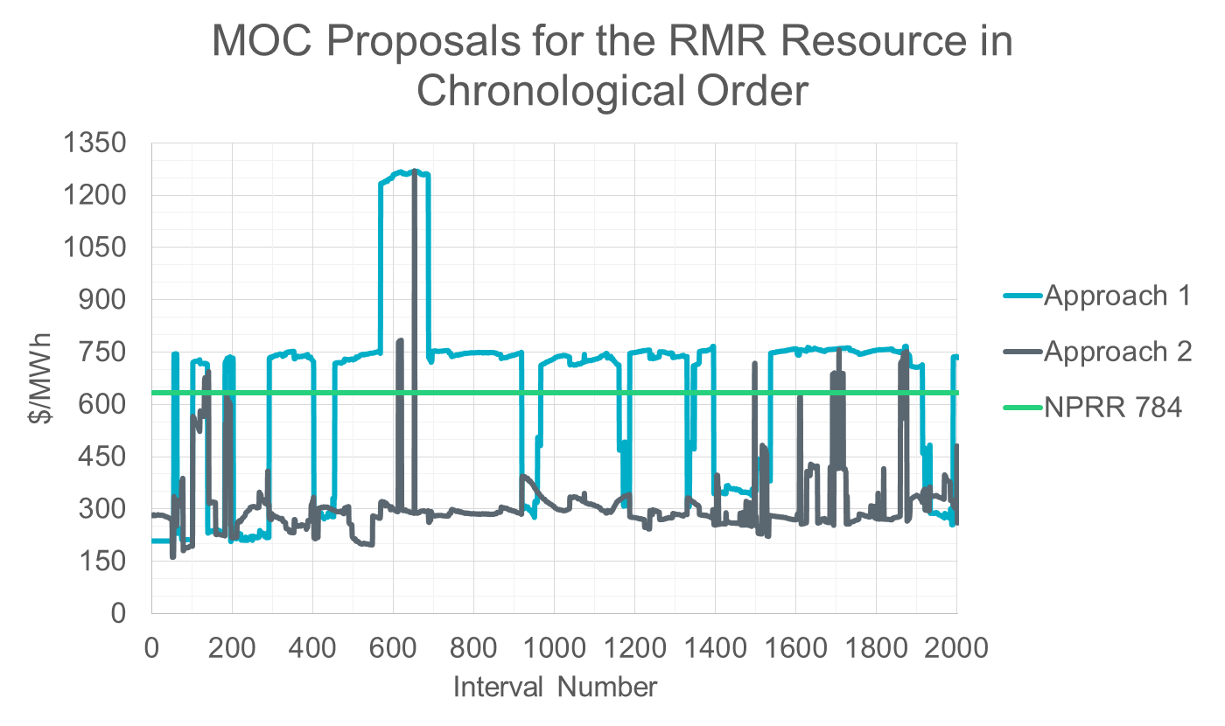
Approach Comparison – 2016 Only

Slide 51
Summary of Analysis Conclusions
Approach 1 generally resulted in MOC values higher than the ~633 $/MWh estimated under the NPRR 784 proposal
Approach 2 generally resulted in MOC values less than the ~633 $/MWh estimated under the NPRR 784 proposal
There are some cases in which approach 1 produces a value less than approach 2
Both approach 1 and 2 were fairly volatile when evaluated for each SCED interval individually
These trends occurred both when looking at all periods since Nodal Go-Live and at only recent history (2016)

