Slide 1
Multi-Interval Real-Time Market (MIRTM)
Supply Analysis Working Group
January 17, 2017
ERCOT Staff
Market Design & Analysis

Slide 2
Today’s Agenda
Review ERCOT findings report
Review Capacity and Load Forecast error at different time horizons
Overview of recent activity
GTBD setup the same way as studies presented in October SAWG
Study design changed in order to get a more “apples to apples” comparison so that all of the offers in each run, MIRTM and Sequential SCED (SSCED), are based on same approved Verifiable Costs
Review of Study day results

Slide 3
MIRTM – Different commitment horizons
ERCOT performed studies to determine the available committable capacity and net load forecast error with different commitment horizons
Although not studied by ERCOT, more capacity may be available if MIRTM can consider transitioning between different combined cycle configurations
*combination of data sources
Horizon | Mean Absolute Error of Net Load Forecast in 2016 | Load Resources From DSWG Survey | Generation Resources * (DSL, SCLE90, SCGT90)
15 minutes | 197 MW | 0 MW | 247 MW
30 minutes | 341 MW | 366 MW | 2983 MW
45 minutes | 485 MW | 501 MW | 3340 MW
Hour Ahead | 575 MW | 601 MW | 3403 MW

Slide 4
MIRTM – MIRTM Study design
Changes to MIRTM inputs and outputs
Any resource that self committed at any point in the study period was treated as self committed in MIRTM
The list of committable Fast Start (FS) resources was changed to include only resources that either:
ran in quick start mode during Production SCED study period; or
had status of OFF for the entire study period
List of MIRTM committable Resource reduced
For each study day, run MIRTM with FS resources as committable (no load resources)
For each study day, run MIRTM with load resources as committable (no FS resources)

Slide 5
MIRTM – Build a story day by day
Committable FS Resources and Total MW for each study day
OD | Number | LSL | HSL
8/11/2015 | 17 | 552 | 956
8/13/2015 | 17 | 584 | 956
11/11/2015 | 14 | 535 | 768
11/27/2015 | 26 | 934 | 1592
3/27/2016 | 26 | 943 | 1541
7/25/2016 | 23 | 905 | 1400

Slide 6
MIRTM 3PO vs. SSCED Study design
MIRTM Three Part Offer (3PO)
SSCED 1
SSCED 2
Fast Start (FS)
Start Up
Run a:
EOC = MOC
(SU/ME Amortized over 2+ hours)
Set FS LSL = 0
Run a:
EOC = MOC
(SU/ME Amortized over 15 min.)
Set LSL = 0
Fast Start
Min Gen
Fast Start
EOC
Run b:
For FS BP > 0
Set LSL = Actual LSL
Run b:
For FS BP > 0
Set LSL = Actual LSL
Note: A SSCED 3b run was also done using Production EOCs. The comparison graphs are made available for review but are not included in comparison slides.

Slide 7
MIRTM 3PO vs. SSCED Study design
Changes to SSCED inputs, design, and outputs
Using the same approved verifiable costs as the MIRTM 3PO, single part Energy Offer Curves were created two ways:
RUN 1: The Start Up/ Min Energy component is amortized in the production Mitigated Offer Cap over a minimum of 2 hour recovery time
RUN 2: The same as above but amortized over a 15 minute recovery time
For both RUN 1 & 2 in order for SSCED to simulate treatment of current SCED for any Fast Start (FS) online resource :
Run an “a” run where all committable FS resources are “ON” with LSL = 0
RUN a “b” run where, for each five minute interval, if the FS resources in the a run with BP > 0 set LSL = actual LSL and status “ON”, else set status “OFF”
Compare both 1b and 2b runs to MIRTM run in order to get a “range” of outcomes

Slide 8
MIRTM Load Only vs. Seq. SCED Study design
MIRTM Loads Only
Sequential SCED 4
366 MW of Committable Loads
FS treated same as Production SCED
Load Resources not included in SSCED;
However, 366 MW added to ORDC

Slide 9
MIRTM Load Only vs. SSCED Study design
A separate SSCED (RUN 4) run was done to compare with the MIRTM Load only case
The Load Resources were not modeled in SSCED
The 366 MW of additional Load Resources capacity was added to the ORDC calculation for SSCED to align with MIRTM Load only run

Slide 10
MIRTM – build a story day by day
MIRTM 3PO
Production Costs, Average Prices, and Make Whole amounts for all days
Compare Production Cost
Main indicator of efficiency improvements, if any
Charge to Load including Make Whole charge, if any
Generator Revenue including Make Whole payment, if any
MIRTM Load Only
Production Costs, Average Prices, and Make Whole amounts for all days
Compare Production Cost
Main indicator of efficiency improvements, if any
Charge to Load including Make Whole charge, if any
Generator Revenue including Make Whole payment, if any

Slide 11
MIRTM – Day by day
MIRTM 3PO by Day

Slide 12
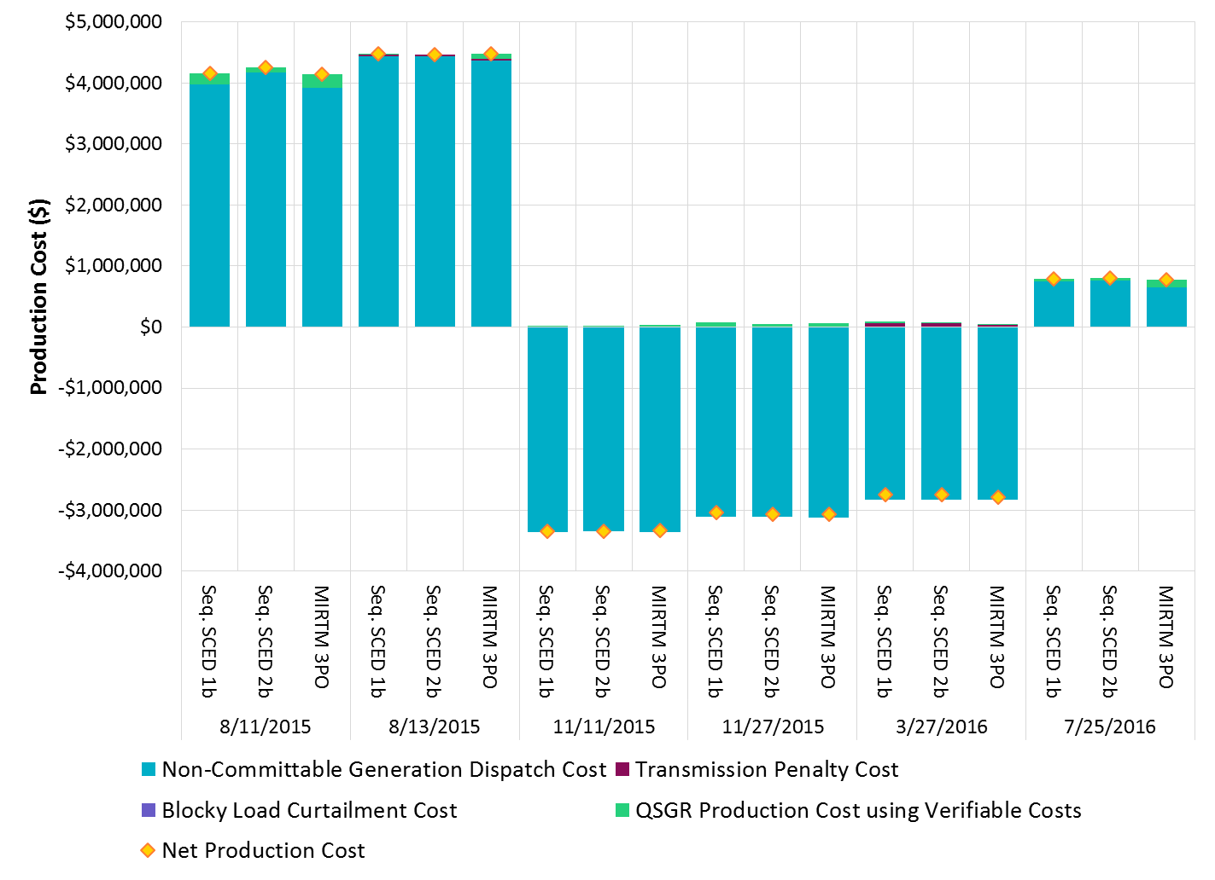
MIRTM 3PO Production Cost for all days

Slide 13
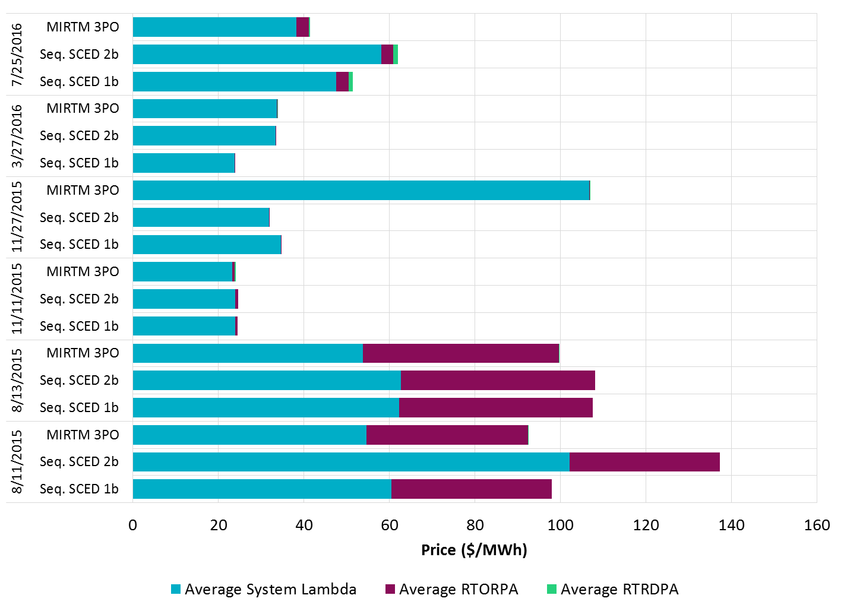
MIRTM 3PO Average Prices for all days

Slide 14
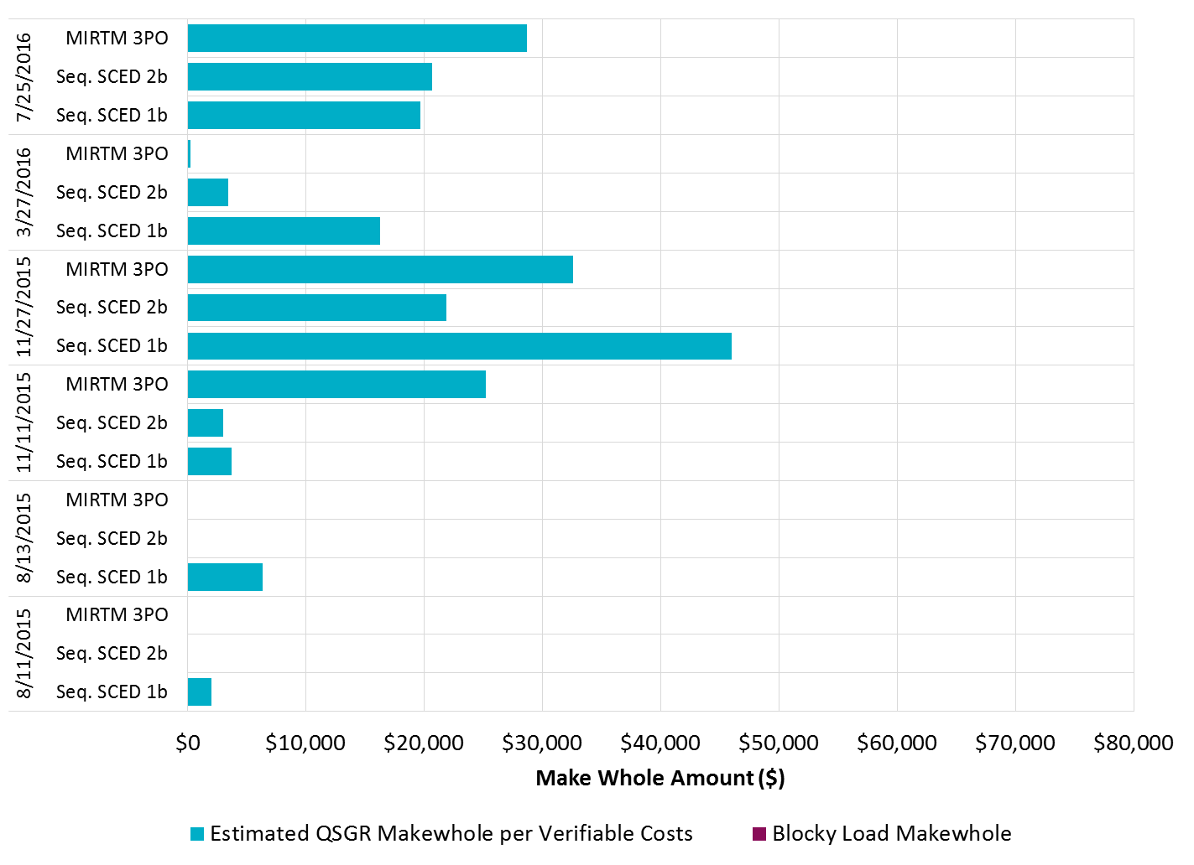
MIRTM 3PO Make Whole Payments for all days

Slide 15
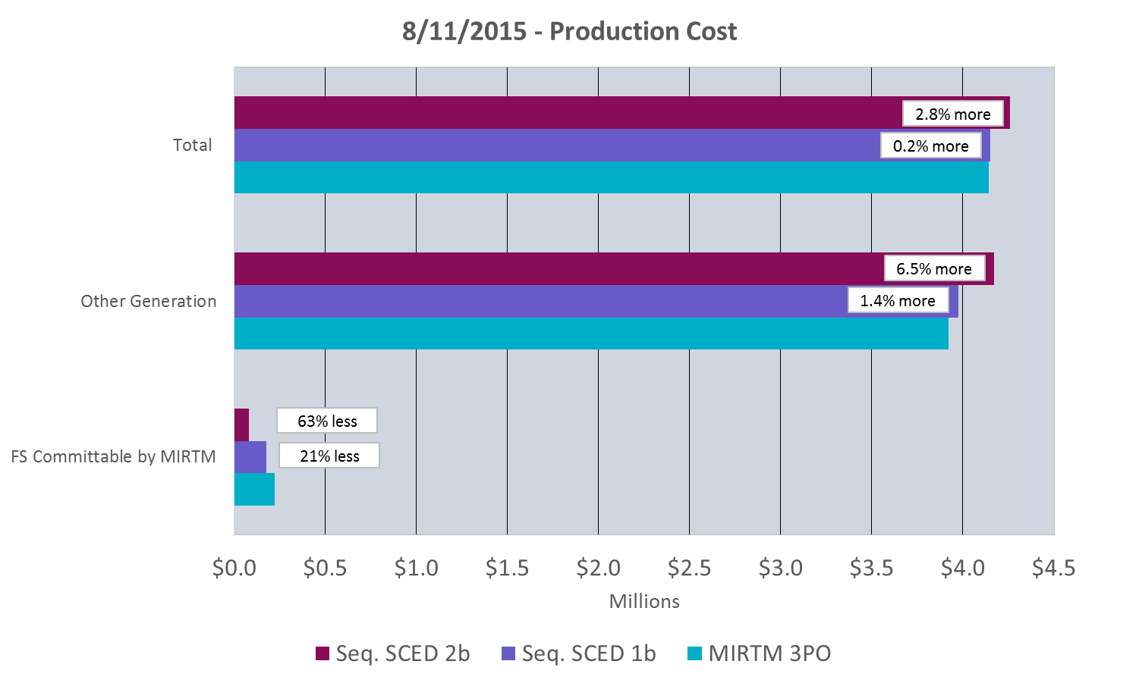
Study Day – MIRTM 3PO: August 11, 2015
Note: Total Production Costs are the sum of Committable, Other Generation, and Transmission penalty costs.

Slide 16
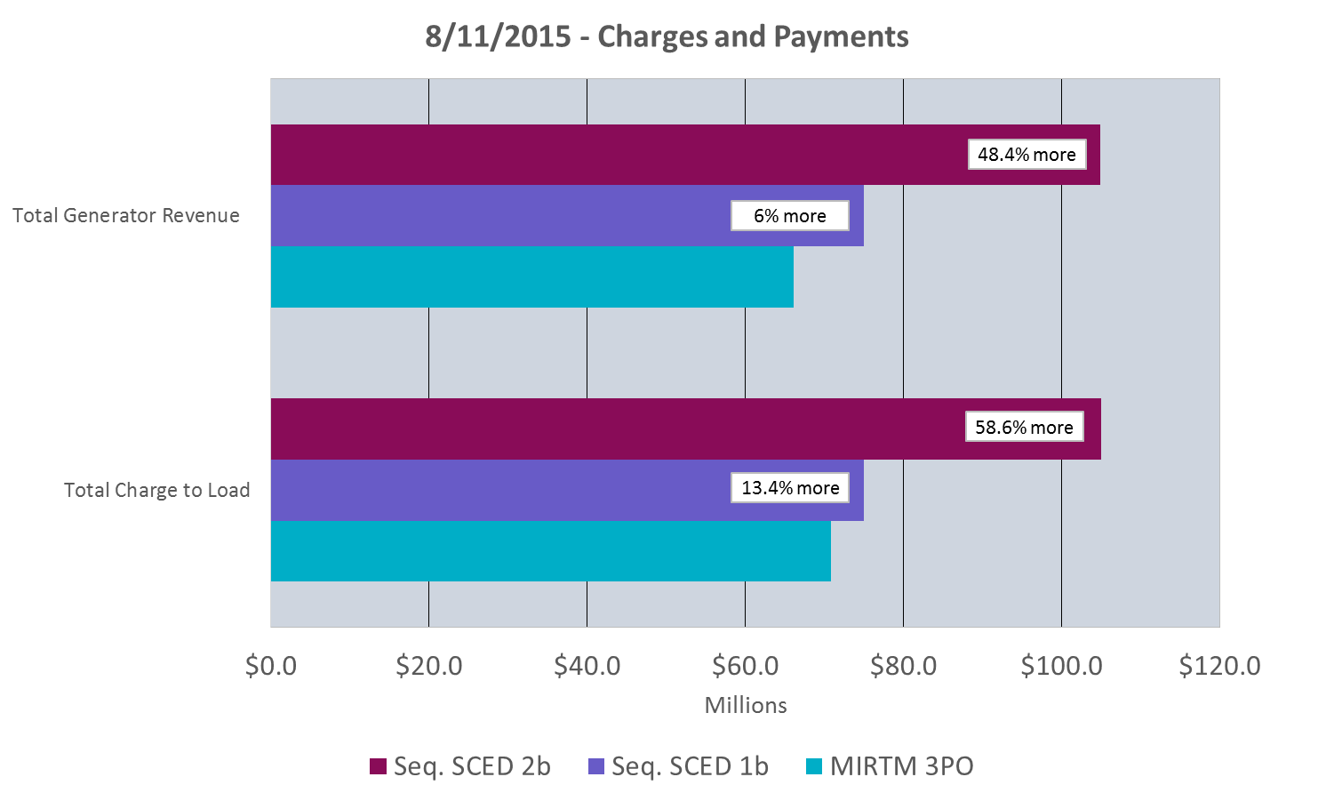
Study Day – MIRTM 3PO: August 11, 2015

Slide 17
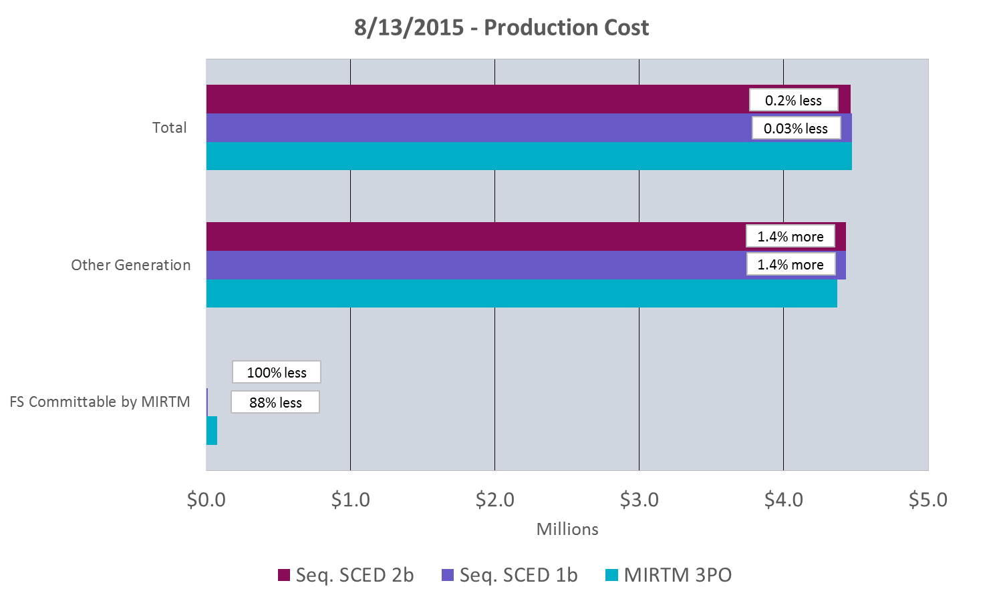
Study Day – MIRTM 3PO: August 13, 2015
Note: Total Production Costs are the sum of Committable, Other Generation, and Transmission penalty costs.

Slide 18
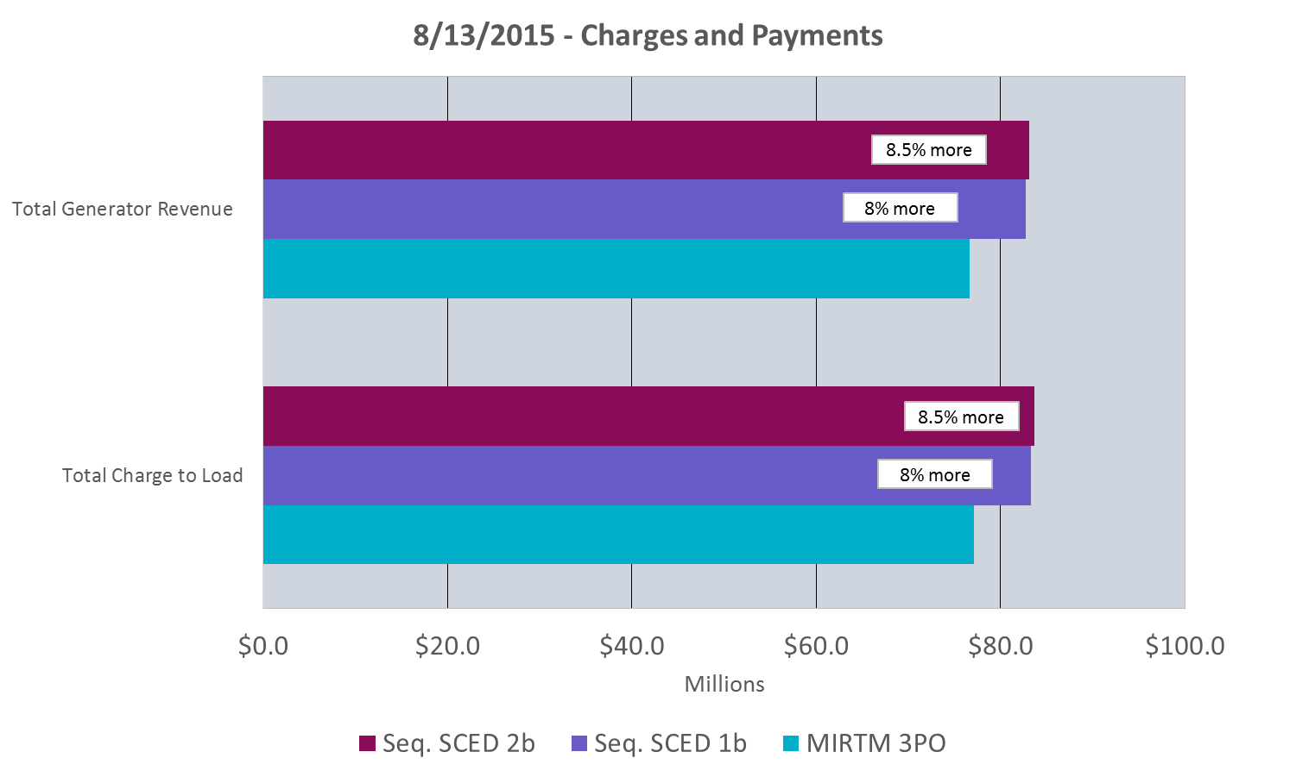
Study Day – MIRTM 3PO: August 13, 2015

Slide 19
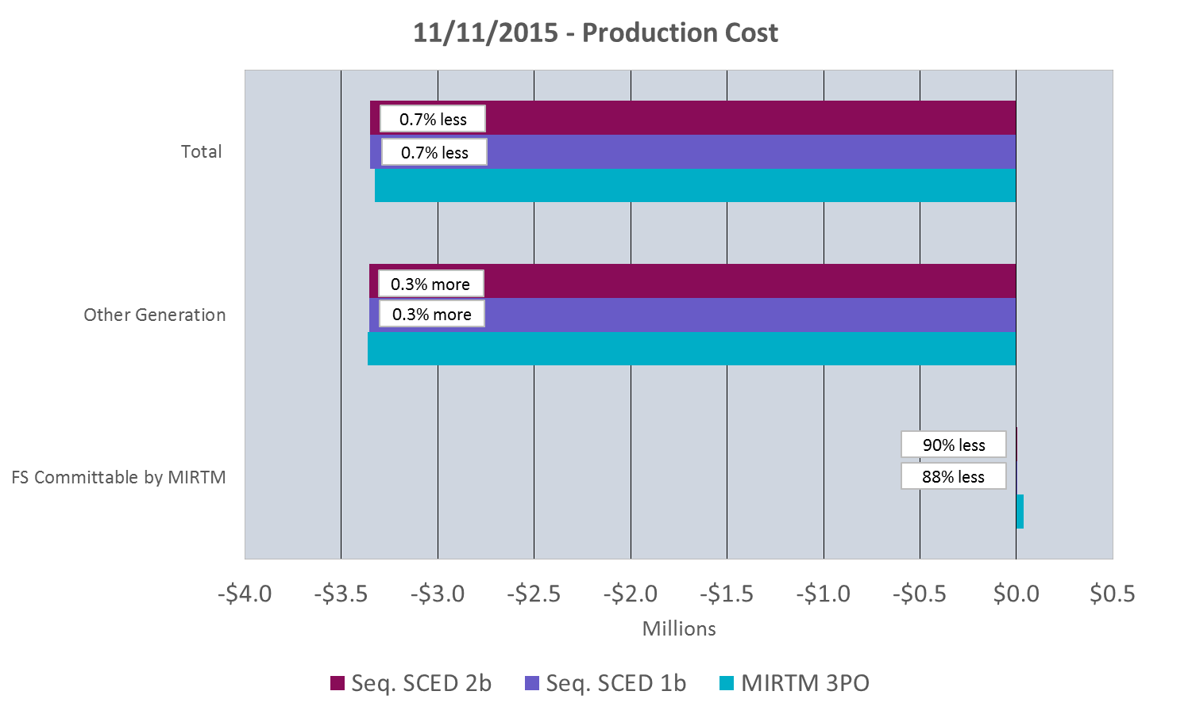
Study Day – MIRTM 3PO: November 11, 2015
Note: Total Production Costs are the sum of Committable, Other Generation, and Transmission penalty costs.

Slide 20
Study Day – MIRTM 3PO: November 11, 2015

Slide 21
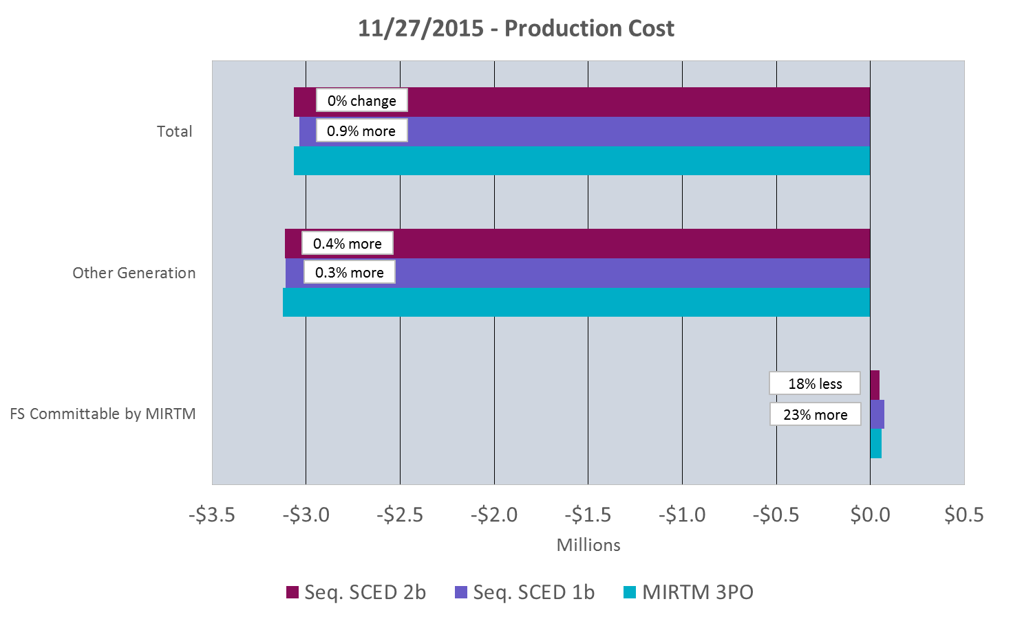
Study Day – MIRTM 3PO: November 27, 2015
Note: Total Production Costs are the sum of Committable, Other Generation, and Transmission penalty costs.

Slide 22
Study Day – MIRTM 3PO: November 27, 2015

Slide 23
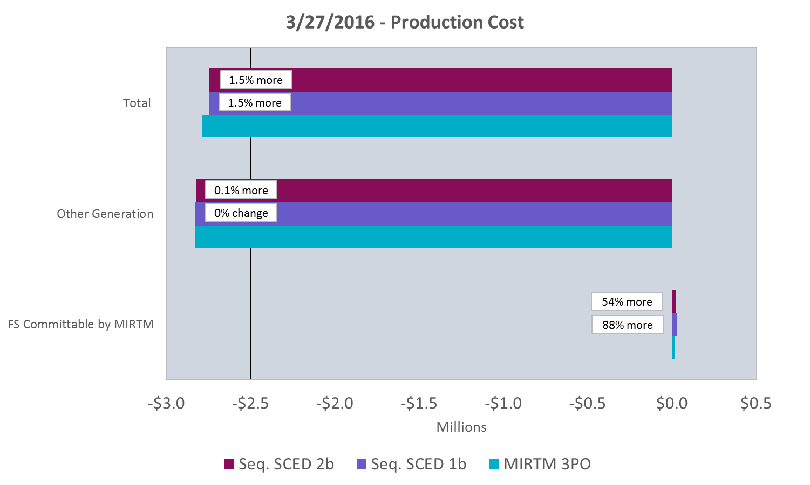
Study Day – MIRTM 3PO: March 27, 2016
Note: Total Production Costs are the sum of Committable, Other Generation, and Transmission penalty costs.

Slide 24
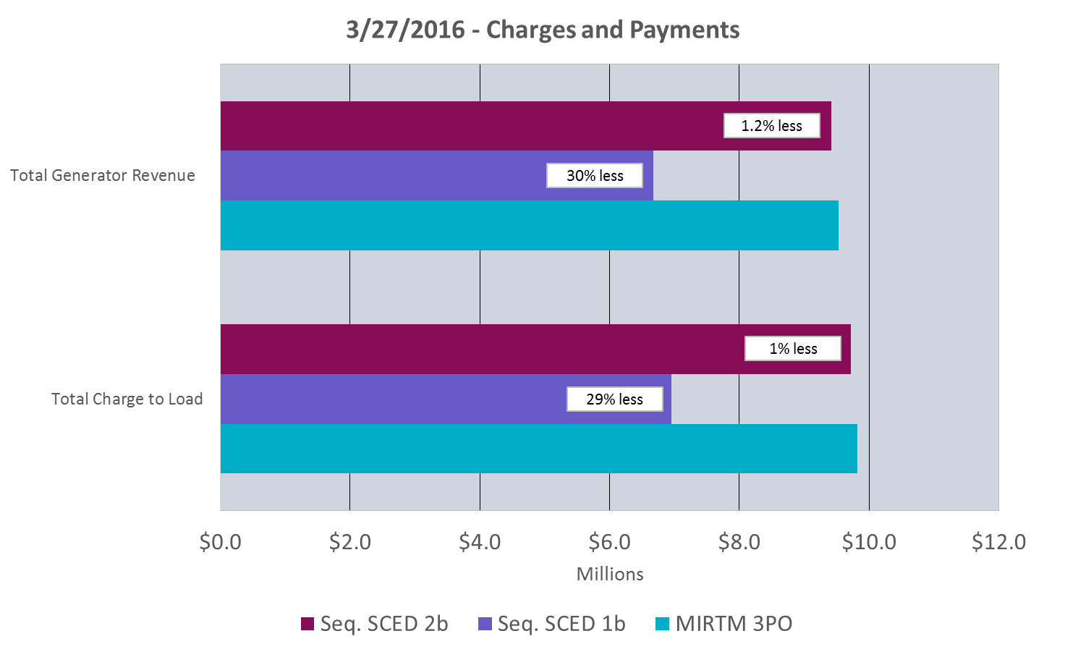
Study Day – MIRTM 3PO: March 27, 2016

Slide 25
Study Day – MIRTM 3PO: July 25, 2016
Note: Total Production Costs are the sum of Committable, Other Generation, and Transmission penalty costs.

Slide 26
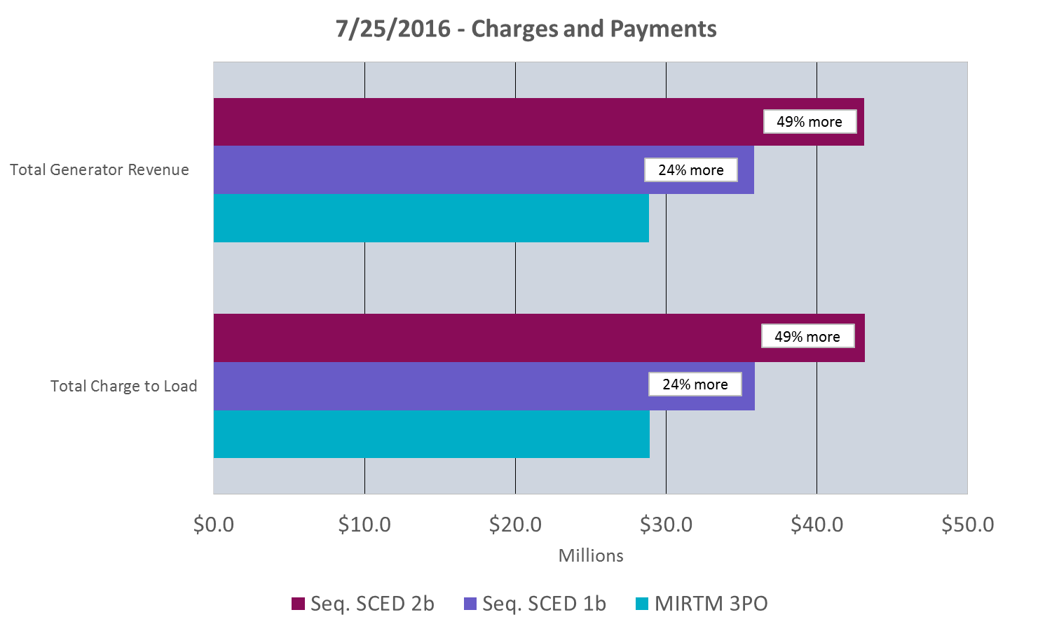
Study Day – MIRTM 3PO: July 25, 2016

Slide 27
MIRTM – day by day
MIRTM Load Only (LO) by Day

Slide 28
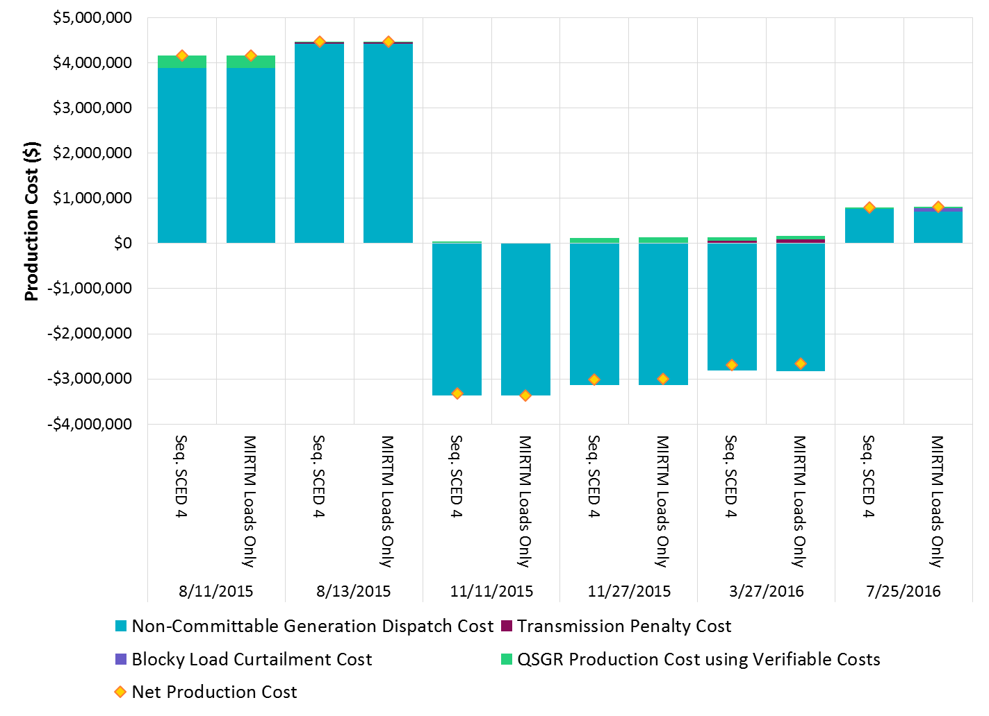
MIRTM LO Production Costs all days

Slide 29
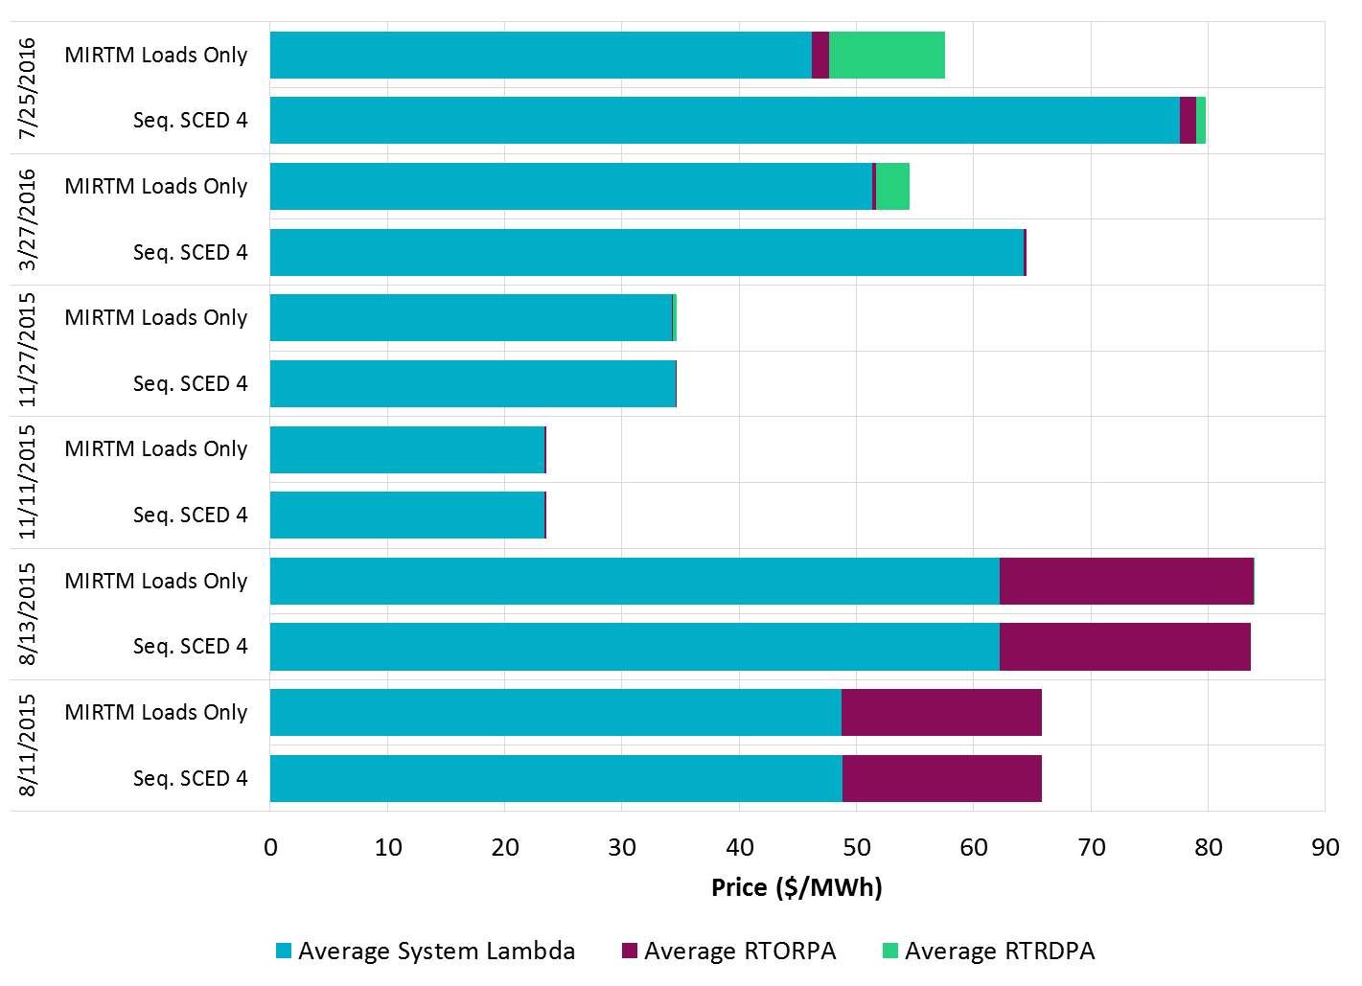
MIRTM LO Average Prices all days

Slide 30
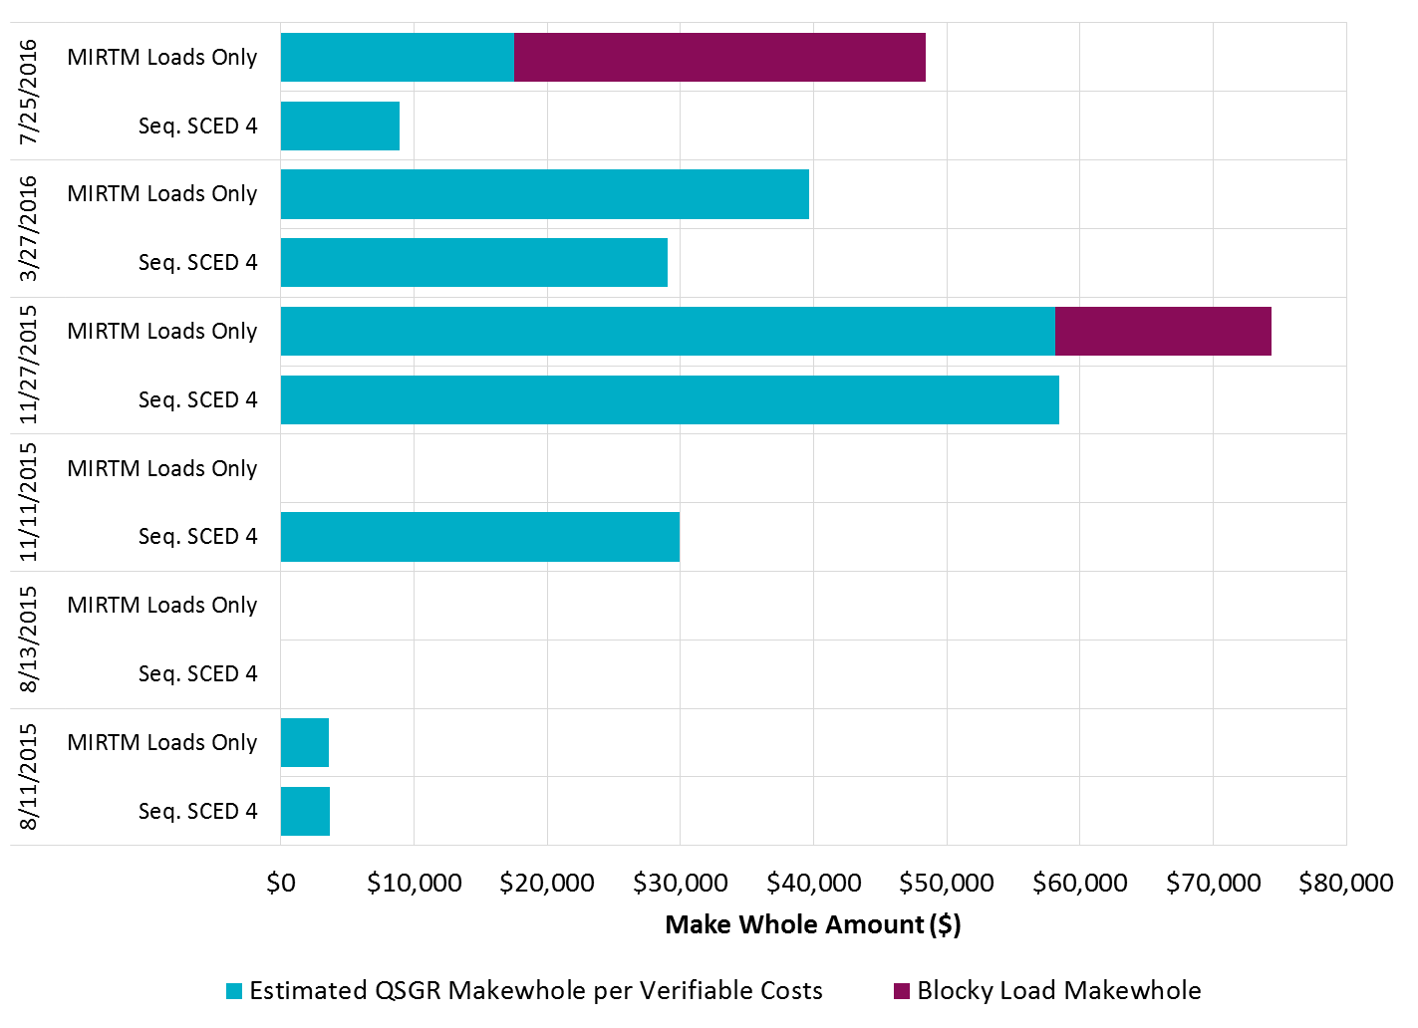
MIRTM LO Make Whole Payments all days

Slide 31
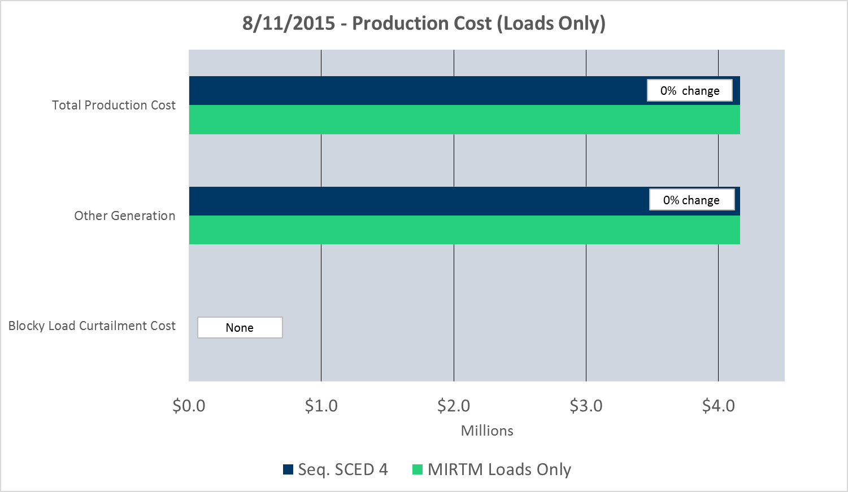
Study Day – MIRTM LO: August 11, 2015
Note: Total Production Costs are the sum of Blocky Load Curtailment, Other Generation, and Transmission penalty costs.

Slide 32
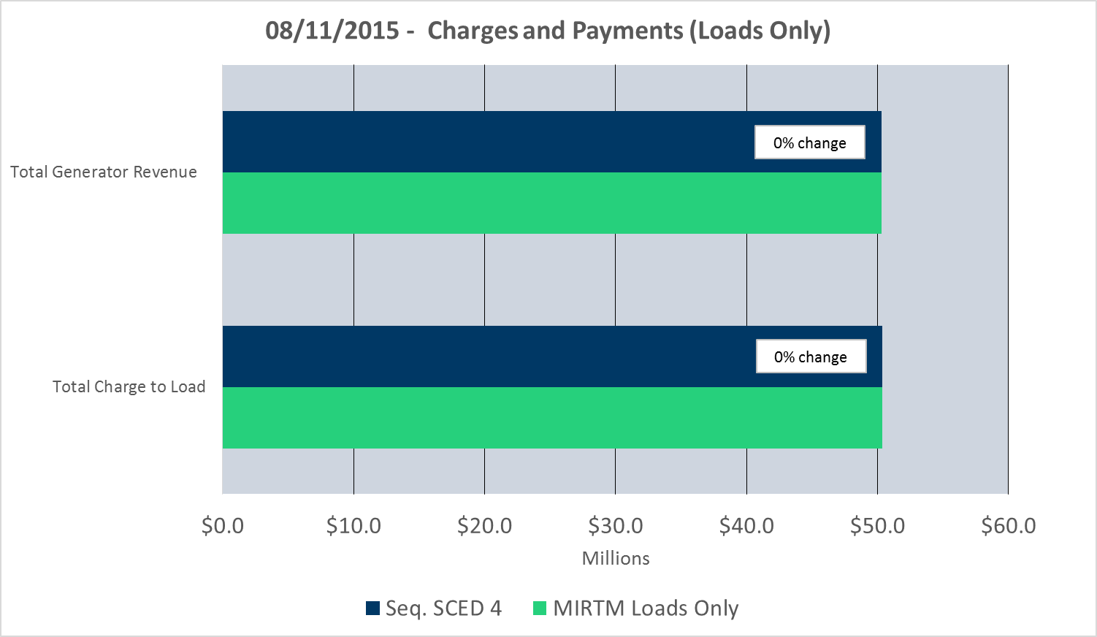
Study Day – MIRTM LO: August 11, 2015

Slide 33
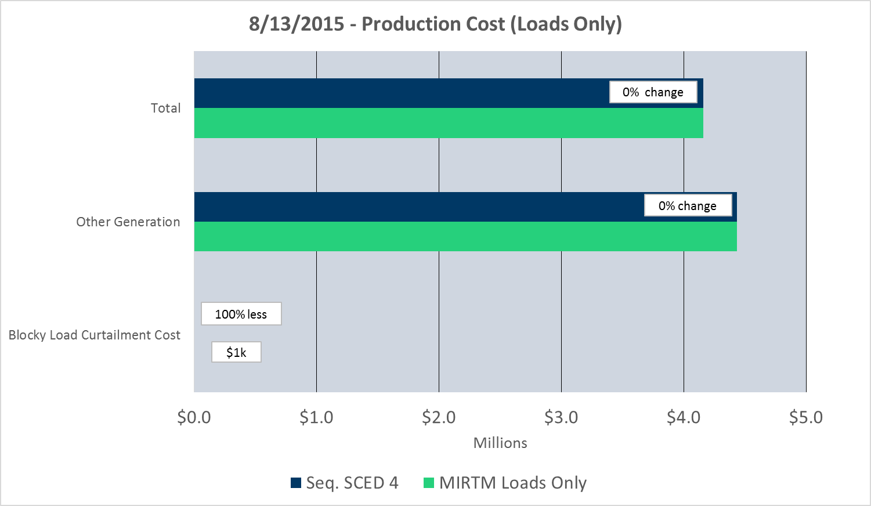
Study Day – MIRTM LO: August 13, 2015
Note: Total Production Costs are the sum of Blocky Load Curtailment, Other Generation, and Transmission penalty costs.

Slide 34
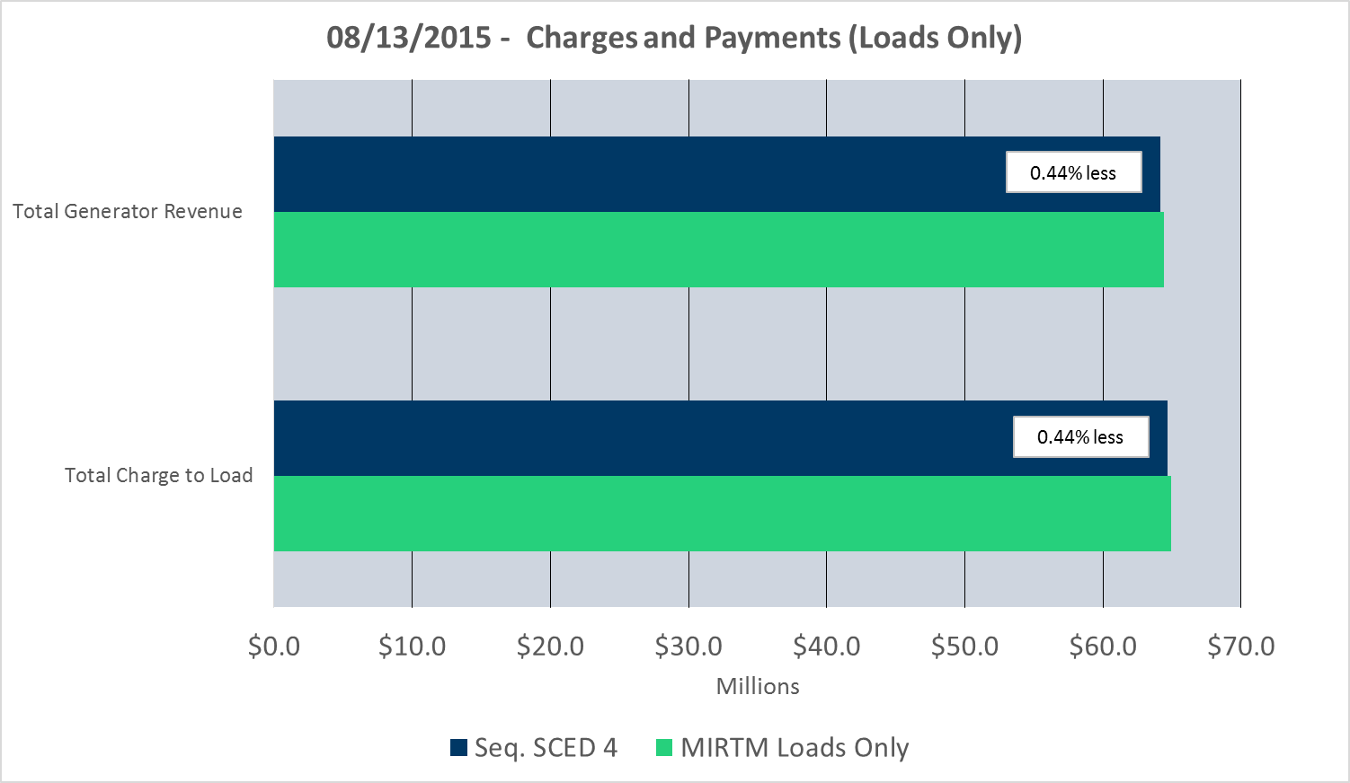
Study Day – MIRTM LO: August 13, 2015

Slide 35
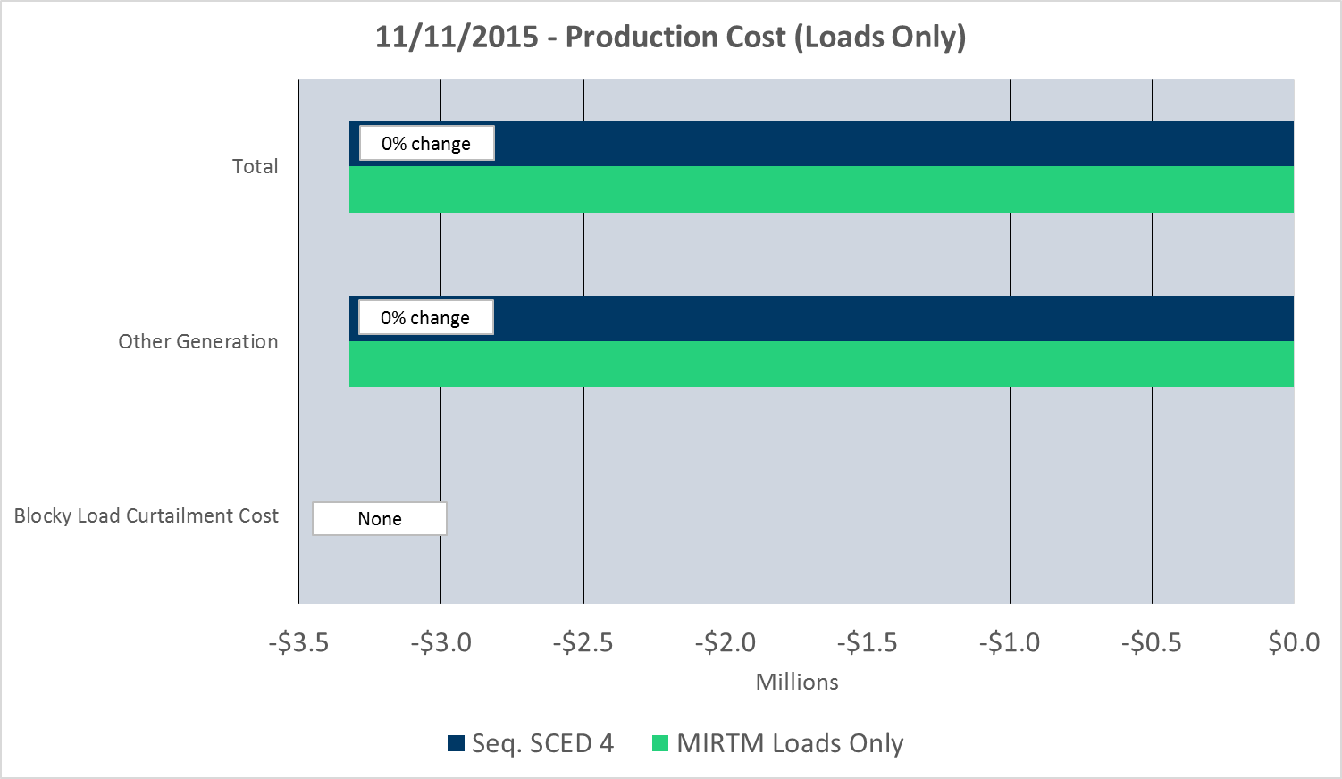
Study Day – MIRTM LO: November 11, 2015
Note: Total Production Costs are the sum of Blocky Load Curtailment, Other Generation, and Transmission penalty costs.

Slide 36
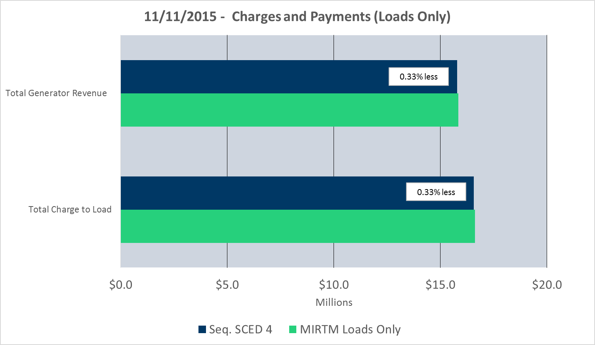
Study Day – MIRTM LO: November 11, 2015

Slide 37
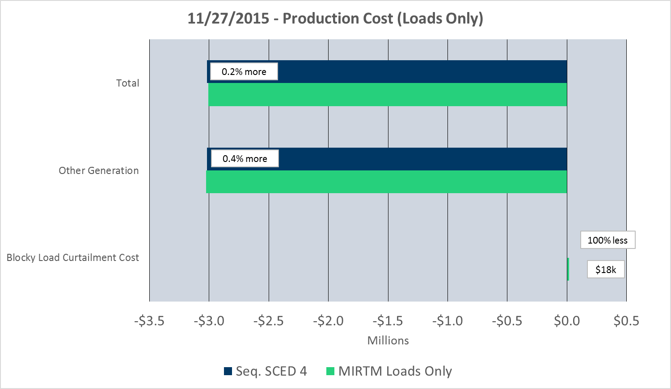
Study Day – MIRTM LO: November 27, 2015
Note: Total Production Costs are the sum of Blocky Load Curtailment, Other Generation, and Transmission penalty costs.

Slide 38
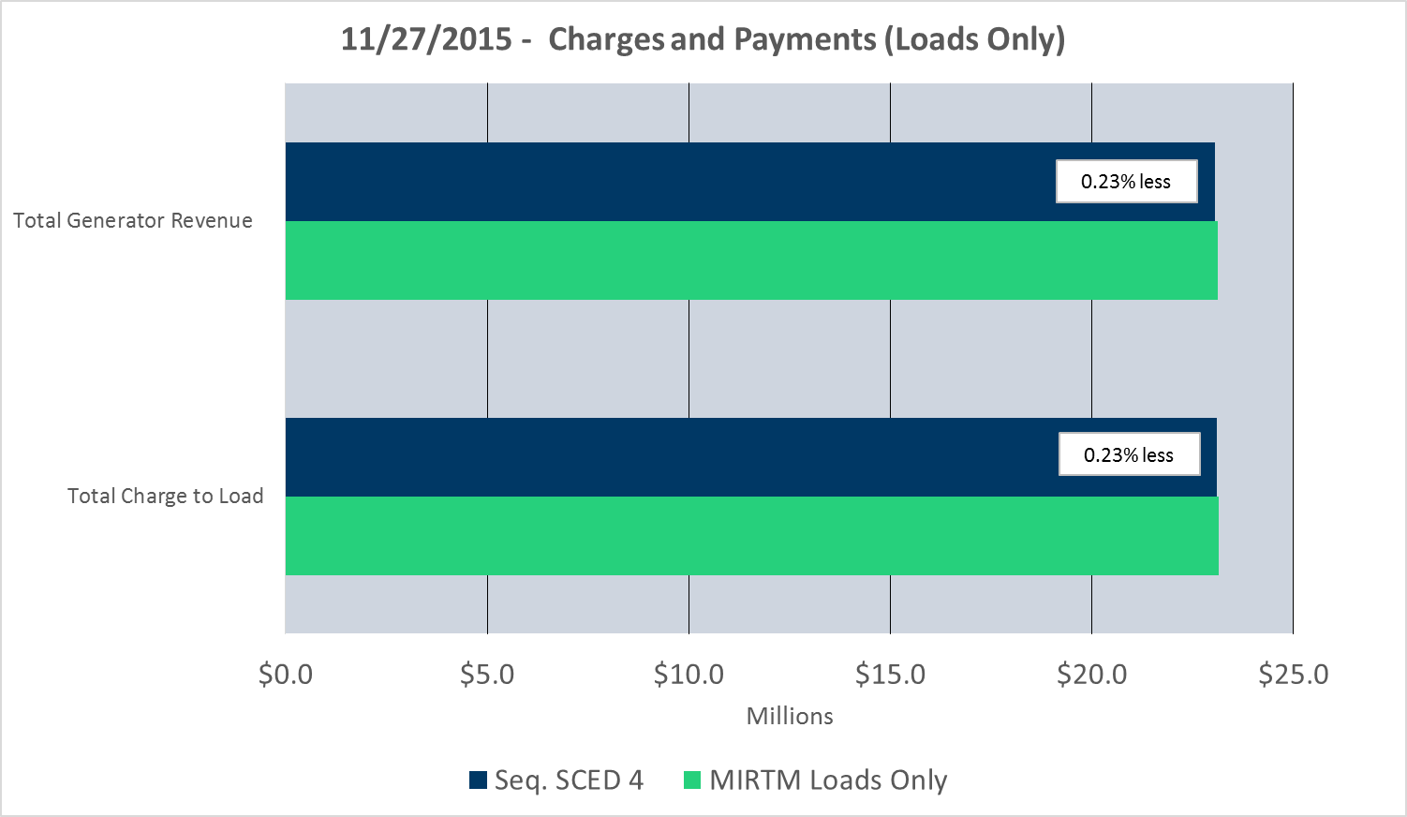
Study Day – MIRTM LO: November 27, 2015

Slide 39
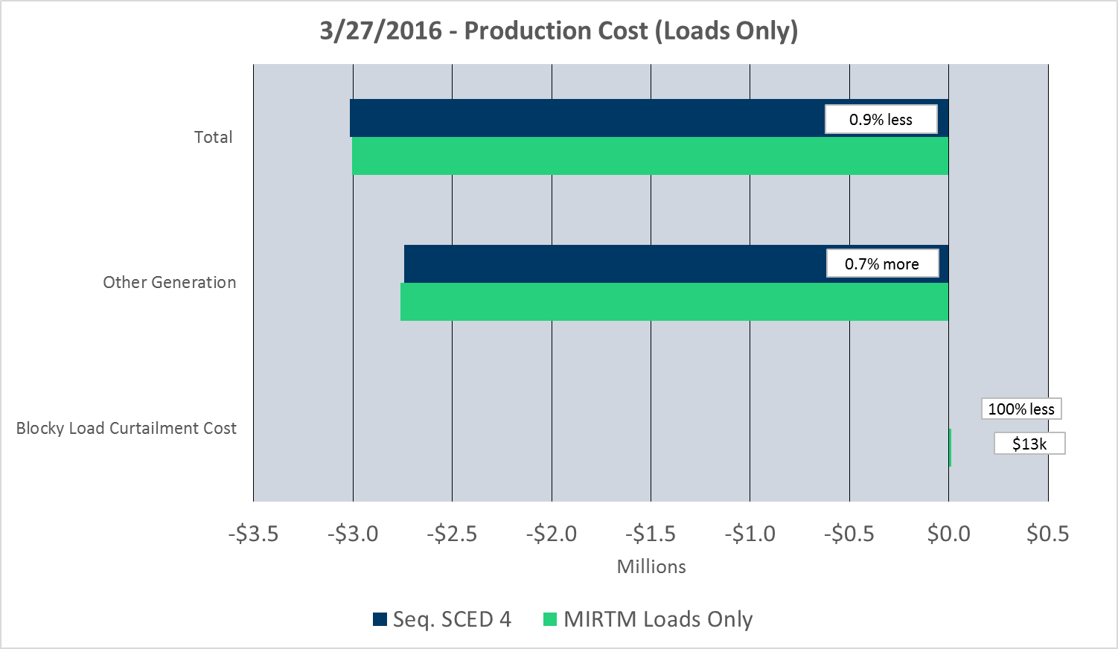
Study Day – MIRTM LO: March 27, 2016
Note: Total Production Costs are the sum of Blocky Load Curtailment, Other Generation, and Transmission penalty costs.

Slide 40
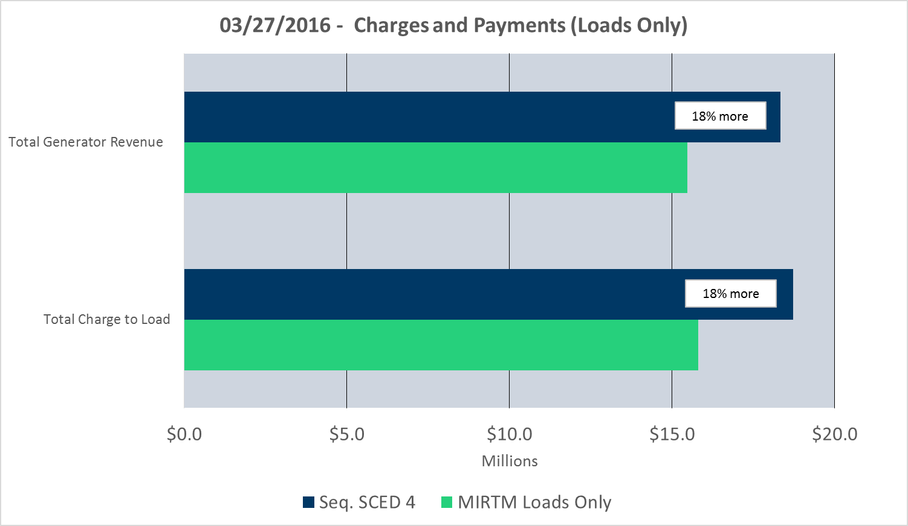
Study Day – MIRTM LO: March 27, 2016

Slide 41
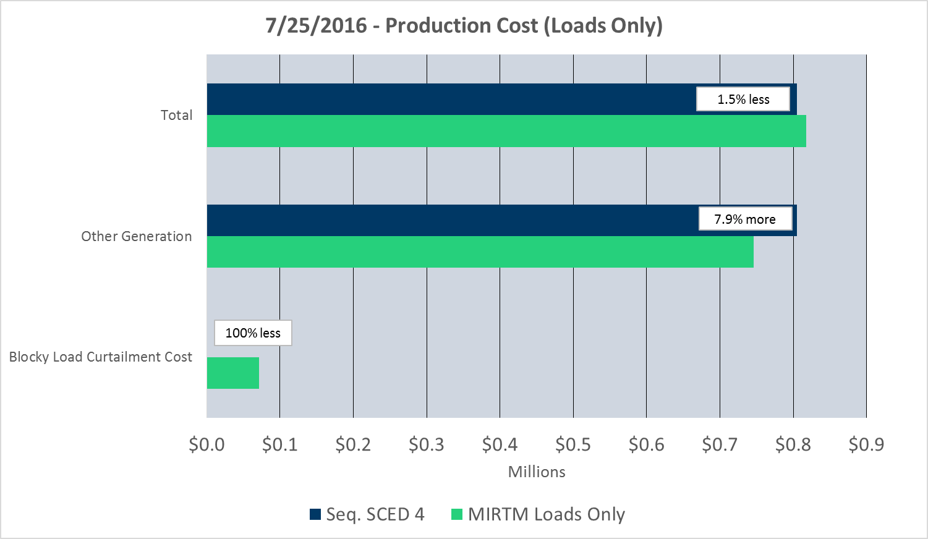
Study Day – MIRTM LO: July 25, 2016
Note: Total Production Costs are the sum of Blocky Load Curtailment, Other Generation, and Transmission penalty costs.

Slide 42
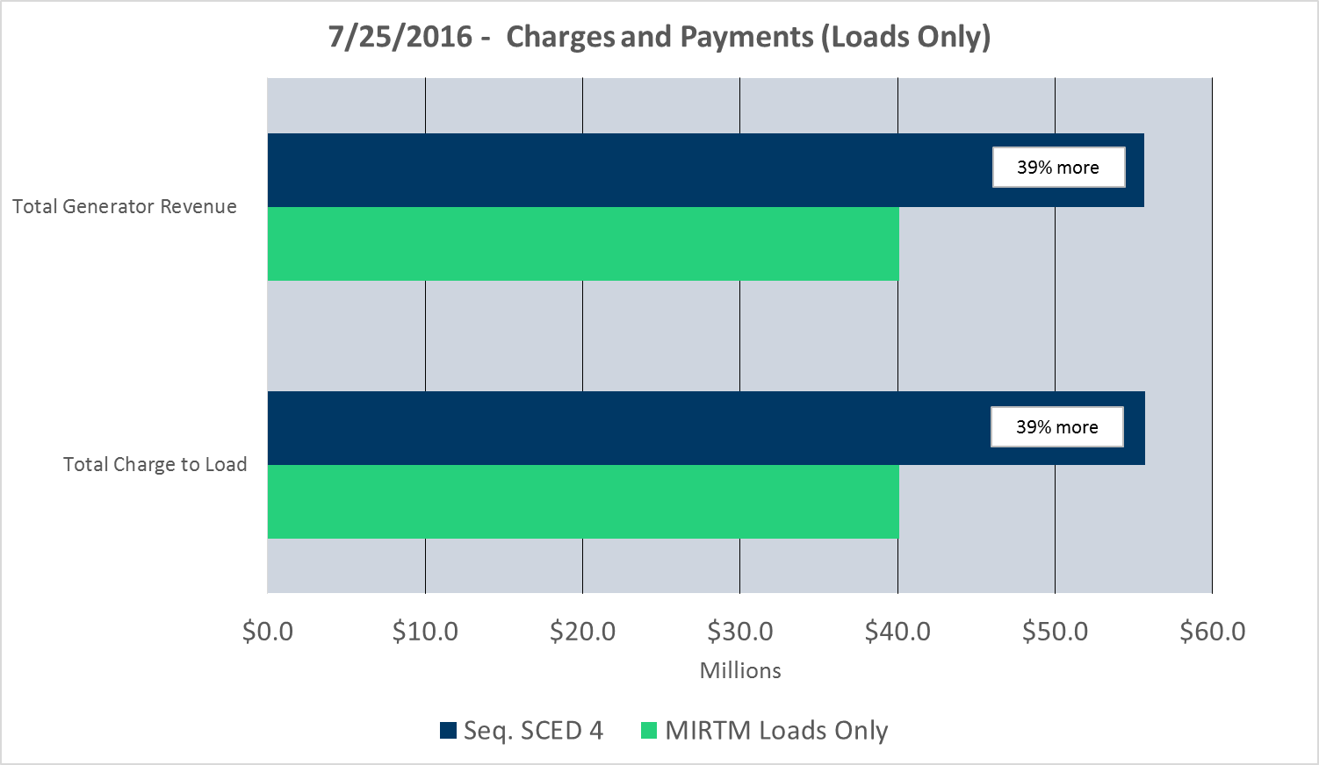
Study Day – MIRTM LO: July 25, 2016

